Slide 1
Ecological Associations of
Alcohol Outlet Density with
Drunk Driving and
Underage Drinking between Latino and White Communities in Los Angeles County (LAC)
Ricardo A. Contreras Girón, MPH, MA
Tina Kim, Ph.D.
Benedict Lee, Ph.D.
Substance Abuse Prevention and Control
Los Angeles County Department of Public Health
November 4, 2013

Slide 2
Presenter Disclosures
Ricardo A. Contreras
(1) The following personal financial relationships with commercial interests relevant to this presentation existed during the past 12 months:
No relationships to disclose

Slide 3

Purpose of Ecological Study
To examine the impact of alcohol outlet density (15,164 outlets) on:
  Drunk driving
  Underage drinking
To Compare ecological outcomes between Latino & White communities
LAC Population:
          4.7 million Latinos
          2.7 million Whites
Notes:
Research examining the ecological associations of alcohol outlet density with a variety of health problems among Latinos is sparse. This study examines the impact of alcohol outlet density on drunk driving and underage drinking among Latinos and compares them to Whites' in LAC.

Slide 4
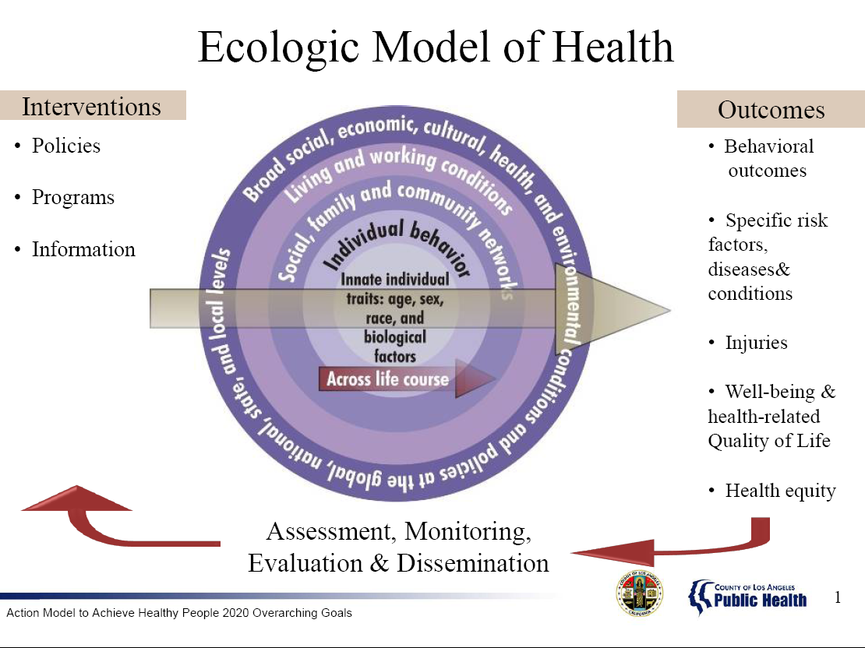

Slide 5

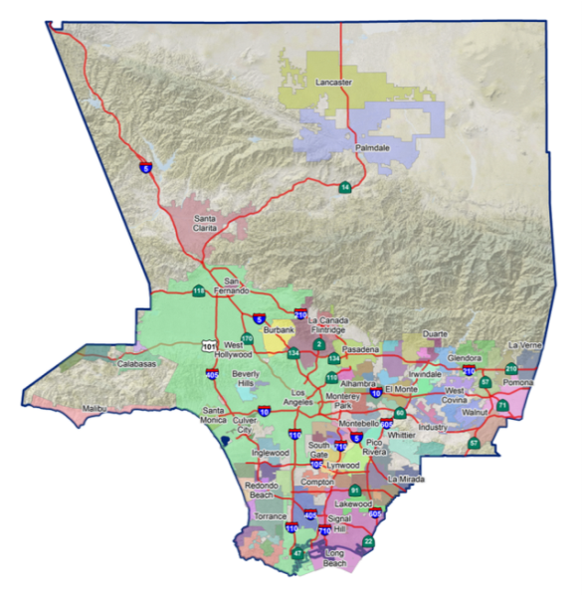
Los Angeles County
Quick Facts
(Census 2010)
Population 9,818,605
Land Area 4,057.88 Sq. Mi
Under 18 Years of Age 24.1%
Persons per Square Mile 2,419.6

Slide 6
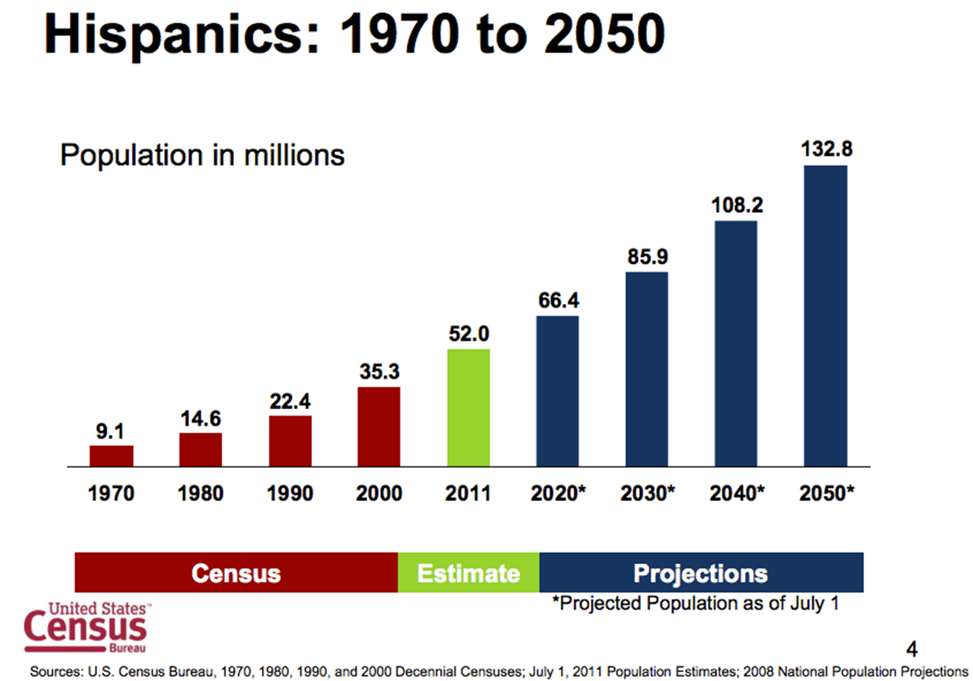
Latino/Hispanic Population Trend in U.S.
Notes:
This shows Latino population trend in US from 1970 to 2050. Currently 53million Latinos…

Slide 7
Latino/Hispanic Population
Los Angeles County, 2011
Total LAC Population, 2011
LAC Population Under 18, 2011
Source: 2010-2015: State of California, Department of Finance, Report P-3: State and County Population Projections by Race/Ethnicity, Detailed Age, and Gender, 2010-2060. Sacramento, California, January 2013.
Notes:
This concerns because Latinos are more likely than any other group to enter substance abuse treatment at a younger age.

Slide 8
Latino/Hispanic Subgroups in Los Angeles County
Source: Pew Research Center, 2011

Slide 9
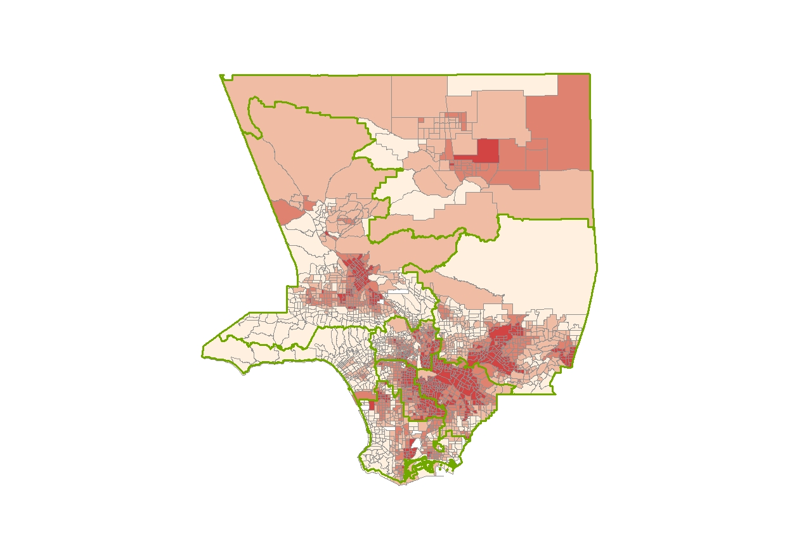
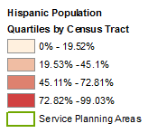
Latino Population Quartile Distribution,
Los Angeles County, 2010
Notes:
Latinos comprise the majority of the population in SPA 7 (73%), SPA 6 (67%), and SPA 4 (52%) while Whites comprise the majority of the population in SPA 5 (62%). Compared to Whites, alcohol outlet density (per 10,000 pop.) was significantly higher among Latinos for all SPAs, except SPA 5. The rate for either underage drinking or drunk driving (per 10,000 pop.) for Latinos was significantly higher than those of Whites for most SPAs, except in SPA 6 and 8.

Slide 10
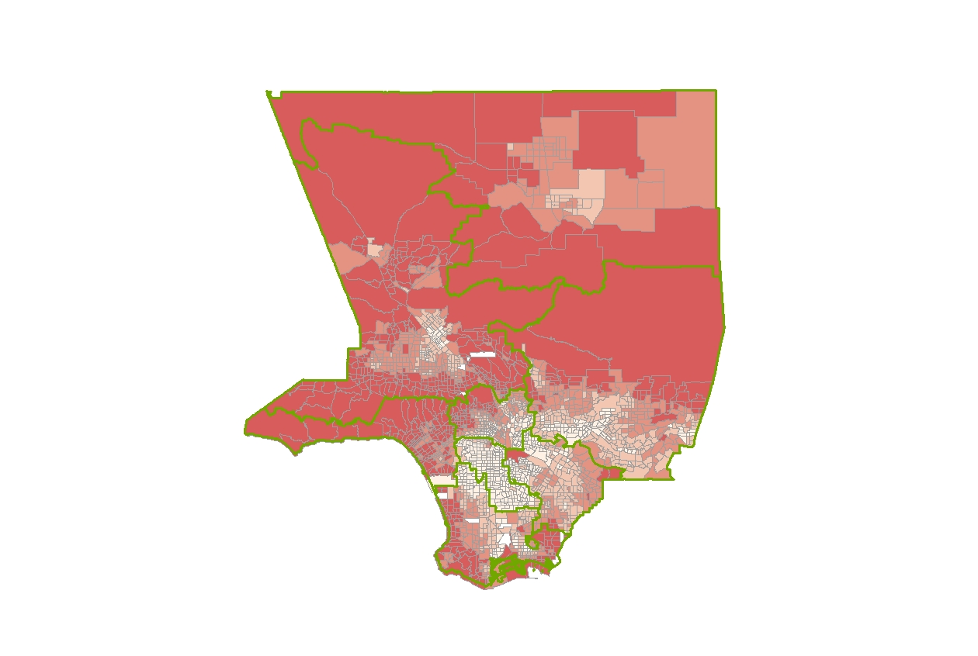
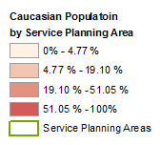
White Population Quartile Distribution
Los Angeles County, 2010
Notes:
Latinos comprise the majority of the population in SPA 7 (73%), SPA 6 (67%), and SPA 4 (52%) while Whites comprise the majority of the population in SPA 5 (62%). Compared to Whites, alcohol outlet density (per 10,000 pop.) was significantly higher among Latinos for all SPAs, except SPA 5. The rate for either underage drinking or drunk driving (per 10,000 pop.) for Latinos was significantly higher than those of Whites for most SPAs, except in SPA 6 and 8.

Slide 11
Drunk Driving Among Latinos is a Public Health Issue
45% percent had been drinking vs. 37% in the general U.S. population
(49%) of all Latino traffic fatalities involve alcohol vs. (42% ) among the general population.
Hispanics are also more likely than other groups to ride in vehicles operated by drivers who have been drinking.
U.S. Department of Transportation National Highway Traffic Safety Administration (NHTSA) Report: Priorities for Reducing Alcohol-Related Driving Among Latino Communities (2007)
Notes:
11
The Impaired Driving Problem in the United States
• More than 42,000 people die in traffic fatalities each year.
• Nearly 3 million people are injured.
• The cost in the United States is about $230 billion each year.
• While alcohol-related traffic fatalities decreased significantly in the United States during the 1980s and early 1990s, they have remained constant over the last decade.
• Of drivers involved in fatal crashes with alcohol in their systems, 84 percent had blood alcohol concentrations (BACs) of .08 grams per deciliter (g/dL) or higher, which is illegal in every State.
Among Latinos
• Latino traffic fatalities are increasing at an alarming rate, much higher than the National
average, and those fatalities involving alcohol are rising as well.
• In 2002, motor vehicle traffic crashes were the leading cause of death among Latinos age
3 to 8, 11, 14, 14 to 34, and 37. In 2005, motor vehicle traffic crashes were the leading
cause of death for every age 3 to 6 and 8 to 34 for the general population.
• Almost half (49%) of all Latino traffic fatalities involve alcohol (42% among the general
population).
• Of Latino drivers who died, 45 percent had been drinking (37% in the general U.S.
population); of Latino non drivers who died, 49 percent had been drinking (40% in the
general U.S. population).
• Hispanics are also more likely than other groups to ride in vehicles operated by drivers who have been drinking.
• Next to Native Americans, Latinos have the highest rate of drinking-and-driving incidents.
• In 2006, the 11 jurisdictions with the highest number of Latino alcohol-related traffic fatalities were California, Texas, Florida, Puerto Rico, Arizona, New Mexico, Illinois, North Carolina, Georgia, Colorado, and South Carolina.
In 2011, there were 9,878 fatalities in crashes involving a driver with a BAC of .08 or higher – 31 percent of total traffic fatalities for the year.

Slide 12
Furthermore, in the US…
Next to Native Americans, Latinos have the highest rate of drinking-and-driving incidents.
In 2006, California was one of 11 jurisdictions with the highest number of Latino alcohol-related traffic fatalities
It is estimated that 49% of all Latino traffic fatalities involve alcohol vs. 42% among the general population.
U.S. Department of Transportation National Highway Traffic Safety Administration (NHTSA) Report: Priorities for Reducing Alcohol-Related Driving Among Latino Communities (2007)
Notes:
Priorities for Reducing Alcohol Related Driving Among Latino Communities (National Highway Traffic Safety Administration (NHTSA )and National Latino Council on Alcohol and Tobacco Prevention)
http://big.assets.huffingtonpost.com/811263.pdf
www.nhtsa.gov/staticfiles/nti/pdf/811263.pdf

Slide 13
The Impact of Alcohol-related Harms in Los Angeles County
Causes 2,500 deaths in LAC each year (75% among men)
Hospitalizations ~$9,500 per person per year
ED Visits estimated over 23,000 per year
Annual Cost $31 Billion
  $9.5 Billion Direct Cost
  $21.2 Billion Quality of Life Cost
Notes:
Cost Category
Alcohol
Medical
$ 2.2 Billion
Wage Work
$ 4.3 Billion
Household Work
$ 1.6 Billion
Public Services
$ 331 Million
Property Damage
$ 497 Million
Misc. Motor Vehicle
$ 499 Million
Subtotal: Tangible Costs
$ 9.5 Billion
Quality of Life
$ 21.2 Billion
Total
$ 31 Billion

Slide 14

Estimated Costs of Alcohol Harms in Los Angeles County, 2010
Cost Category | Alcohol
Medical | $ 2.2 Billion
Wage Work | $ 4.3 Billion
Household Work | $ 1.6 Billion
Public Services | $ 331 Million
Property Damage | $ 497 Million
Misc. Motor Vehicle | $ 499 Million
Subtotal: Tangible Costs | $ 9.5 Billion
Quality of Life | $ 21.2 Billion
Total | $ 31 Billion

Slide 15

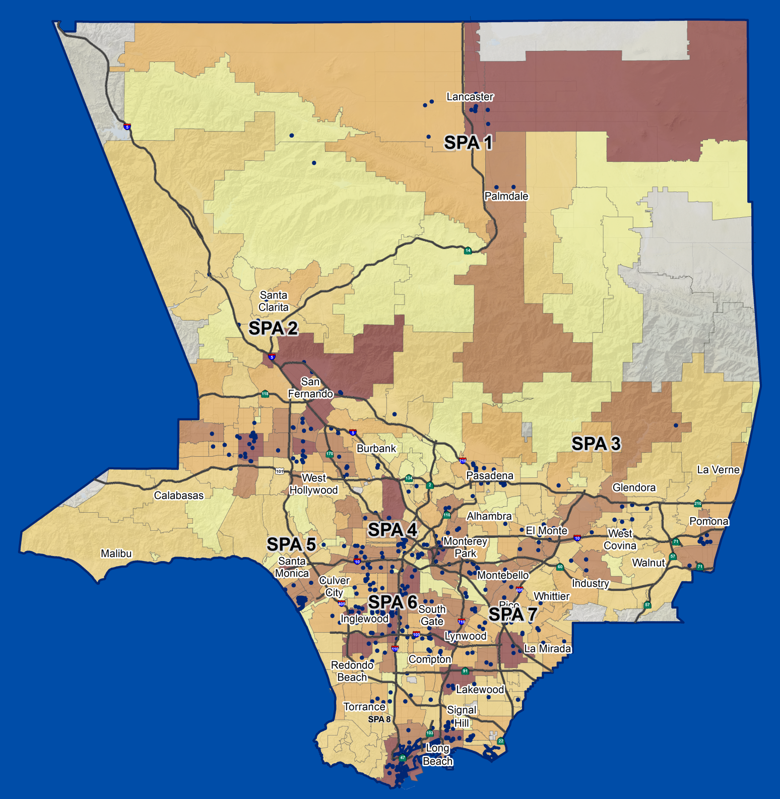

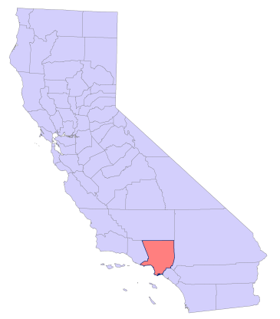


Alcoohol Related Emergency (ED) Visits
By Zip Code of Residence
Los Angeles County
2005-2011
Frequency
5 - 168
169 - 376
377 - 643
644 - 1025
1026 - 1687
Less than 5
LA County Population
Pop: 9,905,351
(ISD, 2012)
Source: HIRS, Calendar Year 2007
SPA 8
Includes all poisoning ICD-9 codes for alcohol type, infant/fetal intoxication, and high blood levels of alcohol
Data Source: OSHPD_EDVisits2005-2011alcohol.xls
Population estimates, supplied by L.A. County ISD. 2012
NAD 1983 State Plane CA FIPS 0405 SAPC, 9/11/2013

Slide 16
Alcohol Related Emergency Visits
in LAC, 2005-2011

Slide 17
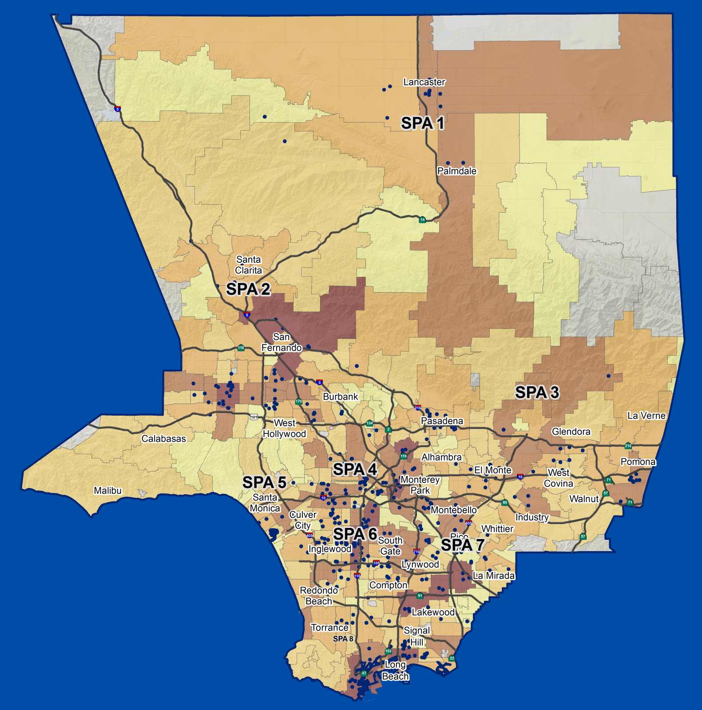
Alcoohol Related Hospitalizations
By Zip Code of Residence
Los Angeles County
2005-2011
Frequency
5 - 77
78 - 150
151 - 234
235 - 369
370 - 825
Less than 5
LA County Population
Pop: 9,905,351
(ISD, 2012)
Source: HIRS, Calendar Year 2007
SPA 8
Includes all poisoning ICD codes for alcohol type, infant/fetal intoxication, and high blood levels of alcohol
Data Source: OSHPD_EDVisits2007-2011alcohol.xls
Population estimates, supplied by L.A. County ISD. 2012
NAD 1983 State Plane CA FIPS 0405 SAPC, 9/11/2013

Slide 18
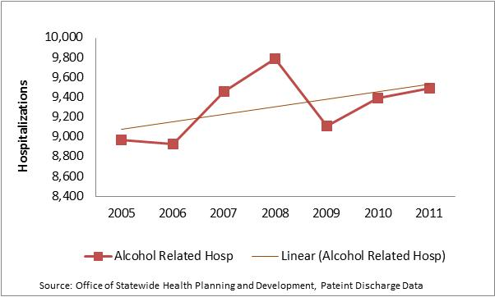
Alcohol Related Hospitalizations in LAC, 2005-2011

Slide 19
What We Know About Alcohol Outlets
Neighborhoods with higher concentrations of alcohol outlets also have higher rates of:
Alcohol-related hospitalizations
Drunk driving accidents
Pedestrian injuries
Among adolescents : Alcohol use seems to increase with:
  Permissiveness of social environment
  Increased perceived availability
Source: The Community Guide to Preventive Services, http://www.thecommunityguide.org/alcohol/index.html
Notes:
19
Source for 1-3:
(Rabow, J., and R.Watts., 1983; Scribner, R.A., D. MacKinnon, and J. Dwyer.,1994)
Source for 4-5:
(Kuntsche E, Kuendig H, & Gmel G., 2008)

Slide 20
Alcohol Outlets are Related to Alcohol-related Harms
Off-premise outlets provide a convenient access to alcohol (legal substance)
Low income/minority urban neighborhoods are known to have:
    Higher concentrations of off-premise (i.e., liquor store) outlets
    More frequent youth-related violence
    More Societal Costs
Source: Reducing Alcohol Related Harms in Los Angeles County Report, Los Angeles County Department of Public Health, 2011
Notes:
Of special interest to this project is to identify off-premise alcohol outlets located in walking distance (2 miles or less) to schools, especially those with a history of ABC license violations
A common venue type for direct purchase of alcohol by underage youth is through off-premise* outlets such as convenience, liquor and grocery stores
There is a tendency for higher concentrations of alcohol outlets to occur in urban minority neighborhoods
Youth-related violence tends to be more frequent in minority neighborhoods where there are off-premise outlets such as liquor and convenience stores
In LA County:
communities with high density of alcohol outlets are nine to ten times more likely to have increased rates of violent crime¹
Have increased rate of domestic violence and child abuse²
Are associated with higher levels of poverty and higher proportions of Blacks and Latinos in urban census tracts³

Slide 21
In Los Angeles County:
Communities with higher density of alcohol outlets suffer from more social harms:
9-10 times more likely to have increased rates of violent crime
Higher rates of domestic violence and child abuse
Concentrations of alcohol outlets higher in areas with higher Latino population and lower income
Source: Reducing Alcohol Related Harms in Los Angeles County Report, LAC DPH, 2011

Slide 22


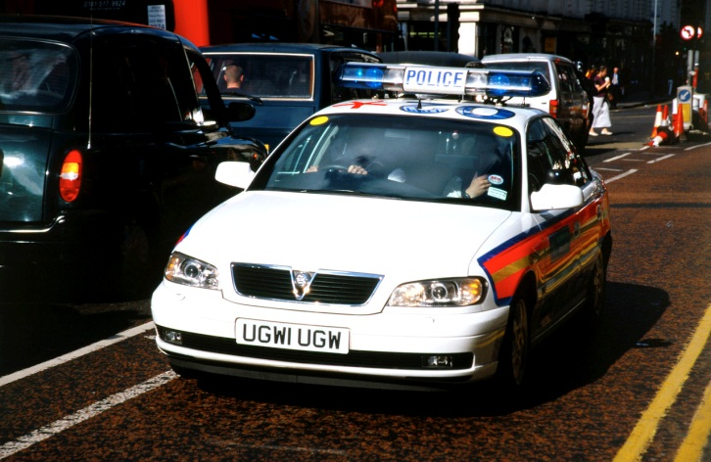
What Choices Do Adolescents Face in Urban Settings?
?

Slide 23
Alcohol-related Risk Behaviors Among Adolescents in Los Angeles County, 2011 YRBS
 | All | Latino | White
Ever had at least one drink of alcohol on at least 1 day | 65.1 | 67.4 | 60.7
(during their life)
Drank alcohol for the first time before age 13 years | 25.5 | 27.5 | 18
(other than a few sips)
Had at least one drink of alcohol on at least 1 day | 32.9 | 34.7 | 30.4
(during the 30 days before the survey)
Had five or more drinks of alcohol in a row within a couple of hours on at least 1 day | 17.9 | 19.6 | 14.5
(during the 30 days before the survey)
Had at least one drink of alcohol on school property on at least 1 day | 9.3 | 10.1 | 4.3
(during the 30 days before the survey)
Source: Centers for Disease Control & Prevention Youth Risk Behavioral Survey (YRBS), 2011

Slide 24
Methods
Geo-coding of data sources, included 2007-2011 California Highway Patrol SWITRS Collisions, California Alcoholic Beverage Control (ABC) License Violations for Outlets in Los Angeles County (2005-2010), California Department of Education Schools registered in Los Angeles County (2011)
Aggregation of Census Tract Populations to selected cities and communities in Los Angeles County
Notes:
Data from 2011 LAC Sheriff's Crime Statistics, 2011 California Alcohol Beverage Control (ABC), and 2010 Census Bureau were analyzed by LAC eight service planning areas (SPA).
Analyses were based on active off-premise alcohol outlet data in LAC as of September, 2011. Analyses showed a total of 6,235 off-sale alcohol outlets in LAC as of September 2011. About 4.7 million Latinos and 2.7 million Whites live in LAC.
Geo-coding was the first step.
I conducted geo-coding of alcohol-related collisions using data from the California Highway Patrol Statewide Integrated Traffic Reporting System (SWITRS) for the years 2007 through 2011.
I conducted geo-coding of all licensed alcohol outlets for Los Angeles County for the year 2011 using data obtained from the State of California Alcoholic Beverage Control (ABC) Office. License violations were linked by license ID using data provided to SAPC’s Prevention Unit by the ABC Office. ABC License violations were for the time period 2005-2010 and included a cumulative history of license violations by licensed outlets in Los Angeles County.
I geo-coded all crimes reported to the Los Angeles County Sheriff’s Crime Reporting System for the year 2011.
I geo-coded locations of all public and private schools in Los Angeles County using data from the California Department of Education for the year 2011.
Data Management/Cleaning
Performed cleaning and re-coding of data to include relevant categories depending on the data set. For example, for LA County Sheriff’s Reported Crime Data, I re-categorized crimes according to alcohol-related incidents found in the data. For ABC License violations, it was important to distinguish between off-premise type License 20 (liquor stores) and License 21 (general stores, markets). I also labeled all alcohol outlets with License 41 (restaurants) and related on-premise licensed outlets.
The GIS analyses including conducting spatial joins of data by location (i.e., location of alcohol outlets and specific-city boundaries, or location of specific alcohol-related crimes and what census tracts these crimes occurred). Spatial joins have played a supportive role in conducting this analysis as I have had to identify each city where alcohol-outlet collisions occurred, where alcohol-related crimes took place, and where alcohol outlets with a history of ABC License violations were located. This was a necessary step before aggregating incident data into city boundaries (using approximate aggregation methods in GIS referred to as “ Assigning a spatial reference to census tract centroids for the creation of census tract centroid shapefiles” ).
The GIS analysis was another necessary step for creating a table that contained the aggregate counts of alcohol-related crimes, alcohol-related collisions, ABC License violations, ABC alcohol outlets, economic hardship indices, and Race and Ethnicity-specific counts by selected cities and communities in Los Angeles County.
Next, this aggregate count table was used to run bivariate and regression analyses to explore the relationship between alcohol outlet violations, liquor stores (ABC License # 20), alcohol-related crimes and alcohol-related collisions and Economic Hardship Index and Hispanic and White-specific population densities (all analyses conducted at

Slide 25
Methods
Geo-coding, Kernel Density Mapping, Spatial Joints by location, Spatial Aggregation by Census Tracts:
    Joined 2008-2010 California Healthy Kids Survey (CHKS) participating schools to Census Tract Population data
    California Alcoholic Beverage Control (ABC)-2011 alcohol outlets with history of license violations
    Census tract level population data joined to school locations in LAC
Notes:
Data from 2011 LAC Sheriff's Crime Statistics, 2011 California Alcohol Beverage Control (ABC), and 2010 Census Bureau were analyzed by LAC eight service planning areas (SPA).
Analyses were based on active off-premise alcohol outlet data in LAC as of September, 2011. Analyses showed a total of 6,235 off-sale alcohol outlets in LAC as of September 2011. About 4.7 million Latinos and 2.7 million Whites live in LAC.
Geo-coding was the first step.
I conducted geo-coding of alcohol-related collisions using data from the California Highway Patrol Statewide Integrated Traffic Reporting System (SWITRS) for the years 2007 through 2011.
I conducted geo-coding of all licensed alcohol outlets for Los Angeles County for the year 2011 using data obtained from the State of California Alcoholic Beverage Control (ABC) Office. License violations were linked by license ID using data provided to SAPC’s Prevention Unit by the ABC Office. ABC License violations were for the time period 2005-2010 and included a cumulative history of license violations by licensed outlets in Los Angeles County.
I geo-coded all crimes reported to the Los Angeles County Sheriff’s Crime Reporting System for the year 2011.
I geo-coded locations of all public and private schools in Los Angeles County using data from the California Department of Education for the year 2011.
Data Management/Cleaning
Performed cleaning and re-coding of data to include relevant categories depending on the data set. For example, for LA County Sheriff’s Reported Crime Data, I re-categorized crimes according to alcohol-related incidents found in the data. For ABC License violations, it was important to distinguish between off-premise type License 20 (liquor stores) and License 21 (general stores, markets). I also labeled all alcohol outlets with License 41 (restaurants) and related on-premise licensed outlets.
The GIS analyses including conducting spatial joins of data by location (i.e., location of alcohol outlets and specific-city boundaries, or location of specific alcohol-related crimes and what census tracts these crimes occurred). Spatial joins have played a supportive role in conducting this analysis as I have had to identify each city where alcohol-outlet collisions occurred, where alcohol-related crimes took place, and where alcohol outlets with a history of ABC License violations were located. This was a necessary step before aggregating incident data into city boundaries (using approximate aggregation methods in GIS referred to as “ Assigning a spatial reference to census tract centroids for the creation of census tract centroid shapefiles” ).
The GIS analysis was another necessary step for creating a table that contained the aggregate counts of alcohol-related crimes, alcohol-related collisions, ABC License violations, ABC alcohol outlets, economic hardship indices, and Race and Ethnicity-specific counts by selected cities and communities in Los Angeles County.
Next, this aggregate count table was used to run bivariate and regression analyses to explore the relationship between alcohol outlet violations, liquor stores (ABC License # 20), alcohol-related crimes and alcohol-related collisions and Economic Hardship Index and Hispanic and White-specific population densities (all analyses conducted at

Slide 26
Drunk Driving Analyses
Conducted regression analyses to explore the relationship between vehicular collisions and Federal Poverty Level (100 %) in Hispanic and White city/communities in Los Angeles County

Slide 27
Alcohol-Related Collisions (2007-2011)
Los Angeles County
Data Source: Statewide Integrated Traffic Reporting System (SWITRS), California Highway Patrol, Years 2007 through 2011

Slide 28
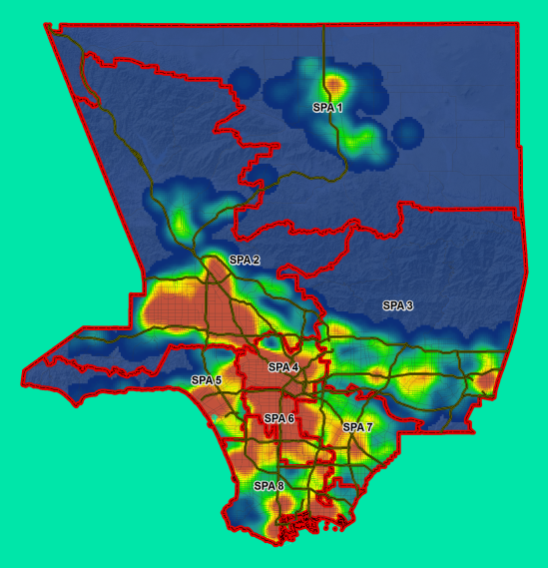
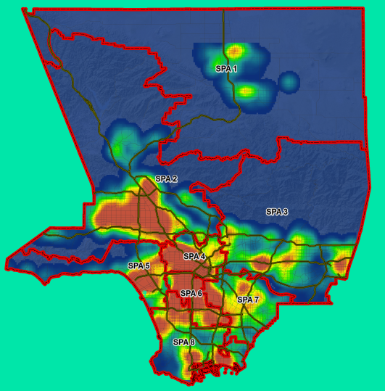

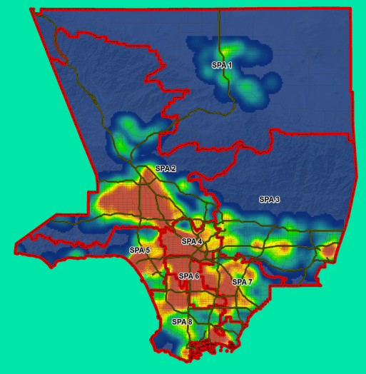

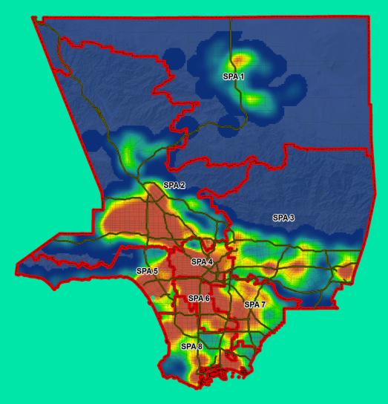
Alcohol Related DUI Injury and Deaths
2007
2008
2009
High
High
High
Low
Low
Low
2010
2011
2007-2011
Source: HIRS, Calendar Year 2007
High
High
High
Low
Low
Low
Data Source: Statewide Integrated Traffic Reporting System (SWITRS), California Highway Patrol

Slide 29
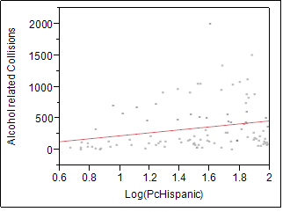
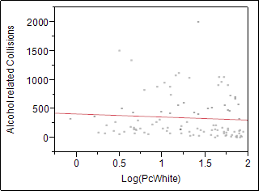
Results
Linear Fit
Alcohol Collisions = -14.55412 + 236.17285*Log(PcHispanic)
n=100
Summary of Fit
RSquare 0.054796; p < 0.05* significant at 0.05 alpha level
Linear Fit
Alcohol Collisions = 410.65085 - 52.994569*Log(PcWhite)
n=100
Summary of Fit:
RSquare 0.004965; p not significant at 0.05 alpha level

Slide 30
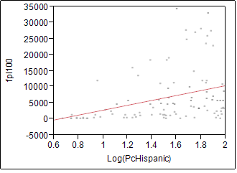
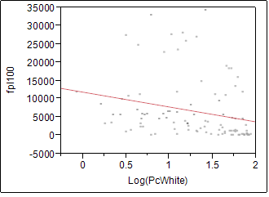
Results
Linear Fit
fpl100 = -4935.139 + 7659.3889*Log(PcHispanic)
n=100
Summary of Fit
RSquare 0.120394; p< 0.05 alpha level
Linear Fit
fpl100 = 11888.392 - 4072.44*Log(PcWhite)
n=100
Summary of Fit
RSquare 0.061245; p< 0.05 alpha level

Slide 31
Results
Regression analyses of alcohol-related collisions and poverty areas showed:
    In cities/communities where more Latinos live, there is a significant association to alcohol-related accidents to have occurred for the 2007-2011 Year period
    In cities/communities where more Latinos live, there is a significant association to observing more people living under poverty (below 100 FPL)
Data Source: State of California Alcoholic Beverage Control (ABC) Office
Notes:
31
Ricardo: Please verify the last bullet

Slide 32
Underage Drinking Behavior and Alcohol Outlet Proximity Analysis
Conducted GIS, regression analyses to explore the relationship between vehicular collisions and Federal Poverty Level (100 %) between Hispanic and White city/communities

Slide 33
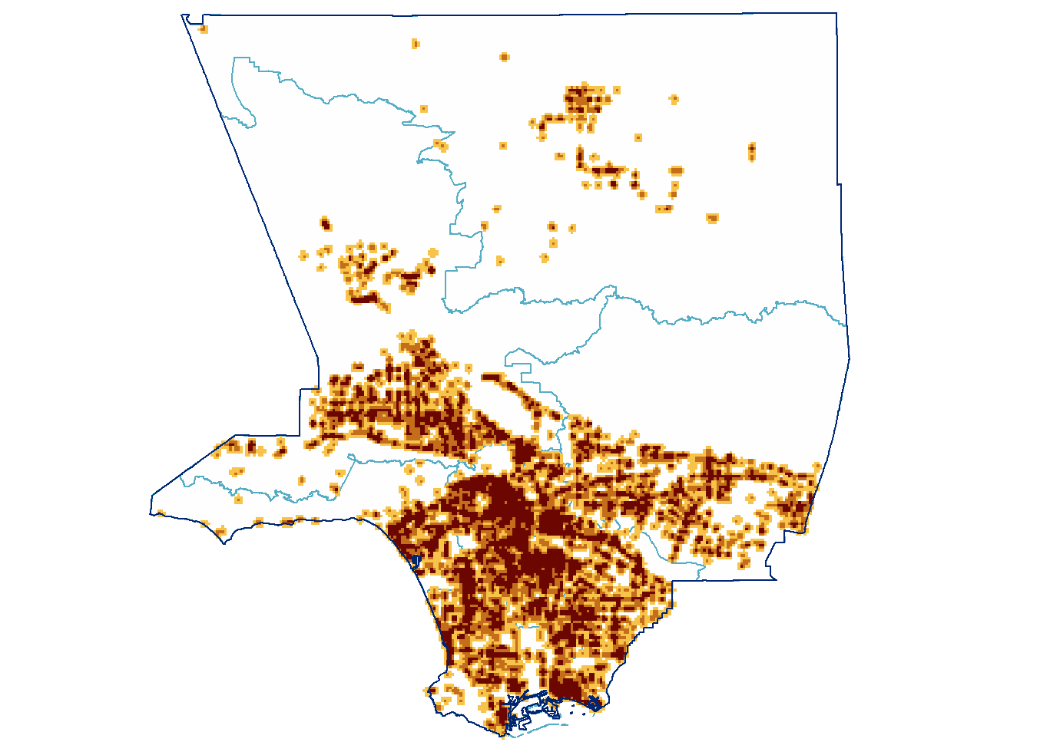
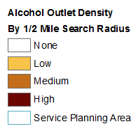
Alcohol Outlet Density Analysis
Los Angeles County, 2011
Notes:
Map of Schools and Outlets

Slide 34

Proportion of Schools with Alcohol Outlets within selected distance thresholds
In this analysis, 3,395 Schools were considered: 70% were public schools
  At 2 Miles:
    In LAC, 98 % of all schools have > 10 outlets within a 2 mile radius
At ½ Mile:
  58% of schools found with at least 1 alcohol outlet with ABC violations
  33% found with > 1 outlet with violations

Slide 35
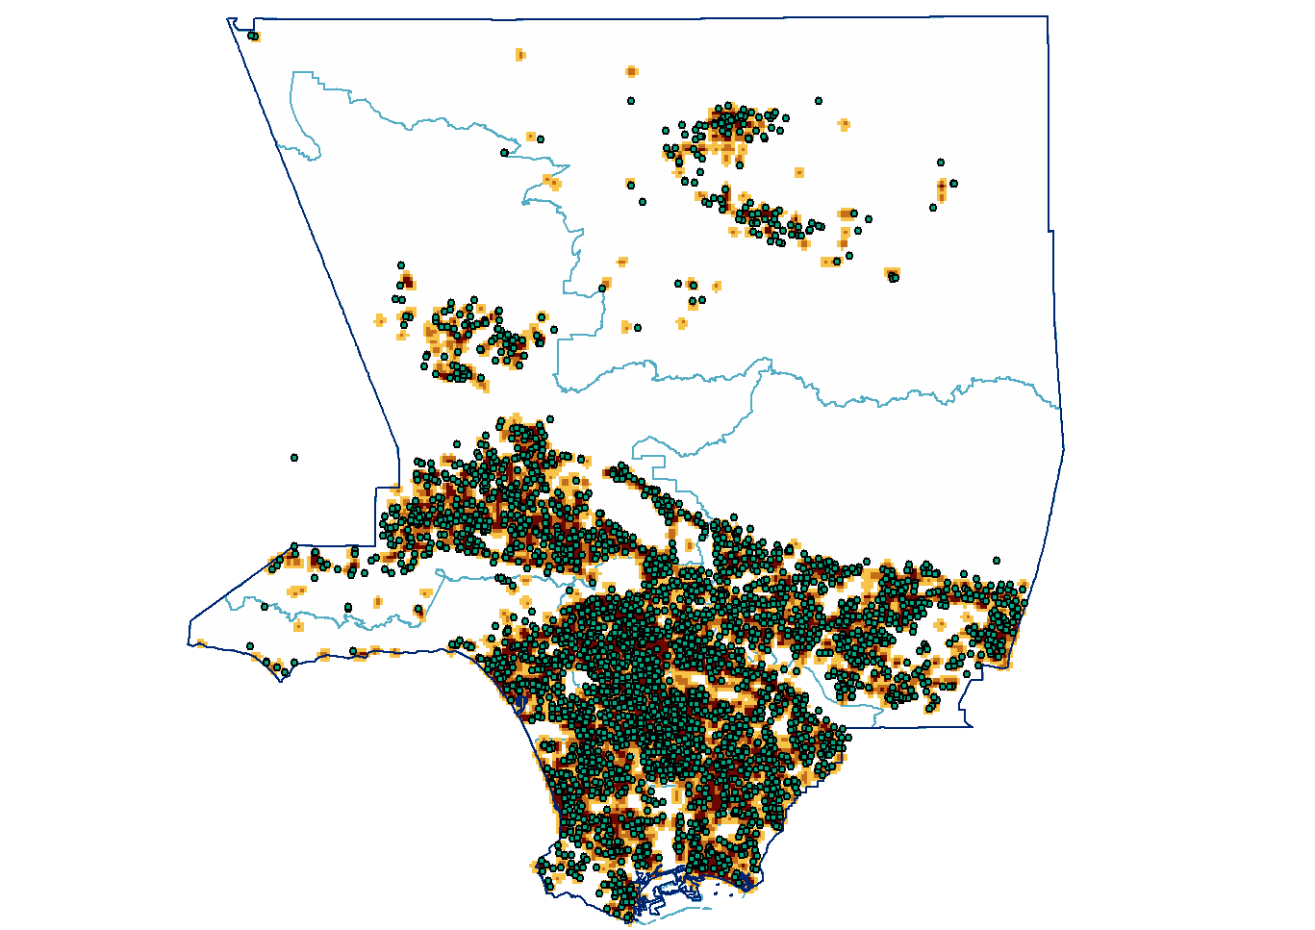
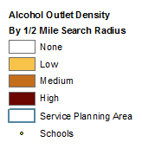
Alcohol Outlet Density and Schools*
* Data Source: California Department of Education, Public and Private School Registry, 2011
Notes:
Map of Schools and Outlets

Slide 36
Outlet to School Risk Score Proximity Analysis
California Healthy Kids Survey (CHKS) Participating Schools (n=114) with 1 or more Outlets with ABC Violations (n=132) within ½ mile, Survey Risk Average Score per School calculated, Census Tract Population used per School Location

Slide 37
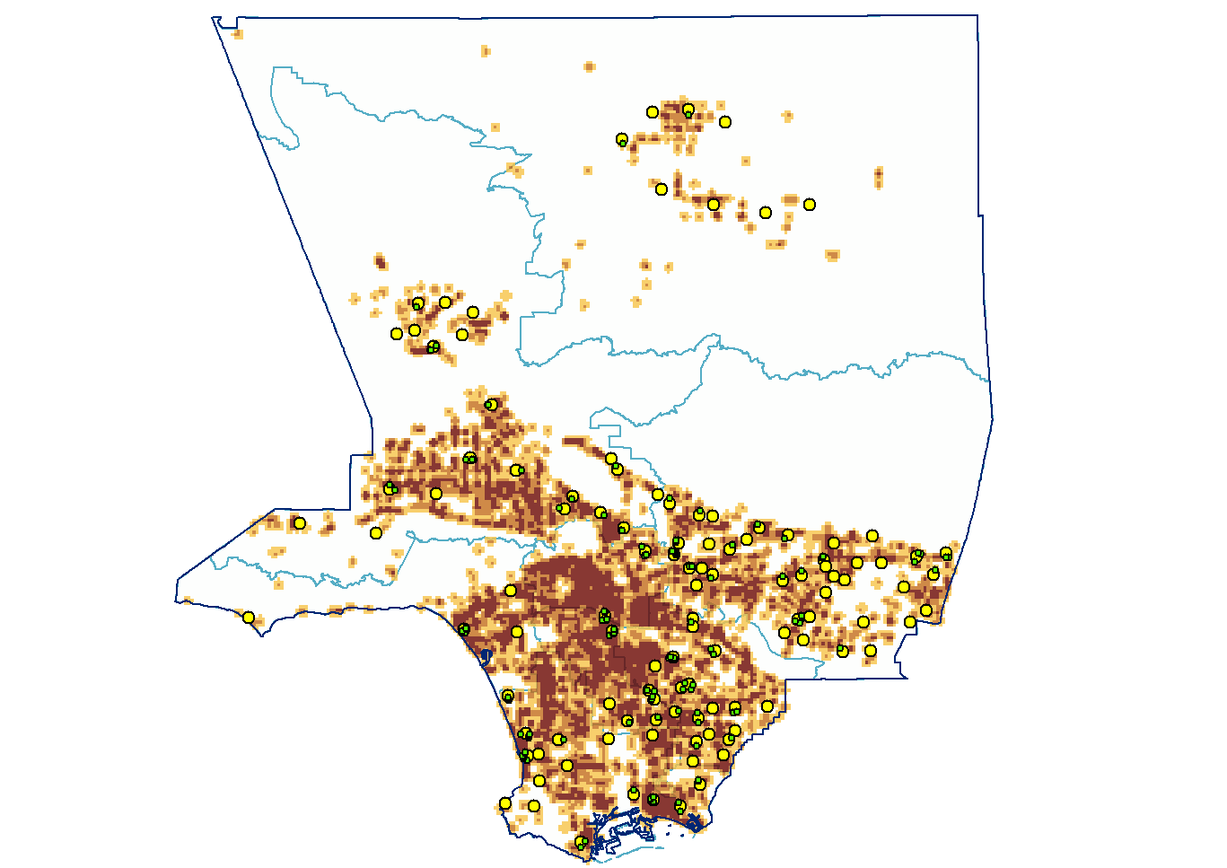
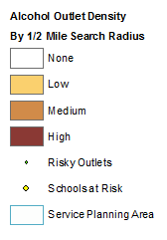
Participating CHKS Survey Schools* and Outlets with Violations within ½ Mile of Schools
* Data Sources: California Healthy Kids Survey (CHKS) 2008-2010 Survey; Census Bureau, 2010, n=114 schools, 132 outlets
Notes:
Map of Schools and Outlets

Slide 38
Proximity Analysis linked to Selected Risk Behavior Outcomes in CHKS*
Exposure variable: the number of outlets with violations within 1/2 a mile of a participating school
Schools with fewer than 35 respondents were excluded
The Scale Average represents the average of the scale scores for each school in sample
* There were 114 participating schools in CHKS Survey with 132 alcohol outlets with license violations within ½ mile of their premises

Slide 39
Proximity Analysis linked to Selected Risk Behavior Outcomes (cont.)
Scale score was calculated using the answers to 7 drinking related questions*
Responses were awarded one point for school respondents having engaged in the behavior once or more
Adjusted for school population
* Alcohol-related questions from the CHKS Survey, 2008-2010 Survey Wave in Los Angeles County; Question items are a37, a53, a55, a63, a64, a73 and a89

Slide 40
Selected Risk Behavior Outcomes*
In your lifetime, Have you had one full drink of alcohol?
In your lifetime, Have you been very drunk or sick after drinking alcohol?
In your lifetime, Have you been drunk or high on school property?
During the past 30 days did you have at least one drink of alcohol?
* Alcohol-related questions from the CHKS Survey, 2008-2010 Survey Wave in Los Angeles County; Question items are a37, a53, a55, a63, a64, a73 and a89

Slide 41
Selected Risk Behavior Outcomes*
During the past 30 days did you have 5 or more drinks of alcohol in a row?
During the past 30 days have you had at least one alcoholic drink on school property?
In your lifetime, Have you ever driven a care while you had been drinking
* Alcohol-related questions from the CHKS Survey, 2008-2010 Survey Wave in Los Angeles County; Question items are a37, a53, a55, a63, a64, a73 and a89

Slide 42
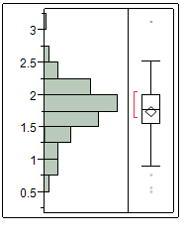
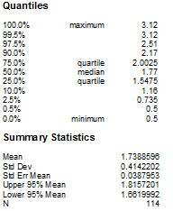
Average Risk Score Results

Slide 43
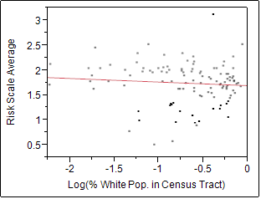
Regression Analysis Results*
R Square=0.007187
n=114
P not significant at 0.05 alpha level
Linear Fit
ScaleAvg = 1.6895521 - 0.0716715*Log(PcWhite)
* Analysis of School Survey Risk Average by Percent of Population in Census Tract where school was located

Slide 44
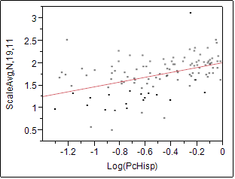
Regression Analysis Results*
R Square=0.202911
N=114
P <.0001 at 0.05 alpha level
Linear Fit
ScaleAvg = 2.0089974 + 0.5390579*Log(PcHisp)
* Analysis of School Survey Risk Average by Percent of Population in Census Tract where school is located

Slide 45
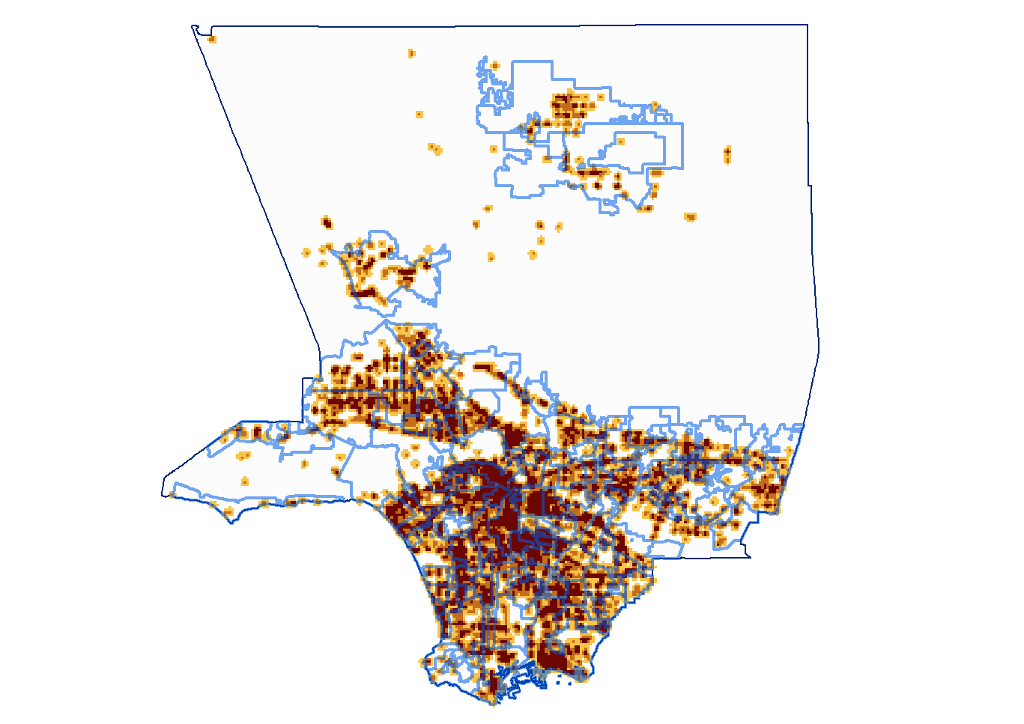
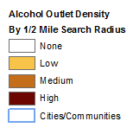
Outlet Density Analysis by City/Community

Slide 46
Results
Comparison of alcohol outlet densities to Federal Poverty Levels and densities of African American, Asian, Hispanic, and White populations by City/Community (n=100) showed:
  A total of 6,235 off-premise alcohol outlets were identified in LAC in 2011.
  Of these off-premise outlets, 2,931 (47 %) were liquor stores.
  Hot spot and regression analyses showed liquor stores tend to be aggregated in inner-city areas with high poverty levels (FPLs < 200%, p < 0.0001, Rsqrd = 0.546)
Notes:
Past month, past year, and lifetime Illicit drug use among Latinos under 18 are higher than US total.

Slide 47
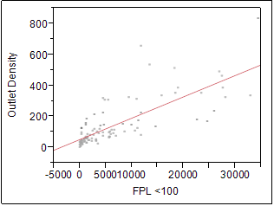
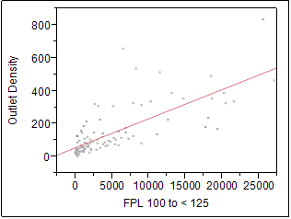
Results
Linear Fit
Total Outlet Density = 49.722545 + 0.0137872*fpl100
n = 98
Summary of Fit
R square= 0.582581; p< 0.05 alpha level
Linear Fit
Total Outlet Density = 53.734951 + 0.0176907*fpl125
n = 98
Summary of Fit
R square = 0.540843; p< 0.05 alpha level

Slide 48
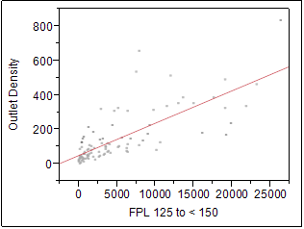
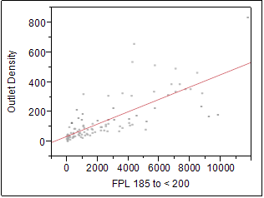
Results (cont.)
Linear Fit
Total Outlet Density = 48.327727 + 0.0188045*fpl150
n = 98
Summary of Fit
Rsquare= 0.557976; p< 0.05 alpha level
Linear Fit
TTotal Outlet Density = 36.309447 + 0.0414117*fpl200
n = 98
Summary of Fit
Rsquare= 0.560293; p< 0.05 alpha level

Slide 49
Differences Between
Proportion of Outlets with ABC License Violations by Type of License,
Los Angeles County, 2005-2010
  Null Hypothesis: There is no difference between the proportion of alcohol outlet violations for off- and on-premise licensed outlets in LAC
              Odds Ratio p Value
    Finding: 1.9 p <.001
    The odds for an off-premise outlet to have a violation compared to an on-premise outlet was about 1.9 times higher
* N = 7,977 violation events for time period 2005-2010
Notes:
896 total off-sale retail alcohol outlets in the 600ft buffer zone of schools
480 Beer & Wine (Lic 20)
416 General (Lic 21)
Null Hypothesis: There is no difference between the proportion of alcohol outlet violations for Off- and On-premise licensed outlets in LA County
Contingency table analysis revealed that there is a statistically significant difference between overall ABC violations by type of outlet (On- vs. Off-premise) at at p<0.0001, Likelihood ratio chi square = 211.049
The odds for an Off-premise outlet to have a violation is about 1.9 times higher than for an On-premise outlet

Slide 50
Differences Between
Proportion of Outlets with ABC License Violations by Type of License,
Los Angeles County, 2005-2010
  Null Hypothesis: There is no difference between the proportion of alcohol outlet violations when a minor was involved for off- and on-premise licensed outlets in LA County
    Odds Ratio p Value
    Finding: 2.6 <.001
    The odds for an off-premise outlet to have a violation when a minor was involved compared to an on-premise outlet was about 2.6 times higher
* N = 7,977 violation events for time period 2005-2010, n=2004 violations involved a minor.
Notes:
896 total off-sale retail alcohol outlets in the 600ft buffer zone of schools
480 Beer & Wine (Lic 20)
416 General (Lic 21)

Slide 51
Summary
The proximity of outlets with violations to schools was significantly associated with selected alcohol related risk behaviors among youth who responded to CHKS survey questions (2008-2010) at schools located in census tracts with higher numbers of Latino residents and people living in poverty (<100 FPL)

Slide 52
Summary
The odds for an off-premise (i.e., liquor store) outlet to have a violation compared to an on-premise (i.e., restaurant) outlet was about 1.9 times higher
The odds for an off-premise (i.e., liquor store) outlet to have a violation when a minor was involved compared to an on-premise (i.e., restaurant) outlet was about 2.6 times higher

Slide 53
Conclusions
Analyses suggest that LAC communities with higher alcohol outlet density (i.e., liquor stores), alcohol-related collisions and underage drinking behaviors may be associated to census tracts, cities and communities where Hispanics and people living in poverty are more likely to live

Slide 54
Limitations
Cross-sectional, retrospective design
Ecological design study
California ABC License violations data was aggregated for 2005-2010 time period
California Healthy Kids Survey Data was for voluntarily participating schools only
Alcoholic Beverage Control (ABC) Office License Violations Data is aggregated to years 2005-2010, ABC Office understaffed, data may be incomplete

Slide 55
Policy Implications
Monitor the urban built environment in LA County
Explore policy opportunities for change at the County & city level (i.e., city-specific ordinances)
Follow The Community Guide* Recommendations to reduce drinking:
  Regulate Alcohol Outlet Density
  Enforce Laws Prohibiting Sales to Minors
  Create limits on days and/or hours of sale by outlets
* The Community Guide on Preventing Excessive Alcohol Consumption can be found at http://www.thecommunityguide.org/alcohol/index.html
Notes:
Examine alcohol outlet distribution in small areas of LA County such as school enrollment areas more closely
Explore policy opportunities for change at the County & city level (i.e,. city-specific ordinances) for alcohol outlet licensing around schools and other public assets
Explore research opportunities that will help assess the urban built environment in LA County to gain a better understanding of urban environment risk factors that influence adolescent behaviors for alcohol and other drugs
Explore policy opportunities for modifying the urban landscape related to alcohol outlets in LA County. Work with community partners to address help reduce alcohol-related harms in Los Angeles County by:
Restricting alcohol availability and accessibility to minors
Reducing alcohol advertising in public places and in areas commonly seen and walked by minors, such as walking paths to school

Slide 56
Policy Implications (cont.)
Work with community partners to address help reduce alcohol-related harms in Los Angeles County by:
  Restricting alcohol availability and accessibility to minors.
  Reducing alcohol advertising in public places and in areas commonly seen and walked by minors, such as walking paths to school.
  Collaborate with other law enforcement agencies for additional crime data to corroborate findings.

Slide 57





Data Sources
Statewide Integrated Traffic Reporting System (SWITRS), California Highway Patrol (2007-2011)
State of California Department of Education School Identification (LAC public and private schools)
California Alcoholic Beverage Control (ABC) Office ( Off-sale alcohol retail outlet licenses )
California Healthy Kids Survey (CHKS)-2008-2010
Census 2010: Census Tract Demographic and Poverty measures
Notes:
CHKS is the larges statewide survey of resiliency, protective factors and risk behaviors in the nation

Slide 58
Acknowledgements
Farimah Fiali, M.S.
Emily Dieschel, M.P.H.
James Martinez, M.P.H., Ed.D.
Tina Kim, Ph.D.
Benedict Lee, Ph.D.
John Viernes Jr.

Slide 59

Mahalo Nui Loa!
kiitos
Diolch yn fawr
אַ דאַנק
תודה
dziękuję
Gracias
grazie
شكرا
dank u
​សូមអរគុណ
Go raibh maith agat
Thank you
धन्यवाद
obrigado
Merci
감사합니다
謝謝
Grazas
তোমাকে ধন্যবাদ
спасибо
Danke
Tack
matur nuwun
ありがとう
Notes:
Kheyli (Muchas) Mam-noon (Gracias)

