Slide 1
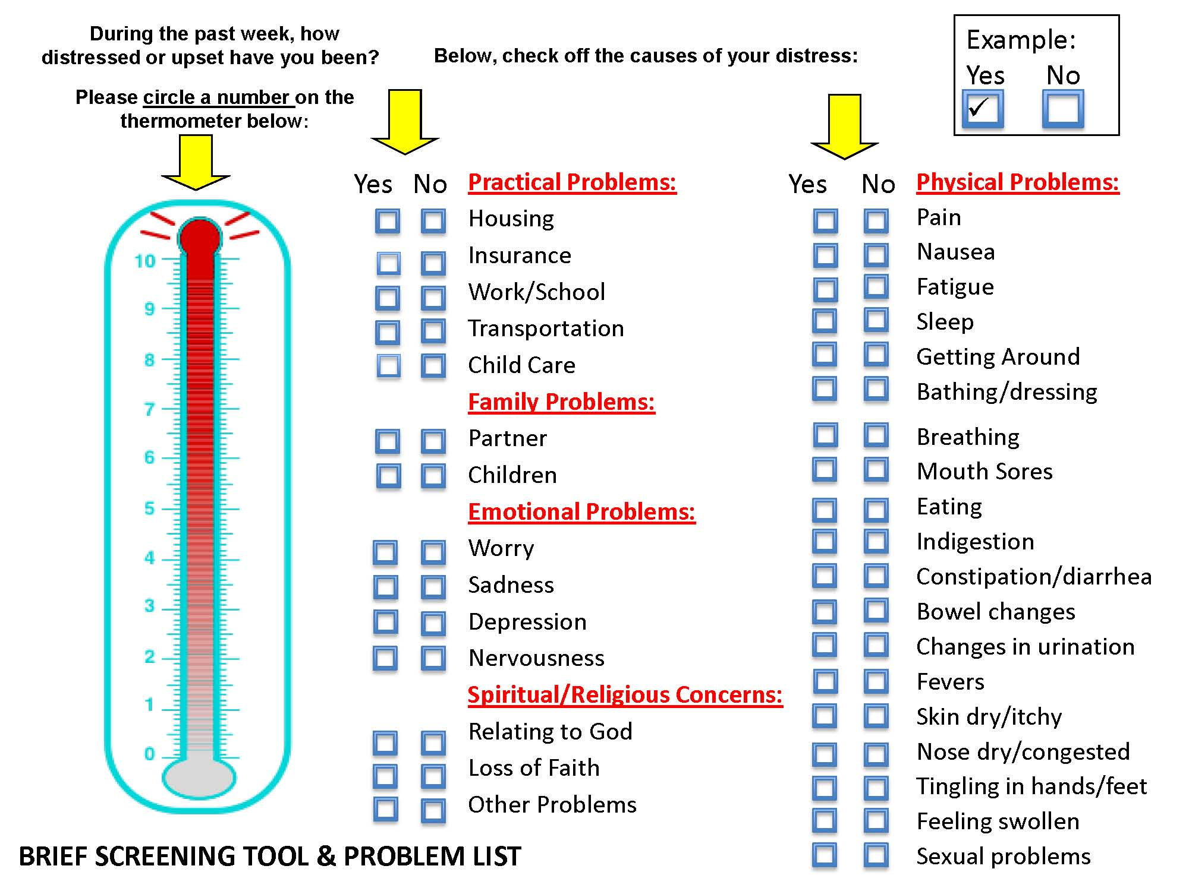
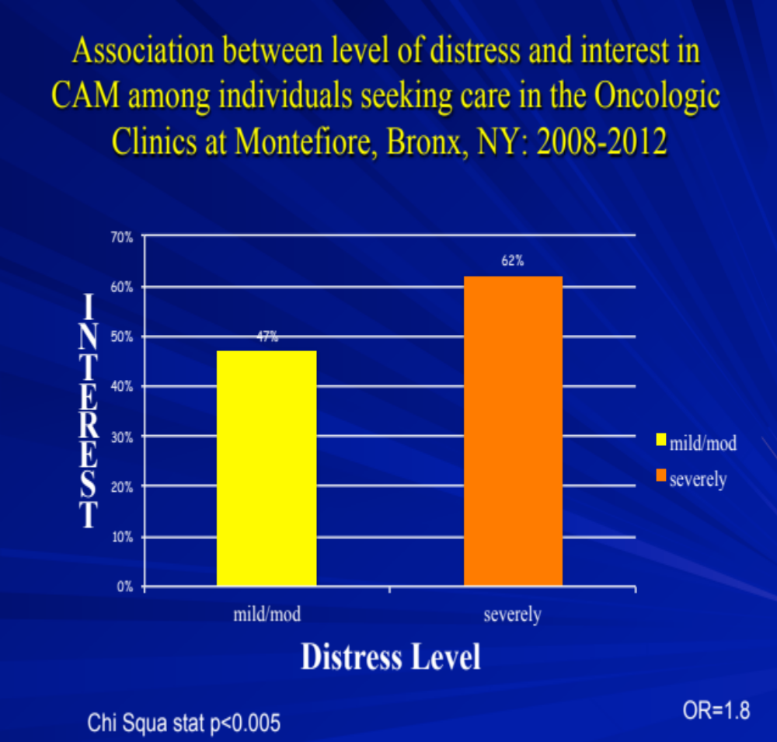
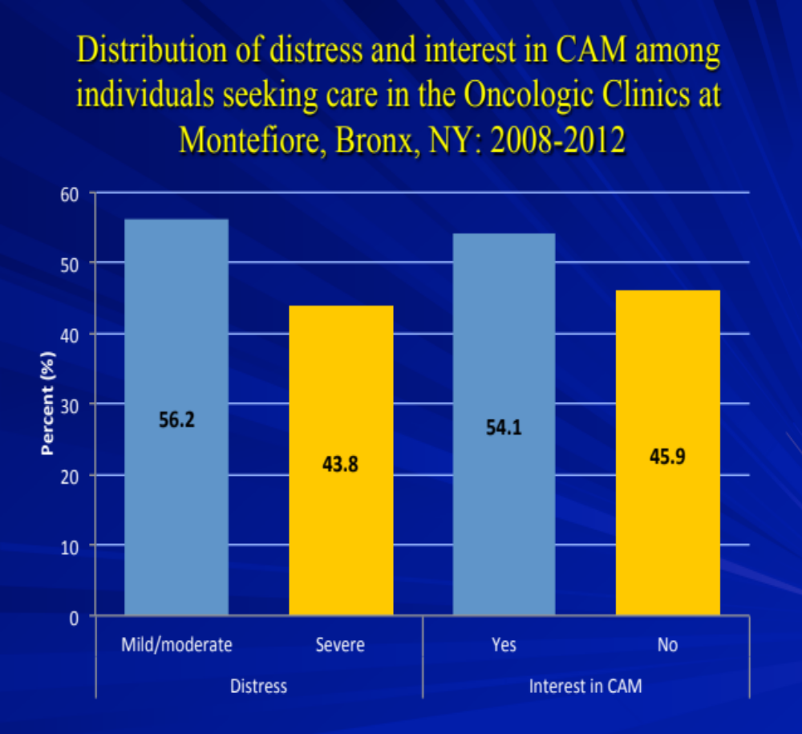
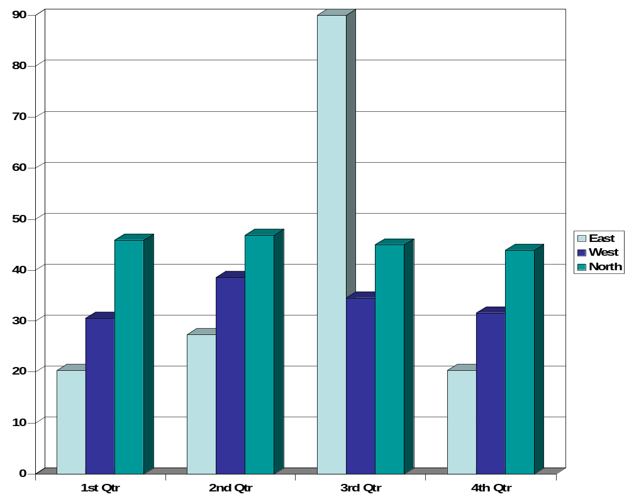
INTEREST IN USING COMPLEMENTARY THERAPIES BY DISTRESSED CANCER PATIENTS IN CLINICS AFFILIATED WITH MONTEFIORE HOSPITALS FROM 2008 TO 2012
Asif Patel , MBBS MPH¹; Evelyn Kolidas, PhD²; Melissa Martinez, MS²; Alyson Moadel, PhD²
¹Lehman College CUNY, ^{2,}Albert Einstein College of Medicine
Introduction
Methods and materials
Results
Discussion
Cancer continues to be a major public health problem despite advances in the medical sciences. Estimated figures of cancer survivors stand at 15 million.
They have fear of recurrences and death, anxiety, stress stemming from the financial burdens associated with their therapy, depression, and sometimes suicidal tendencies.
The American Cancer Society estimated that almost one quarter of patients with cancer undergoing treatment became clinically depressed. Research found that the prevalence of mental distress in cancer patients is between 22% and 58%.
The National Comprehensive Cancer Network (NCCN, 2005) defined distress as “a multifactorial, unpleasant emotional experience of a psychological (cognitive, behavioral, emotional), social, and/or spiritual nature that may interfere with the ability to cope effectively with cancer, its physical symptoms, and its treatment”.
The National Center for Complementary and Alternative Medicine (NCCAM) defines Complementary and Alternative (CAM) therapies as “a group of diverse medical and healthcare system, practices, and products that are not generally consider part of conventional medicine.”
Over the past few decades, the use of CAM by Americans has increased substantially from 33.8 percent to 42.1 percent.
A few studies have shown that distressed individuals are more likely to use complementary medicine than non-distressed individuals. However, there is no consensus among researchers whether an association exists between distress among cancer survivors and their interest in using complementary medicine.
The aim of this study is therefore to determine whether distressed individuals diagnosed with cancer are interested in complementary therapies in Montefiore Hospital clinics during 2008 and 2012.
Ku and colleagues showed that highly distressed patients were more likely to use complementary medicine (OR=14) and the prevalence of using these therapies among their sample was 87%. Vehoeff et al study also showed that distressed patients were more likely to use complementary therapies and the prevalence of using complementary therapies among their sample was 97%. In contrast, however, Sollner concluded against any association.
This is one of the first studies to examine the association of CAM use and distress in a predominantly underserved and ethnic minority population of cancer patients in the U.S.
Our study has a few limitations. Because all participants are from the clinics affiliated with Montefiore hospital, the sample does not represent the general population..
Our sample is overrepresented by women.
We administered questionnaires to individuals diagnosed with cancer at visiting oncology clinics. Interviews with participants were conducted either on the phone or face to face in English or Spanish. A total of 967 cancer patients participated in the study, the majority (78%) of whom were women.
After excluding questionnaires that had missing data on our key variables of interest, our resulting final sample was 290. All participants took part in the study voluntarily.
We used the Distress Thermometer (DT), a self-reported 11-point scale, to measure the level of distress among participants (15-16). Respondents were asked how distressed they felt in the past week by pointing to the number. The higher the number, the more distressed they were. Their responses were recorded and those answering between 0 and 4 were classified as mild or moderately distressed and those answering between 5 and 10 as severely distressed.
Demographic characteristics such as age, sex, race/ethnicity, and language were recorded in the survey.
Descriptive statistics were calculated for each characteristic according to distress and interest in CAM use.
We used chi square statistics and odds ratios to examine the association between distress and interest in CAM use. Data were analyzed with SPSS.
    Over half (52%) of respondents reported interest in complementary medicine. Nearly two-thirds (62%) of severely distressed respondents reported interest in complementary medicine, while only 49% of mildly or moderately distressed individuals reported interest in complementary medicine. Distress was significantly associated with interest in complementary medicine (p<0.05, OR=1.8 CI 1.19-2.9). Even after adjusting age, this association was significant (p<0.05, OR=1.8 CI 1.11-2.81).
 | Interest in CAM % | Interest in CAM %
Character | YES | NO | P-value | OR ( Confidence interval)
SEX Male Female | 44.2 56.3 | 55.8 43.7 | 0.07 | 1.63(0.9-2.9)
AGE <49 >49 | 69.4 49.1 | 30.6 51.9 | 0.002 | 1.41(1.15-1.75)
RACE African American Hispanics Whites Others | 54.6 59.5 38.3 56.0 | 45.5 40.5 61.7 44.0 | REF 0.5 0.08 0.9 | 1 1.2(0.7-2.0) 0.5(0.3-1.0) 1.0(0.4-2.3)
DISTRESS Mild/Moderate Severe | 47.9 62.2 | 52.1 37.8 | 0.01 | 1.8(1.19-2.9)
Conclusions
Cancer patients with severe distress were more likely to use complementary medicine compared to those mildly or moderately distressed.
Further studies are needed to know whether cancer patients with severe distress may benefit from an extra layer of counseling.
Characterstics | Total(n=290) | Proportion(%)
Age <49 >49 | 72 218 | 24.8 75.2
Sex Male Female | 52 238 | 17.9 82.1
Race African American Hispanics Whites Others | 97 121 47 25 | 33.4 41 16.2 8.6
Interest No Yes | 133 157 | 45.9 54.1
Distress Mild to moderate Severe | 163 127 | 56.2 43.8
Language English Spanish | 237 53 | 81.7 19.3
References
ffman BM, Zevon MA, D'Arrigo MC, et al. Screening for distress in cancer patients: the NCCN rapid-screening measure. Psychooncology.
2004; 13(11): 792-799.
Carlson LE, Waller A, Mitchell AJ: Screening for distress and unmet needs in patients with cancer: review and recommendations. J ClinOncol. 2012; 30(11): 1160-1177
 | A | B | C | D
Patient 1
Patient 2
Patient 3
Patient 4
Acknowledgement
Many thanksto internship advisor Dr. Emma Tsui( Lehman College) and Bold team at Albert Einstein College of Medicine.
Chart 1. Label in 24pt Arial.

