Slide 1

More Than the Sum of Our Parts:
Defining Workforce Needs for Governmental Public Health
INSERT LOGO HERE

Slide 2
Challenges to Our Workforce
Retirements
Shrinking workforce
Competition amongst ourselves for limited funds
Focus on our silos
Categorical funding streams

Slide 3


Slide 4

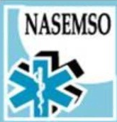


















Slide 5
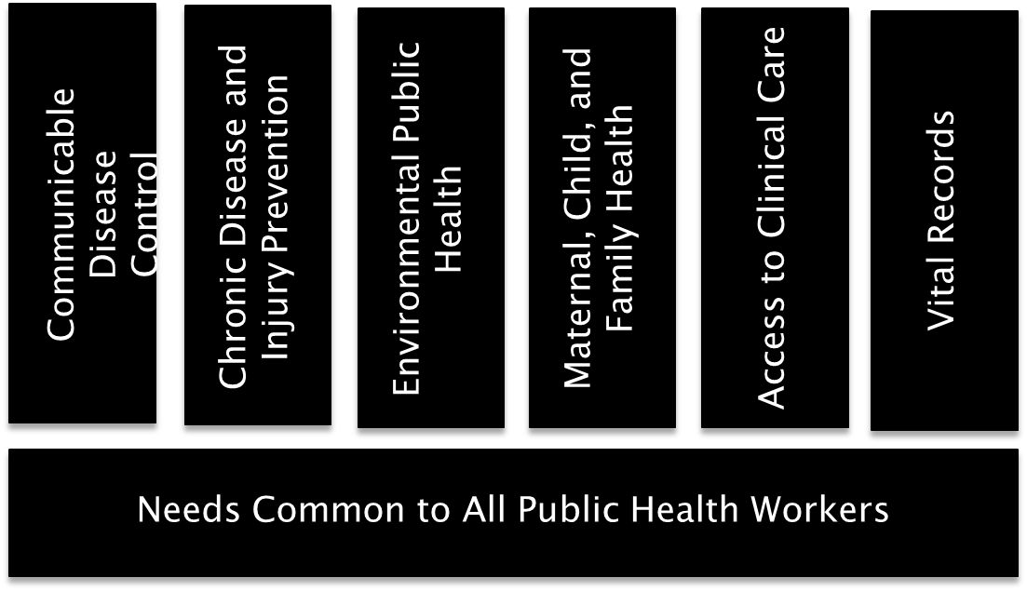
Framework for Considering Workforce Needs

Slide 6
Guiding Principle
In an environment of growing demands and diminishing resources, we need to focus on our workforce development efforts on trainings that will have the most impact for the most people.

Slide 7
Research Question
By convening various public health membership groups, peer networks, and other partners, could we identify cross-cutting public health needs that would be valued universally?

Slide 8
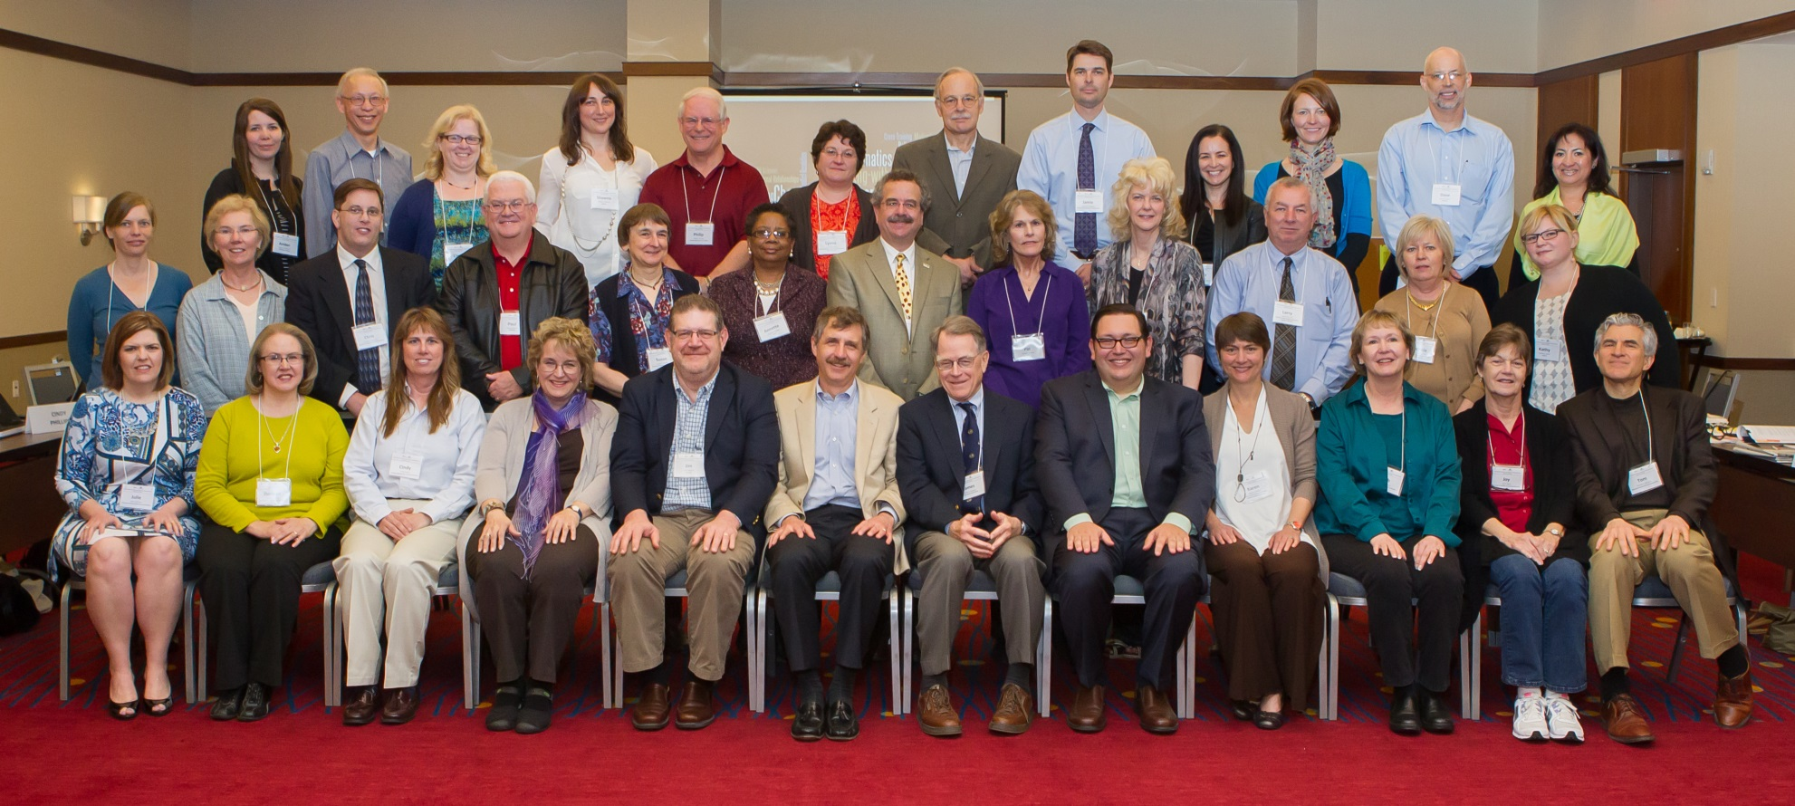
Public Health Workforce
Strategic Advisory Group

Slide 9
Advisory Group Participants
Affiliates | Peer Networks | Partners
Association of Health Facility Survey Agencies AMCHP APHL Public Health Nurses ASTDD Health Liaison Officials Nutrition Directors CSTE DHPE NPHIC NACDD State EMS Officers NAPHSIS NASTAD Safe States Alliance | Accreditation Coordinators Chief Fiscal Officers Environmental Health Directors Human Resource Directors Informatics Directors Preparedness Directors Primary Care Officers Senior Deputies State Legislative Liaisons | APHA CDC HRSA NACCHO National WIC Association Public Health Foundation Northwest Center for Public Health Practice

Slide 10
Charge
Look beyond individual priorities
Think about universal public health workforce needs

Slide 11
Methods

Slide 12
Methods: Data Collection
1-1½-hour semi-structured telephone interviews
Development of background working documents
In-person consensus building meeting (1.5 days)

Slide 13
Background on Advisory Group
Strong Experience in Workforce Development
1/2 have staff dedicated to workforce development activities at their organization; the rest have volunteers or no designated staff
Capacity assessments of their professional areas aren’t done routinely
39% | 20+ years
10% | 11-19 years
50% | 1-10 years

Slide 14
Results

Slide 15
Call for a More Focused & Coordinated WD Strategy
See working in common as way to accelerate progress
Most calling for collaborative approach & excited about it
Confusion over who is leading workforce development for the field

Slide 16
Goal of Workforce Development: 3 Themes Emerged
Prepare workforce for 10 years from now, to deliver the “new public health”
Attract & develop quality workforce, so they find joy in current jobs while understanding opportunities for growth in the profession (Retain)
Right number of people in right jobs, with right skills & attitudes, ensuring a strong, effective workforce that keeps Americans healthy

Slide 17
Greatest PH Challenges: 2014
Financial crises
Staffing
Retirements
ACA implementation
Poor perceptions of government

Slide 18
Greatest PH challenges: 2020
Challenge | Result
PH’s ACA role | lost revenue & visibility
Undervaluing PH | declining resources & credibility
Informatics & technology | requires new skill sets
Retirements | loss of experienced manager & leader skills
Complex issues | require nimbleness, broader skills
Not a singular profession | weak pipeline & career paths no core requirements skill sets limited attracting young difficult

Slide 19
Greatest Opportunities for Strengthening Public Health
ACA support of PH
Raise visibility, demonstrate value
Prepare next generation—entrepreneurship, new skills sets & thinking
Integrate & use data faster
Performance based staffing– new mechanism
Social media tools

Slide 20
Top 10 List – KSA Rankings
Systems thinking
Communicating Persuasively
Change management
Informatics & analytics
Working with diverse populations
Political sensitivity
Recruiting & managing diverse workforce
Staff development
Resilience
Problem solving

Slide 21


Slide 22


Attributes Needed
  Knowledge
  Data/Informatics
  Political policy process
  Public health role
  Health care system
  Systems thinking
  CQI/ROI
  Skills
  Communication
  Data savvy
  Management
  Critical thinking
  Attitudes
  Openness
  Servant leadership
  Political sensitivity
  Values differences
  Learning spirit

Slide 23
Factors Influencing KSA’s
Leadership engagement
Learning by doing
Work environment
Staff training
Networking with peers
Public recognition of value

Slide 24
Workforce Training Options
In-person immersion
Distance on-demand
Peer network
Webinar
Mentoring
In-place or in-person
Mentoring/coach-ing
Distance learning self-paced, with personal back-up
In-person immersion
Peer learning collaborative
Distance learning self-paced, online learning collaborative
Web-based
Bring training in
Train the trainers
Appeal Most
Create Lasting Changes
Most Feasible

Slide 25
What Next?

Slide 26
Capacity Assessment
Many national membership organizations do not complete regular workforce assessments
Those that are done are not comparable
Information needed on the strengths, weaknesses, attitudes, and beliefs, as well as,
  Morale
  Burn out
  Important national initiatives

Slide 27
ASTHO/de Beaumont Workforce Survey
Drivers and Goals
  Baseline to measure success
  Change messaging about key public health topics
  PHAB Workforce Assessment requirements
  Individual-level data
Challenges
  Sampling
Tool is in development
  National Scientific Advisory Committee

Slide 28
Next Steps
Explore and develop WD trainings based on the top 3 priorities
Investigate a WD Consortium Model
Phase 2: de Beaumont/ASTHO Workforce Survey will begin
Present findings at the 2013 APHA Meeting and Expo

Slide 29
Who Should be at the Table?
ASTHO
CDC
HRSA
NACCHO
APHA
PHF Council on Linkages
ASTHO Affiliates
State government
Local governments
Schools of public health
Others?
Foundations
FEMA
CMS
Association Directors of Civil Service
NGA
NCSL
ACO’s
Others?
Typical partners
Stretch partners

Slide 30
For more information
Please contact:
Jim Pearsol, jpearsol@astho.org
Brian Castrucci, castrucci@debeaumont.org
Katie Sellers, ksellers@astho.org

