Slide 1

A LEAP Toward an Educated Citizenry: The Role of Public Health
APHA Washington, DC
November 1, 2011
Susan Albertine
Vice President
Association of American Colleges & Universities

Slide 2
Presenter Disclosures
Susan Albertine
(1) The following personal financial relationships with commercial interests relevant to this presentation existed during the past 12 months:
No relationships to disclose

Slide 3
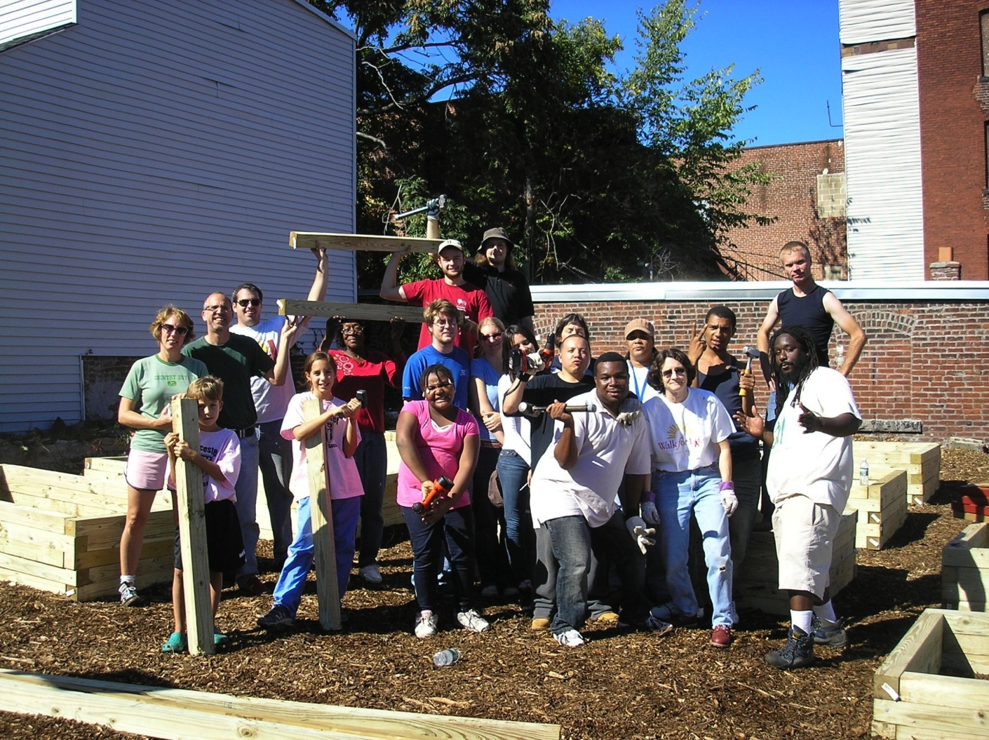
HIV/AIDS Project
Notes:
Foster civic, intercultural, and ethical learning.
I am graduating with a major in Environmental Studies and focus in project management. Evan Sawyer, ’11
First example: Figure out partnership. What is going on in this picture? Prompt a bit. What does this group picture have to do with HIV/AIDS? (chat with neighbor)

Slide 4
Institute of Medicine (IOM) Recommendations*
“Public Health is an essential part of the training of citizens”
“…all undergraduates should have access to education in public health”
*Gebbie K, Rosenstock L, Hernandez LM. Who will keep the public healthy? Educating public health professionals for the 21st century. Washington DC: National Academy Press, 2003: 144.

Slide 5
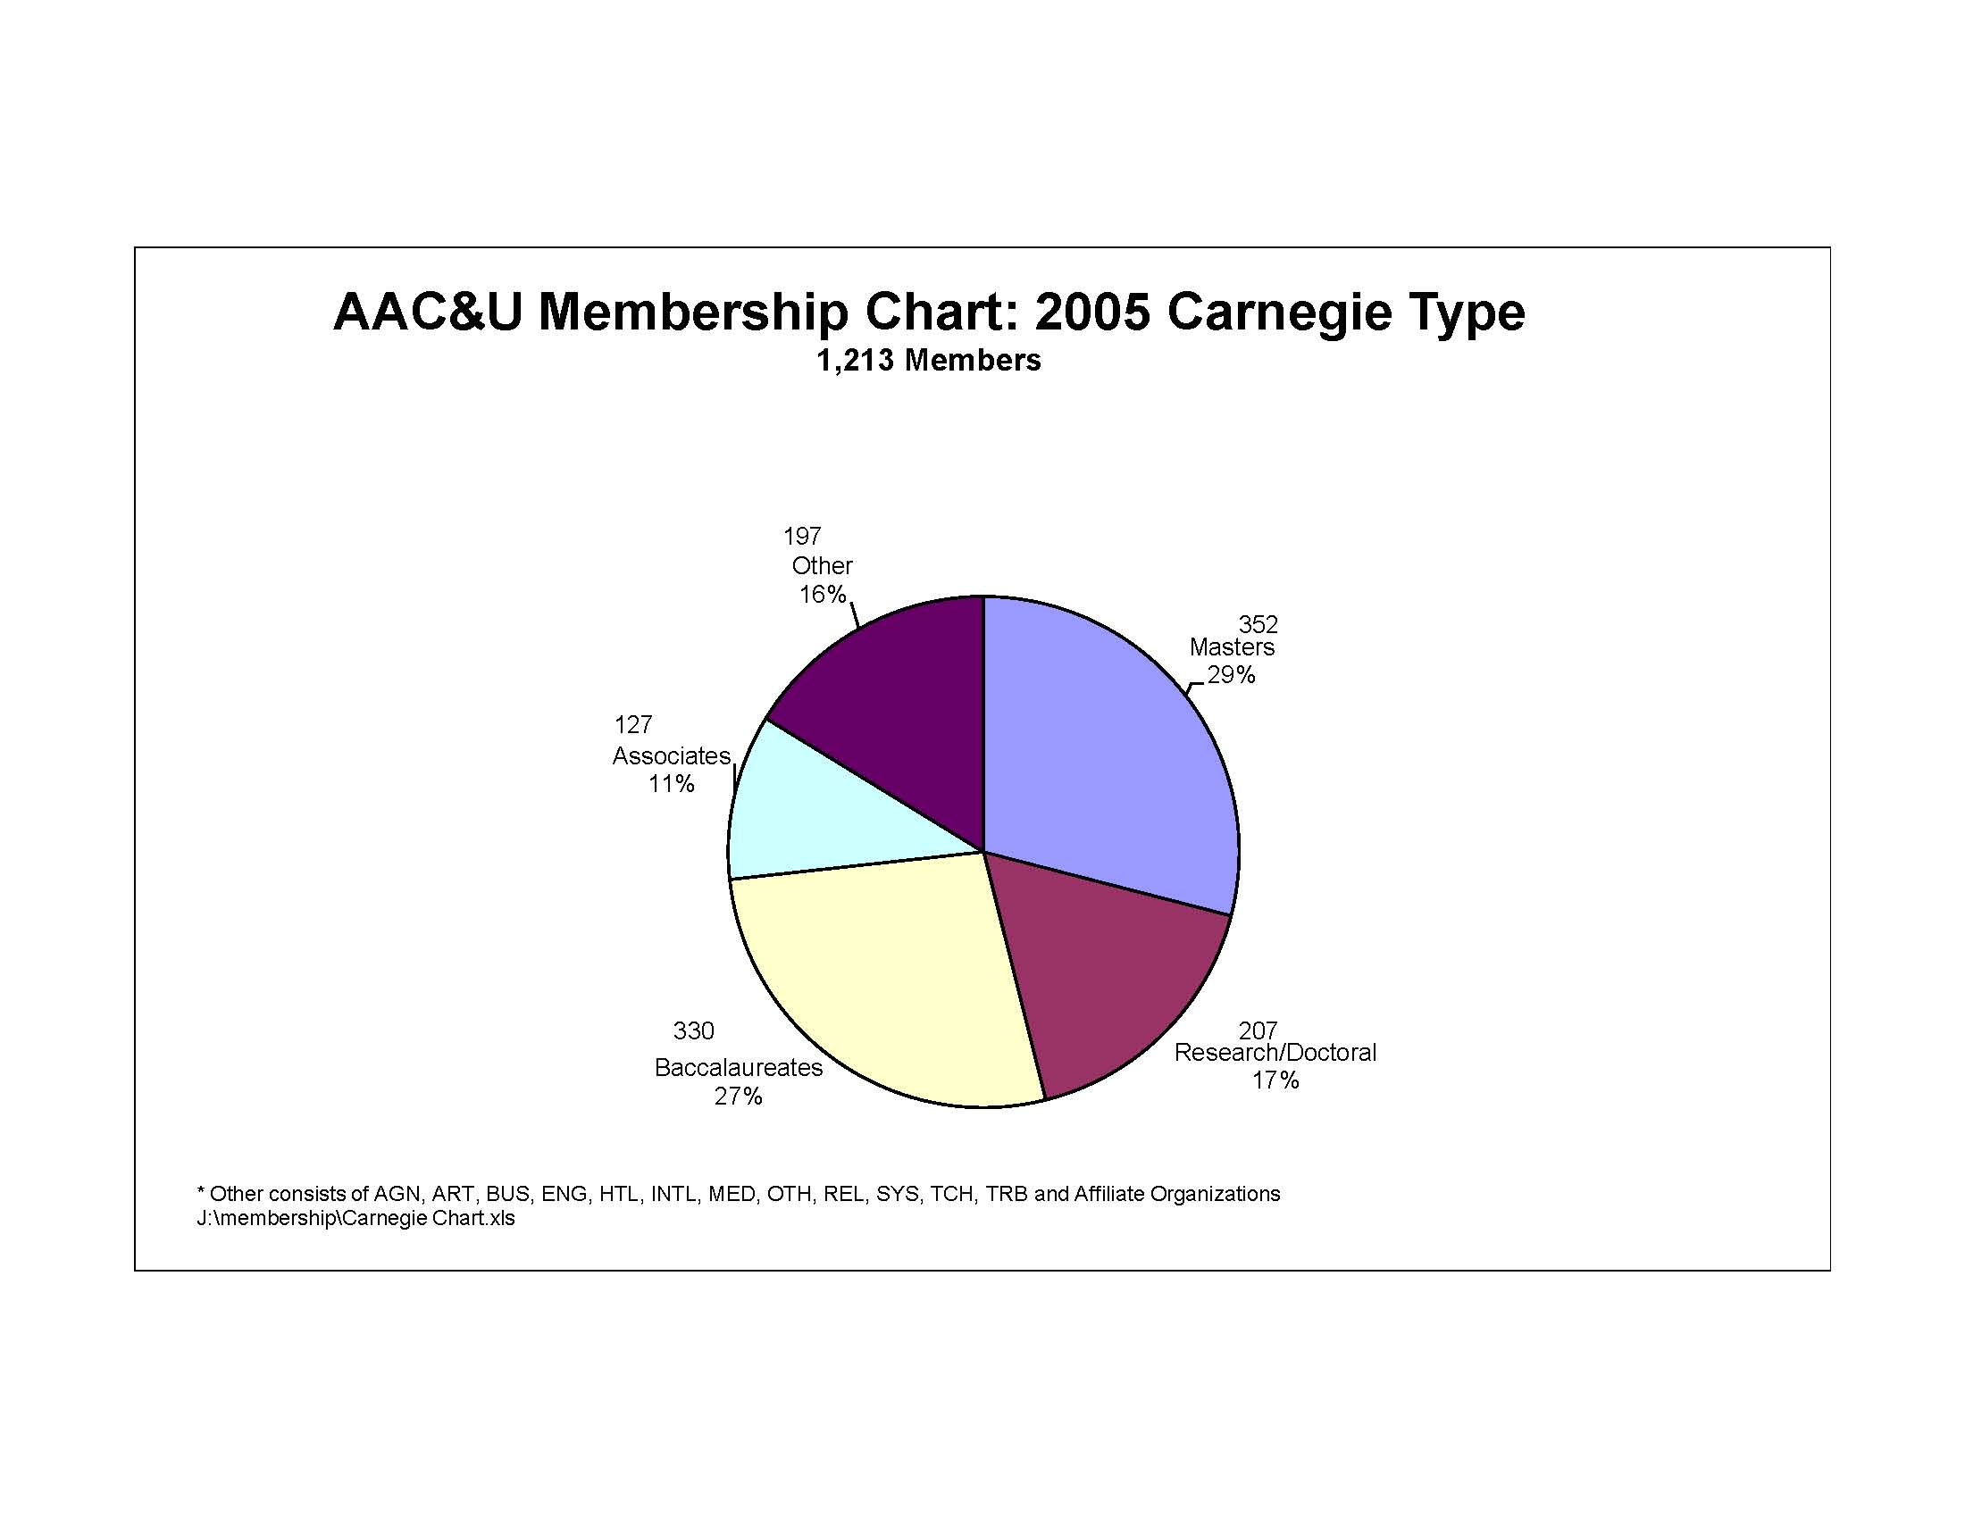
What Is AAC&U?

Slide 6
What Is LEAP?
Liberal Education and America’s Promise:
A ten-year campus action and advocacy initiative for liberal education.
The initiative focuses attention on campus practices that foster essential learning outcomes for all students, whatever their chosen field of study.
LEAP shines a spotlight on ways that campuses employ high-impact practices and enact principles of excellence that ensure success for all students.

Slide 7


The Essential Aims and Outcomes of Undergraduate Education
Knowledge of Human Cultures and the Physical and Natural World
Intellectual and Practical Skills
Personal and Social Responsibility
Integrative and Applied Learning
Notes:
Mention our social contract as faculty

Slide 8
LEAP
The Essential Learning Outcomes
Knowledge of Human Cultures and the Physical and Natural World
  Through study in the sciences and mathematics, social sciences, humanities, histories, languages, and the arts
  Focused by engagement with big questions, both contemporary and
  enduring.
Intellectual and Practical Skills, including
  Inquiry and analysis
  Critical and creative thinking
  Written and oral communication
  Quantitative literacy
  Information literacy
  Teamwork and problem solving
  Practiced extensively, across the curriculum, in the context of
  progressively more challenging problems, projects, and standards for
  performance.

Slide 9
LEAP
The Essential Learning Outcomes
Personal and Social Responsibility, including
  Civic knowledge and engagement—local and global
  Intercultural knowledge and competence
  Ethical reasoning and action
  Foundations and skills for lifelong learning
  Anchored through active involvement with diverse communities and real
  world challenges.
Integrative and Applied Learning, including
  Synthesis and advanced accomplishment across general and specialized studies
  Demonstrated through the application of knowledge, skills, and
  responsibilities to new settings and complex problems.

Slide 10
LEAP
The Essential Learning Outcomes
Knowledge of Human Cultures and the Physical and Natural World
  Through study in the sciences and mathematics, social sciences, humanities, histories, languages, and the arts
  Focused by engagement with big questions, both contemporary and
  enduring—in public health.
Intellectual and Practical Skills, including
  Inquiry and analysis
  Critical and creative thinking
  Written and oral communication
  Quantitative literacy
  Information literacy
  Teamwork and problem solving
  Practiced extensively, across the curriculum, in the context of
  progressively more challenging problems, projects, and standards for
  performance. Public health offers a worthy challenge.

Slide 11
LEAP
The Essential Learning Outcomes
Personal and Social Responsibility, including
  Civic knowledge and engagement—local and global
  Intercultural knowledge and competence
  Ethical reasoning and action
  Foundations and skills for lifelong learning
  Anchored through active involvement with diverse communities and real
  world challenges. What more urgent than public health?
Integrative and Applied Learning, including
  Synthesis and advanced accomplishment across general and specialized studies
  Demonstrated through the application of knowledge, skills, and
  responsibilities to new settings and complex problems of human and environmental health.

Slide 12

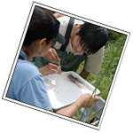
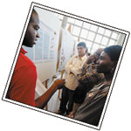
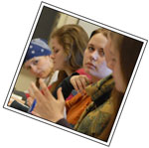


Making Excellence Inclusive
Notes:
Aim High and Make Excellence Inclusive.
It takes a community.
Move from deficit thinking to asset thinking. Students are our future. They are hugely valuable. They are assets. Think of them all that way. By 2019, a majority of the U.S. population under 18 will be comprised of
African-American, Asian-American and Pacific Islander, Hispanic and other non-White youth. (Nat’l Coalition for College Completion)
Enthusiasm, more than anything, builds the fortitude to persevere, and what we currently do to students is patently designed to eliminate any enthusiasm they bring to college.
Reimagining Remediation. By Stephen J. Handel and Ronald A. Williams. Change March/April 2011.

Slide 13
An Essential Tension?
“…all undergraduates should have access to education in public health”
Undergraduate majors in health education departments and programs should have a defined and specific program of learning

Slide 14
Resources
LEAP 101 leap.aacu.org/toolkit
APSH Undergraduate Public Health Learning Outcomes Development Project http://www.asph.org/document.cfm?page=1085
Electronic mailing list, ECPH
http://www.aacu.org/public_health/index.cfm
The Educated Citizen and Public Health
http://www.aacu.org/public_health/index.cfm

