Slide 1
Assisted Outpatient Treatment:
The Data and the Controversy
Carl Taube Award Lecture 2011
Marvin S. Swartz, M.D.
Services Effectiveness Research Program
Duke University Medical Center
Support from: National Institute of Mental Health
MacArthur Research Network on Mandated Community Treatment

Slide 2
AOT Questions
Can Assisted Outpatient Treatment (AOT) be effective and under what conditions?
What is the nature of the controversy about AOT?
Is it cost effective?

Slide 3
Assisted Outpatient Treatment (AOT)
Permitted in all but a few states
Explicitly permitted by 44 states and the District of Columbia
Despite statutory support, used inconsistently

Slide 4
VARIANTS OF AOT
Conditional release for involuntarily hospitalized patients
Alternative to hospitalization for patients who meet inpatient commitment criteria
Alternative status for patients who do not meet inpatient criteria

Slide 5
Controversies about AOT
Availability of appropriate services with aggressive outreach might obviate the need
Should not be used as a substitute for inadequacies in service systems
Applying coercion to patient blames the victim for service deficiencies.
Systems of care should be held accountable for gaps in care.

Slide 6
Views of AOT
“Today, the forced drugging common inside of institutions has climbed over the walls and is now out in our communities. Citizens in the USA & parts of the world, living peacefully at home, are now court ordered to take powerful psychiatric drugs against their will. Typically these are "neuroleptic drugs" that can cause structural brain damage and even kill.”
David Oaks
MindFreedom

Slide 7
Views of AOT
“Civil libertarians have made it almost impossible to treat psychotic individuals who refuse care. These misguided activists have created a morass of legal obstacles that prevents us from helping many psychotic individuals until they have a finger on a trigger...It's time to reverse course. Mandatory treatment for those too ill to recognize they need help is far more humane than our present mandatory nontreatment.”
— E. Fuller Torrey

Slide 8
Views of AOT
“Laws change for a single reason, in reaction to highly publicized incidents of violence. People care about public safety. I am not saying it is right, I am saying this is the reality... So if you're changing [OPC] laws in your state, you have to understand that... You have to take the debate out of the mental health arena and put it in the criminal justice/public safety arena.”
— D. J. Jaffe

Slide 9
Criteria for AOT in N.C.
Presence of a serious mental illness
Capacity to survive in the community with available supports
Clinical history indicating a need for treatment to prevent deterioration that would predictably result in dangerousness
Mental status that limits or negates the individual's ability to make informed decisions to seek or comply voluntarily with recommended treatment

Slide 10
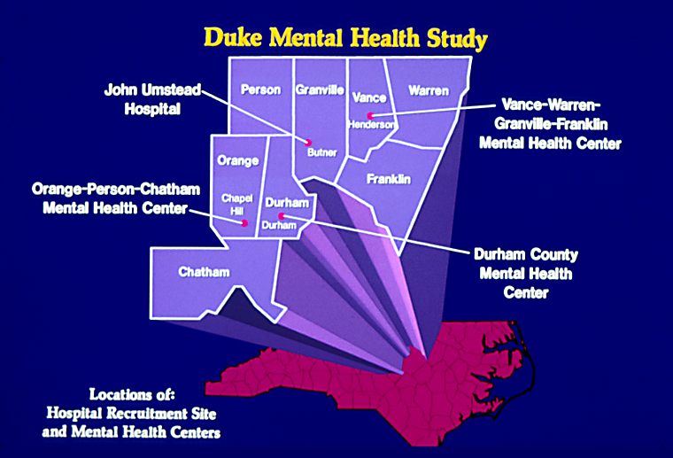

Slide 11
Odds ratio for hospital readmission during any given month of 1-year trial
------------------------------------------------------------------
Odds
Ratio 95% CI p value
======================================
Control group [1.00]
OPC group 0.64 (0.46 – 0.88) p<0.01
----------------------------------------------------------

Slide 12
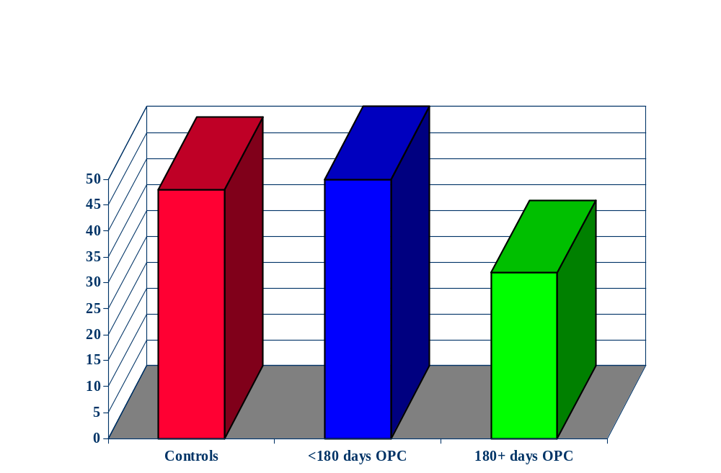
Involuntary Outpatient Commitment (OPC): Percent Subjects With Any Psychiatric Hospital Admissions by Days of OPC
48
50
32
Percent Admitted

Slide 13
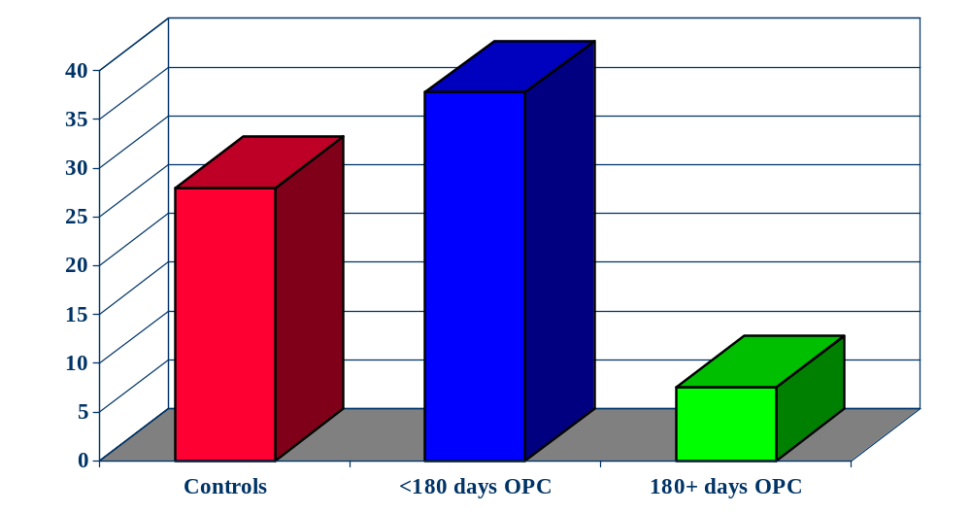
Mean Psychiatric Hospital Days by Days of OPC
37.7
27.9
Mean Hospital Days
7.51

Slide 14
Summary of NC OPC Findings
OPC can reduce hospital recidivism
However:
  OPC must be applied for an extended period
  It is only effective when delivered in combination with frequent mental health services.

Slide 15
Summary (continued)
Other findings:
  OPC can reduce violence, victimization, family strain, arrests and improve medication adherence and quality of life.
However:
  To be effective, it must be delivered for an extended period AND in combination with regular mental health services.
  Limitations: the ‘dose’ of OPC and service intensity could not be controlled.

Slide 16
Assisted Outpatient Treatment (AOT) in NYC: Summary of Pilot Study
New York enacted a pilot statute to be tested in NYC
Bellevue Hospital Study of pilot NYC Law (pre-Kendra’s Law)—by order of Legislature.
Consumers randomly received AOT + Enhanced Services vs. Enhanced Services Alone.
Findings: No differences between AOT vs. Enhanced Services
Limitations: Law was in start-up and sample was small.
Accompanied by fierce opposition the law was headed to sunset

Slide 17

January 1999:
“In an incident that has gnawed at New Yorkers' sense of security, Kendra Webdale was killed in January 1999 when Andrew Goldstein, a 30-year-old schizophrenic, picked her up on the platform of a 23rd Street subway station and threw her into the path of an oncoming train.”
(New York Times, 3/23/2000)
New York passed preventive OPC statute in 1999. Statute was named “Kendra’s Law”
Kendra Webdale

Slide 18
The Carrot: NY Kendra’s Law Fiscal Changes
$32 million directly allocated yearly in support of the OPC program
  $15 million -- medication grant program
  $4.4 million -- prison and jail discharge managers
  $2.4 million -- oversight programs
  $9.55 million -- new case management slots
  $0.65 million -- drug monitoring
$125 million yearly for enhanced community services
  Used to increase ICM and ACT
  Used to develop Single Point of Access Program (SPOA)

Slide 19
Preventive AOT laws named for victims of homicides by people with schizophrenia
New York
  Kendra’s Law (1999)
California
  Laura’s Law (2003)
Michigan
  Kevin’s Law (2005)

Slide 20


Slide 21
Recipient Outcomes During AOT: Findings
Substantial reduction in psychiatric hospitalizations and in days in the hospital
Modest evidence that AOT reduces arrests
Substantial increases in receipt of intensive case management services
More likely to adhere to psychotropic medications
Subjective improvements in personal functioning.
Notes:
21

Slide 22
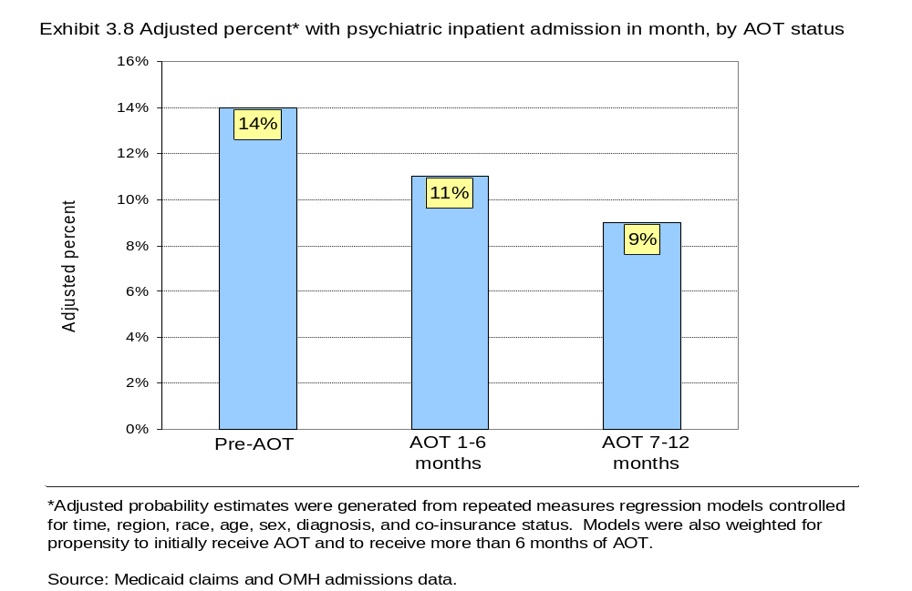

Slide 23
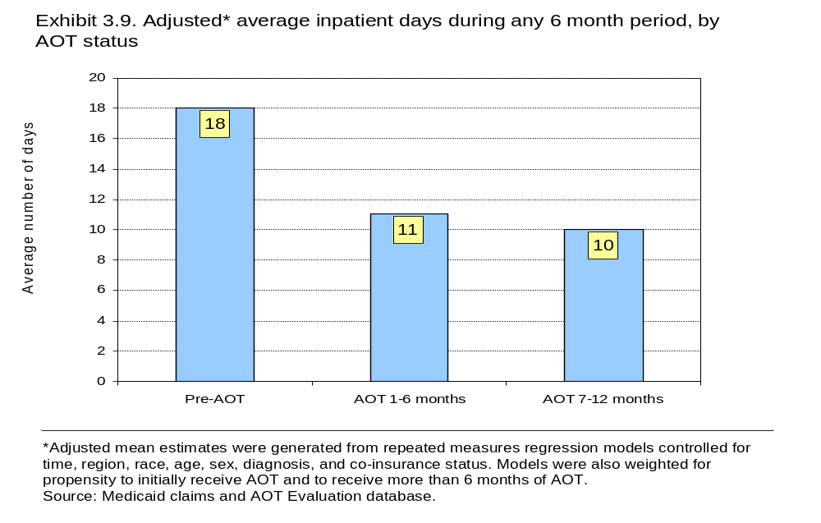
Adjusted average number of inpatient days per month during months with any hospitalization

Slide 24
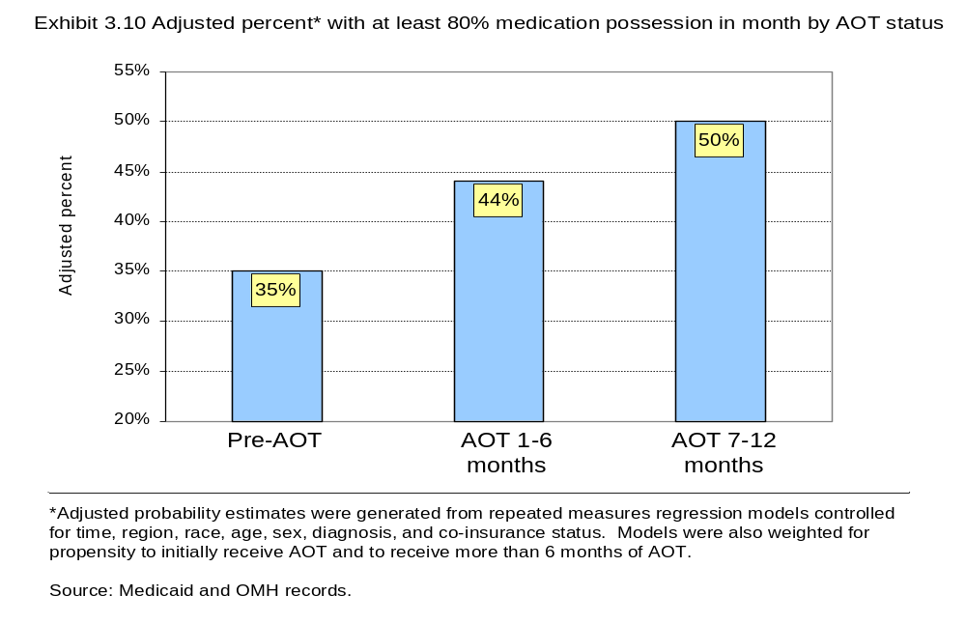

Slide 25
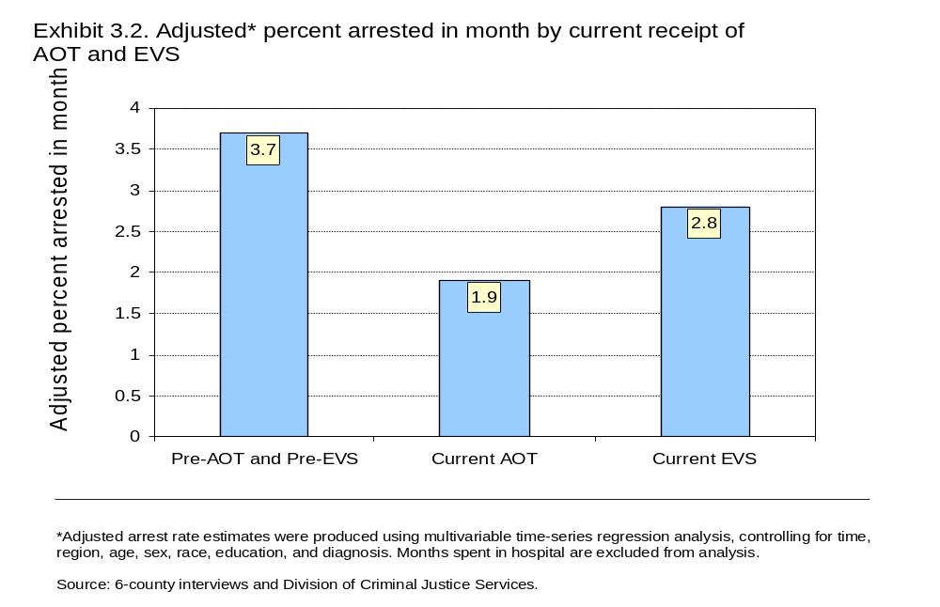

Slide 26
Highlights of Findings (1)
New York State’s AOT Program improves a range of important outcomes for its recipients.
The increased services available under AOT clearly improve recipient outcomes,
However, the AOT court order and its monitoring do appear to offer additional benefits in improving outcomes.
It is also important to recognize that the AOT order exerts a critical effect on service providers.

Slide 27
Highlights of Findings (2)
Improvements are more likely sustained post-AOT among those who receive intensive treatment services or had longer periods of AOT—especially 6 months or longer.
In its early years the AOT Program did appear to reduce access to services for non-AOT recipients, but in recent years the reduction in new AOT cases has attenuated this effect.
Lack of continued growth of new service dollars will likely increase competition for access to services once again.

Slide 28
Cost Impact of Assisted Outpatient Treatment (AOT) in New York and Outpatient Commitment (OPC) in North Carolina
Joint project goal: Estimate net cost impact of AOT and OPC
  New York: Compare AOT and non-AOT Enhanced Services (ES) recipients on total costs over three years
  North Carolina: Compare OPC and non-OPC controls on total costs over study year
  Compare costs between AOT in NY and OPC in NC
New York Sponsor: NY State Office of Mental Health and the John D. and Catherine T. MacArthur Foundation Research Network on Mandated Community Treatment
North Carolina Sponsor: Stanley Research Foundation

Slide 29
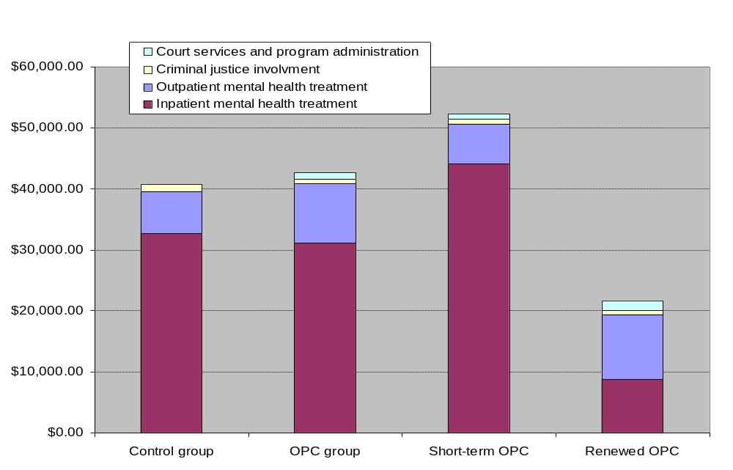
$54,858
$46,510
$43,516
$25,922

Slide 30
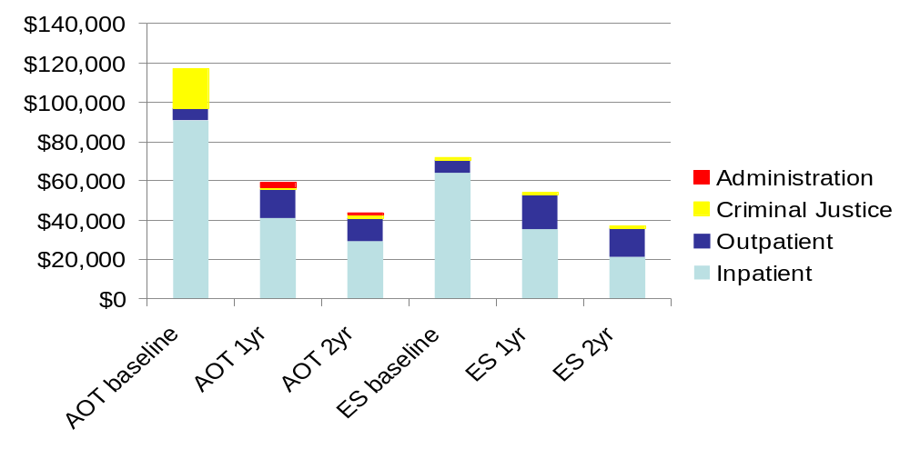
Distribution of Annual Costs by Group and Time: New York City

Slide 31
Cost Findings Summary
Conclusions about the cost impact of outpatient commitment depend on comparison group
  In New York, AOT appears to be more costly when comparing AOT to ES, but less costly when comparing AOT to pre-AOT for the same people
    Large decrease in both inpatient treatment and criminal justice costs moving from pre-AOT to first year of AOT
  In North Carolina, OPC appears to be more costly when compared to controls in a straight RCT, but less costly when comparing short vs. long-term OPC
AOT in New York is slightly more costly than OPC in North Carolina
  Program costs in New York higher than in North Carolina, but these costs are relatively small in either case relative to mental health treatment costs

Slide 32
From AOT to PADs
Growing interest in PADs as alternatives to AOT
PADs can be seen as self-mandate

