Slide 1

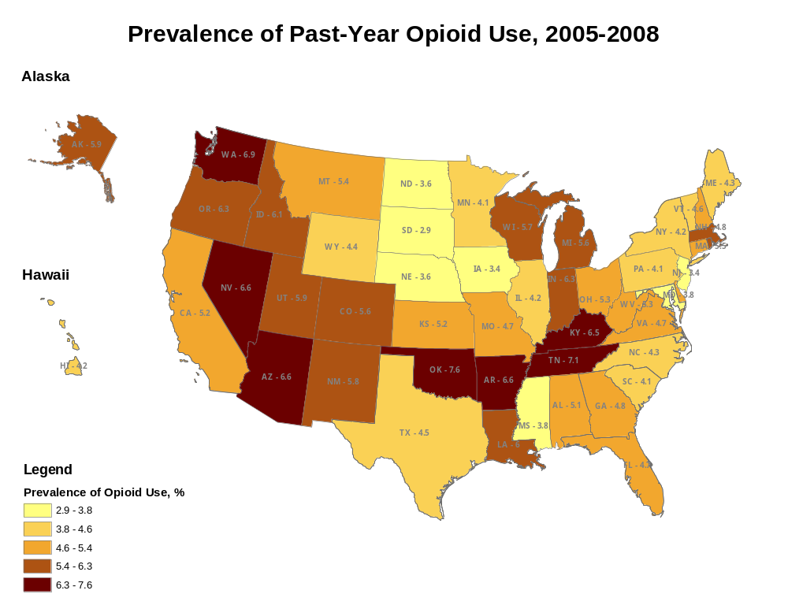
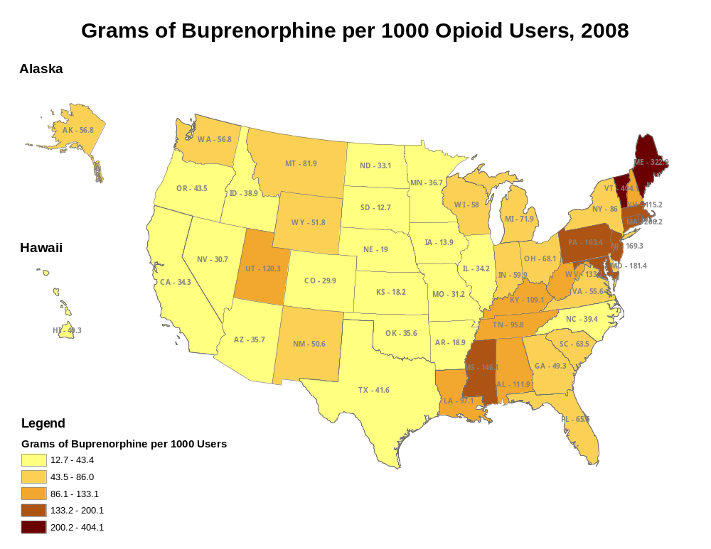
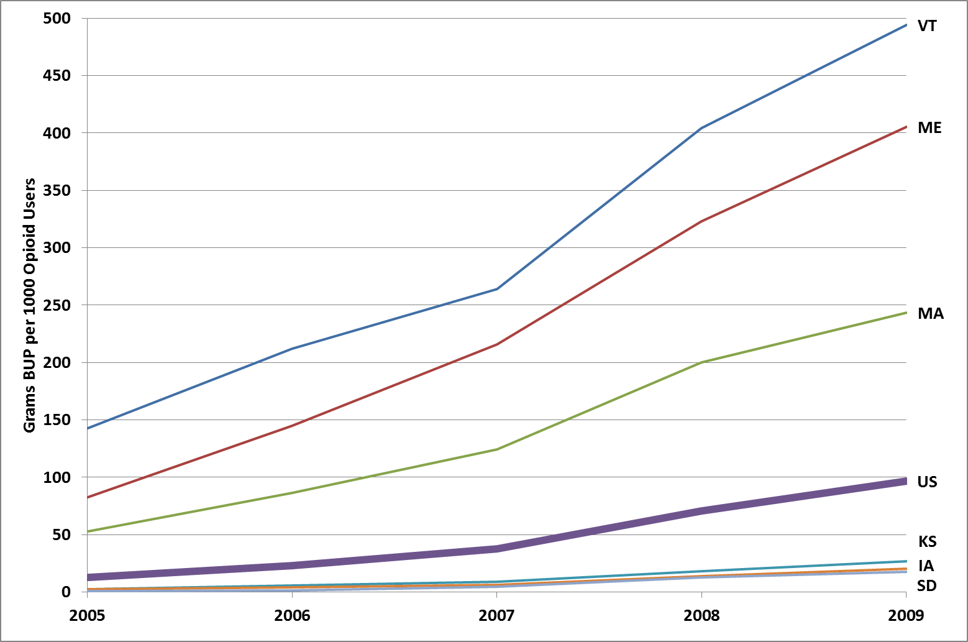
State-level Influences on Buprenorphine Utilization: Variations in Opioid Addiction Treatment
Lisa M. Lines, MPH and Robin E. Clark, PhD
University of Massachusetts Medical School, Worcester, MA; lisa.lines@umassmed.edu
Presented at the American Public Health Association’s Annual Research Meeting, October 31, 2011, Washington, DC
1. Background
3. Results
Buprenorphine is a prescription medication used to treat opioid addiction.
Opioids include heroin and/or prescription painkillers (OxyContin, Vicodin, Percoset, etc.)
  Abuse of prescription pain medication was the second-most common type of illicit drug use in the United States in 2008 (after marijuana)
  400% increase over 10 years in the proportion of Americans treated for prescription painkiller abuse
  9.8% of hospital admissions for substance abuse in 2008 involved painkillers
Buprenorphine is a partial opioid agonist, which in the US is generally combined with naltrexone to reduce potential for abuse (trade name: Suboxone)
  Can be dispensed in office settings, unlike methadone – this can improve patients’ ability to hold a job and may prevent relapse
  Patient acceptance is higher – avoids stigma associated with methadone clinics/treatment
  Doctors must receive special Drug Enforcement Agency (DEA) certification to prescribe buprenorphine
There are large differences by state in amount of buprenorphine prescribed
Research question: what accounts for the variations in buprenorphine use at the state level?
Table 1. Descriptive characteristics of the sample
 | Mean | Min | State | Max | State | Source, Data Yr
Buprenorphine grams | 17,130 | 241 | SD | 69,460 | PA | DEA, 2008
Buprenorphine g per 1000 opioid users | 84.6 | 12.7 | SD | 404.1 | VT | DEA, 2008
Number of opioid users (000) | 241.87 | 19 | ND | 1,531 | CA | NSDUH, 2005-08
Prevalence of past-year opioid use | 5.0% | 2.9% | SD | 7.6% | OK | NSDUH, 2005-08
Number of DATA-certified physicians | 303 | 11 | SD | 1,822 | NY | SAMHSA, 2008
Number of DATA-certified physicians per 10,000 opioid users | 13.9 | 2.3 | AR | 66.4 | VT | Calculation
Number of OTPs | 23.4 | 0 | * | 157 | NY | SAMHSA, 2008
Number of OTPs per 100,000 opioid users | 10.3 | 0 | * | 45 | DC | Calculation
Substance abuse treatment spending per substance abuser | $113 | $5 | WI | $746 | CT | CASA, 2005
% of states with any Medicaid coverage of buprenorphine | 84% |  |  |  |  | NCSL, 2008
Trends in Buprenorphine Prescribing, 2005-2009:
Overall & in Selected States
The mean prevalence of past-year opioid use was ~5%
From 2005 to 2009, the mean amount of buprenorphine per 1000 opioid users increased from 13g to 97g per year
In 2008, the population-adjusted amount of buprenorphine prescribed was highest in Vermont, Maine, and Massachusetts, and lowest in South Dakota, Iowa, and Kansas
In unadjusted bivariate analyses, higher numbers of physicians and of OTPs were significantly associated with higher buprenorphine volume
In multivariate analyses, only the supply of physicians remained significantly associated
*MT, ND, SD, WY
Table 2. Bivariate associations between buprenorphine volume and state characteristics
2. Methods
 | Coef.* | Std. Err. | P value | 95% Conf. Interval
Number of DATA-certified physicians per 10,000 opioid users | 0.047 | 0.006 | <.001 | (0.034 to 0.060)
Number of OTPs per 100,000 opioid users | 0.044 | 0.010 | <.001 | (0.023 to 0.064)
State spending on substance abuse treatment per substance abuser | 0.001 | 0.001 | .159 | (-0.001 to 0.003)
Medicaid coverage | -0.092 | 0.300 | .760 | (-0.695 to 0.511)
We developed a state-level database using data for buprenorphine prescribing and factors hypothesized to influence variations in prescribing
  Sources: DEA, Substance Abuse and Mental Health Services Administration (SAMHSA), National Conference of State Legislatures (NCSL), Columbia University Center on Addiction and Substance Abuse (CASA)
  All data were from 2005-2008
Factors:
  Demand: prevalence of past-year use of heroin and/or prescription analgesics
  Supply: number of licensed prescribers per 10,000 users; number of opioid treatment programs (OTPs) per 100,000 users; Medicaid coverage of buprenorphine; state spending on substance abuse treatment
Linear regression models were constructed with the log of the cumulative grams of buprenorphine distributed in each state in 2008 per 1000 users as the dependent variable
4. Conclusions
*Ordinary least-squares regression coefficient
At the state level, the supply of physicians predicts the population-adjusted volume of buprenorphine prescribed
State substance abuse treatment spending and Medicaid coverage of buprenorphine do not appear to affect the volume of buprenorphine prescribed
States that encourage physician certification may improve access to effective opioid treatment
This assumes that access is currently inadequate, based on existence of waiting lists in many areas
Future studies should examine factors associated with physicians deciding to become DATA certified, including state policies that encourage certification
Table 3. Multivariate associations between buprenorphine volume and state characteristics
 | Coef.* | Std. Err. | P value | 95% Conf. Interval
Number of DATA-certified physicians per 10,000 opioid users | 0.048 | 0.010 | <.001 | (0.028 to 0.068)
Number of OTPs per 100,000 opioid users | -0.002 | 0.013 | .869 | (-0.027 to 0.023)
*Ordinary least-squares regression coefficient

