Slide 1
Medicare and Medicaid Drug Payments for Medicare Only and Medicare/Medicaid Dual Eligible Populations
APHA Conference
Washington, DC
November 2, 2011

Slide 2
Presenter Disclosures
Brian O’Donnell, PhD
(1) The following personal financial relationships with commercial interests relevant to this presentation existed during the past 12 months:
No relationships to disclose

Slide 3
Buccaneer Team
Brian O’Donnell, PhD
Michelle Roozeboom, PhD
Greg Lessman, MS
Glenda Martens, MS

Slide 4
Background - CCW
The Chronic Condition Data Warehouse (CCW) contains Medicare and Medicaid Analytic Extract (MAX) claims data for 1999+
Linkage of the Medicare and MAX files allows for complete analysis of services for the dual eligible population

Slide 5
Background
Dual eligible population
  Accounts for a disproportionate share of Medicare spending
  Higher proportion of chronic conditions compared to Medicare only
Medicare Prescription Drug benefit began in 2006
  Dual Eligible Prescription coverage included

Slide 6
Methods
Medicare Enrollment Data | Medicaid Analytic eXtract (MAX) Data | Medicare Claims Data
Beneficiary Summary File Chronic Condition Summary File | Personal Summary (PS) Long Term Care (LT) Inpatient Care (IP) Prescription Drug (RX) Other Services (OT) | Part A HOP Part B Part D
The Beneficiary Summary, Chronic Condition Summary and MAX Personal Summary files are merged by the unique CCW beneficiary identifier (BENE_ID). The merged file is rolled up to one record per BENE_ID/State and the derived demographic and enrollment variables are defined

Slide 7
Methods
Dual eligibility
  determined from merging the MAX Personal Summary file with the CCW Beneficiary Summary file by beneficiary ID
  monthly enrollment and eligibility codes were used to determine dual status.
Full dual - determined as an individual with at least one month of both full fee for service Medicare without HMO and full Medicaid
QMB dual – not full dual with QMB only dual code
Partial dual – not full or QMB dual with restricted Medicaid benefits
Notes:
Detailed descriptions of dual identification on the next slides

Slide 8
Methods – Identification of Dual Status
Full Dual – at least one month where:
  Medicare Buyin ≠ 0 (Not Eligible)
  Medicaid Uniform Eligibility ≠ 00 (not eligible) or 99 (unknown)
    MAX reported Medicare Dual code = 02 (QMB plus), 04 (SLMB plus), 08 (other dual), 52 (QMB plus), 54 (SLMB plus) or 58 (other)
    Or Unknown Dual Code with restricted benefits flag indicating full dual coverage

Slide 9
Methods – Identification of Dual Status
QMB Dual – not classified as full dual and at least one month where:
  Medicare Buyin ≠ 0 (Not Eligible)
  Medicaid Uniform Eligibility ≠ 00 (not eligible) or 99 (unknown)
  MAX reported Medicare Dual code = 01 or 51 (QMB only)

Slide 10
Methods – Identification of Dual Status
Partial Dual – not classified as full or QMB dual and at least one month where:
  Medicare Buyin ≠ 0 (Not Eligible)
  Medicaid Uniform Eligibility ≠ 00 (not eligible) or 99 (unknown)
    MAX reported Medicare Dual code = 03 (SLMB only), 05 (QDWI), 06 (QI-1), 07 (QI-2), 53 (SLMB only), 55 (QDWI), 56 (QI-1), or 57 (QI-2)
    Or Unknown Dual code with Restricted Benefit indicating pharmacy coverage

Slide 11
Methods – Identification of Dual Status
Medicare Only – Eligible for Medicare (buyin ≠ 0) and not identified as full, QMB, or partial dual
Medicaid Only – Eligible for Medicaid based on disability and not identified as full, QMB, or partial dual
  Disability indicated by MAX eligibility code = 12 (blind/disabled, cash), 22 (blind/disabled, medically needy), 32 (blind/disabled, poverty), 42 (other blind/disabled, 52 (disabled, 1115)

Slide 12
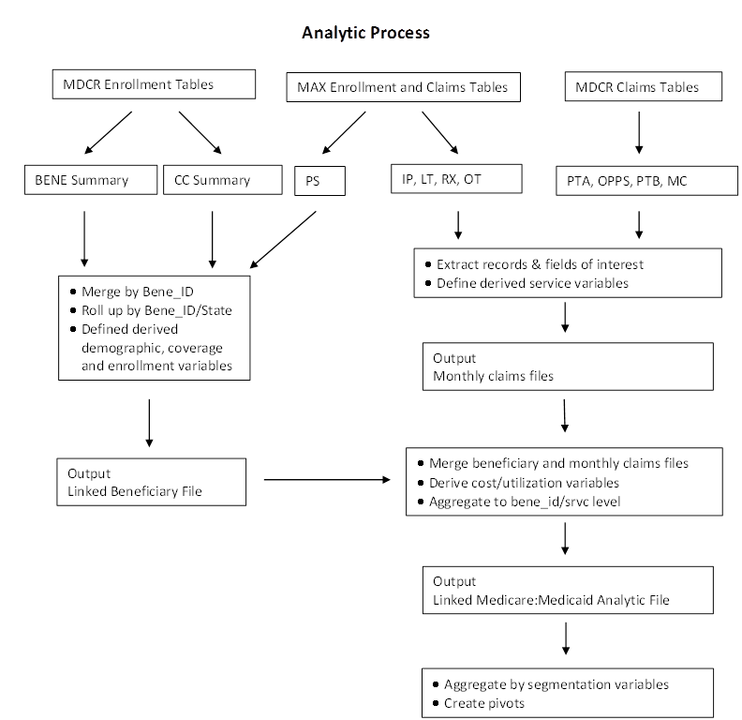
Methods

Slide 13
Consideration When Merging Medicare and Medicaid Files
One Beneficiary Record in Medicare can merge to multiple records in MAX
  Multiple states for a beneficiary in MAX
Medicare and Medicaid Rx payments can appear for the same NDC with the same date of service

Slide 14
Results – Dual Status
Dual Status | # Beneficiaries | % Of Medicaid | % of Medicare
Medicaid Only - Disabled | 5,380,579 | 37.13%
Medicare Only | 36,494,111 |  | 80.03%
Partial Dual | 1,020,731 | 7.04% | 2.24%
QMB Dual | 847,843 | 5.85% | 1.86%
Full Dual | 7,240,604 | 49.97% | 15.88%

Slide 15
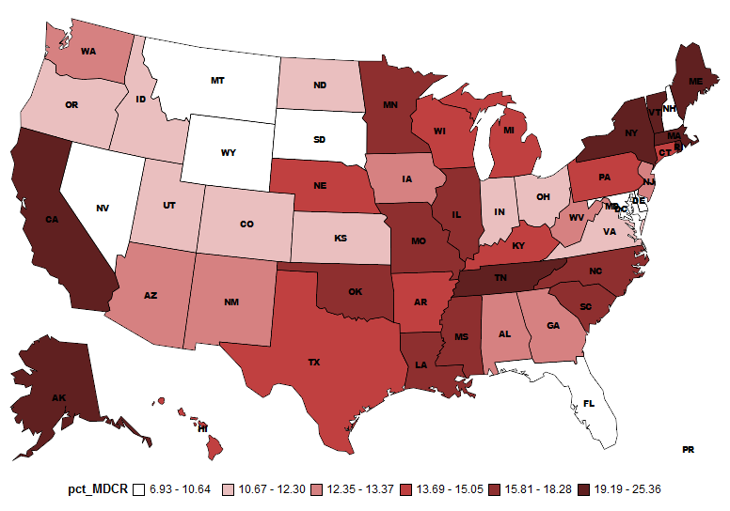
Results – Full Dual Status as a
Percentage of Medicare Beneficiaries
Percentage of Medicare Beneficairies - Full Dual
Notes:
Percentage of Medicare Beneficiaries in a state who are classified as Full Dual

Slide 16
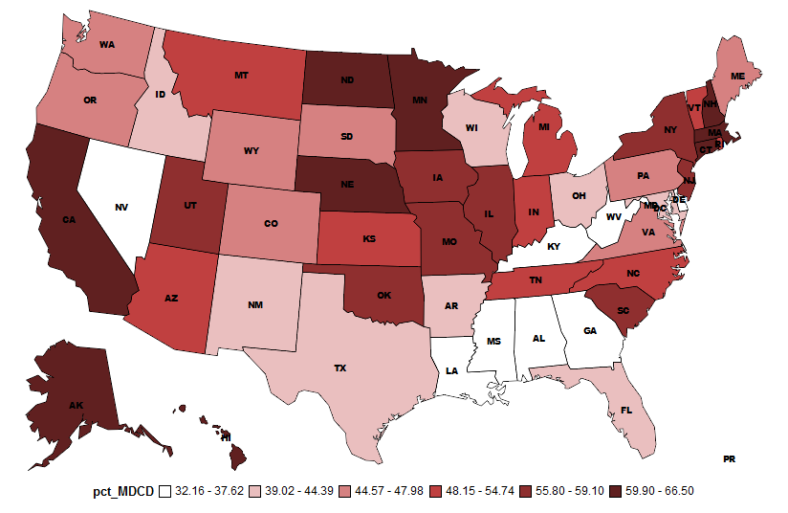
Results – Full Dual Status as a
Percentage of Medicaid Beneficiaries
Notes:
Percentage of Medicaid Beneficiaries Classified as Full Dual. Note: Women and Children are not included, Medicaid Only was limited to Medicaid Disabled

Slide 17
Results – Race/Ethnicity
Race | Medicaid Only | Medicare Only | Partial Dual | QMB Dual | Full Dual
White | 45.40% | 88.23% | 77.29% | 67.16% | 64.07%
Black | 27.07% | 7.71% | 18.18% | 25.44% | 19.98%
Asian | 1.35% | 1.04% | 1.06% | 1.35% | 6.43%
Hispanic | 1.55% | 1.03% | 1.85% | 0.85% | 7.79%
Other | 15.34% | 1.96% | 0.59% | 0.52% | 1.73%

Slide 18
Results – Current Reason for Entitlement

Slide 19
Results – Number of Chronic Conditions
Notes:
Next slide breaks out dual eligible into full, partial, QMB

Slide 20
Results – Number of Chronic Conditions

Slide 21
Results –Percentage with Condition
 | Medicare Only | Partial Dual | QMB Dual | Full Dual
Alzheimer's or Related Disorders | 6.30% | 5.54% | 5.57% | 19.66%
Breast Cancer | 2.16% | 1.84% | 1.82% | 1.72%
Cancer | 7.29% | 5.30% | 4.98% | 5.14%
Congestive Heart Failure | 13.39% | 17.98% | 18.57% | 25.51%
Chronic Kidney Disease | 8.94% | 11.38% | 12.15% | 16.29%
COPD | 11.21% | 17.62% | 19.51% | 20.38%
Colorectal Cancer | 1.17% | 1.03% | 1.01% | 1.16%
Depression | 12.11% | 20.99% | 26.62% | 32.94%
Diabetes | 19.81% | 27.36% | 29.94% | 33.29%
Ischemic Heart Disease | 27.18% | 29.66% | 30.46% | 34.36%
Lung Cancer | 0.93% | 1.03% | 1.01% | 0.97%
Osteoporosis | 15.80% | 13.37% | 14.68% | 18.79%
Prostate Cancer | 3.34% | 1.64% | 1.37% | 1.54%
Rheumatoid/Osteoarthritis | 18.13% | 19.74% | 23.31% | 25.93%
Stroke | 5.73% | 6.32% | 6.79% | 10.96%
Notes:
Only uses Medicare Claims for Chronic Condition identification. Future projects will use combined Medicare and Medicaid files for identification of Chronic Conditions and include additional conditions.

Slide 22
Prescription Drug Analysis
Medi-Span was used for determination of Therapeutic class
Max RX and Part D Medicare was merged by a unique Beneficiary ID
Duplicate Medicare and MAX records for a beneficiary/NDC/date were attributed to Medicare
Duals consisted of Partial, QMB, and Full

Slide 23
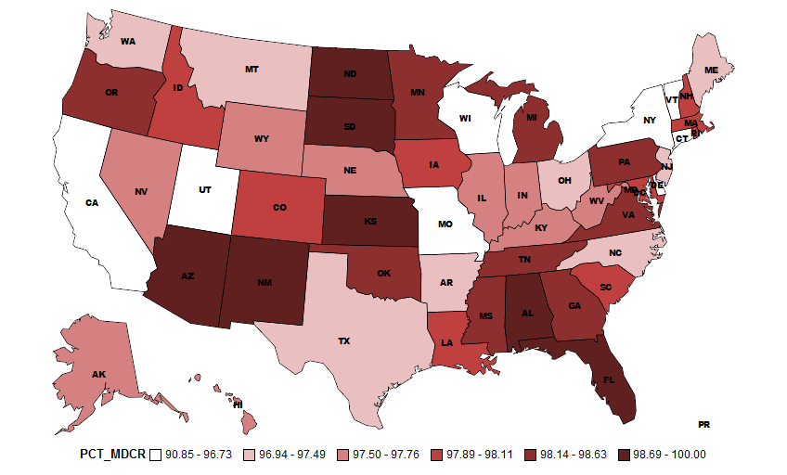
Prescription Drugs – % Medicare by State

Slide 24
Prescription Drugs – Therapeutic Class
Medi-Span Therapeutic Classification | Medicare |  |  |  | Medicaid
 | Payment | % Total Payment | Fills | % Total Fills | Payment | % Total Payment | Fills | % Total Fills
UNKNOWN |  |  |  |  | $30,389,219 | 4.8% | 680,387 | 4.0%
ANTI-INFECTIVE AGENTS | $1,930,501,555 | 7.9% | 18,320,618 | 4.6% | $39,599,147 | 6.2% | 505,638 | 3.0%
BIOLOGICALS | $52,914,665 | 0.2% | 67,231 | 0.0% | $1,258,351 | 0.2% | 5,545 | 0.0%
ANTI-NEOPLASTIC AGENTS | $418,460,755 | 1.7% | 2,028,287 | 0.5% | $12,395,071 | 1.9% | 34,778 | 0.2%
ENDOCRINE AND METABOLIC DRUGS | $3,049,012,865 | 12.5% | 58,607,144 | 14.6% | $41,363,374 | 6.5% | 626,166 | 3.7%
CARDIOVASCULAR AGENTS | $4,656,186,263 | 19.1% | 144,527,697 | 36.0% | $60,736,788 | 9.5% | 1,419,338 | 8.4%
RESPIRATORY AGENTS | $1,852,611,941 | 7.6% | 25,343,668 | 6.3% | $56,113,516 | 8.8% | 2,057,406 | 12.2%
GASTROINTESTINAL AGENTS | $2,571,530,527 | 10.6% | 35,745,467 | 8.9% | $49,061,841 | 7.7% | 1,617,285 | 9.6%
GENITOURINARY AGENTS | $614,293,241 | 2.5% | 9,237,345 | 2.3% | $6,813,754 | 1.1% | 125,034 | 0.7%
CENTRAL NERVOUS SYSTEM AGENTS | $5,852,320,933 | 24.0% | 57,717,169 | 14.4% | $123,110,925 | 19.3% | 3,098,982 | 18.4%
ADHD/ANTINARCOTIC/ANTI-OBESITY/ANOREXIC AGENTS | $108,303,261 | 0.4% | 815,132 | 0.2% | $2,727,709 | 0.4% | 21,195 | 0.1%
MISC. PSYCHOTHERAPEUTIC/NEUROLOGICAL AGENTS | $1,316,248,183 | 5.4% | 7,599,599 | 1.9% | $14,689,350 | 2.3% | 101,049 | 0.6%
ANALGESICS AND ANESTHETICS | $1,949,134,936 | 8.0% | 41,974,191 | 10.4% | $39,360,279 | 6.2% | 1,957,414 | 11.6%
NEUROMUSCULAR DRUGS |  |  |  |  | $48,621,527 | 7.6% | 973,300 | 5.8%
NUTRITIONAL PRODUCTS |  |  |  |  | $12,695,684 | 2.0% | 1,338,869 | 7.9%
HEMATOLOGICAL AGENTS |  |  |  |  | $41,469,929 | 6.5% | 1,013,248 | 6.0%
TOPICAL PRODUCTS |  |  |  |  | $22,948,173 | 3.6% | 877,905 | 5.2%
MISCELLANEOUS |  |  |  |  | $33,355,339 | 5.2% | 421,267 | 2.5%
TOTAL | $24,371,519,124 | 100% | 401,983,548 | 100% | $636,709,976 | 100% | 16,874,806 | 100%
Notes:
Includes Partial, QMB, and Full Duals

Slide 25
Prescription Drugs - Medicare
Top Therapeutic Classes (96 categories)
Therapeutic Classification System Description | Medicare Payments | Percent Medicare
ANTIPSYCHOTICS | $4,082,630,555 | 20.12%
ULCER DRUGS | $1,985,941,536 | 9.79%
ANTIDIABETICS | $1,853,583,083 | 9.14%
ANTIHYPERLIPIDEMICS | $1,844,983,768 | 9.09%
ANTIASTHMATIC AND BRONCHODILATOR AGENTS | $1,442,881,191 | 7.11%
ANTIDEPRESSANTS | $1,404,334,712 | 6.92%
PSYCHOTHERAPEUTIC AND NEUROLOGICAL AGENTS - MISC | $1,316,248,183 | 6.49%
ANTIVIRALS | $1,292,554,772 | 6.37%
ANALGESICS - OPIOID | $1,231,672,955 | 6.07%
ANTIHYPERTENSIVES | $1,208,373,187 | 5.96%
ENDOCRINE AND METABOLIC AGENTS - MISC | $910,214,207 | 4.49%
CALCIUM CHANNEL BLOCKERS | $620,181,718 | 3.06%
ANALGESICS - ANTI-INFLAMMATORY | $618,413,949 | 3.05%
BETA BLOCKERS | $521,673,541 | 2.57%
ANTINEOPLASTICS | $418,460,755 | 2.06%
GASTROINTESTINAL AGENTS - MISC | $386,651,310 | 1.91%
URINARY ANTISPASMODICS | $310,316,866 | 1.53%
HYPNOTICS | $306,443,927 | 1.51%
GENITOURINARY AGENTS - MISCELLANEOUS | $246,777,350 | 1.22%

Slide 26
Prescription Drugs – Medicaid
Top Therapeutic Classes (96 categories)
Therapeutic Classification System Description | Medicaid Payments | Percent Medicaid
ANTIPSYCHOTICS | $61,284,496 | 9.63%
ANTICONVULSANTS | $43,054,172 | 6.76%
ULCER DRUGS | $31,314,284 | 4.92%
UNKNOWN | $30,389,219 | 4.77%
ANTIDIABETICS | $26,028,253 | 4.09%
ANTIDEPRESSANTS | $25,726,674 | 4.04%
ANTIASTHMATIC AND BRONCHODILATOR AGENTS | $24,390,212 | 3.83%
ANTIANXIETY AGENTS | $24,200,136 | 3.80%
ANTIHYPERLIPIDEMICS | $23,040,704 | 3.62%
ANTIVIRALS | $20,664,560 | 3.25%
ANALGESICS - OPIOID | $20,265,850 | 3.18%
HEMATOPOIETIC AGENTS* | $19,534,062 | 3.07%
COUGH/COLD/ALLERGY | $19,055,529 | 2.99%
HEMATOLOGICAL AGENTS - MISC* | $16,802,019 | 2.64%
DIAGNOSTIC PRODUCTS* | $15,596,977 | 2.45%
ANTIHYPERTENSIVES | $15,360,665 | 2.41%
ASSORTED CLASSES* | $14,775,383 | 2.32%
PSYCHOTHERAPEUTIC AND NEUROLOGICAL AGENTS - MISC | $14,689,350 | 2.31%
DERMATOLOGICALS* | $13,946,611 | 2.19%
* Only found in Medicaid Payments

Slide 27
Prescription Drugs – Medicare Plans for Dual Eligible
Medi-Span Therapeutic Classification | Employer Sponsored Plan |  | MA PD |  | PDP |  | Other
 | Medicare Payments | # Fills | Medicare Payments | # Fills | Medicare Payments | # Fills | Medicare Payments | # Fills
ANTI-INFECTIVE AGENTS | $220,668 | 6,367 | $188,551,528 | 2,032,593 | $1,733,273,182 | 16,095,249 | $8,456,176 | 186,409
BIOLOGICALS | $1,295 | 11 | $3,526,099 | 10,236 | $49,224,644 | 55,368 | $162,626 | 1,616
ANTI-NEOPLASTIC AGENTS | $105,386 | 918 | $48,369,948 | 252,070 | $365,345,600 | 1,746,965 | $4,639,822 | 28,334
ENDOCRINE AND METABOLIC DRUGS | $754,754 | 21,185 | $338,024,633 | 7,844,979 | $2,673,392,502 | 49,841,734 | $36,840,976 | 899,246
CARDIOVASCULAR AGENTS | $1,132,879 | 50,620 | $562,807,571 | 20,420,645 | $4,034,480,624 | 121,599,233 | $57,765,189 | 2,457,199
RESPIRATORY AGENTS | $374,962 | 7,228 | $202,506,706 | 2,998,710 | $1,628,485,477 | 22,018,750 | $21,244,796 | 318,980
GASTROINTESTINAL AGENTS | $685,696 | 14,667 | $209,172,452 | 3,847,136 | $2,334,719,234 | 31,233,390 | $26,953,145 | 650,274
GENITOURINARY AGENTS | $284,289 | 5,423 | $62,173,007 | 1,044,942 | $542,873,627 | 8,027,794 | $8,962,319 | 159,186
CENTRAL NERVOUS SYSTEM AGENTS | $1,200,985 | 23,491 | $467,200,424 | 5,989,795 | $5,338,402,779 | 50,919,884 | $45,516,745 | 783,999
ADHD/ANTINARCOTIC/ANTI-OBESITY/ANOREXIC AGENTS | $14,140 | 173 | $8,893,078 | 71,089 | $98,815,543 | 737,390 | $580,501 | 6,480
MISC. PSYCHOTHERAPEUTIC/NEUROLOGICAL AGENTS | $846,119 | 7,826 | $127,018,409 | 757,601 | $1,169,214,190 | 6,683,571 | $19,169,466 | 150,601
ANALGESICS AND ANESTHETICS | $399,983 | 13,001 | $190,922,725 | 4,981,833 | $1,742,302,094 | 36,325,336 | $15,510,133 | 654,021

Slide 28
Prescription Drugs – Medicaid Type of Program for Dual Eligible
Medi-Span Therapeutic Classification | No Special Program |  | Family Planning |  | Rural Health Clinic |  | Federally Qualified Health Center |  | Indian Health Services |  | Home and Community Based Waiver Services
 | Medicaid Payments | Medicaid Fills | Medicaid Payments | Medicaid Fills | Medicaid Payments | Medicaid Fills | Medicaid Payments | Medicaid Fills | Medicaid Payments | Medicaid Fills | Medicaid Payments | Medicaid Fills
UNKNOWN | $30,303,396 | 675,057 | $12,897 | 674 |  |  | $4,282 | 199 | $7,147 | 218 | $61,497 | 4,239
ANTI-INFECTIVE AGENTS | $39,428,886 | 502,801 | $58 | 4 | $346 | 6 | $50,520 | 1,268 | $17,995 | 251 | $101,342 | 1,308
BIOLOGICALS | $1,257,937 | 5,524 |  |  |  |  |  |  | $414 | 21
ANTI-NEOPLASTIC AGENTS | $12,337,546 | 34,552 | $570 | 4 |  |  | $33,670 | 88 | $3,655 | 26 | $19,630 | 108
ENDOCRINE AND METABOLIC DRUGS | $40,458,557 | 607,700 | $643,908 | 13,591 | $13 | 1 | $92,247 | 1,759 | $45,618 | 517 | $123,031 | 2,598
CARDIOVASCULAR AGENTS | $60,485,940 | 1,410,474 | $44 | 3 | $152 | 8 | $113,030 | 4,767 | $32,905 | 704 | $104,717 | 3,382
RESPIRATORY AGENTS | $55,624,660 | 2,027,997 | $200 | 20 | $30 | 2 | $61,387 | 1,835 | $68,339 | 855 | $358,900 | 26,697
GASTROINTESTINAL AGENTS | $48,417,339 | 1,571,122 | $181 | 6 | $165 | 7 | $65,722 | 1,285 | $70,127 | 717 | $508,307 | 44,148
GENITOURINARY AGENTS | $6,769,810 | 123,961 | $1,454 | 116 | $162 | 3 | $13,942 | 294 | $4,764 | 47 | $23,622 | 613
CENTRAL NERVOUS SYSTEM AGENTS | $122,521,001 | 3,069,168 | $185 | 16 | $563 | 28 | $73,757 | 1,853 | $55,835 | 537 | $459,584 | 27,380
ADHD/ANTINARCOTIC/ANTI-OBESITY/ANOREXIC AGENTS | $2,722,964 | 21,158 |  |  |  |  | $3,029 | 19 |  |  | $1,716 | 18
MISC. PSYCHOTHERAPEUTIC/NEUROLOGICAL AGENTS | $14,594,129 | 100,412 |  |  | $59 | 1 | $7,239 | 66 | $4,666 | 23 | $83,257 | 547
ANALGESICS AND ANESTHETICS | $38,993,378 | 1,920,084 | $81 | 7 | $41 | 3 | $46,634 | 2,126 | $104,163 | 1,790 | $215,982 | 33,404
NEUROMUSCULAR DRUGS | $48,323,038 | 966,488 | $2,123 | 37 | $285 | 7 | $25,720 | 745 | $25,034 | 244 | $245,327 | 5,779
NUTRITIONAL PRODUCTS | $12,255,852 | 1,290,479 | $907 | 117 | $105 | 5 | $3,800 | 430 | $103,122 | 1,796 | $331,898 | 46,042
HEMATOLOGICAL AGENTS | $41,201,793 | 994,023 | $471 | 45 | $124 | 5 | $37,816 | 672 | $42,345 | 507 | $187,380 | 17,996
TOPICAL PRODUCTS | $22,608,891 | 853,369 |  |  | $83 | 4 | $29,061 | 1,103 | $44,026 | 828 | $266,112 | 22,601
MISCELLANEOUS | $33,212,714 | 414,645 | $16,393 | 2,004 |  |  | $53,089 | 525 | $41,246 | 1,045 | $31,897 | 3,048

Slide 29
Conclusions
Linking of Medicare and Medicaid data is not trivial
Dual eligible population has $24 billion in Medicare prescription drug payments and $636 million in Medicaid prescription drug payments for 2007
Largest percentage of payments for both Medicare and Medicaid are for Central Nervous System Agents

