Slide 1
Academic Health Department
Learning Community:
A New Opportunity for Academic-Practice Collaboration
C. William Keck, MD, MPH
APHA 139th Annual Meeting
Washington, DC
November 1, 2011

Slide 2
Presenter Disclosures
C. William Keck, MD, MPH
Bryn Manzella, MPH
Charles B. Hamilton, DrPH, MPH
(1) The following personal financial relationships with commercial interests relevant to this presentation existed during the past 12 months:
No relationships to disclose

Slide 3
Overview
Introducing the Academic Health Department (AHD) Learning Community and the AHD model
AHD Case Studies
  Setting the Stage
  Established AHD
  New AHD
  AHDs in Progress?
AHD Learning Community
  Role
  Resources

Slide 4
Overview
Introducing the Academic Health Department (AHD) Learning Community and the AHD model
AHD Case Studies
  Setting the Stage
  Established AHD
  New AHD
  AHDs in Progress?
AHD Learning Community
  Role
  Resources

Slide 5
Council on Linkages Between Academia and Public Health Practice
To improve public health practice, education, and research by:
  Fostering, coordinating, and monitoring links among academia and the public health and healthcare community;
  Developing and advancing innovative strategies to build and strengthen public health infrastructure; and
  Creating a process for continuing public health education throughout one’s career.
19 National Public Health Organizations:
  American College of Preventive Medicine
  American Public Health Association
  Association for Prevention Teaching and Research
  Association of Accredited Public Health Programs
  Association of Public Health Laboratories
  Association of Schools of Public Health
  Association of State and Territorial Health Officials
  Association of University Programs in Health Administration
  Centers for Disease Control and Prevention
  Community-Campus Partnerships for Health
  Health Resources and Services Administration
  National Association of County and City Health Officials
  National Association of Local Boards of Health
  National Environmental Health Association
  National Library of Medicine
  National Network of Public Health Institutes
  National Public Health Leadership Development Network
  Quad Council of Public Health Nursing Organizations
  Society for Public Health Education
Funded by CDC and HRSA
Staffed by PHF
.

Slide 6
Academic Health Department
Learning Community
National community of public health professionals learning about developing, maintaining, and expanding AHDs
  Practitioners, educators, and researchers
  Nearly 90 professionals from 27 states, DC, and 5 national organizations
Facilitates shared exploration of the AHD concept
Encourages knowledge sharing and collaboration

Slide 7
Academic Health Department
Affiliation of a health department and an academic health professions institution
Public health’s version of the teaching hospital/medical school partnership
Collaborative relationship to enhance public health education and training, research, and service
Strengthens the linkages between academia and public health practice

Slide 8
Academic Health Department: Elements
Relationship between an academic and a public health practice organization
Formal written partnership agreements
Collaborative public health education or training
Joint research projects
Shared provision of public health services
Shared personnel
Shared resources
Compensation for services provided

Slide 9
How might an AHD get started?
Collaborative public health education or training
  Student internships or practica
  Guest lectures by health department staff
Joint research projects
  Letters of support for funding proposals
  Access to community populations and health data
Shared provision of public health services
  Consultations

Slide 10
Where might this lead?
Collaborative public health education or training
  Workforce development training
  Faculty appointments for health department staff
Joint research projects
  Collaborative funding proposals
  Shared data collection and analysis
Shared provision of public health services
  Collaborative community health assessments

Slide 11
Academic Health Department: Benefits
Address community health needs more effectively
Build practice-based evidence
Maximize resource use
Better prepare students for public health practice careers
Support recruitment of qualified professionals
Facilitate lifelong learning
Increase awareness of public health
Meet accreditation standards
Improve public health system and community health

Slide 12
Overview
Introducing the Academic Health Department (AHD) Learning Community and the AHD model
AHD Case Studies
  Setting the Stage
  Established AHD
  New AHD
  AHDs in Progress?
AHD Learning Community
  Role
  Resources

Slide 13
AHD Case Studies: Setting the Stage
C. William Keck, MD, MPH
Northeast Ohio Medical University

Slide 14
AHD Case Studies: Established AHD
Bryn Manzella, MPH
Jefferson County (AL) Department of Health

Slide 15
Evolution of an Academic Health Department: The Jefferson County (AL) Story
Bryn Manzella, MPH
Director of Quality Improvement
Jefferson County Department of Health
Birmingham, AL

Slide 16


Slide 17
Strategic Priorities
Protect Health and Improve Quality of Life
Community Health Improvement Plan: Health Action - CPPW
Health Care Environment: Responsive to Health Reform
Environmental Engagement
All-Hazard Preparedness
Ensure Organizational Excellence
Accreditation
Financial Accountability/Stability
Technology
Academic Health Department

Slide 18
Academic Health Department Attributes
Involvement between at least one academic institution and health department
Formal written partnership agreements between institutions
Shared personnel
Organizational structures allowing cross-institutional resource sharing
Exchange of Resources

Slide 19
AHD Attributes (continued)
Collaboration to provide education and training for students and public health professionals grounded in public health theory and practice
Joint proposal and implementation of research projects
Shared support for and participation in public health service provision
Collaborative and mutually beneficial relationships

Slide 20
SomeONE had a Great Idea…
In 1991, a contract established with the University of Alabama’s Department of Human Nutrition and Jefferson County Department of Health (JCDH) established a preceptorship in Public Health Dietetics
  Staff nutritionist recognized need to develop and encourage dieticians in training to enter the public health workforce
    Ability to expand services to JCDH patients
    Opportunity to provide “real-life” experience
    Opportunity to “sell” public health nutrition as a career

Slide 21
SomeONE’s Great Idea Led to Public Health Internships
JCDH co-provides internships in:
  Multiple Public Health Disciplines through its Public Health Internship Program
    UAB School of Public Health (1994 – present)
  Public Health Dietetics
    University of Alabama at Birmingham’s School of Health Related Professions (1993 – present)
    Oakwood College (2006 – present)
  Public Health Pharmaceutical Practice
    Samford University’s McWhorter School of Pharmacy (2002 – present)

Slide 22
SomeONE’s Great Idea Led to Academic Rotations
Academic rotations at JCDH are offered for:
  Dental Hygiene and Dental Assistant Students
    Wallace State Community College (1995 – present)
    Lawson State Community College (2007 – present)
  Family Practice and Pediatric Residents
    UAB School of Medicine (1996 – present)
  Dental Students and Residents
    UAB School of Dentistry (1998 – present)

Slide 23
SomeONE’s Great Idea Led to..
The first Pharmacy/Public Health Residency in the country
  Established in partnership with the Samford University McWhorter School of Pharmacy (2004 – present)
    Eight residents have completed this program
    Two residents are currently participating

Slide 24
An Academic Health Department is Formed
Evolved naturally from the recognition of the intimate link that necessarily exists between academic public health and public health practices, as well as the various shared benefits that result from this linkage.
Fueled by early successes with academic agencies with nutrition students
Formalized with an Affiliation Agreement

Slide 25
Affiliation Agreement
Affiliation Agreement between UAB’s School of Public Heath (SoPH) and Jefferson County Department of Health (JCDH) established – 1994
    Created a joint Advisory Committee
      Provides counsel regarding SoPH and JCDH interactions and fosters a close working relationship inclusive of the following:
        Appointment of JCDH personnel as adjunct SoPH faculty
        SoPH faculty assignment to responsibilities at JCDH
        Student Activities such as Internships and Field Projects
        Job Placement
        Technical Assistance and Curriculum Consultation
        Research Collaboration
        Information Exchange

Slide 26
And the Ideas Continued…
Recognition of the opportunity for written agreements and contracts to expand/enhance service provision
  Agreement with UAB’s Division of Infectious Disease provides additional physician and clinical staff support for JCDH’s STD Program - 1994
  Contract with UAB’s School of Optometry provides vision screening and ocular disease services - 1996
  Contract with UAB’s School of Dentistry provides specialty dental services - 1997

Slide 27
And the Ideas Continued…
  Contract with the McWhorter School of Pharmacy provides pharmaceutical education and instruction - 2002
  Contract with Stanford University to use its Chronic Disease Self-Management Program increases JCDH Community Health’s reach - 2010
  JCDH provides training for pharmacy interns on adverse drug event detection, monitoring, and management - 2011
  JCDH staff serve as adjunct faculty and guest lecturers for UAB’s School of Public Health

Slide 28
And the Ideas Evolved…
To include research and grant activities:
  CDC-funded “Sexually Transmitted Disease/HIV Prevention Center” with UAB’s Division of Infectious Disease (2006 – present)
  CDC-funded “Moon Dust Project” with UAB’s Division of Infectious Disease (2007 – 2010)
  American Pharmacy Association Foundation-funded “Project IMPACT” (2011-2012)

Slide 29
AHD Success Story #1
  Contract with UAB School of Public Health to identify and introduce potential research projects (2010-11)
    Identification and selection of three research topics
    Staff support in conducting the research and analyzing results
    “How to Get Published” Lecture Series
    Submission of two grant proposals
    Submission of four articles (two accepted for publication)
    Three national presentations
    Strengthened Partnership

Slide 30
AHD Success Story #2
Partnership with the McWhorter School of Pharmacy over the past 12 months resulted in:
  Participation in HRSA’s Patient Safety and Pharmacy Services Collaborative 3.0 and 4.0
    Mean decrease in A1C of >2% in focused population
  Selection as one of 25 communities awarded Project IMPACT grant funding through the APhA Foundation
    Expansion to four high-risk diabetes education clinic locations
  Numerous national presentations

Slide 31
AHD: Lessons Learned
It all begins with SomeONE having a GREAT IDEA
Start from where you are; look for natural synergies between agencies (You just may be an AHD and didn’t know it!)
Let small successes breed larger successes
Recognize that maximizing opportunities takes time and the right partners
Consider AHD as part of your strategic plan
Be the SomeONE!

Slide 32
AHD Case Studies: New AHD
Charles Hamilton, DrPH, MPH
University of Tennessee

Slide 33
Linking Public Health Academia and Practice: Forming an Academic Health Department in
Knox County, Tennessee
Charles Hamilton, DrPH, MPH
Professor & Director, MPH Program
Department of Public Health
University of Tennessee
Knoxville, TN
November 1, 2011

Slide 34
Items of Discussion
1. Partnering Organizations
  University of Tennessee Department of Public Health
  Knox County Health Department
2. Historical Underpinnings
3. Memorandum of Understanding
4. Academic Health Department Leadership
5. Academic Health Department Coordinator
6. Public Health Grand Rounds
7. Benefits and Challenges
8. Acknowledgements

Slide 35
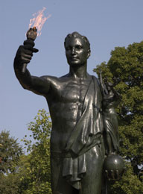

UT Department of Public Health
Academic Programs
MPH Degree (accredited by Council on Education for Public Health)
Community Health Education
Health Planning/Administration
Veterinary Public Health
Dual MS-MPH Degree (PH Nutrition)
PhD in Health Behavior/Health Education
Faculty
9 full-time + 4 adjunct
3 Veterinary Medicine + 4 PH Nutrition
Special Highlight
Celebrating 40th anniversary of MPH Program (1971-2011)

Slide 36

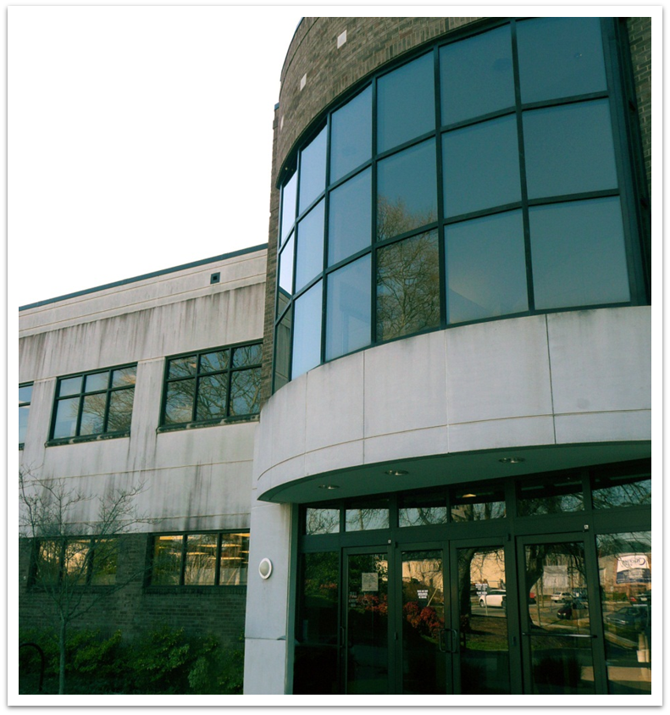
Knox County Health Department
Operations
435K county population
Operating budget $25.1 million and $5.7 million in grants
TN Metro Region -1 of 6
272 personnel FT/PT
Adult & pediatric services outsourced to FQHC
Strategic Planning
Together! Healthy Knox: A Community Approach to Better Health
Will apply winter 2012 for Accreditation through PHAB
Special Highlight
Public Health Workforce Development Series designated by NACCHO as a Promising Practice

Slide 37
Collaboration: Historical Underpinnings < 2011
UT & KCHD have been active participants in East Tennessee Public Health/Preventive Medicine Forum (1995-present)
UT Public Health
faculty served on KCHD advisory committees
faculty participated in KCHD initiatives
MPH students completed nine-week field internships with KCHD
MPH service learning courses (e.g. health planning) engaged students in community planning projects with KCHD
KCHD Personnel
served as MPH course instructors and held adjunct faculty titles
provided presentations to an interdisciplinary seminar
engaged in workforce development discussions with the MPH Academic Program Committee
met with CEPH site visitors regarding accreditation

Slide 38
Memorandum of Understanding (MOU)
Rationale
  to formalize a partnership between the two settings that would continue regardless of leadership/personnel turn-over
  to broaden involvement by more faculty and more practitioners
  to encourage practice-focused research projects engaging both faculty and practitioners
  to contribute to advancing community health improvement
Concern
Appropriate involvement for tenure-seeking faculty?
Approach—broadened faculty support thru discussions
Early win
MOU signed March, 2011

Slide 39


Slide 40
Academic Health Department Leadership
UT Department of Public Health
Knox County Health Department
Department Head has consultant role with KCHD
      Academic Health
      Supervised by Director of MPH Program
Director has adjunct faculty role with DPH
      Department Coordinator
Supervised by Director of Quality Improvement & Accreditation

Slide 41
Academic Health Department Coordinator
Shared position with equal funding by UT DPH and KCHD
Responsibilities
  Coordinate MPH field internships including placement
  Serve as primary contact for student inquiries to KCHD (all UTK programs and other universities)
  Contribute to workforce development activities
    Conduct needs/interests assessment
    Coordinate Public Health Grand Rounds at KCHD (4/year)
    Facilitate bringing PH practice to UT campus through seminar (2/year)
    Arrange for specialized workshops
Concerns
Hiring freeze and lack of budgeted personnel line
Approach—use limited duration appt. & salary recovery $
Early win
Appointment of Coordinator effective August 1

Slide 42
Public Health Grand Rounds
Defined
Collaborative learning sessions between academia & practice regarding a public health area (4/year)
Concerns
1. Selecting topical areas of mutual interest to both settings
2. Designing a format appealing to practitioners & faculty
Approach—initially, the faculty speaker met with several members of KCHD to determine a topic, and
two KCHD staff agreed to serve as members of a reactor panel to the presentation
Early win
First PHGRs held September 23 with the second scheduled for November 18

Slide 43
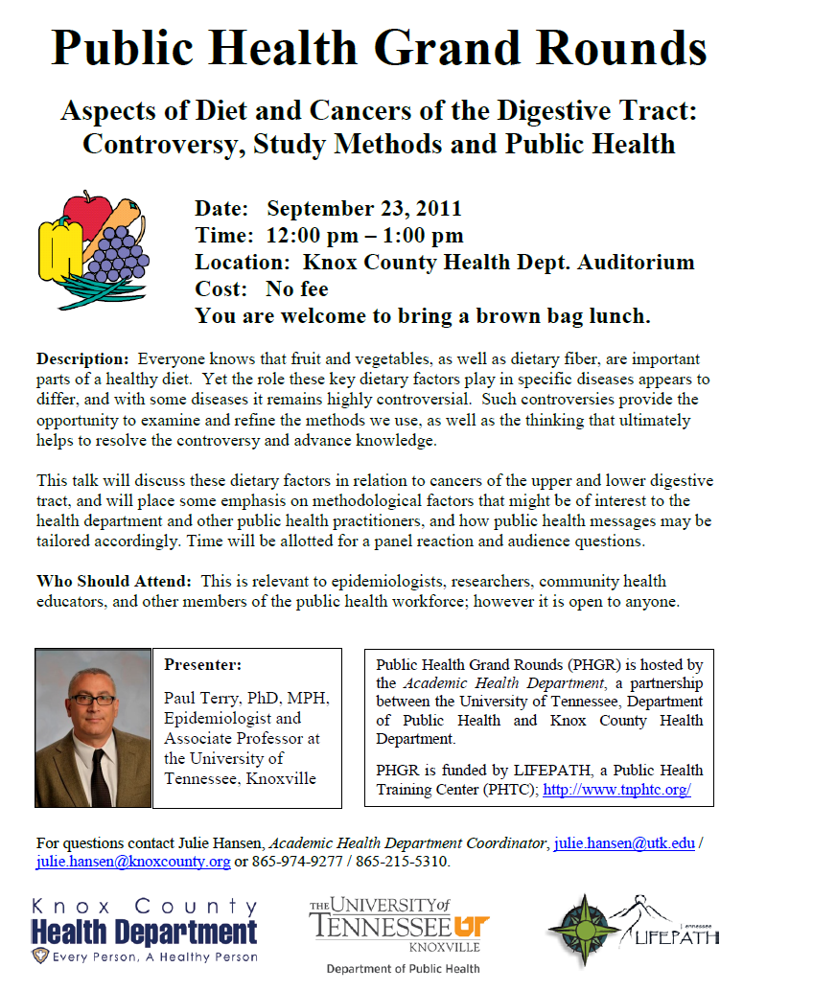

Slide 44
Benefits and Challenges
Benefits
1. Enhances public perception of both organizations
2. Strengthens existing relationships & builds new ones
3. Engages faculty & students in practice setting
4. Provides continuing education for the public health workforce
5. Improves community health status by accessing a broader range of resource persons
6. Positions partners for joint funding opportunities
7. Strengthens capacity for program evaluations
Challenges (near-term)
1. Convert limited duration appointment to full-time budgeted line
2. Determine suitable presentation format for Public Health Grand Rounds (exploring co-presenters)
3. Increase attendance at Public Health Grand Rounds
4. Enhance sustainability of AHD through mutual successes
5. Foster practice-focused research projects

Slide 45

Acknowledgements
Julie Hansen, MPH, CHES
Academic Health Department Coordinator
Paul Erwin, MD, DrPH
Head, UT Department of Public Health
Martha Buchanan, MD
Director & Health Officer, Knox County Health Dept.
Jennifer Johnson, MSN, RN
KCHD Director of Quality Improvement & Accreditation

Slide 46
AHD Case Studies: AHDs in Progress?

Slide 47
Overview
Introducing the Academic Health Department (AHD) Learning Community and the AHD model
AHD Case Studies
  Setting the Stage
  Established AHD
  New AHD
  AHDs in Progress?
AHD Learning Community
  Role
  Resources

Slide 48
AHD Learning Community: Role
Encourage Learning
  Sharing professional experiences
  Highlighting AHD materials
Facilitate Discussion
  Conference call meetings
  Email and online
Offer Support
  Sharing expertise
  Collaborative resource development

Slide 49
AHD Learning Community: Resources
Concept Paper
  Describes basic elements of the AHD model
  Working draft
Discussion Paper
  Highlights potential benefits of AHDs
  Designed to facilitate discussion about AHDs
Bibliography
  List of AHD-related literature
  Updated as new materials are discovered

Slide 50
AHD Learning Community: Resources
Under Development
  List of Established AHDs
  Partnership Agreement Collection
  AHD Roles and Responsibilities
  Competencies for AHD Leaders
All Resources
  Developed with input from the AHD Learning Community
  Available through PHF’s Resources & Tools Library

Slide 51

AHD Learning Community Discussion
Currently on the PHF Pulse Blog:
  AHDs and the AHD Learning Community
  Steps in AHD Development
  Model AHD Health Officer Qualities
  Translating Research into Practice
Posts written by Learning Community members
Add your comments online at http://www.phf.org/phfpulse

Slide 52
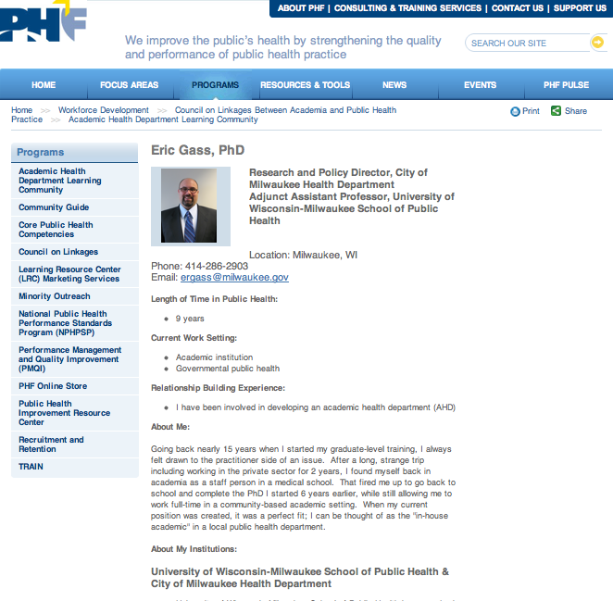
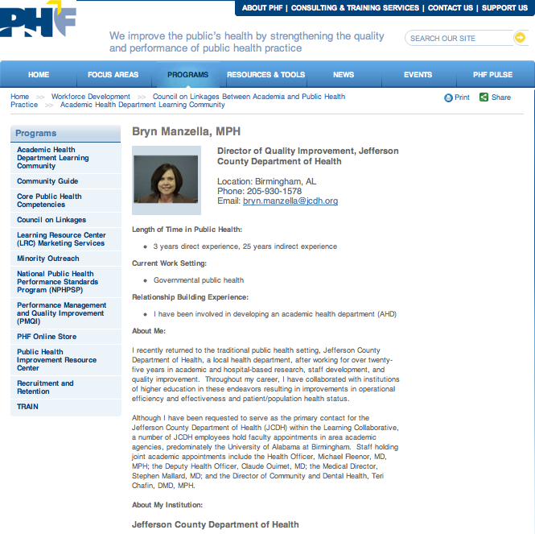
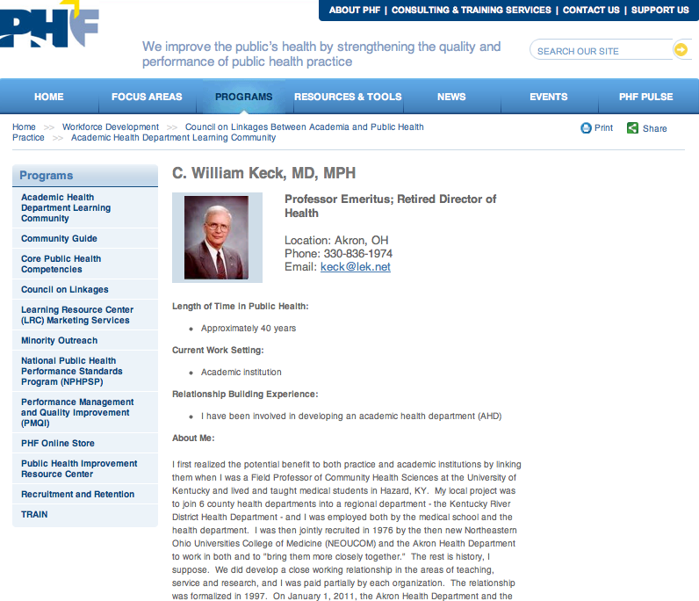
AHD Learning Community Profiles
Personal profiles for AHD Learning Community members to share their experiences
Available online

Slide 53
And we’re just getting started!
Visit us online:
  http://www.phf.org/programs/AHDLC
Join our community:
  Contact Council on Linkages Project Manager, Kathleen, at kamos@phf.org
Join the conversation:
  Next conference call in early December

Slide 54
Thank You!
Today’s Speakers:
  Bryn Manzella, MPH, Jefferson County (AL) Department of Health
  Charles Hamilton, DrPH, MPH, University of Tennessee
AHD Workgroup
AHD Learning Community

