Slide 1
How to Focus Your Training and Professional Development Efforts to Improve the Skills of Your Public Health Organization
October 31, 2011
Ron Bialek, MPP – CEO and President, Public Health Foundation
John Moran, PhD – Senior Quality Advisor, Public Health Foundation and
Senior Fellow, University of Minnesota, School of Public Health

Slide 2
Presenter Disclosures
Ron Bialek and Jack Moran
The following personal financial relationships with commercial interests relevant to this presentation existed during the past 12 months:
No Relationships to Disclose

Slide 3

Innovative Solutions.
Measurable Results.
PHF Mission:
We improve the public’s health by strengthening the quality and performance of public health practice
www.phf.org
Notes:
3

Slide 4
Presentation Learning Objectives
  Describe the Core Competencies for Public Health Professionals
  Describe the Core Competencies strengths and weaknesses of your public health organization
  Describe how a tool of quality improvement can help prioritize what Core Competencies to focus on
  Explain how the use of the Advanced Quality Improvement Tools in a defined sequence makes problem solving more focused and successful
  Use one of the Advanced Quality Improvement Tools, Prioritization Matrix, in a participative exercise

Slide 5
Overview
Given current economic, organizational, and political realities, are there particular competencies where it makes sense to focus your organization’s limited professional development time and funds?
This session will discuss the Core Competencies for Public Health Professionals and a method to prioritize these Core Competencies to identify ones that will help your organization meet the realities of today.

Slide 6
Council on Linkages Between Academia and Public Health Practice
19 National Public Health Organizations:
  American College of Preventive Medicine
  American Public Health Association
  Association for Prevention Teaching and Research
  Association of Accredited Public Health Programs
  Association of Public Health Laboratories
  Association of Schools of Public Health
  Association of State and Territorial Health Officials
  Association of University Programs in Health Administration
  Centers for Disease Control and Prevention
  Community-Campus Partnerships for Health
  Health Resources and Services Administration
  National Association of County and City Health Officials
  National Association of Local Boards of Health
  National Environmental Health Association
  National Library of Medicine
  National Network of Public Health Institutes
  National Public Health Leadership Development Network
  Quad Council of Public Health Nursing Organizations
  Society for Public Health Education
To improve public health practice, education, and research by:
  Fostering, coordinating, and monitoring links among academia and the public health and healthcare community;
  Developing and advancing innovative strategies to build and strengthen public health infrastructure; and
  Creating a process for continuing public health education throughout one’s career.
Funded by CDC and HRSA
Staffed by PHF
.

Slide 7

The Core Competencies for Public Health Professionals
Are a set of skills desirable for the broad practice of public health
Reflect characteristics that staff of public health organizations may want to possess as they work to protect and promote health in the community
Are designed to serve as a starting point for academic and practice organizations to understand, assess and meet training and workforce needs
Notes:
Difference between the COL CCs and ASPH competencies: COL CCs guide practice, while ASPH competencies guide academia.

Slide 8

History of the Core Competencies

Slide 9
About the Core Competencies
Purpose: to help strengthen public health workforce development
Original Core Competencies adopted (April 2001)
Set of skills, knowledge and attitudes
Specified skill levels
Focus on the practice of public health in different settings and sectors
Difficult to measure—intentional
Re-visit every 3 years
Notes:
Core Competencies developed to assure a competent workforce-
Hundreds of health departments are using the Core Competencies

Slide 10
Revising the Core Competencies
Major changes to public health (September 11, 2001, new technologies, aging workforce, etc.)
Wide spread use
Demonstrated benefits and validity

Slide 11
Does Anyone Really Care?!?!
  State Health Departments (SHDs)
    ASTHO reported in 2009 that more than half of the SHDs were using the Core Competencies
  Local Health Departments (LHDs)
    NACCHO’s 2008 profile study noted that over 30% of LHDs are using the Core Competencies
  Academe
    Results of a 2006 COL survey showed that over 90% of academic public health programs use the Core Competencies
  Federal Agencies
    Centers for Disease Control and Prevention – developing discipline-specific competencies and guiding training
    Health Resources and Services Administration – needs assessments and training programs offered by Public Health Training Centers
  Learning Management Systems for Public Health
Notes:
ASTHO survey – 60% of SHDs were using the CCs in 2009
NACCHO survey – over 50% using CCs in 2005, over 30% (approx 39%) reported using CCs in 2008

Slide 12
Comments Received
Over 1,000 comments received (over 600 individuals)
Council on Linkages website
Town hall meetings in 2008 (APHA, ASTHO-NACCHO, NALBOH)
Email messages
Letters

Slide 13
The New Core Competencies
Maintain the original 8 domain framework
Designed for Tier 1, Tier 2 and Tier 3 public health professionals
Follow rules for competency development:
  One verb per statement
  No internal modifiers
  Each competency statement placed in one domain
    Makes each competency more manageable
    Makes each competency more measureable
Notes:
T1 – entry level
T2 – supervisors
T3- snr mgrs/leaders of PH organizations

Slide 14

The Core Competencies are helping organizations
Develop
Job descriptions
Workforce competency assessments
Discipline-specific competencies
Training plans
Workforce development plans
Performance objectives
Continuing education programs
Conduct
Curricula review and development
Performance reviews/evaluations
Notes:
Job descriptions – Livingston County NY
Workforce competency assessments – PHTCs are doing this
Discipline-specific e.g. QUAD Council CCs use COL CCs as a starting point, CDC’s Epidemiology Competencies, CDC’s informatics competencies & ASPH Competencies for PH Preparedness & Disaster Response workers
Performance reviews/evaluations – LA Dept of PH

Slide 15
Future Uses
Accreditation
    Core Competencies are incorporated into the Public Health Accreditation Board (PHAB) standards
Healthy People 2020 Objectives
    Increase the proportion of Federal, Tribal, State, and local public health agencies that incorporate Core Competencies for Public Health Professionals into job descriptions and performance evaluations.
    Increase the proportion of Tribal, State, and local public health personnel who receive continuing education consistent with the Core Competencies for Public Health Professionals (Developmental).
    Increase the proportion of Council on Education for Public Health (CEPH) accredited schools of public health, CEPH accredited academic programs, and schools of nursing (with a public health or community health component) that integrate Core Competencies for Public Health Professionals into curricula.
Notes:
Accreditation – For example, 8.2.2 of the State Standards says that under required documentation the CCs can be written into agency development plans. While not required, using the CCs can help agencies demonstrate and document attainment of this standard
The ccs are incorporated into three of the objectives for HP2020

Slide 16
Core Competencies Domains
Analytic/Assessment Skills
Policy Development/Program Planning Skills
Communication Skills
Cultural Competency Skills
Community Dimensions of Practice Skills
Basic Public Health Sciences Skills
Financial Planning and Management Skills
Leadership and Systems Thinking Skills

Slide 17
Core Competencies Domains
Analytic/Assessment Skills
  Identify and understand data
  Turn data into information for action
  Assess needs and assets to address community health needs

Slide 18
Core Competencies Domains
Policy Development/Program Planning Skills
  Determine needed policies
  Effectively advocate for policy
  Plan, implement, evaluate, and improve programs

Slide 19
Core Competencies Domains
Communication Skills
  Listen
  Interpret
  Communicate

Slide 20
Core Competencies Domains
Cultural Competency Skills
  Understand and effectively respond to diverse needs
  Assess organizational cultural diversity and competence
  Ensure organizational cultural competence

Slide 21
Core Competencies Domains
Community Dimensions of Practice Skills
  Evaluate and develop linkages and relationships within the community
  Maintain and advance partnerships and community involvement
  Defend public health policies and programs
  Evaluate effectiveness and improve community engagement

Slide 22
Core Competencies Domains
Basic Public Health Sciences Skills
  Incorporate core public health functions into practice
  Apply basic sciences to practice
  Critique and develop research
  Establish academic partnerships

Slide 23
Core Competencies Domains
Financial Planning and Management Skills
  Leverage community resources
  Manage partnerships and ensure programs are well managed
  Evaluate program performance
  Motivate
  Establish Performance Management System

Slide 24
Core Competencies Domains
Leadership and Systems Thinking Skills
  Incorporate ethical standards into the organization
  Integrate systems thinking into public health practice
  Mentoring
  Ensure CQI
  Adjust practice to address changing needs and environment
  Manage organizational change

Slide 25
General Approach On How To Use The Advanced Tools Of
Quality Improvement
Large Issue, Cross Functional Problem, or Sensitive Situation
Brainstorming
Affinity Diagram
Explore
Interrelationship DiGraph
Prioritization Matrix
Sort &
Prioritize
Monitor
Understand &
Baseline
Radar Chart
SWOT Analysis
SMART Chart
Develop
Actions &
Tasks
Develop
Project Plans
Prioritize
Actions &
Tasks
Tree
Diagram
Problem
Prevention
PERT
Gantt Chart
Control & Influence Plots
Prioritization Matrix
Know & Don’t Know Matrix
PDPC
Source: The Public Health Quality Improvement Handbook,
R. Bialek, G. Duffy, J. Moran, Editors, Quality Press, © 2009, p.190

Slide 26
Funnel Approach
Start with a large issue or problem which we want to analyze
Advanced QI
Tools Problem
Solving
Process
Constant process of refinement and insight
Clear Action Plan to Resolve The Problem or Issue Statement
Source: The Public Health Quality Improvement Handbook, R. Bialek, G. Duffy, J. Moran, Editors, Quality Press, © 2009, p.191

Slide 27
Prioritization Matrices

Slide 28
Decisions Decisions Decisions

Slide 29
Prioritization Matrices
Rigorous decision-making tool
L-shaped matrix
Pair wise comparisons of items Utilizes a decision criteria to make a selection

Slide 30
Why Prioritization Matrices?
Consistency in the judgment process
Pick decision criteria drivers before starting
Develop a numerical scale to represent each judgment
Pairwise comparison – how do they relate
Develop weighting by consensus

Slide 31
Why Prioritization Matrices?
Best to do it quickly – first inclination is usually correct
Let the experts decide – expertise will rotate in the group on different pairwise comparisons

Slide 32
Decision Criteria
Develop standards for judgment before starting
Must stick to them
Must group standards set and not your own
Cannot switch standards part way through
Easy to skip this step and just assign arbitrary priorities

Slide 33
Some Decision Criteria Drivers
  Improved quality
  Lower costs
  Improved delivery
  Improved productivity
  Better Human Resource allocation
  Improved financial results
  Use of latest technology
  Easy to sell
  Effectiveness
  Improved outcomes
  Better service
  Increased client satisfaction
  Minimal impact to group
  Improved flexibility
  Easily used
  High probability of success
  Efficiency
  Equitable

Slide 34
Pairwise Comparison Questions
Does having ______ contribute more than ________ in achieving the goal?
Will ____ lead towards the goal more than ______?
Your first inclination is usually correct

Slide 35
Prioritization Matrix
Score

Slide 36
Prioritization
Based on the works of Thomas L. Saaty
  Decision Making: The Analytical Hierarchy Process
  Decision Making for Leaders

Slide 37
Prioritization Matrix
Need weighting criteria for pairwise comparisons:
Rating Scale:
  1 – equally important
  5 – significantly more important
  10 - exceedingly more important
  1/5 - significantly less important
  1/10 - exceedingly less important

Slide 38
Prioritization Matrix
Benefits:
  Rules
  Quantitative
  Objective
  Discipline
  Focus

Slide 39
Best Method Of Cooking Tasty Popcorn - Prioritization
1 2 3 4
Score Rank
1
1. Microwave
2. Air Popped
3. Popped in
Oil
4. Pre-
Packaged

Slide 40
What are the particular competencies where it makes sense to focus your organization’s limited professional development time and funds?
Break into groups
Use the Prioritization Matrix
Time 30 minutes
Rating Scale:
  1 – equally important
  5 – significantly more important
  10 - exceedingly more important
  1/5 - significantly less important
  1/10 - exceedingly less important

Slide 41
1 2 3 4 5 6 7 8
Score/Rank
Analytic/
Assessment
2. Policy
Development
3. Communication
4. Cultural
Competency
5. Community
Dimensions
6. Basic Sciences
Skills
7. Financial P&M
8. Leadership and
Systems
What are the particular competencies where it makes sense to focus your organization’s limited professional development time and funds?

Slide 42
What are the particular competencies where it makes sense to focus your organization’s limited professional development time and funds?
Rating Scale:
  1 – equally important
  5 – significantly more important
  10 - exceedingly more important
  1/5 - significantly less important
  1/10 - exceedingly less important

Slide 43





1 2 3 4 5 6 7 8
Score
Analytic/
Assessment
2. Policy
Development
3. Communication
4. Cultural
Competency
5. Community
Dimensions
6. Basic Sciences
Skills
7. Financial P&M
8. Leadership and
Systems
1/5
1/5
1
1/5
5
1/5
1/5
7
5
1
5
5
10
1
1
28
5
1
10
10
10
1
47.2
1
1/5
1/10
10
1/5
1/5
11.9
5
1/5
1/10
1/5
1/5
20.7
1/10
1/10
0.8
1/5
1/10
1/10
1/10
1/10
1
5
5
1/5
27.2
5
1
5
5
5
5
31
Example from a Commission on Health

Slide 44
PHF Available Training and Learning Resources
TRAIN – www.train.org
Learning Resource Center – bookstore.phf.org
  Examples:
    Public Health Leadership: Putting Principles into Practice
    Public Health Quality Improvement Handbook
Performance Management and Quality Improvement – www.phf.org
  Tools
  Tutorials
  Case Studies
  White Papers

Slide 45
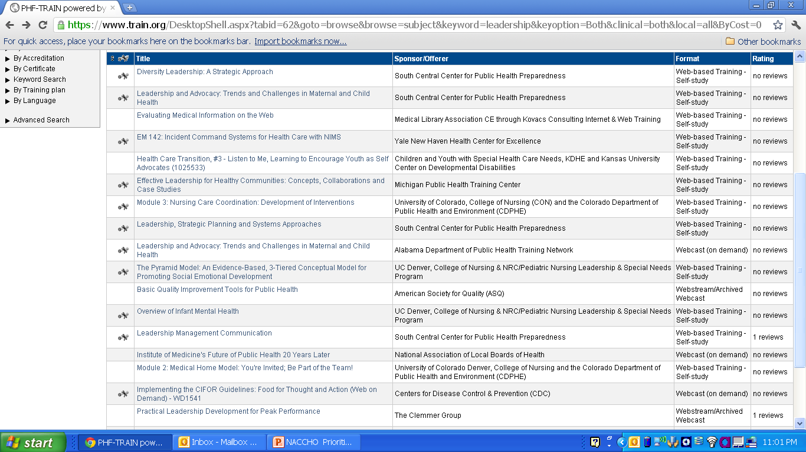

Slide 46
PHF Available Training and Learning Resources
TRAIN – www.train.org
Learning Resource Center – bookstore.phf.org
  Examples:
    Public Health Leadership: Putting Principles into Practice
    Public Health Quality Improvement Handbook
Performance Management and Quality Improvement – www.phf.org
  Tools
  Tutorials
  Case Studies
  White Papers

Slide 47
Where Else To Get Training
American Public Health Association
National Association of County and City Health Officials
National Network of Public Health Institutes
Association of State and Territorial Health Officials
Public Health Training Centers
CDC Learning Connection - http://www.cdc.gov/learning/
CDC Performance Improvement Managers –
http://www.cdc.gov/ostlts/performance/index.html
Partners in Information Access for the Public Health Workforce – phpartners.org

Slide 48
Thank you!!!

