Slide 1
Efficacy of Telephone-Delivered Cognitive Behavioral Therapy for Chronic Pain
Dawn M. Ehde, Ph.D.
Dept. of Rehabilitation Medicine
UW Medicine, Seattle, WA
2011 APHA Annual Meeting
November 1, 2011, Washington, DC

Slide 2
Acknowledgements
National Center for Medical Rehabilitation Research, National Institute of Child Health and Human Development: R01 HD057916, HD057916-03 S1
Co-investigators: Mark Jensen, Ph.D., Judith Turner, Ph.D., Marcia Ciol, Ph.D.
Postdoctoral Fellows: Tiara Dillworth, Adam Hirsch, Anna Kratz, Sarah Sullivan, Mark Goetz
Study staff: Kevin Gertz, Christina Garcia, Maria Acosta, Nathan Bell, Amy Kupper

Slide 3
Presenter Disclosures
Dawn M. Ehde, PhD
(1) The following personal financial relationships with commercial interests relevant to this presentation existed during the past 12 months:
No relationships to disclose

Slide 4
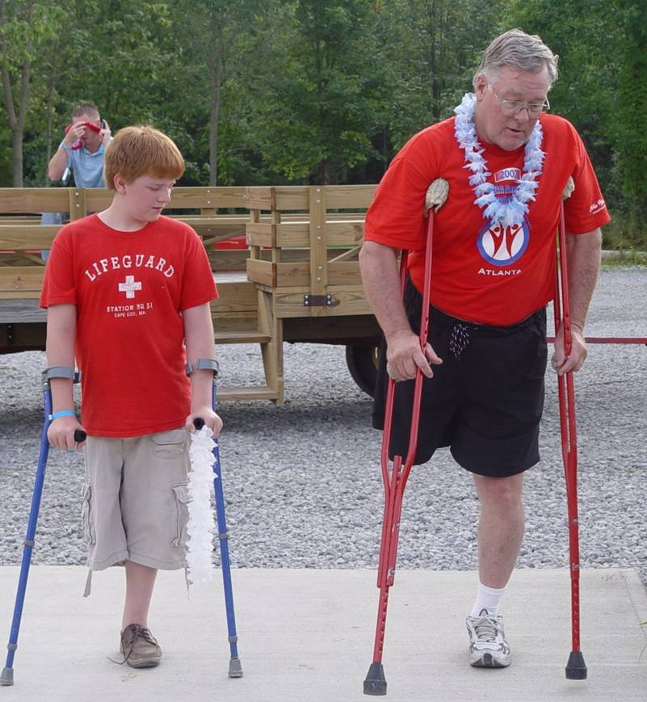
And Thank You to…
the study participants from whom I’ve learned a lot about living life with chronic pain after disability

Slide 5
Overview
Present preliminary findings from a randomized controlled trial evaluating the efficacy of a telephone-delivered cognitive behavioral therapy (CBT) for pain in individuals with acquired limb loss, multiple sclerosis, and spinal cord injury
  Rationale for and description of the intervention
  Preliminary results regarding efficacy
  Results on feasibility & implementation, including acceptance, treatment satisfaction, and therapeutic alliance

Slide 6
Chronic Pain is a Significant Problem for Many People with Acquired Disabilities
percent
Notes:
In the last 15 years we’ve seen CP in Dis get attention
BRIEFLY MENTION IMPACT
POINT OUT HIGHLY VARIABLE DEPENDING ON WHEN ASSESSED, HOW ASSESSED
25-35% of those with pain report severe pain
Majority have pain > 1 site
Significantly higher levels of pain severity relative to national norms
Pain is associated with poorer physical functioning, mental health, participation in roles/activities, and quality of life
MS: point prevalence of pain is nearly 50%, with 75% reporting pain within one month of assessment. O’Connor et al., 2008, Pain 137, 96-111.
Stroke: 55% had pain in the first year post stroke; seems the study excluded those with severe cognitive or language disorders, so actual number may be different. Sackley et al., 2008, Stroke, 39, 3329-3334.

Slide 7
Psychosocial Factors & Disability Pain: Results from a Systematic Review
Psychosocial factors are significantly associated with pain & dysfunction in acquired amputation, multiple sclerosis, & spinal cord injury, in particular:
  Catastrophizing cognitions
  Coping: task persistence, guarding, & resting
  Perceived social support & solicitous responding
  Jensen et al. (2011). Arch Phys Med Rehabil 2011;92:146-60.
Notes:
Mention that our group’s work, along with work from others (Richards, mention a few more) built a body of evidence that suggested that, indeed, psychosocial factors play an important role in disability pain
We conducted a systematic review and found 29 studies met review inclusion criteria

Slide 8
Gaps in Psychosocial Treatment
Despite an evidence base suggesting psychosocial interventions decrease pain and improve functioning in samples where pain is primary,
few (10-15%) individuals with chronic pain and amputation, multiple sclerosis, or spinal cord injury report having tried a psychological intervention for pain.
Ehde et al., 2006; Hanley et al., 2006; Turner et al., 2001; Widerstrom-Noga & Turk, 2003
Notes:
Fill in references

Slide 9
Barriers to Treatment
In a randomized controlled trial of CBT for pain after disability, over half (n=141) of those screened for the RCT wanted to participate but ultimately did not, primarily due to transportation barriers (Ehde et al., under review.)
Survey research has suggested that many people (65%) with comorbid chronic pain and disability report inadequate access to pain treatments, including psychosocial treatments (Dillworth et al., in preparation).
Notes:
P2 info:
Major barrier: transportation (82%)
Lack of transportation
Not eligible for DSHS transport
Transportation too burdensome (e.g., take 4-5 hours)
Concerned transportation would exacerbate pain or discomfort
Lack of childcare
(Multiple reasons given)
Another survey study: 80% (132) of sample reported current chronic pain problem
Of these:
65% reported inadequate access to pain treatments in the previous 6 months
47% reported difficulty accessing care
35% reported financial barriers
28% reported logistical barriers (e.g., distance, lack of transportation)

Slide 10

Telephone Intervention for
Pain Study (TIPS)
Harborview Medical Center, UW Medicine
(NCMRR, NICHHD, R01 HD057916, HD057916-03 S1)

Slide 11

TIPS Study Aims
To evaluate the efficacy of a telephone-delivered CBT pain intervention relative to a telephone-delivered pain education intervention in adults with limb loss (LL), multiple sclerosis (MS), or spinal cord injury (SCI) via a randomized controlled trial (RCT)
To examine potential mediators and moderators of treatment effects
Notes:
Manualized treatment
Also interested in moderators
To study potential mediators (pain catastrophizing, beliefs, coping) and moderators (e.g., demographics, pain severity, adherence) of treatment effects

Slide 12
Inclusion Criteria
Definitive diagnosis of LL, MS, or SCI confirmed by participant’s provider
Average pain intensity in the past month of > 3 on 0-10 numeric rating scale (NRS)
Pain worse or started post disability
Pain of at least six months duration & present in the last month > half the days
Read and speak English
Age 18 or older

Slide 13
Exclusion Criteria
Severe cognitive impairment defined as > 1 error on Six-item Screener (Callahan et al., 2002)
Self-reported current or previous participation in a CBT intervention for pain or other psychological disorders
Previous participation in a clinical trial of any psychological treatments for pain
Notes:
Note low prevalence of severe cognitive impairment in these groups

Slide 14
Measures
All measures are administered at pre-treatment, mid-treatment, post-treatment, and 3-, 6-, & 12 month post randomization
Primary Outcome: Average pain intensity in the past week
  Asked to rate their pain intensity in the past 24 hours using 0-10 numeric rating scale
  Collected 4 times within the week
Notes:
Mention that telephone delivery allows those with limited or no ability to write to participate
Administered by telephone by research assistants blind to study assignment

Slide 15
Other Outcomes & Measures
Secondary Outcomes
  Pain Interference (Interference Scale BPI)
  Depression: Patient Health (PHQ-9)
  Global rating of improvement
Mediators: catastrophizing cognitions, pain beliefs, & coping
Process: credibility, expectations, motivation, adherence, therapeutic alliance

Slide 16
Procedures
Participants randomly assigned after pre-tx data collection and immediately before Session 1 to:
  Telephone-delivered CBT
  Telephone-delivered pain education
Treatment fidelity protocol includes:
  Recordings of sessions
  Therapist manuals
  Session checklists
  Weekly clinician meetings

Slide 17
Intervention Protocol
8 weekly 50-60 minute sessions conducted by phone at a scheduled time
Brief (< 15”) booster calls at 2, 4, 8, 12, 18, & 24 weeks made to both groups
Study clinicians: postdoctoral fellows or clinical psychologists supervised by study investigators
Sessions are conducted as if they were face-to-face
Notes:
Perform the sessions as if they were being conducted in person (set stage in session 1)
Regularly scheduled
Ask them to call us if they cannot keep their appointment
Timely

Slide 18
Cognitive Behavioral Therapy (CBT)
Relaxation training adapted for disability (7 different exercises, available via CD or MP3 files)
Behavioral activation & goal-setting
Pacing
Cognitive therapy
Includes in-session rehearsal of skills, readings, & homework
Notes:
Adaptations:
Provide relaxation recordings in multiple formats
Provide CD player if needed
Some relaxation skills are introduced but not fully practiced in session due to lack of visual cues for clinician (progressive muscle relaxation)
Tailor relaxation exercises as needed to participant’s disability
Cognitive therapy is taught in smaller steps than past in-person interventions to accommodate telephone delivery
Thought records are also broken down

Slide 19
Education Intervention (Ed)
Information on a variety of pain topics relevant to disability, such as:
  Facts about chronic pain in the individual’s disability type
  The physiological processes underlying pain
  Comorbidities (e.g., depression, sleep)
Interactive, supportive format
Readings & related homework included
CDs/MP3 files of readings included
Notes:
. The educational topics were selected from the group education lectures that are given as part of the UW Multidisciplinary Pain Clinic’s intensive treatment program.
In rehab setting pain tx often involves telling people what to do (but not teaching skills)
No rehearsal of specific skills
Mention used this control group before and is credible

Slide 20
Adaptations to Study Procedures
Enrollment, informed consent, data collection, and disability confirmation procedures all occur by telephone, mail, e-mail, or fax
Provide telephone headsets & response keys
Study staff help problem solve technical issues with participants
Notes:
Adaptations for 2 things: disability & use of telephone to deliver treatment

Slide 21
Adaptations to Interventions
Provide detailed & organized participant manuals to both groups
Multiple formats for materials: CD, PDFs, large print, paper
Deliberately query about ability to physically & cognitively complete homework
Therapist helps problem-solve challenges to homework completion
Use disability-specific examples in manuals
Notes:
Give examples of accommodations:
Writing
If pt’s disability may impact his or her ability to complete the plan in writing, brainstorm with him/her other strategies for accomplishing the same goals. Start by first asking pt how he/she normally tracks information, and encourage use of existing strategies. If these are not feasible, other ideas include:
Pt typing the plan on an electronic file using keyboard or, if they use it, a Dragon Dictate software program
Asking someone to help him/her complete the plan
The therapist sending (via TIPS email, mail, or fax) the pt a plan completed during session which can then be completed electronically or on paper

Slide 22


TIPS
TIPS Personal Plan Dates: From Oct. 18, 2009 to Oct. 24, 2009
Remain active with my family despite my pain.
Long-term goals:
Activity/Skill | Frequency | Confidence (0-10) | Sun | Mon | Tues | Weds | Thurs | Fri | Sat
Practice relaxation | At least 1x/day | 8 | I | I | I | I | I | 0 | II
Review my handouts | 1x/week | 9 | I | 0 | 0 | 0 | I | 0 | 0
Gardening | 15 min 2x/week | 7 | 0 | I | 0 | I | 0 | 0 | I
Using pain management skills
Obstacles | Possible solutions
1) Friday is a busy day - not sure I will have time to practice | Do extra relaxation on Saturday
2) | Do a short one that day (5 minutes)
3)
4)
5)

Slide 23

  38% SCI
  44% MS
  18% AMP
TIPS National Enrollment Map
N = 160 as of 10/1/2011

Slide 24
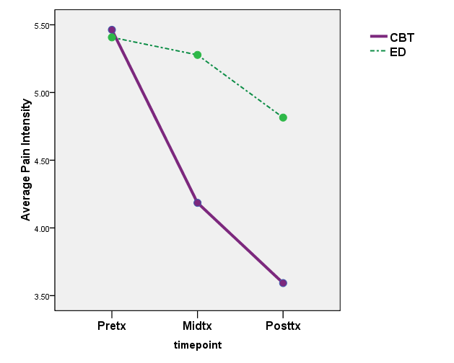
Preliminary Results: Pain Intensity

Slide 25
Treatment Satisfaction Ratings
Using 0 (not at all) to 10 (extremely) NRS:
  Helpfulness: 8.0 (SD = 2.2)
  Convenience: 9.5 (SD = 1.1)
97% of the sample would recommend TIPS to a friend with pain and disability
Attrition is < 5%
Adherence: 88% attended all 8 sessions
Notes:
72.5% of those screened are eligible
Only 7.4% of eligible potential participants have declined study participation

Slide 26
Preferred Delivery Method
“If given the choice, what is your preferred method of treatment delivery?”
  Telephone: 42%
  In person: 22%
  Web/internet: 13.8%
  Other: 8%
    Skype
    “all options”
    “phone or internet”, “phone or in-person”
    Texting
    Webcam
Notes:
“Easier” & “convenient”: 53%
No travel or driving: 47%
Don’t have to “dress up”: 30%
Physically more comfortable: 24%
Other comments:
“Services not available in my rural, small town”
“I can attend sessions even if I’m not feeling well”
“Beats just reading about it”
“Headphones are terrific/helpful”
Drawbacks:
None: 71%
Not being able to have face-to-face communication/seeing the person: 24%
Other comments:
“Harder to get a connection with someone over the phone” (1 participant)
“Pain in neck from phone length” (1 participant)

Slide 27
Telephone Delivery
Benefits
Drawbacks
“Easier” & “convenient”: 53%
No travel or driving: 47%
Don’t have to “dress up”: 30%
Physically more comfortable: 24%
Other comments:
  “Services not available in my rural, small town”
  “I can attend sessions even if I’m not feeling well”
  “Beats just reading about it”
None: 71%
Not having face-to-face communication/seeing the person: 24%
Other comments:
  “Harder to get a connection with someone over the phone” (1 participant)
  “Pain in neck from phone length” (1 participant)

Slide 28
TIPS Therapeutic Alliance
*
*p=.01
Working Alliance Inventory-Short Revised (Hatcher & Gillaspy, 2005)
Notes:
The relationship between the therapist and client, including the bond that develops through mutual trust and the collaborative work of establishing and working toward treatment goals (Bordin, 1979)
Bond
Agreement on therapy goals
Agreement on how to achieve therapy goals
Beckner et al. 2007: CBT around a 5.93, SET = 4.75
5.87, mid, 5.9 for post-tx in universit ycounseling students (Tyler article) using WAI-SF
Scores range from 1 (lowest) to 7 (highest)
This is for total score, similar pattern for subscales
Bond: development of personal bond
Goal: agreement on goals
Task: agreement on how to achieve goals

Slide 29
Conclusions from TIPS
The study supports the feasibility and acceptability of a telehealth pain CBT intervention in persons with LL, MS, or SCI
Results suggest that therapeutic alliance is high and does not appear to be compromised by use of the telephone
Telehealth interventions for chronic pain hold promise for addressing issues of access
Notes:
These preliminary data support the feasibility and acceptance of the TIPS interventions
Recruitment and enrollment are strong, particularly among people with MS
High degree of adherence to treatment
Participants are satisfied with the treatments and list many benefits
Treatment fidelity is also strong
We will complete the trial in 2012 & examine both efficacy and potential mechanisms of effects

Slide 30

Future Directions
Continue to address the chasm between RCTs & implementation of pain interventions in real world settings via research on:
  Telehealth
  Mechanisms of effects
  Effectiveness research
Notes:
chasm between conducting successful clinical trials and implementing effective treatment strategies in “real world” settings. Therefore
May be an Issue that are interventions are not attractive or have poor external validity, but I suspect it has more to do with access, feasilibty, etc.
As central as rehabilitation is to my id, need to consider the challenges from other perspectives.
How can we improve our interventions’ external validity? Effectiveness?
How can we improve our reach?
Minorities
The underserved
What about secondary prevention?
What steps do we need to take to ensure sustainability & knowledge translation when the study ends?

Slide 31

Thank you! ehde@uw.edu
Mt. Rainier from Kerry Park, Seattle, WA
(Photo by Randi Blaisdell)

