Slide 1
Cancer Care Resources in Appalachia:
Breast Cancer as An Example
Nengliang Yao, PhD candidate
Health Policy and Administration
The Pennsylvania State University

Slide 2
Background
National Cancer Institute has designated Appalachia as a priority area characterized by significant disparities in cancer outcomes.
Little research focuses on the availability of cancer care resources in this region and how resource availability may relate to cancer outcomes.
This paper will describe the distribution of breast cancer care resources in Appalachia

Slide 3
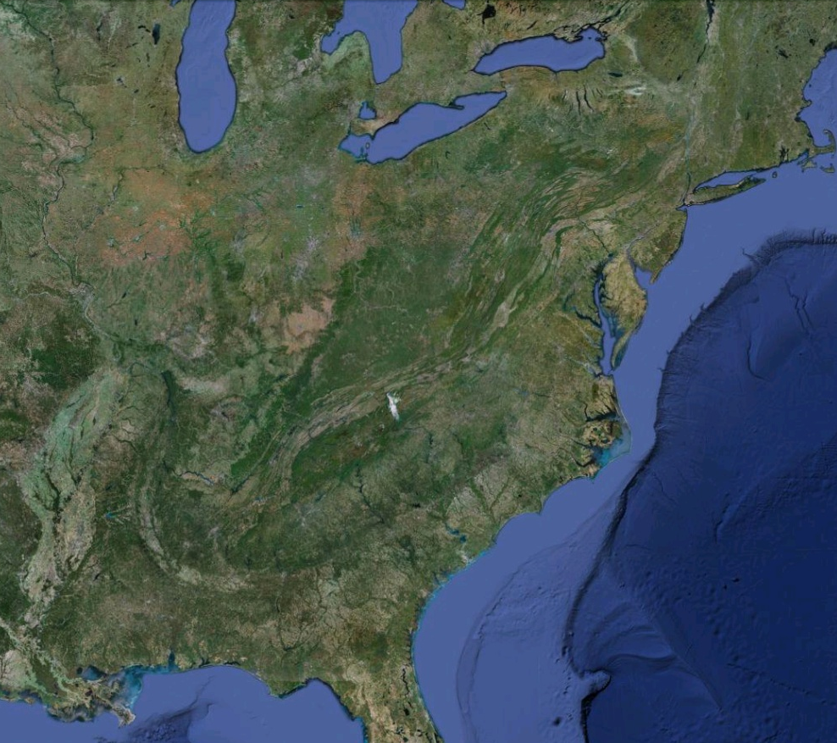
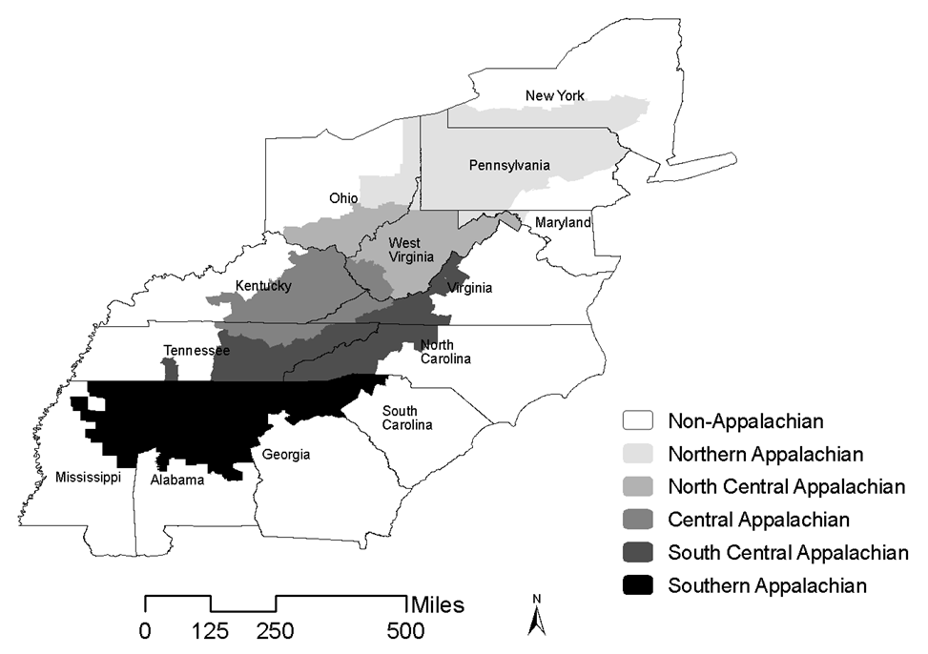
Appalachia

Slide 4
Method
This study uses county-level data extracted from the Area Resource File 2007.
420 counties and 8 independent cities in thirteen states are classifies as Appalachian counties.
I measured cancer-care-related providers and cancer care facilities who/which are involved in breast cancer screening, diagnosing, treatment, and survivorship care.
Frequency analysis, mean analysis, T-tests, and exploratory spatial data analysis were applied

Slide 5
Results-1

Slide 6
Results-2

Slide 7
Results-3

Slide 8
Results-4

Slide 9
Results-5

Slide 10
Results-6

Slide 11
Results-7

Slide 12
Conclusion
Physician supply per capita: Appalachia < non-Appalachia
Availability of hospitals per square miles: Appalachia < non-Appalachia
Availability of hospitals per capita: Appalachia > non-Appalachia
Central Appalachia had fewest physician and facility resources
Notes:
Compared to the non-Appalachian counties, Appalachian counties (especially Central and Southern Appalachia) had significant fewer physicians per capita in primary care, Obstetrics &Gynecology, Diagnosing Radiology, Surgery, Anesthesia, Clinical Pathology, Radiation Oncology, Radiology, and Internal Medicine Subspecialty in 2006.
In contrast, Appalachian counties had more hospitals per capita with women health service, mammography, adult surgery, oncology service, and chemotherapy were than non-Appalachian counties. However, Appalachian counties had significant fewer hospitals per 1000 square miles with oncology service, and chemotherapy than non-Appalachian counties.
Central Appalachia had fewest physician and facility resources per square miles, and spatial analysis also showed clustering of scarce breast cancer care resource in Central Appalachia.

Slide 13
Does it matter?
Study 1
Fewer diagnostic radiologists per capita in is associated with lower percentage of early stage breast cancer incidence in the Central Appalachia region.
ASCO 2011 Breast Cancer Symposium in September 2011
Study 2
Clustering of scarce breast cancer care resource exists in Central Appalachia, which is associated with disparities of guideline-concordant radiotherapy
AACR 4th cancer health disparities conference September 2011
AACR San Antonio Breast Cancer Symposium

Slide 14
Thank you!
Questions & comments

