Slide 1

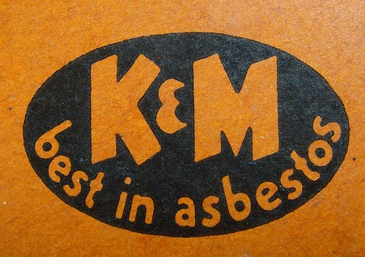
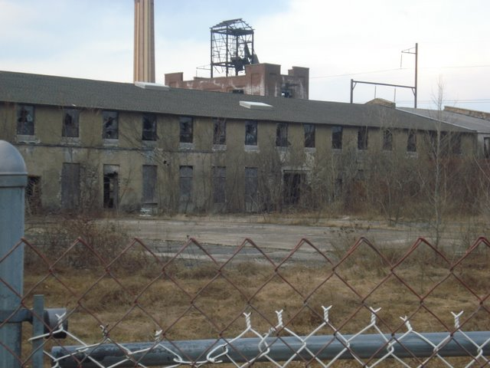
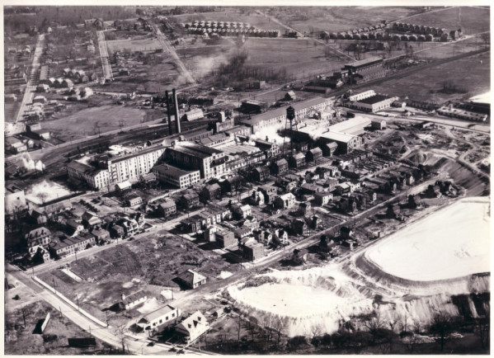
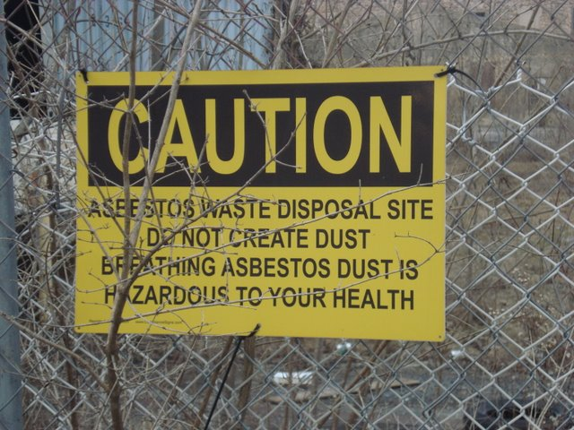
BACK TO THE FUTURE: UNDERSTANDING PAST EXPOSURES TO INFORM FUTURE PRACTICE
John Wierzbowski, MSc, MPH¹, Frances Barg, PhD², Rosie Frasso, PhD³, Edward Emmett,MD,MS⁴
University of Pennsylvania, Perelman School of Medicine, Philadelphia, PA
INTRODUCTION
RESULTS
DISCUSSION
The purpose of the study was to reconstruct likely past asbestos exposure, sources of exposure, and exposure levels referable to the workplace.
Ambler, PA is located 15 miles north of Philadelphia. Residents have long been exposed to industrial and environmental asbestos in and around a factory owned by the Keasbey and Mattison Company.
The plant operated from the 1880s to the late 1980s. 1.4 million cubic yards of asbestos waste was dumped onto 2 sites. The 1st site (25 acres) was remediated as a Superfund site. The 2nd and larger site (Bo-Rit) is still undergoing remediation.
This analysis deepened our understanding of past asbestos exposures. Notably:
Exposures varied between workers and secondary contacts in families
  Persistent evidence of “Take Home” exposures
Plant culture may have hindered adoption of safety interventions
Medical programs evolved in reaction to evidence and legislation
  There is a history of varied understanding of risk and distrust of authorities in the community (many argue that all morbidity and mortality was linked to the plant)
Analysis of these data revealed that asbestos exposure type, intensity, related policies, and responses varied over the years.
Keasbey and Mattison Label
Time Frame | Findings
1940s – 1950s | Fiber arrived via rail car in jute bags from mines Unloaded by hand and emptied into tubs Fiber and millboard cut by saws Loose fibers cleared with air hose, dry sweeping Little or no dust control devices present in the plant No evidence of plant physician
1960s-1970s | Plants had designated wet sides and dry sides Exposure controls present but poorly maintained Variation in occupational exposure by role in plant Air sampling data indicated mixer man, pulverizer, grinder, and dust collector/cleaner had highest exposures 73 Samples in 1979 (0.5 f/cc to 2.24 f/cc TWA) Recreation commonly found near asbestos waste piles Formal voluntary medical surveillance program by 1979
1980s to present | Prior to closing air concentrations exceeded 2.25 f/cc in millboard scrap department Prior respiratory protection required Plants closed in 1984 ~ abandoned plants and waste piles still present and are attractive nuisances in the community
METHODS
Qualitative Methods:
  CBPR
  Industrial archaeology
  Participant observation
  Semi-structured interviews
  Field Immersion
Data:
  Documents
  Newspapers
  Analytical Reports
  Memos
  Interview Transcripts
      Purposive sampling
      (Former workers & family members, adults currently living in Ambler or past residents)
Analysis:
  All data were entered into NVIVO 9.0 software and analyzed employing grounded theory
CONCLUSIONS
  Examination of temporal patterns of exposure deepens understanding of historical context and may also help to inform future policy. Future surveillance should consider dose
  This community based research can serve as a template for future occupational safety and health practice
PROTECTION OF HUMAN SUBJECTS
IRB approval was granted by the University of Pennsylvania
Certificate of Confidentiality was obtained from the NIH
REFERENCES
Bernard, H.R., Research Methods in Anthropology. 3rd ed. 2002, Walnut Creek: Alta Mira Press.
Creswell, J.W., et al., Advanced Mixed Methods Research Designs, in Handbook of Mixed Methods in Social and Behavioral Research, A. Tashakkori and C. Teddlie, Editors. 2003, Sage: Thousand Oaks.
Others furnished upon request: john.wierzbowski@uphs.upenn.edu
Boiler house (Present)
Waste pile circa 1952.
Sign fence around waste pile (Present)

