Slide 1
Health Navigator Program
Helping Families Navigate the Healthcare System – Using the Community Health Worker Model
Marci Aguirre, MPH
Director of Community Outreach

Slide 2
Inland Empire Health Plan
Joint Powers Agency – public entity, not-for-profit, established 1994
Local Initiative Medi-Cal managed care health plan
Riverside & San Bernardino Counties, California
Over 520,000 Members
Medi-Cal, Healthy Families, Healthy Kids, & Medicare Advantage Special Needs Plan

Slide 3
The Problem
Very high Emergency Department (ED) utilization
  655 Per Thousand Members Per Year (2009)
23% for “avoidable” visits
  California Department of Health Care Services Statewide ED Collaborative definition (2009)
Significant utilization for those 2 years old and younger for non-emergent visits
Medi-Cal: No ED co-payment allowed

Slide 4
Reduce ED Utilization
Prior efforts include:
  Promotion of 24-Hour Nurse Advice Line (NAL)
  Open Access Urgent Care – no authorization required, large network
  Education & marketing directed toward Member through mail and/or phone
  Targeted letters to frequent users

Slide 5
ED Focus Groups in 2009
Results showed interventions needed for parents with small children
  Utilization differs if parent is ill vs. child is ill
  Parents more likely to take children for non-urgent issues
  Concept of Urgent Care not widely understood
Barriers to non-ED care
  Lack of awareness of ED alternatives
  Lack of understanding regarding benefits & how to use alternative options

Slide 6
Literature Review
Efficacy of Community Health Workers
Promotores model
  Culturally & linguistically similar to population
  Social model rather than medical model, used to impact various social issues, e.g. healthcare
  Don’t provide clinical care
  Link between underserved communities & formal healthcare networks

Slide 7
IEHP Goals
Primary goal to reduce ED utilization among young children
Secondary Goals
  Link Member to Primary Care Physician (PCP)
  Increase well child and immunization compliance
  Link Member to IEHP resources (Member Services)

Slide 8
IEHP Health Navigators
Decision made to hire staff internally
  Lack of mature Promotores Program in community
  Direct control over activities
  Quality Assurance – training, follow-up, link to internal units (Care Management, Enrollment Assistance Unit, Member Services)
Located within Community Outreach Department

Slide 9
HN Program Development
  Funding
      Applied for and received grants from First 5 Riverside and First 5 San Bernardino
      IEHP funding – commitment from Health Plan
  Staff Recruitment
      Initial focus – metro San Bernardino and Riverside city areas
      Hired individuals living and active in those communities
      Bilingual Spanish required

Slide 10
HN Program Development
  Internal training
      Healthcare system & managed care practices
      Importance of primary care and preventive services
      IEHP network
  External training
      Latino Health Access (mature Orange County Promotores Program)
      Provided training on Promotores skills
      Shadowing of experienced Promotores

Slide 11
HN Program Implementation
  Family identification & stratification
      Children ages 0-5 in the home
      Multiple ED visits
      Children missing preventive services
  31.2% of families successfully reached (1,153/3,698)
      Many disconnected and wrong numbers
  85.4% of families interested (985/1,153)
      Members are interested once contact is made

Slide 12
HN Program Implementation
  Generally 3 home visits
      Initial assessment of knowledge, barriers, behaviors
      Tailored education based on assessment
      Wrap-up and final assessment

Slide 13
What Health Navigators Do
  Provide education
      “Health System” – PCP connection, Health Plan, etc.
      Urgent Care options & 24-hour Nurse Advice Line
  Schedule PCP visits
  Connect to IEHP Member Services Department
      Enroll in Health Education classes, change PCP, etc.
  Connect to other resources
      Dental providers
      Community-based agencies

Slide 14
Health Navigator Visits
July 1, 2010 – September 30, 2011
Visit Counts
Initial Visit | 757
Middle Visit | 751
Final Visit | 755
Total | 2,263

Slide 15
Members Visited by HNs
July 1, 2010 – September 30, 2011
Total Members Visited
Total | 2,257
Language
English | 1,003 | 44%
Spanish | 1,238 | 55%
Other | 16 | 1%
Age Range
5 and under | 946 | 42%
6 + | 1,311 | 58%

Slide 16
What We’ve Found
  Don’t know the difference between Urgent Care and ED
  Believe ED is the best option for care of their child
  Believe children are current with immunizations & well-child exams
      Even when our records show they are not

Slide 17
Anecdotal Feedback
Mom with a 1 year-old Member reported at the final visit that one evening she called the NAL instead of going to ED
She used the thermometer provided by the HN, called the NAL, and was able to see PCP the following morning
Avoided ED visit for slight fever

Slide 18
Anecdotal Feedback
Adult Member with chronic ED use explained to HNs that she goes to the ED for migraine medication
Due to work schedule, she is unable to see her PCP during daytime hours, so she goes to ED
HNs were able to call the PCP office – they had evening appointments twice a week
Member later told HNs she had seen the PCP and received a prescription with 3 refills

Slide 19
Assessment Questions
  “Do you know the difference between an urgent care and an ER?”
Answer | Initial Assessment | Final Assessment
Yes | 15 % | 99%
No | 83% | 0%
No Answer | 2% | 1%

Slide 20
Assessment Questions
  “It’s a weekday evening and your child says his/her tummy hurts. You’ve tried OTC meds but it hasn’t seemed to work. What would you do?”
Answer | Initial Assessment | Final Assessment
Take child to ER | 55 % | 1%
Take child to UC | 18% | 41%
Call Nurse Advice Line | 13% | 55%

Slide 21
Assessment Questions
  “It’s Saturday morning and your child has hardly slept due to vomiting all night. You gave OTC meds, but isn’t getting better. What would you do?”
Answer | Initial Assessment | Final Assessment
Take child to ER | 66 % | 5%
Take child to UC | 18% | 82%
Call Nurse Advice Line | 5% | 10%

Slide 22
Access Standards
  “You need to get shots for your 2 year old. When you make an appt with his PCP, how long do you think it should take for your son to be seen?”
Answer | Initial Assessment | Final Assessment
1-3 days | 37% | 3%
A week | 34% | 7%
2 weeks | 9% | 86%

Slide 23
Access Standards
  “You need to make an appt for your 14 year old to get a physical. How long do you think it should take for your teen to be seen?”
Answer | Initial Assessment | Final Assessment
1-3 days | 28% | 1%
1 week | 37% | 3%
2 weeks | 17% | 25%
1 month | 6% | 69%

Slide 24
Access Standards
  “Your 2 year old son has diarrhea for 3 days. He’s not eating. You need to get him in to see his PCP. How long do you think it should take for him to be seen?”
Answer | Initial Assessment | Final Assessment
Same Day | 81% | 23%
1-3 days | 15% | 75%

Slide 25
Primary Health Concerns
  Self reported by the family…
    Asthma – mainly in children
    Dental – children and uninsured adults
    Vision – children and uninsured adults
    Weight – children and adults
    Diabetes – mainly adults

Slide 26
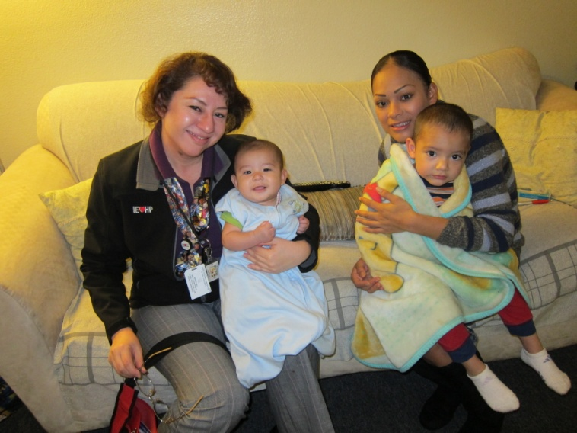
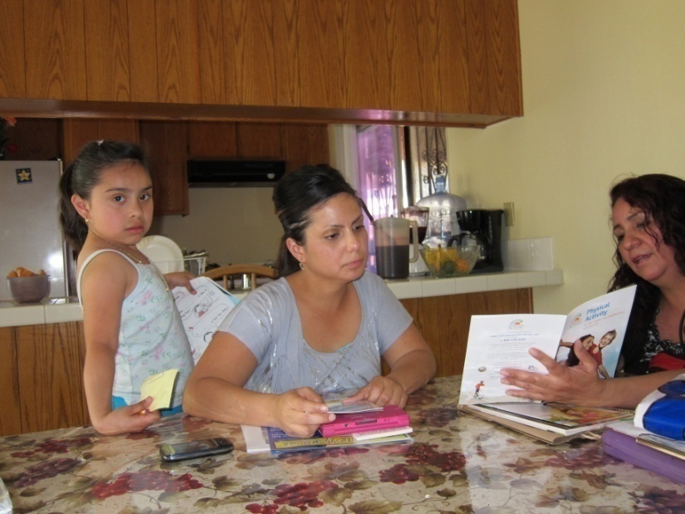
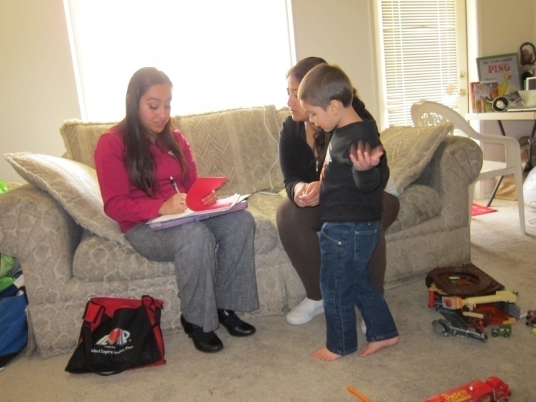
An Inside Look
“ I liked the personal attention at home, it was more clear and I was able to ask questions until I understood.”
“I hope that every IEHP member can take advantage of this program.”
“Thank you for being so persistent, I kept cancelling and forgetting. You still kept calling me.”

Slide 27
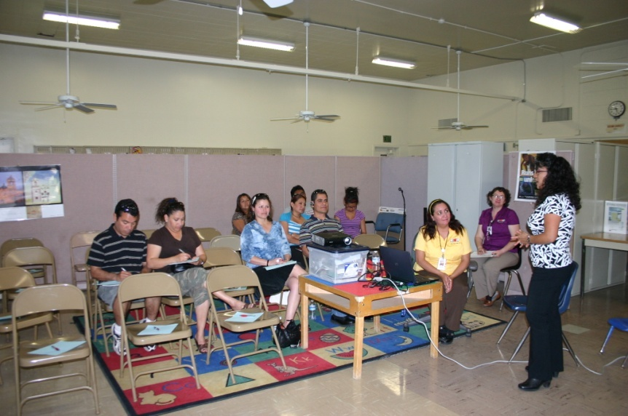
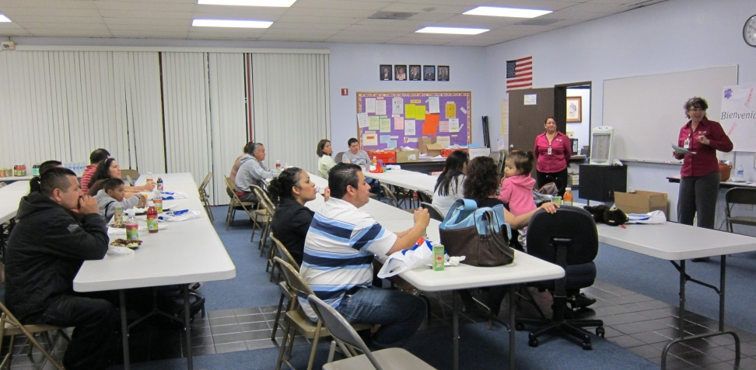
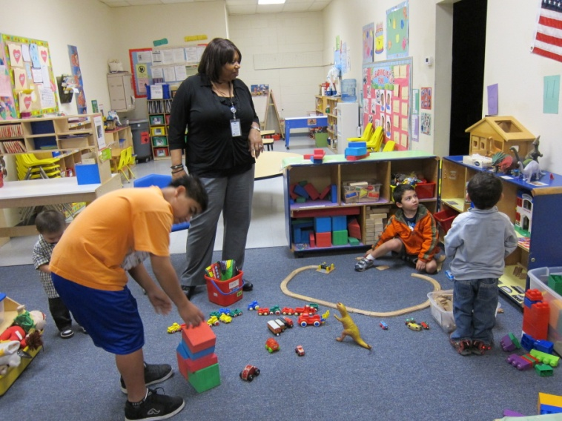
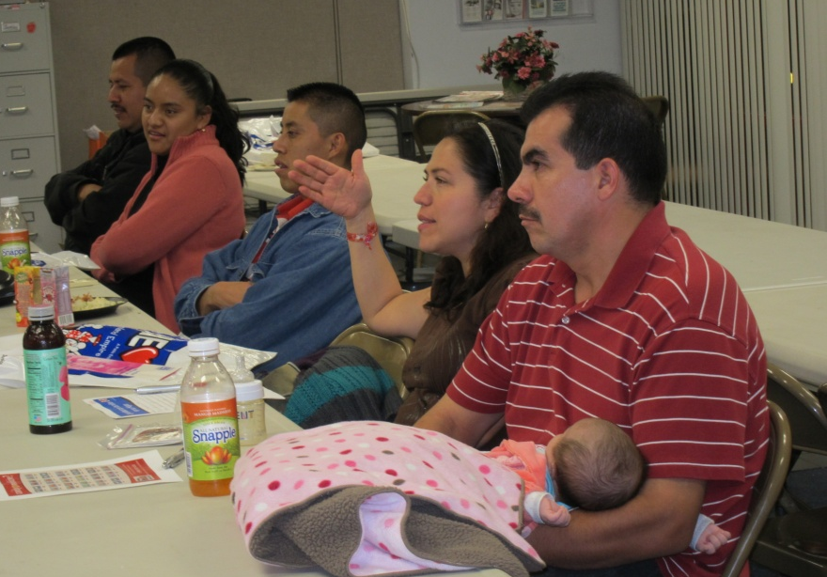
HN Community Classes

Slide 28
IEHP Internal Impact
Reasons the HNs called into Member Services:
MSR and PCP phone numbers were programmed in 560 cell phones/house phones
NAL Phone number - 510
355 PCP visits were scheduled
  238 calls for benefit questions
  229 new ID cards ordered
  91 PCP changes
  86 calls to follow up on referrals
  400Helmets ordered
  95 calls for car seat program
  107calls for asthma program

Slide 29
Utilization Data
Member Utilization | Before | After
Emergency Room | 1,045 | 695
Nurse Advice Line | 207 | 322
Urgent Care | 325 | 588
Well Child / HEDIS
So far, 306 Members received a well child exam following a visit from a Health Navigator
Utilization data based on the family linked to the Member visited by the Health Navigators with a middle visit between 06/15/2010 and 05/31/2011
Rates based on Per 1000 Members

Slide 30
Marci Aguirre, MPH
Director or Community Outreach aguirre-m@iehp.org
Jessica Castillo, BA
Health Navigator Program Manager castillo-j@iehp.org
Contact Info

