Slide 1
UNIVERSAL HEALTH COVERAGE: AN ASSESSMENT OF A NATIONAL HEALTH INSURANCE SCHEME IN A RESOURCE-LIMITED ENVIRONMENT
Dr. Chidi Ukandu
International Health Management Services Ltd
cukandu@ihmsnigeria.com
Dr. David Newlands
Economics Department, Aberdeen University, Scotland, UK
d.newlands@abdn.ac.uk

Slide 2
AIM AND OBJECTIVES
To assess the performance of a National Health Insurance Scheme in achieving Universal Health Coverage in a resource limited environment

Slide 3
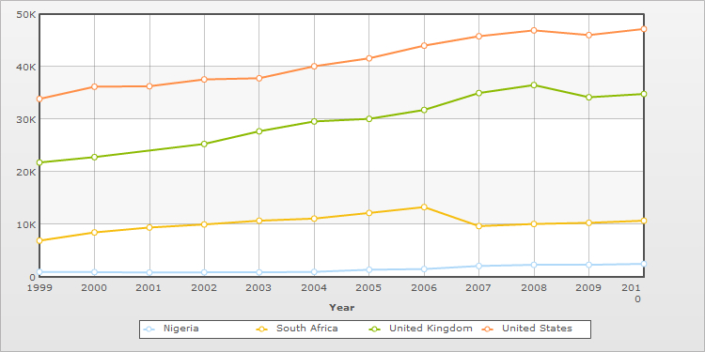
Background
National Health Insurance Scheme (NHIS) initiated in 2005, with the broad objective of achieving Universal Health Coverage for Nigerians by 2015
Initiation of the NHIS is in part a response to the worsening health status of Nigerians and an inadequately funded health system
Nigeria with a population of about 150 million is one of the poorest countries in the world with a GNI per capita of only U$ 2300 (2008) with 70% of the population living below the poverty line (2007)
Fig 1. Comparison of GDP - per capita (PPP) (US$) in four countries

Slide 4
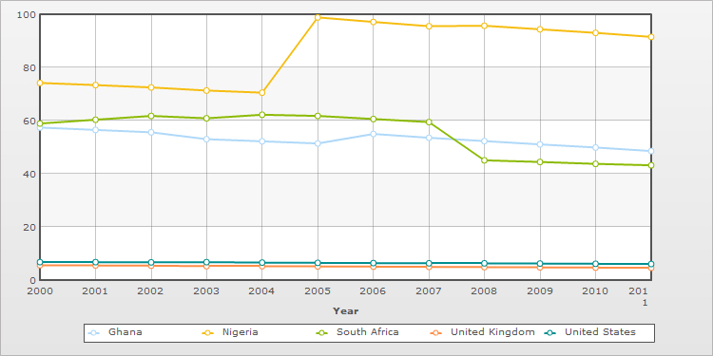
Background
In 2008, Life expectancy was 48 and 49 years for males and females respectively; Infant mortality rate; 99 per 1000 live births and; maternal mortality ratio; 1100 per 100000 live - one of the highest in the world
The general government health expenditure per capita of US$17 was far lower than the US$34 per capita recommended by the WHO commission on macroeconomics and health in 2001
Between 1998 and 2002, households accounted for an average of 64.2 % of total health expenditure while government accounted for only 20.6%
Fig 2: Comparison of Infant mortality rates in four countries
Figure 3: Distribution of total health expenditure (THE) by sources (%)

Slide 5
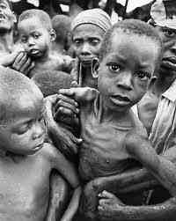
Background
Annual out of pocket expenditures by households on health exceeded $20 per capita and represents one of the largest shares of health expenditure by households in developing countries
4 % of households spent more than 50% of total income on health in 2002 (suggesting that a significant proportion of Nigeria’s population become impoverished as a result of catastrophic expenditures)

Slide 6
Background
Many African countries and other low and middle income countries are introducing social health insurance schemes in an attempt to achieve universal health coverage
Social health insurance schemes allow for the pooling of risks, across rich and poor people and across healthy and ill people
Prepayment protects against catastrophic health spending which results from large out-of-pocket payments

Slide 7
BACKGROUND
Often insufficient understanding of the preconditions for successful social health insurance schemes which high income countries meet but most LMICs do not
  An economy dominated by a formal monetised sector – to facilitate system of income related contributions
  A competent (and honest) bureaucracy – to administer a very complex system of regulators, insurers and providers

Slide 8
BACKGROUND
  Comprehensive, high quality health care services – to ensure that the supply of health care is responsive to the demands made upon it
  High average incomes – to enable cross-subsidy from rich to poor (although donor funds might be used to provide insurance cover for the poor)
These factors interact and are mutually reinforcing

Slide 9
METHODS
Carrin and James (2005) have developed a framework for analysing the progress of social health insurance schemes against twelve process based indicators
The framework assesses the performance of social health insurance schemes in the core health financing functions of revenue collection, pooling and purchasing

Slide 10
METHODS
This framework was extended to include 3 indicators for which data may be readily available:
  scale and coverage of CBHI schemes in rural areas and the urban informal sector
  strength of the health care system as proxied by scale and distribution of human resources for health
  scale of total health expenditure

Slide 11
Carrin and James framework
Function | Performance indicator
REVENUE COLLECTION
Population coverage | % population covered
Method of finance | Ratio prepaid contributions to THE
 | % households with catastrophic expenditure
POOLING
Composition of risk pools | Membership compulsory?
 | Dependents compulsorily insured?
Fragmentation of risk pools | Multiple funds?
 | If yes, risk equalisation measures?
 | Efficiency incentives for risk pools?
PURCHASING
Benefit package | Explicit efficiency and equity criteria?
 | Monitoring mechanisms in place?
Provider payment mechanisms | Incentives to provide appropriate care?
Administrative efficiency | % of expenditure on administrative costs

Slide 12
Additional indicators
Performance indicator | Target/ benchmark | Rationale
COMMUNITY BASED HEALTH INSURANCE SCHEMES
Number of schemes | -
% of informal sector population covered | 25% | Rwanda experience
HUMAN RESOURCES FOR HEALTH
Number of health workers per 1,000 population | 2.5 | Upper limit of low health worker density for delivery of MDGs
TOTAL HEALTH EXPENDITURE
Total health expenditure | $120 | Threshold for increased effectiveness of health care delivery (2001 figure uprated by 50%)
Government health expenditure as % of total government expenditure | 15% | Abuja Declaration

Slide 13
Extended framework for analysis of social health insurance schemes RESOURCE CONSTRAINED ENVIRONMENTS
Function
REVENUE COLLECTION
POOLING
PURCHASING
COMMUNITY BASED HEALTH INSURANCE SCHEMES
HUMAN RESOURCES FOR HEALTH
HEALTH EXPENDITURE

Slide 14
NIGERIA’S NATIONAL HEALTH INSURANCE SCHEME (NHIS)
Established in 2005, with six schemes, covering:
  Formal sector workers
  Urban self-employed
  Rural community
  Children under five
  Permanently disabled persons
  Prison inmates
Presently covers 5.3 million people (3.7% of population)

Slide 15
NIGERIA’S NATIONAL HEALTH INSURANCE SCHEME (NHIS)
Only the formal sector scheme is fully operational and for only some of its intended coverage (civil servants of the federal government)
Contributions are earnings-related; the employer pays 10% while the employee pays 5%
Contributions covers the employee, spouse and four children under the age of 18

Slide 16
NIGERIA’S NATIONAL HEALTH INSURANCE SCHEME (NHIS)
Legally defined benefit package covers basic out- and in-patient care including maternity care and basic/intermediate surgery
Services are provided through a network of registered private and public Health Care Providers (HCPs), including pharmacies, labs and diagnostic centres
Management of the NHIS is by the National Health Insurance Scheme – as regulators and Health Maintenance Organisations (HMOs) – as fund and quality assurance managers

Slide 17
NIGERIA’S NATIONAL HEALTH INSURANCE SCHEME (NHIS)
Currently 63 HMOs and about 8000 registered HCPs
HMOs also offer services in the organised private sector; government is working on making insurance cover compulsory in this sector
Maternal and Child Health Project covers women and children in twelve states (1.6 million in total)

Slide 18
NIGERIA’S NATIONAL HEALTH INSURANCE SCHEME (NHIS)
TISHIP (Tertiary Institutions Social Health Insurance Programme) launched recently
Government plans voluntary CBHI scheme for urban self employed and rural communities for 2011, supported by philanthropists, government and donor agencies

Slide 19
Performance against Carrin and James framework
Performance indicator | Target/benchmark | NHIS
% population covered | 100% | 3.7%
Ratio prepaid contributions to THE | >70% | 30.3%
% households with catastrophic expenditure | OOPs <15% THE | 90.3%
Membership compulsory? | Yes | Yes
Dependents compulsorily insured? | Yes | Yes
Multiple funds? | No/Yes | Yes
If yes, risk equalisation measures? | Yes | Partially
Efficiency incentives for risk pools? | Yes | Yes
Explicit efficiency and equity criteria? | Yes | No
Monitoring mechanisms in place? | Yes | Yes
Incentives to provide appropriate care? | Yes | Partially
% of expenditure on administrative costs | 6-7% | 20%

Slide 20
Performance against extended framework
Performance indicator | Target/ benchmark | Nigeria
COMMUNITY BASED HEALTH INSURANCE SCHEMES
Number of schemes | - | Not known but very few
% of informal sector population covered | 25% | Not known but very small
HUMAN RESOURCES FOR HEALTH
Number of health workers per 1,000 population | 2.5 | 2.3 (2000-09 average) (0.4 physicians; 1.6 nurses and midwives, 0.3 other)
TOTAL HEALTH EXPENDITURE
Total health expenditure | $120 | $59 (2000) $131 (2007)
Government health expenditure as % of total government expenditure | 15% | 6.5% (2007)

Slide 21
KEY FINDINGS
The performance of the NHIS in the core functions of revenue collection, pooling and purchasing has been poor
Population coverage is low
Small prepayment proportions and high out-of-pocket payments suggest that many people are still expending a major part of their income on health care

Slide 22
KEY FINDINGS
The arrangements for risk pooling are not adequately addressed, increasing the likelihood of pool fragmentation
The benefit package does not appear to have been subject to analysis of cost effectiveness or explicit equity criteria
There are high administrative costs although competition among HMOs may drive them down in the long run

Slide 23
Key findings
While some of the limitations of the NHIS are due to its design, they also reflect:
  the limited number of successful CBHI schemes in the urban informal sector and among rural communities on which to build
  ill resourced health care delivery, as indicated by limited human resources for health
  low health care expenditure, partly reflecting low prioritisation of health care by government

Slide 24
Conclusions
Our findings suggests:
That resource constraints may be a limiting factor in achieving universal coverage
That successful CBHI schemes in the urban informal sector and among rural communities may significantly improve chances of attaining universal health coverage in resource constrained environments
That higher prioritisation of health care by governments as evidenced by higher government health care expenditures may increase chances of achieving universal health coverage
That the Nigeria Health Insurance Scheme will benefit from a review of the design especially in the areas of benefit design and risk pooling arrangements

Slide 25
REFERENCES
Carrin, G., Doetinchem, O., Kirigia, J. & Musango, L. 2008, December 3, 2008-last update, Social health insurance: how feasible is its expansion in the African region? [Homepage of International Institute of Social Studies of Erasmus University Rotterdam], [Online]. Available: http://www.iss.nl/DevISSues/Articles/Social-health-insurance-how-feasible-is-its-expansion-in-the-African-region [2009, August 3] .
Carrin, G., Evans, D. & Xu, K. 2007, "Designing health financing policy towards universal coverage", Bulletin of the World Health Organization, vol. 85, no. 9, pp. 652.
Carrin, G. & James, C. 2005, "Key performance indicators for the implementation of social health insurance", Applied Health Economics and Health Policy, vol. 4, no. 1, pp. 15-22.
Carrin, G., James, C., Adelhardt, M., Doetinchem, O., Eriki, P., Hassan, M., van den Hombergh, H., Kirigia, J., Koemm, B., Korte, R., Krech, R., Lankers, C., van Lente, J., Maina, T., Malonza, K., Mathauer, I., Mboya Okeyo, T., Muchiri, S., Mumani, Z., Nganda, B., Nyikal, J., Onsongo, J., Rakuom, C., Schramm, B., Scheil-Adlung, X., Stierle, F., Whitaker, D. & Zipperer, M. 2007, "Health financing reform in Kenya - Assessing the social health insurance proposal", South African Medical Journal, vol. 97, no. 2, pp. 130- Gottret, P. & Schieber, G. 2006, Health financing revisited: a practitioners guide, The World Bank, Washington DC.
CIA World Factbook, 2011
Hsiao, W.C. & Shaw, R.P. 2007, Social Health Insurance for Developing Nations, The World Bank, Washington DC.
FRN 1999, National health insurance scheme decree 1999, Federal Republic of Nigeria, Nigeria.
FRN/NHIS 2005, NHIS operational guidelines 2005, National Health Insurance Scheme, Abuja, Nigeria.
McIntyredle, D. 2007, Learning from experience: health financing in low-and middle-income countries, Global Forum for Health Research, Geneva.
Muiser, J. 2007, The new Dutch health insurance scheme: challenges and opportunities for better performance in health financing, World Health Organization, Geneva.
Preker, A.S., Carrin, G., Dror, D., Jakab, M., Hsiao, W. & Arhin-Tenkorang, D. 2002, "Effectiveness of community health financing in meeting the cost of illness", Bulletin of the World Health Organization, vol. 80, no. 2, pp. 143-150.
Rannan-Eliya, R. 2009, "Strengthening health financing in partner developing countries" in G8 Hokkaido Toyako Summit follow-up -Global action for health system strengthening: policy recommendations to the G8 Japan Centre for International Exchange, Japan, pp. 59-90.
WHO 2002, Mobilization of domestic resources for health: the report of Working Group 3 of the Commission on Macroeconomics and Health., World Health Organization, Geneva.
WHO 2001, Macroeconomics and Health: Investing in Health for Economic Development, World Health Organization, Geneva.
World Bank 2005, Nigeria health, nutrition, and population country status report (in two volumes) volume II: Main report, The World Bank, Washington DC.

Slide 26


Slide 27


