Slide 1

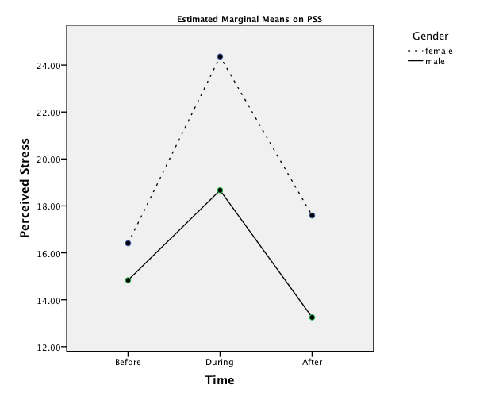
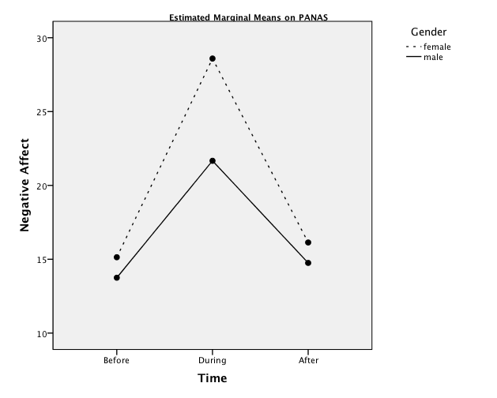
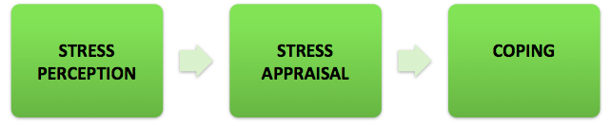
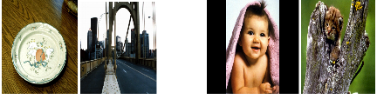
The Role of Gender on Stress Perception
and its Resultant Negative Affect
Irum Abbasi, Greg Feist, Alana Cordeiro, & Latasha Barnwell
San Jose State University
Stress is not considered a mental disorder, but is considered a contributing factor to mental illnesses and is also linked with suicide ideation and depression in young adults (Welle & Graff, 2010). We analyzed a study data to see if there were any gender differences between the stress and negative affect scores in three treatment conditions.
We found that women were generally more stressed during all three conditions, but reported significantly higher stress scores, than men, only during the stress task (t(32) = 2.30, p = .03). Moreover, women reported higher negative affect than males, but this difference was significant only during the stress task, t(32) = 2.22, p = .03.
Based on Dedovic et al. (2009) report that social rejection stressor in women elicits a significant cortisol increase as compared to men; one explanation of why women in our study showed more intense reaction to the stress task may be because the confederate acting as the mock participant and getting negative feedback was a woman and the female participants identified readily with the mock.
Women participants in our study, when compared with men participants, appraised the anticipation of the upcoming stress task as significantly more stressful and coped with it through a significantly higher negative affect.
Previous studies have reported that just the anticipation of an upcoming psychosocial stress task cause a significant free cortisol response in men as compared to women (Kudielka and Kirschbaum,2005).
It is important to note that we cannot compare these findings since we did not measure cortisol levels and we are only basing our results on the reported stress and negative affect scores.
To our knowledge, it was the first study that used only the anticipation of giving a speech and doing mental arithmetic along with the viewing of a poor performance by the mock followed by a critical feedback, as a mean of inducing stress; as opposed to actually making the participants perform. Both manipulation checks (written and oral) confirmed that this laboratory stressor was successful in inducing stress.
—Small sample size
—Unequal no. of males and females
—Sample mostly between 18-20 (91%)
—Possibility of varied levels of stress induced by TSST
—Dissimilar number of participants in each session
—Did not track or block sleep, smoking, and lunch consumption (sleep, smoking, and lunch consumption are all associated with increases in cortisol levels (Hanson et al., 2000).
This study is the result of a collective effort by the authors, Dr. Ronald Rogers, Dr. Clifton Oyamot, and Evan Silverman.
For additional questions regarding the study, please contact
Irum.abbasi@gmail.com.
ABSTRACT
METHODS
RESULTS
DISCUSSION
There is contemporary literature reporting the role of the gender in the stress process. Men and women show different patterns in their resilience to stress and predisposition to stress related diseases. Dysregulation of the stress-hormone is linked with development, onset, and progression of psychological and physical disorders in both men and women. The influence of gender on stress perception and its resultant negative affect was explored in a post-hoc study. In the primary study, the mood of pre-screened college students (N=34, Females = 22, Males = 12), who scored high and low on the neuroticism subscale, was initially neutralized to their respective base level by using neutral pictorial stimuli. Later, their mood and stress perception were manipulated using a laboratory psycho-social stressor. In the end, their mood and stress perception were manipulated again through exposure to positive pictorial stimuli. The results indicated that the female group generally had greater stress and negative affect scores throughout the study, as compared to the male group. Females reported significantly higher stress perception and negative affect during the stress task, than males. The between subject effects revealed a non-significant main effect of gender (across all three treatment conditions) for stress perception and for the negative affect. These results suggest that females, when compared to males, may be more sensitive to the negative stimuli and appraise stressors as more aversive and use emotion focused coping leaving them in a negative mood following a stressor.
Males and females appraise and cope differently to stressful situations. Men are more likely to confront problems directly, deny, or avoid their existence altogether. Whereas, women are more emotional in their responses to stress and therefore seek social support from family and friends (Greenglass, 2002). Although women are more likely to seek social support and use emotion-focused coping, both genders use problem-focused or avoidant coping behaviors at some point (Carver, Scheier, & Weintraub, 1989; Lengua & Stormshak, 2000). Men and women respond to stress differently biologically (Welle & Graff, 2010). Men are more likely to take on the 'flight or fight’ approach. This approach is a biological response to threatening situations by preparing to ‘fight’ with aggressive behavior, or to flee the situation. However, studies have found that women are more likely to use the ‘tend and befriend’ response historically. This response means to protect children and loved ones (tend) and use strengths in numbers (befriend) by banding together when situations get hard (Welle & Graff, 2010).
A human stress hormone axis called the hypothalamic pituitary adrenal (HPA) gets activated under stress and leads to the release of glucocorticoids (cortisol in humans) in the body (Dedovic et al., 2009).
PARTICIPANTS
236 San Jose State University Introductory-Psychology were prescreened.34 participants were included in the main study: 17 high in N (based on a score of 28 +/40) and 17 low in N (based on a score of 18 or lower).22 Females, 12 Males. Age range: 18 to 30 (M= 19.5, SD=2.42).
MEASURES
Partial Big Five Inventory (BFI) (John, Donahue, & Kentle, 1991).15 items including all eight neuroticism subscale items, (e.g., I see myself as someone who is: depressed, blue, can be tense, worries a lot…).
Positive Affect Negative Affect Scale (PANAS) (Watson et al., 1988). 10 positive affect adjectives (e.g., determined, enthusiastic, inspired, strong). 10 negative affect adjectives (e.g., afraid, ashamed, distressed, guilty, nervous). Stressed added as a manipulation check (not scored).
Perceived Stress Scale (PSS-10) (Cohen et al., 1983). Modified PSS scale to get momentary stress perception after each manipulation. Response format was based on a 4-point scales (0 = not at all and 4 = completely).
International Affective Picture System (IAPS) (Lang et al., 1995). Twelve neutral and 12 positive pictures from the international affective picture system (IAPS) were shown for eight seconds each.
Modified Trier Social Stress Test (TSST) (Kirschbaum et al.,1993). Anticipation period. Viewing of a poor performance by the mock participant and the critical feedback from the judges..
PROCEDURE
—Consent form
—12 Neutral pictures
—1st PSS and PANAS
—Modified TSST
—2nd PSS and PANAS
— Cancellation of the TSST
—12 Positive pictures
—3rd PSS and PANAS.
—Debriefing and verbal account of fluctuation in the stress levels.
The data were analyzed using the 2x3 mixed design general linear model (GLM) repeated measures.
For Stress Perception
We found a significant within subjects main effect of time for stress perception (F (2, 64) = 19.19, p < .001, η_{Ρ}²= .38).
GLM tests of between-subjects effects showed a non-significant main effect for gender, F(1, 32) = 4.10, p = .05, η_{Ρ}²= .11.
There was no significant gender by time interaction for stress scores, F(2, 64) = 1.77, p = .18, η_{Ρ}²= .05.
Perceived Stress Scores of Males and Females Participants before, during, and after the Stress Task.
IMPLICATIONS
INTRODUCTION
PSS 1 = Perceived stress score before stress task
PSS 2 = Perceived stress score during stress task
PSS 3 = Perceived stress score after stress task.
For Negative Affect
There was no significant between- subjects main effect for gender, F(1, 32) = 3.11, p = .08, η_{Ρ}²= .09.
We found a significant within subjects main effect for time, F (2, 64) = 35.42, p < .001, η_{Ρ}²= .53.
There was no statistically significant interaction seen between time and gender, F(2, 64) = 2.60, p = .08, η_{Ρ}²= .07.
LIMITATIONS
Normal Biological Stress-Response
Negative Affect Scores of Males and Females Participants before, during, and after the Stress Task.
Psychological Stress Response
ACKNOWLEDGEMENT
EXAMPLES OF NEUTRAL PICTURES EXAMPLES OF POSITIVE PICTURES
Adverse Health Consequence
Continuous strong and negative reactions to stress adversely affect the HPA axis leading to its dysfunction (Zobel et al., 2004) . Chronically elevated cortisol levels are linked to hippocampal damage, which is involved in cognitive functioning and memory consolidation (Jelicic et al., 2003).
NA 1 = Negative Affect score before the stress task.
NA 2 = Negative Affect score during the stress task.
NA 3 = Negative Affect score after the stress task.

