Slide 1
Opportunities and Obstacles in Genetic Counseling Training:
The Philippines’ Experience
Mercy Laurino, MS CGC
Licensed Genetic Counselor
November 2, 2011
APHA 139th Annual Meeting and Exposition

Slide 2
Presenter Disclosures
Mercy Laurino
The following personal financial relationships with commercial interests relevant to this presentation existed during the past 12 months:
“ No Relationships to Disclose ”

Slide 3




URGENT NEED

Slide 4
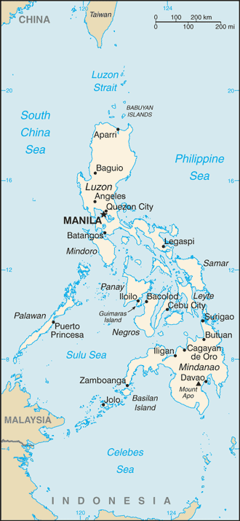
PHILIPPINES
  ~ 92 million people
  ~ 2 million newborns
  5 clinical geneticists
    Birth Defects Surveillance Project
    Telegenetics Project
    Newborn Screening Program
    Philippine Genome Center

Slide 5
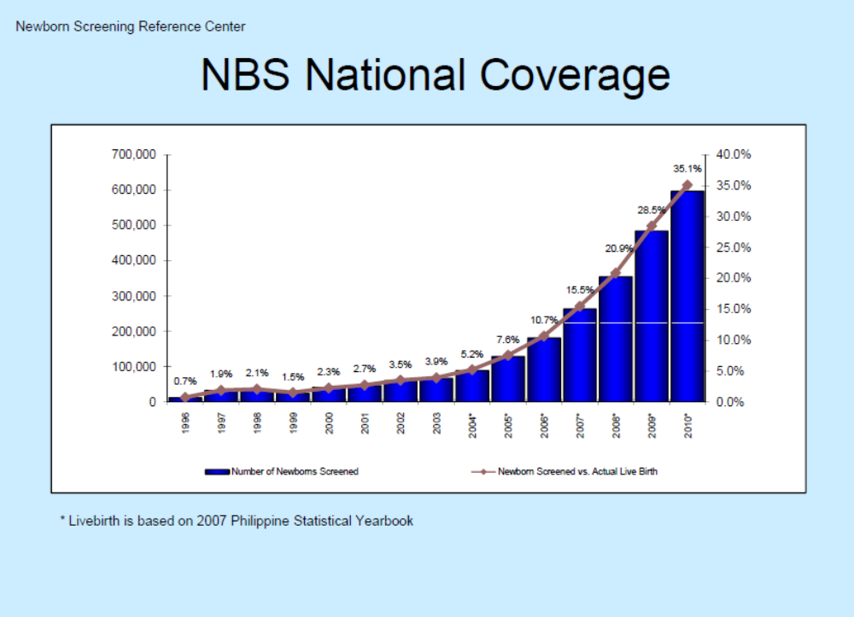
http://www.newbornscreening.ph/

Slide 6
RA 9288 (Newborn Screening Act of 2004)
IRR Rule 1 Sec 8e: “Once patient is located, the newborn with confirmed diagnosis shall be referred for treatment and management to a duly licensed physician or a medical specialist such as but not limited to neonatologist, pediatric endocrinologist, and geneticist. Prompt management of newborn with positive screen is essential to prevent the debilitating consequence or death of the newborn.
IRR Rule 111 Sec 13h: “Ensure that a network of health facilities for referral and management of all positive cases is established.”
IRR Rule 111 Sec 13j: “Develop referral center and identify referral teams in strategic areas for referral and management of patients with any of the disorders.”
http://www.doh.gov.ph/ra/ra9288.html

Slide 7
The training of students to become competent genetic counselors serve a vital role in the access, delivery, and expansion of medical genetics in the Philippines and in Southeast Asia.

Slide 8
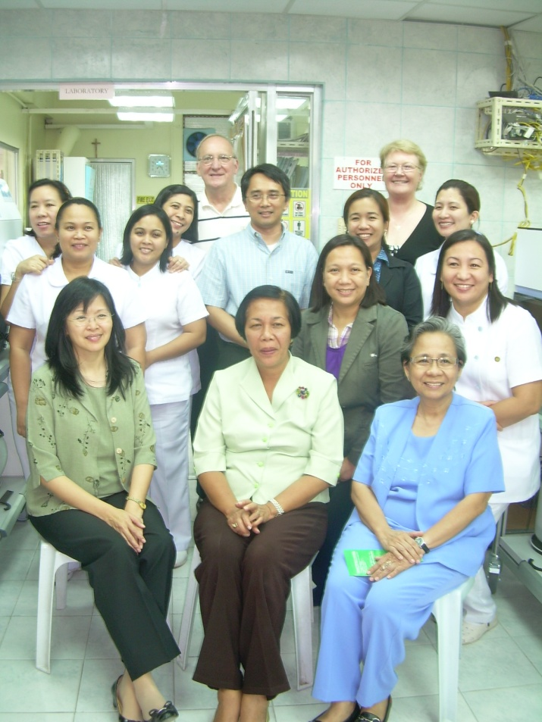

2007 - American Society of Human Genetics Meeting, San Diego
Carmencita Padilla, MD MAHPS
Director, Institute of Human Genetics, NIH
Director, Newborn Screening Program
Professor, Department of Pediatrics, University of the Philippines Manila
College of Medicine

Slide 9

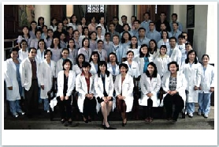
IHG Celebrated It's 10th Year Anniversary
The Institute of Human Genetics (IHG) of the National Institutes of Health, University of the Philippines Manila, the largest provider of genetic services in the country, celebrated its 10th year anniversary (1999-2009) last February 23-26, 2009.
Services
Cytogenetics
Molecular
Biochemical
Clinical Services
Newborn Screening
http://www.humangenetics.com.ph/

Slide 10
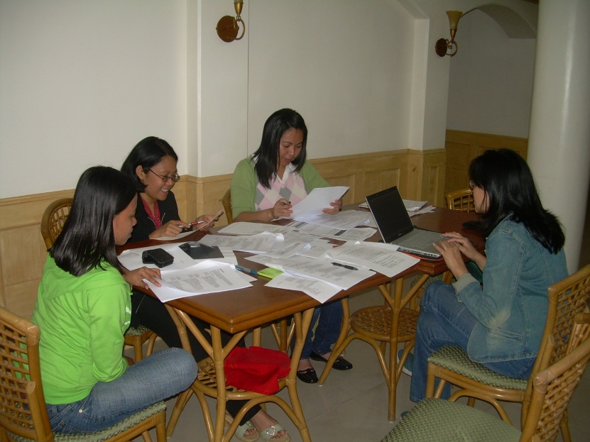
Curriculum Development – 2009

Slide 11


Advocacy and student recruitment
At least 81 job positions (1 per province) available

Slide 12
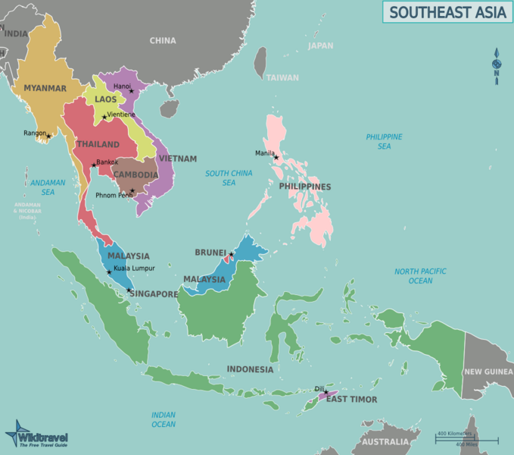
Strategic Vision
1999 – Institute of Human Genetics (Manila)
  Fellowship in Medical Genetics
June 2011- Genetic Counseling Training Program
20 ? – Philippine Society of Medical Genetics
20 ? – Philippine Society of Genetic Counselors
http://wikitravel.org/en/Southeast_Asia

Slide 13
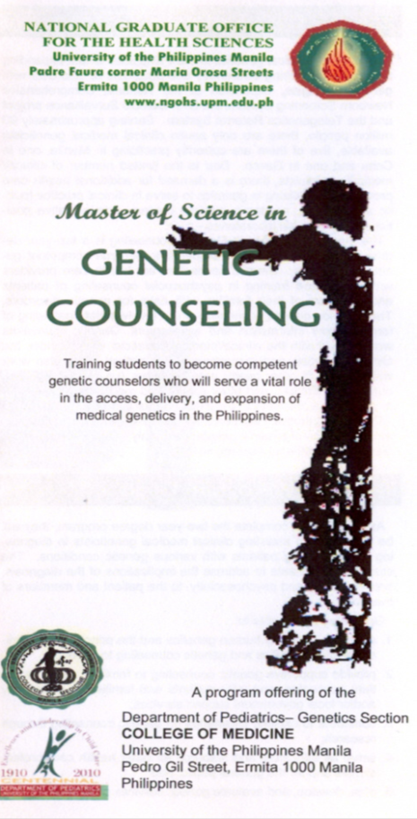
University of the Philippines Manila
January 2011 –
Board of Regents approval

Slide 14
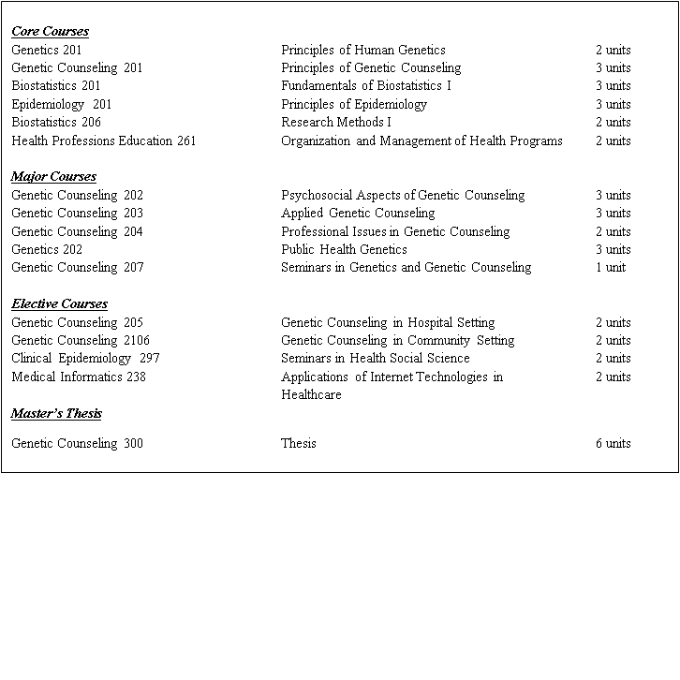
Curriculum – two years, 37 units
http://ihg.upm.edu.ph/

Slide 15

Clinical Rotation Sites
Cancer clinics
General (Pediatric) clinics
Metabolic clinics
Inpatient clinics
Newborn Screening Centers
Prenatal Clinics
Community Support Groups
http://www.psod.org.ph

Slide 16
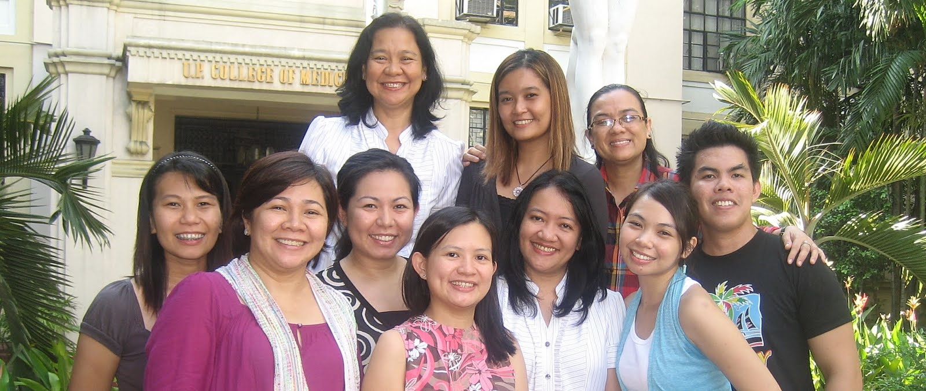
Pioneer Genetic Counseling Students
National Graduate Office For the Health Sciences, University of the Philippines Manila
Phone: (+632) 526-5870, 523-1495
Fax: (+632) 523-1498
Email: ngohs@post.upm.edu.ph
Website: www.ngohs.upm.edu.ph

