Slide 1
Youth Encouraging Success (Y.E.S)
Speaker : Vantasia Joe
Dr. Lena Hatchett

Slide 2
History
The Proviso Action Committee is a community coalition designed to promote positive youth development through local policy change in Proviso Township.
Youth-led : independent arm of the Proviso Action Committee
Established in 2008
Dr. Lena Hatchett, Barbra Cole and two youth who wanted to empower youth to succeed in their life
Location : Stritch School of Medicine at Loyola University
Notes:
Given the challenge of engaging and sustaining youth in the collaborative process

Slide 3
MISSION
The mission of YES is to encourage young adults ages 14 to 18, who are disenfranchised socially and politically to achieve their goals
Empower young adults to change their lives and empower themselves.
Implement change in the lives of individuals by increasing awareness of self image.
Notes:
We want youth to recognize who they are in today's world.

Slide 4
Goal 2011
For youth to realize that they are defined through character and not the opinion of others.
youth -led peer education program designed to increase awareness of self-identity
encourage self-development among disenfranchised high school youth aged 14-18.

Slide 5
Community: Maywood-Broadview- Bellwood (Illinois)
Challenges
Opportunities
Violence, Gangs, Crime
Drug & Alcohol usage
Inadequate Village Services
Only one local Boys and Girls Club
Limited youth activities
Men Women and Youth mentoring program
Vegetable Garden in which youth can participate
Famer’s Market
Proviso United with Loyola Students for Education Enrichment (PULSE)
Y.E.S
Notes:
Explain my community ………

Slide 6

Identity
The issue of Identity in the context of race, class, age, and gender.
What does Identity means to you?
Y.E.S goal is for youth to recognize who they are in society and that they shape their own identity.
A Person debating what their identity means to them.
Source : http://online-identity-theft.net/online-identity-theft/11-7-million-persons-reported-identity-theft-victimization-in-2008
Notes:
Mention the Four Colored Girls

Slide 7
Can you define Identity ?
A person’s true character.
Who you are when no one is looking.
Our identity is our distinct voice within a crowd.
Shapes the society we live in and our culture.
Various characteristics which makes up an individual.
Notes:
Ask the audience what does Identity represent to them ? This is great, interactie

Slide 8

Advertisements
Goal – Drug and Alcohols
Year 2009-2010

Slide 9

Y.E.S Flyers for promoting events

Slide 10
We the generation: impact 2010
Drugs & Alcohol – 2009-2010
Youth Summit
Presenters
Speakers
Open Mic
Spoken Word
Group Discussion
Speaker discussed their life dealing with drugs and alcohol
Encourage students through Rap, Poetry and spoken word
Communicate and connect with the youth in the community
Notes:
Use the creative titles

Slide 11
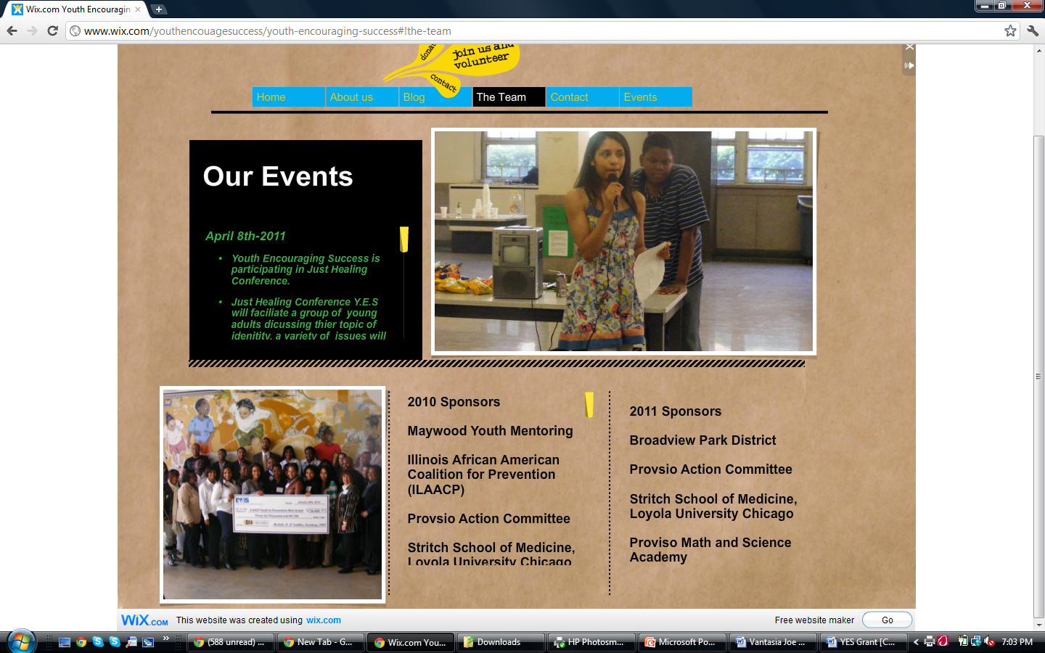
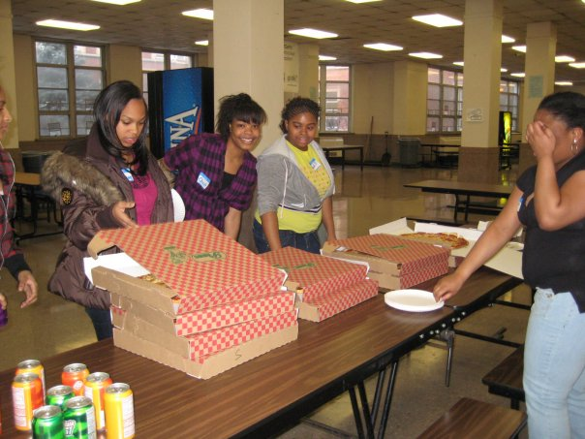
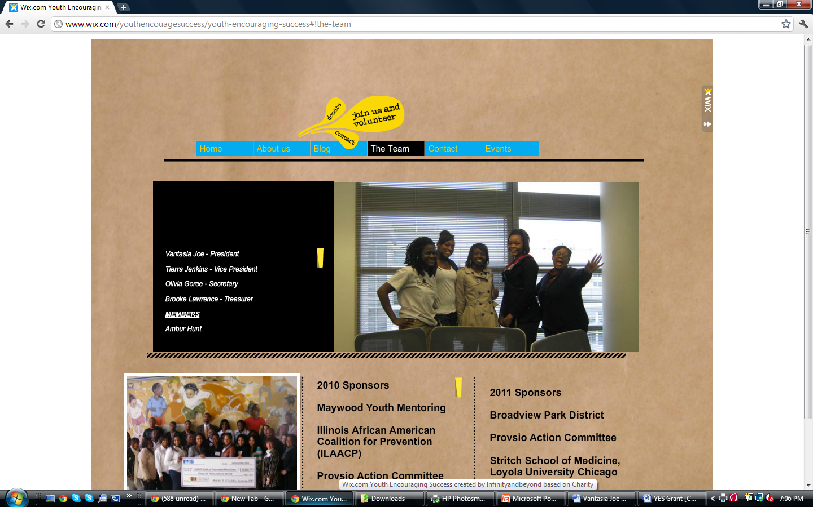
Members
Youth Encouraging Success Members in 2011 and youth in the community

Slide 12
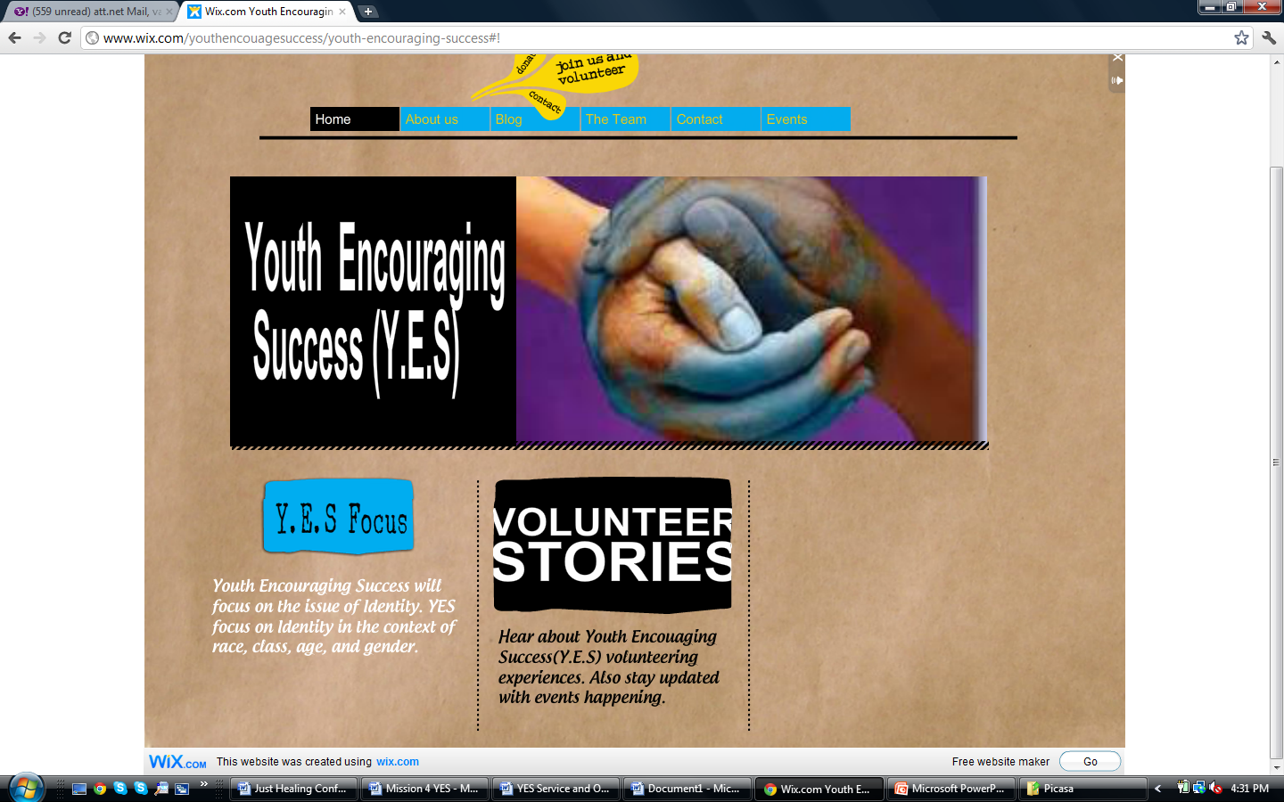

Youth Encouraging Success (Y.E.S)
Website : http://www.wix.com/youthencouagesuccess/youth-encouraging-success
Notes:
This is the screen shot of Y.E.S website. Spend five minutes showing everyone these.

Slide 13
Sponsors 2011
Broadview Park District
Proviso Action Committee
Stritch School of Medicine, Loyola University Chicago
Proviso Mathematics and Science Academy

Slide 14
Current Events
Where
Audience Response
Christ King High school
Location : South side of Chicago, IL
Perform a Skit
Typical Barbie
Objectives : Open Youth minds, grasp their attention on issue of Identity
Shared what identity represented to themselves
Informed us about their community
How identity impacted their school
Felt a lack of identity expression
Notes:
Add title of skit, objective of skis

Slide 15
Y.E.S Projects
Just Healing Conference
Walking for The Answers
YES team walked to raise funds for autism and developmental disorder awareness
Broadview Park District Build Day
Help build a park with volunteers in the community.
Notes:
Dates not needed,

Slide 16
Future Projects
Camping trips
Help Building a park
One on one conversation
youth -led peer education program groups
Taking youth out of their comfort zone
Allowing them to find themselves

Slide 17
Gain Youth
Connecting with them on a personal level
Communicating effectively
Relating life events to their personal lives
youth -led peer education program
Self Development

Slide 18
Contact Information
Website Youth Encouraging Success (Y.E.S) http://www.wix.com/youthencouagesuccess/youth-encouraging-success
Vantasia Joe
Vantasia.Joe@marquette.edu
Dr. Lena Hatchett
Lhatchett@lumc.edu

Slide 19
Thanks
Any Questions

