Slide 1

Civility versus Incivility –
Strategies to Promote a
Healthy Workplace Community
Patricia M. Schoon, MPH, RN, PHN
Cynthia Lee Dols, MN, RN, PHN
APHA 2011

Slide 2
Presenter Disclosures
Patricia M. Schoon
Cynthia Lee Dols
The following personal financial relationships with
commercial interests relevant to this presentation
existed during the past 12 months:
No relationship to disclose.

Slide 3

Objective
One
Identify the barriers to developing and maintaining a healthy workplace community.

Slide 4
Socialization of the
Nursing Workforce
Personal Life Experiences
First Professional Degree
First Year of Professional Employment
Role Expectations
and
Performance

Slide 5
Socialization of
Nursing Workforce
Academic
  Students report experiencing and/or observing interpersonal abuse
  Students of color report being alienated
Clinical
  Students report experiencing and/or observing interpersonal abuse between and among staff, students, preceptors, clinical faculty
Workplace
  Primary reason new grads leave acute care is interpersonal abuse in the workplace

Slide 6
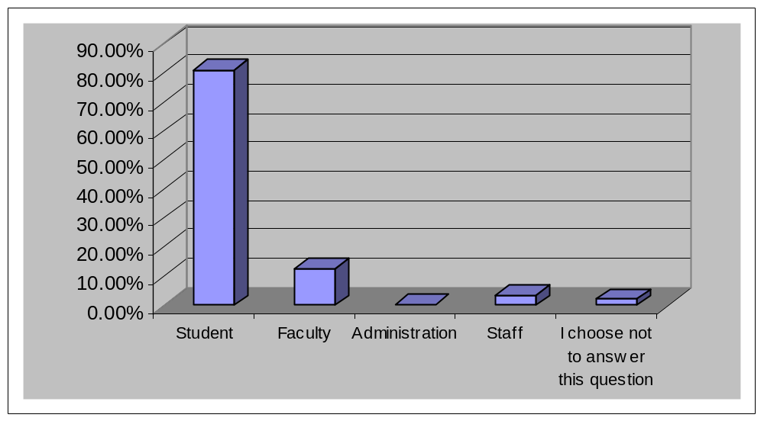
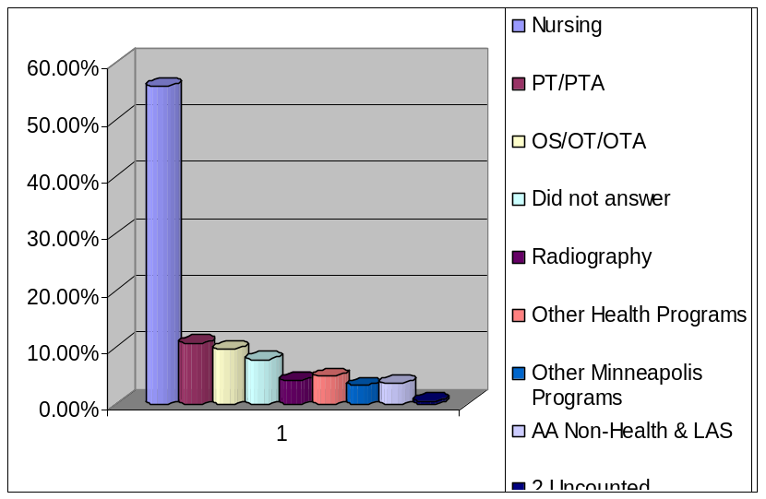
Example of Incidence of Interpersonal Abuse in the Academic Environment
?w2222222
411
N = 534
RR = 35%
Question: Who has experienced or observed interpersonal abuse?
65
18
2
11
Schoon & Dols, 2007 Survey of Health Professions Departments at a Private Midwestern University, unpublished

Slide 7
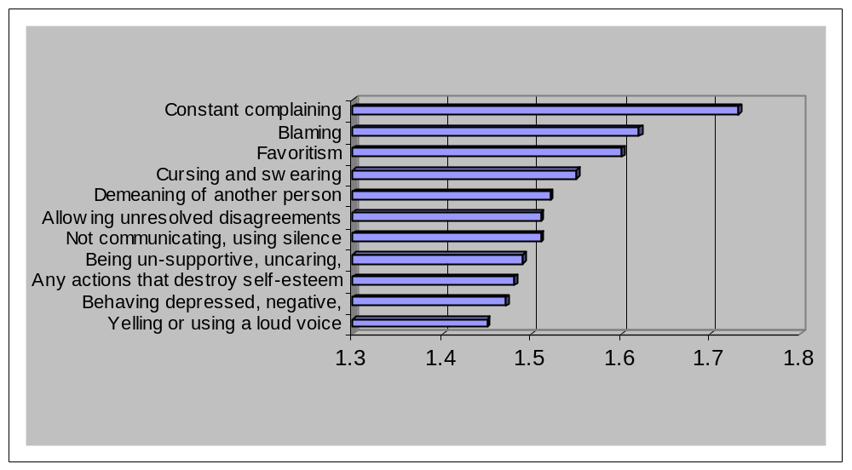
Most Common Abusive Behaviors Reported
Mean
Schoon & Dols, 2007

Slide 8
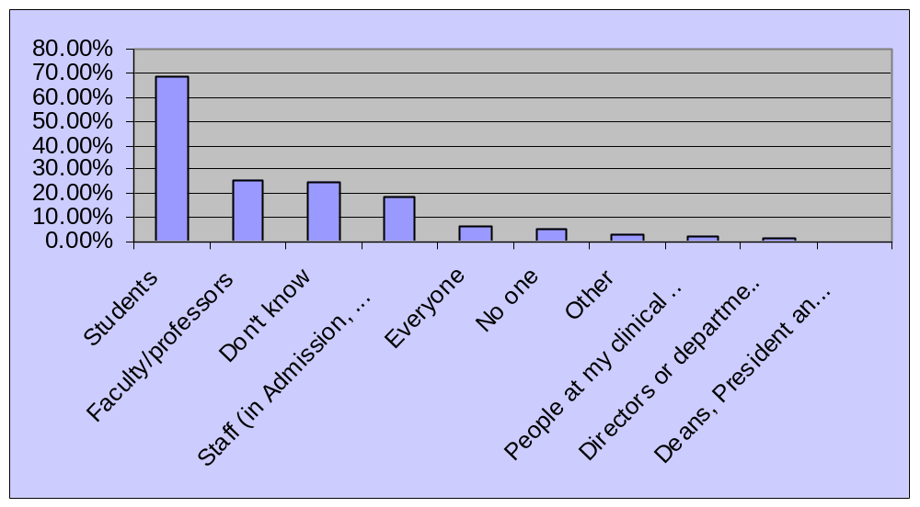
Who is the most victimized?
N = 517
Schoon & Dols, 2007
Respondents selected up to 3 choices

Slide 9
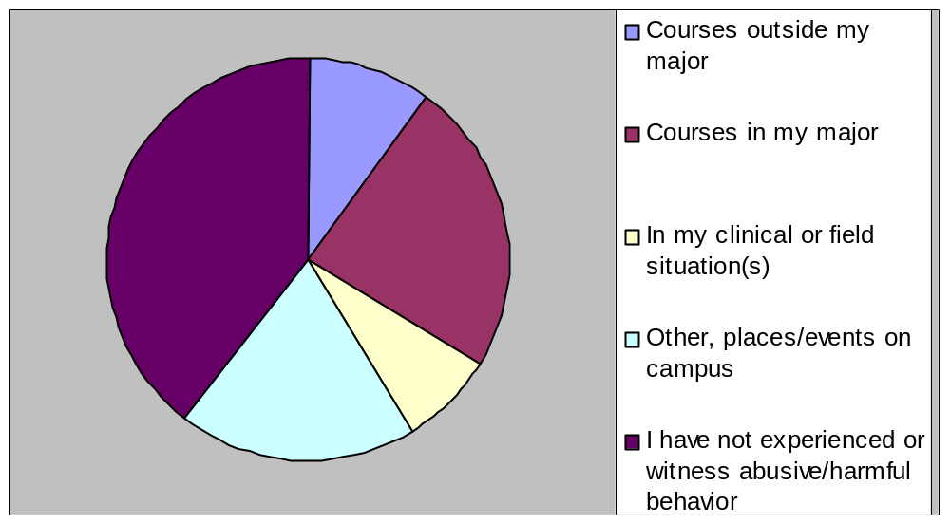
Where Student Abuse Occurred
N = 415
9.6 %
39.3 %
24.1 %
7.7 %
19.3 %
Schoon & Dols, 2007

Slide 10
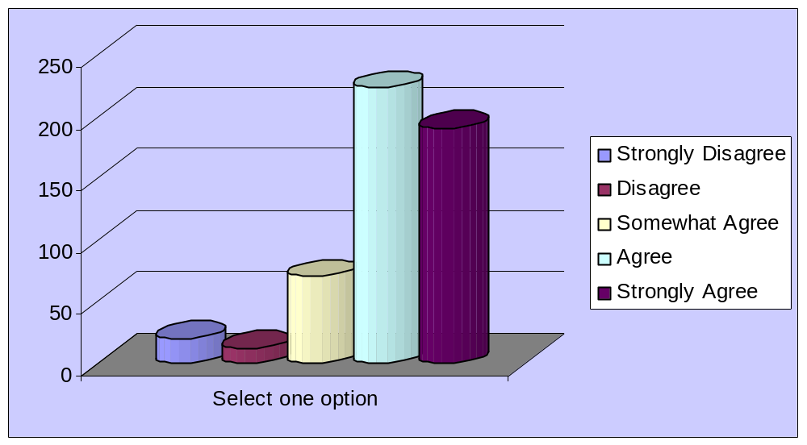
I am in a safe learning environment
80% feel safe
20% don’t feel safe or are not sure
224
191
70
20
12
N = 517
Schoon & Dols, 2007

Slide 11
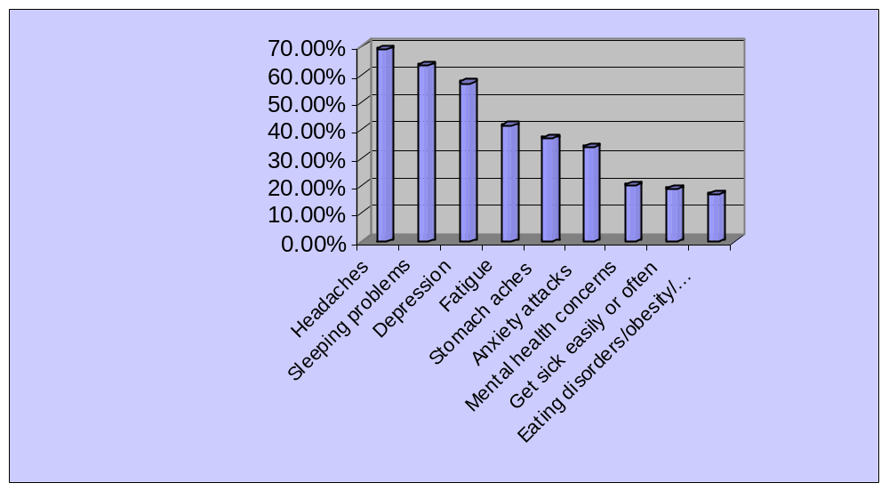
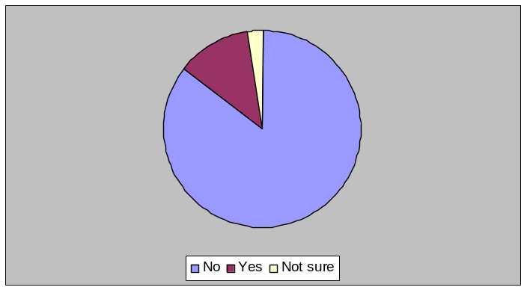
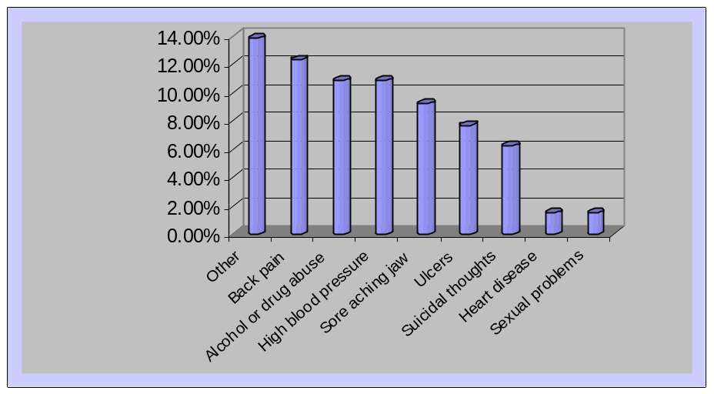
Have you experienced medical problems related to abusive/harmful behaviors?
Top 9
Medical
Problems
12.5 %
Yes
N = 65
85.6% No
Range = 11 = 45
N = 521
Schoon & Dols, 2007
N = 65
Range 1-9

Slide 12
Prior Work Experience in Acute Care
90% of health care workers report experiencing or observing harmful behaviors at work
      Olson, 2007
27 – 85% of nurses report being bullied or harassed or experiencing incivility
      Cleary, 2007; Hutton, 2008
30 – 60% of new grads change employment locations within the first year
      Bowles & Candela, 2005; Delaney, 2003

Slide 13
Victimization and Revictimization in Workplace Violence
Incivility & bullying victimization
Shame
Anger
Self-blame
Self-attack
Revictimization
Hostile workplace
Felblinger, 2008

Slide 14
Common Examples of
Workplace Incivility
Exclusion from important work activities
Taking credit for another’s work
Refusing to work collaboratively
Interrupting others
Disrupting meetings
Discounting input from others
Berating workers on e-mail
Failing to share credit for collaborative work
Withholding important information
Yelling, screaming, verbal attacks
Emotional tirades, angry outbursts
Overt temper tantrums
Gossiping
Name-calling
Condescending speech, rudeness
Spreading rumors
Inability to empathize
Damaging coworker’s reputation
Felblinger, 2008

Slide 15
Contemporary Stresses in
Public Health Nursing Practice
Severe feeling of powerlessness because not able to measure efficiency of PHN practice
  Grumbach et al, 2004
Work overload
  Lee & Wang, 2002; MacDonald & Schoenfeld, 2003
Colleagues negative attitudes due to changing external environment and inadequate administrative support
  Lin, 2000

Slide 16
Major Stressors in
Work Environment
Change and Complexity
Lack of Support
Reduction in Funding and Staffing
Interpersonal Abuse and Incivility

Slide 17

Objective
Two
Describe the leadership, collaboration, and communication skills required to create and maintain a healthy workplace community.

Slide 18
Leadership
Organizational Leadership:
Leadership directed at carrying out the mission and goals of an organization…
Transactional Leadership: Leadership that focuses on immediate needs; meets day-to-day functional needs of organization
  Schaffer, Garcia, & Schoon, 2011, 282
Shared Leadership: Leadership initiatives shared by a team working together to achieve common goals
  Alvolio, Walumbwa, & Weber, 2009
Servant Leadership: Leadership that starts with serving others and leads when it is the best way to serve others…
  Swearingen & Liberman, 2004

Slide 19
Entry-Level PHN Leadership Skills
Seeks learning opportunities
Works independently; autonomous in practice
Willing to work in an unstructured environment; tolerates ambiguity
Seeks consultation and support
Takes initiative; is a self-starter
Adapts to change
Is willing and able to respond to population needs
Demonstrates flexibility
Contributes to team efforts
Prioritizes and organizes workload, time, materials and resources
  Henry Street Consortium, 2003

Slide 20
Collaboration
Best practices
Working together “to achieve a common goal through enhancing the capacity of one or more of the members to promote and protect health.”
Keller, Strohschein, Lia-Hoagberg, & Schaffer, 2004, 456
Effective leadership
Commitment of the participants
Shared values and a sense of purpose
Linkages between groups and individuals
Identification of strategies and resources to achieve the goals, a structure to support the collaborative work
Internal systems to support the structure (i.e. communication mechanisms, a place to meet, time available in assigned workload
Schaffer, Garcia, & Schoon, 2011, 116

Slide 21
Effective Communication
Essential Skills
Using silence
Reassuring
Expressing appreciation
Using humor
Conveying acceptance
Asking related questions
Attending
    Kelly, 2011, 207
Responding
Clarifying
Confronting
Supporting
Focusing
Open-ended questioning
Providing information

Slide 22

Objective Three
Discuss the organizational attributes necessary to develop and maintain a healthy workplace community.

Slide 23
Organizational Culture of Support for Public Health Nursing Practice
Staff-, Team-, Supervisory-Level Leadership
Program- and Management-Level Leadership
Administrative- Level Leadership
Entry-level PHN
Schoon in Schaffer et al, 2011, Figure 13.1, 295

Slide 24
Organizational Structures that Support PHN Practice
Organization
Staff
Supportive organizational culture
Good management practices
Clear organizational vision
Flexibility in funding, program design and job descriptions
Strong leadership that promotes public health, values their staff’s work and invests in education and training
Share vision and goals of organization
Work collaboratively and autonomously in creative atmosphere
Need flexible funding and management support to work with community and team members
Need more access to CE, policies, evidence, and debriefing sessions to sustain competencies and confidence
Underwood et al, 2009

Slide 25
Organizational Culture and Job Satisfaction in PHN
Increase in vertical and horizontal decision-making opportunities correlated with increased job satisfaction
Enjoyment in work, autonomy, flexibility, scheduling, benefits, and low job stress correlated with “intent to stay”
Job would be more satisfying with increased pay, increased management feedback and staff recognition, more input into decision-making, more role clarity
      Campbell, Fowles, & Weber, 2004

Slide 26

Objective
Four
Identify strategies to promote a healthy workplace community.

Slide 27
Three Approaches to Changing the Socialization Process in PHN
Conquering Operational Space to Overcome Chaos and Insecurity in Students
  Three Phases
  Positioning, Involving, Integrating
      Hjalmhult, 2009
Work Unit Transformation to Welcome New Grads
  Selecting Seasoned Staff as Preceptors
  Preceptor Training
  Cohort Specific Goals and Work Plan
      Halter et al, 2011
Empowerment-Based
Educational Program for
PHNs
  Dimensions of Cognitive Empowerment Model
  Meaningfulness, Competence, Choice, and Impact
  Participation in 3-Stage Method
  Listening to others
  Dialogue to analyze problem
  Create action plan
      Chang et al, 2008

Slide 28
Creating a Culture of Civility
Increase awareness of civility issues and stimulate call to action
Create institutional framework that identifies expected behaviors
Define program and process that makes framework of civility operational
  Lower, 2007
Build trust in the new system so issues can be discussed and resolved
Provide education and development
Maintain momentum until actual change of culture occurs
Create external support and collaboration with professional organizations

Slide 29
Creating a Healthy Work Environment
Principles
Management Actions
Caring, collaboration, and teamwork as cornerstones
Empower staff and victims
Promote respectful staff relationships
Target potentially problematic behaviors before they escalate
Realistic workload grounded in respect and cooperation
Clear and honest communication
  Assess workplace relationships and environment
  Role model and champion respectful behavior
  Establish healthy unit culture
  Create zero tolerance
  Acknowledge unhealthy behaviors and situations
  Address staff concerns and workplace stressors
  Establish and publish standards for staff cooperation and communication
Modified from Cleary et al, 2009

Slide 30
Effective Change Process in Private Midwestern University
Use an action research approach that involves the total organization in identifying the healthy and unhealthy components in the organizational culture.
Create a caring culture that is consistently reinforced from “top down” and “bottom up” with commitment from all.
Involve everyone at all levels in the organization in the action research process and action response process.
Embed the process in the ongoing work of the organization.
Develop community connections with health care organizations to create mutual solutions.
Schoon & Dols, 2011

Slide 31
Planning for Success in Private Midwestern University
Policy Development
  Transparency
  Clear
  Equitable Policies
  Adherence
  Follow through
Openness
  Honest self-evaluation
  Identifying challenges
  To Change
100% Engagement
Committed Core
Communication

Slide 32
Setting the Ground Rules
Agency
Academic
Peer-to-peer
PHN-to-supervisor and supervisor to PHN
PHN to work team
PHN to clients/community
Student-to-student
Student-to-faculty/staff
Faculty-to-student
Faculty-to-faculty
Faculty-to-staff

Slide 33
Process
Identify behaviors that are healthy (not stories but one to two words [i.e. respect] and everyone has input
Identify behaviors that are harmful
Identify how individual(s) want to be approached
Modeling healthy behaviors and how to address unhealthy behaviors
Education at all levels on conflict management

Slide 34
Community Level
Conferences for Community Partners and University
Consultation
Institution Level
Diversity of Core Team (Roles, Culture, Ethnicity, Gender)
Team membership included in performance review
Student-Faculty Level
Posters (words – healthy and unhealthy)
Education & development about horizontal & vertical violence
Sharing survey results with everyone
Collaboration
Resource Sharing
Providing & sharing interdisciplinary & departmental tools
Partner with Human Resources and Administration
Resource List for Support and Counseling (phone & electronic)
Team part of academic load
Professional Presentations
Classroom behavior identification activities (beginning of course)
Creating pamphlet for students and faculty (separate) – guide for how to work in teams
“Climatalog” provides examples of collaborative team activities to promote healthy
Strategies for Success
& Sustainability

Slide 35
Lessons Learned
Ongoing Journey
Change does not occur overnight
  Time
  Energy
  Commitment
THINGS CAN IMPROVE!
Climate of the organization impacts:
  workforce recruitment and retention
  student recruitment and retention
  quality and productivity of everyone’s
  work
  EVERYTHING!

Slide 36
Presenter Contact Information
Patricia M. Schoon, MPH, RN, PHN
Adjunct Associate Professor
Saint Mary’s University of Minnesota
Distance Clinical Instructor, University of Wisconsin Oshkosh
871 Mendakota Court, Mendota Heights, MN 55120 (home)
Phone: 651-452-5337 (home); 651-335-5337 (cell)
Email: patschoon@gmail.com
Cynthia Lee Dols, MN, RN, PHN
Associate Professor
Department of Nursing
Henrietta Schmoll School of Health
601 25th Avenue South
Minneapolis, MN 55454
Phone: 651-690-7720
Email: cldols@stkate.edu
Contact Pat Schoon if you
would like references
for any of the citations.

