Slide 1

Preparing Nursing Students for PHN Practice in the 21st Century
APHA Annual Meeting, October 31, 2011
Washington, D.C.
Patricia M. Schoon, MPH, PHN
Saint Mary’s University of Minnesota
University of Wisconsin Oshkosh
Carolyn Garcia, PhD, RN, University of Minnesota
Marjorie Schaffer, PhD, RN, Bethel University

Slide 2
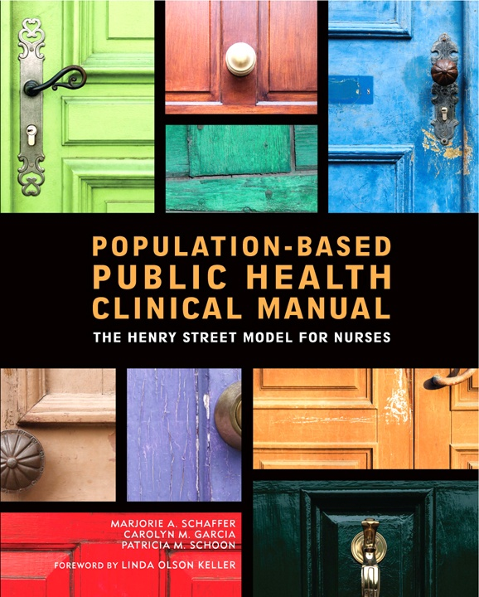
Disclaimer – Conflict of Interest
This presentation is based on the outcome of a collaborative project that produced a clinical manual for PHN that has been published and is being sold by Sigma Theta Tau International.
Each of the three authors receive 3.33 % of profits after the first 2000 copies of the manual are sold.

Slide 3

Objective One
Discuss the educational challenges for preparing BSN graduates for 21st century PHN workforce.

Slide 4

Public Health Nursing Workforce Needs…
United States Population ~ 310,238,239
Number of Nurses ~ 3,000,000
Estimated number of PHNs ~ 40,000 PHNs
PHNs comprise ~21.3% of local health department staff
1 in 75 US nurses is a PHN
One PHN for every 7756 persons
Data from Linda Olson Keller

Slide 5
Proportion of Nurses by Initial Education in Nursing 2008
20.4%
34.2%
Highest Educational Preparation in 2010
13.9% Diploma
36.1% ADN
36.8% BSN
13.2% Master’s or Doctorate
AACN, 2011
45.4%
HRSA, 2010

Slide 6

Why Does
Education Matter?
Communication
Epidemiology & Biostatistics
Community/Population Assessment
Community/Population Planning
Policy Development
Assurance
Health Promotion & Risk Reduction
Illness & Disease Management
Information & Healthcare Technology
Environmental Health
Global Health
Human Diversity
Ethics & Social Justice
Coordinator & Manager
Emergency Preparedness, Response, & Recovery
What knowledge and competencies are required for entry into public health nursing practice?
Quad Council Competencies
ACHNE Baccalaureate Nursing Essentials

Slide 7
U.S. Population Diversity 2010
Race, Ethnicity & Gender | Registered Nurses | U.S. Population | Disparity
White Non-Hispanic | 83.2% | 65.1% | + 18.1%
Black, African-American (Non-Hispanic) | 5.4% | 12.9% | - 7.5%
Asian/Pacific Islander/Native Hawaiian (Non-Hispanic) | 5.8% | 4.8% | + 1.0%
Hispanic/Latino | 3.6% | 15.8% | - 12.2%
American Indian/Alaskan Native | 0.3% | 1.0% | - 0.7%
Two or More Racial Backgrounds | 1.7% | 1.7% | 0.0%
Males | 6.2% | 47.3% | - 41.1%
Schoon, P. (2011). Ch. 7, Population-Based Health Care Practice, in Kelly,
Nursing Leadership & Management (3rd Ed.), Table 7-2, 171.

Slide 8
Percent of Students Enrolled in Baccalaureate Nursing Programs in 2008 by Race, Ethnicity & Gender
How are we doing?
Students | Enrolled | US Population
Minority | 26% | 34.9%
White | 74% | 65.1%
Male | 10.6% | 47.3%

Slide 9

Educational Challenges in
PHN Curriculum
Lack of clinical sites
Variability of clinical sites
Faculty shortage
Scarce resources for faculty/agencies
Increasing student populations
Student differences in learning styles, interests & needs
Variety of nursing programs, pathways
Curriculum squeeze

Slide 10
Photovoice Example:
Themes…
Differences | PHN Clinical | Hospital-based Clinical
Setting | Variety: Local public health department School Homeless shelter Correctional facility | Hospital unit; location does not change.
Hours | Can be flexible, for example participating in a weekend health fair, or evening education program. | Shift assigned is set.
Student cohort | Variable- Together at start of day or not at all Separate throughout clinical (assigned to PHN schedule) | Generally, start and end shift together. On same unit so can take breaks together.
Assignments | Community assessment Journaling/reflection Project-dependent | Direct patient care Journaling/reflection Charting
Faculty | Spread over multiple sites. Might have space assigned in the partnering agency May be unable to directly supervise | One unit Works within available unit space Often able to directly supervise

Slide 11
Content
Process
Context
Competence

Slide 12
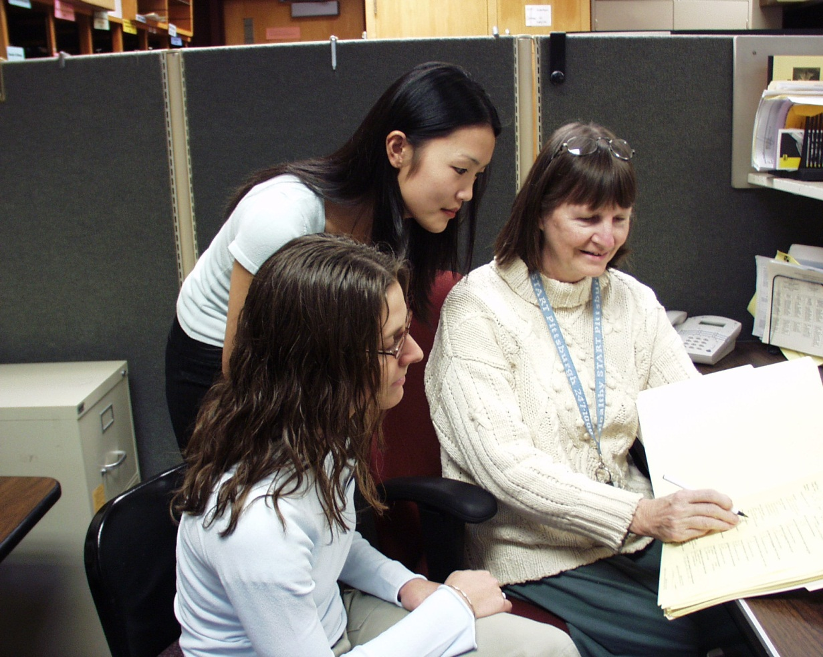
Objective Two
Describe the advantages of a competency-based approach to PHN clinical experiences.

Slide 13
Responding to Students’ Diverse Learning Styles and Needs
Student Characteristics and Needs
Teaching-Learning Strategies
Diverse Student Population
Competing Roles and Responsibilities
Looking for Meaning
Committed Scholar
Disengaged Learner
Difficulty Translating Knowledge and Theory
into Practice
Student Centered Learning
Focused Meaningful Learning
Relevant Real-Time Learning
Evidence-Based Practice
Foster Active Learning and Reflective Practice
Guide by the Side versus Sage on the Stage
Clinical Based Learning Model

Slide 14
Need to Provide a Variety of Learning Activities to Engage Students
Meeting Diversity of Student Learning Style Needs
Providing Diverse Opportunities for Developing Entry-Level Public Health Nursing Competencies
Providing Clarity of Written and Verbal Information for Students with English as a Second Language
Pique Student Interest
Provide for Student Choice
Cognitive
Domain
Affective Domain
Psychomotor Domain

Slide 15
to address these challenges…
In response to needs of educators, and
In response to needs of clinicians, public health departments
We formed a consortium comprised of public health nursing educators and practitioners…
…The Henry Street Consortium

Slide 16
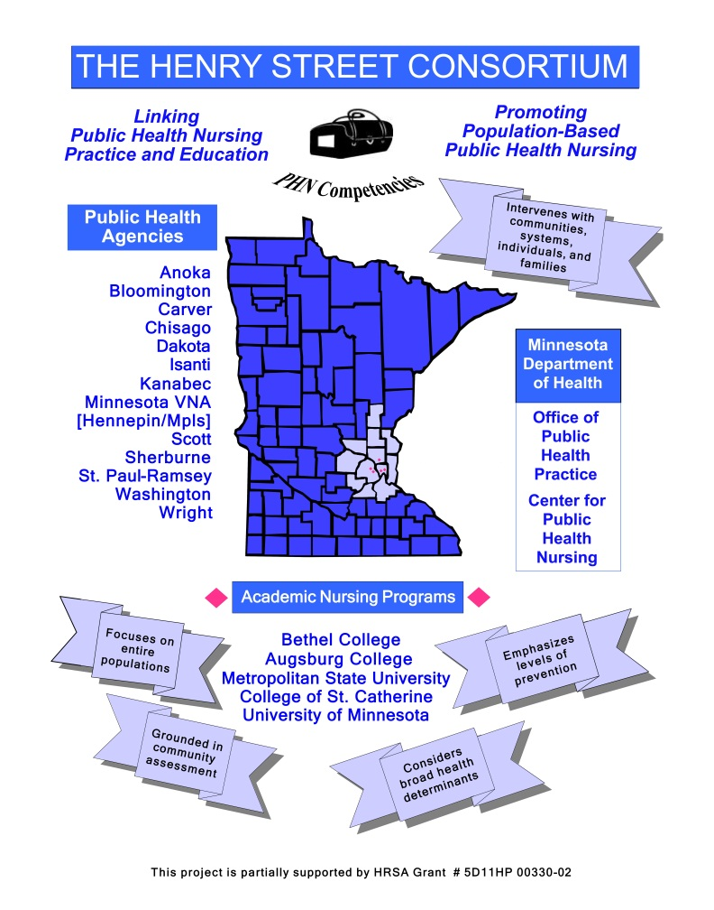
The Henry Street Consortium
2002 - 13 agencies and 5 nursing programs receiving funding to develop model for academic-practice collaboration to prepare public health nursing workforce for 21st century
  Developed set of entry-level competencies based on national standards
  Developed clinical guidelines and clinical menu as communication and planning tools for PHN faculty, agency preceptors, and students
2010 - 16 agencies and 8 nursing programs
  Developed evidence-based practice action-oriented clinical manual to provide guidance to faculty, agency preceptors, and students in the teaching-learning process for developing entry-level competencies.
Context – Competence – Process

Slide 17
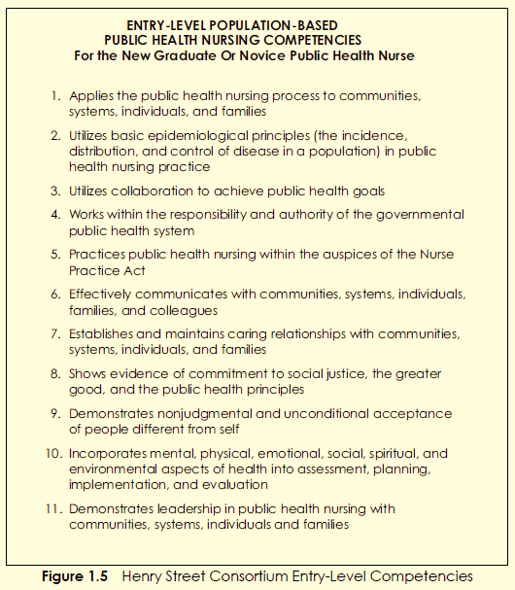

Henry Street Consortium 2003
Based on Nationally Accepted Public Health Frameworks & Standards
QUAD Council
Council on Linkages
American Nurses Association
Core PH Functions Steering Committee
Schaffer, Garcia, and Schoon (2011)

Slide 18
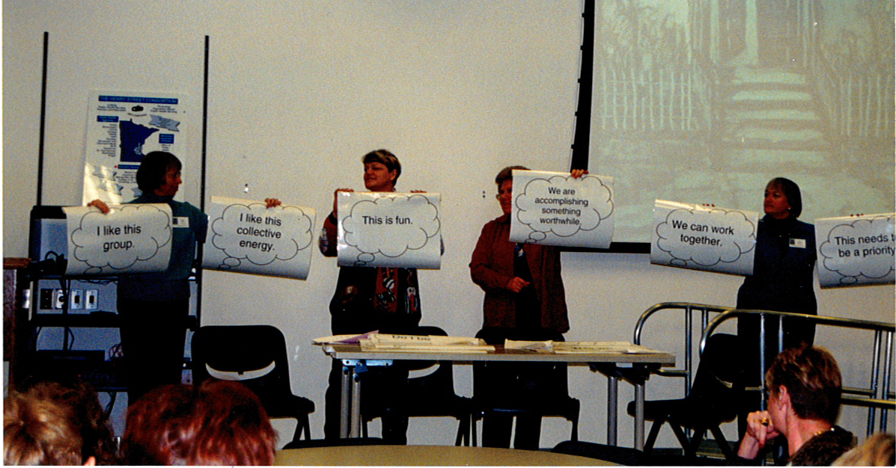
Focusing on clinical practice needs produced cohesion and commitment

Slide 19
So we wrote a clinical manual
Provides a staff orientation and development resource for agencies with new or novice PHNs
Provides agency preceptors with a versatile resource when working with students from a variety of academic programs
Provides agency staff with opportunity to influence what is taught based on their real world day-to-day experiences
Provides practicing PHNs an opportunity to share their expertise with academic faculty and students.

Slide 20
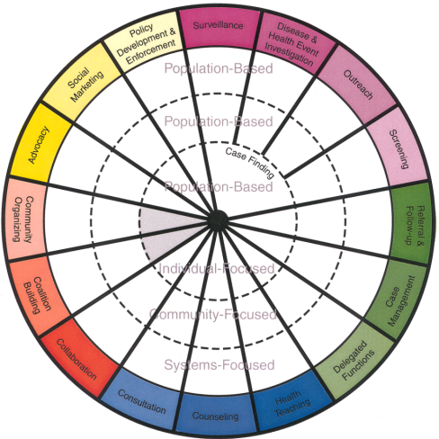
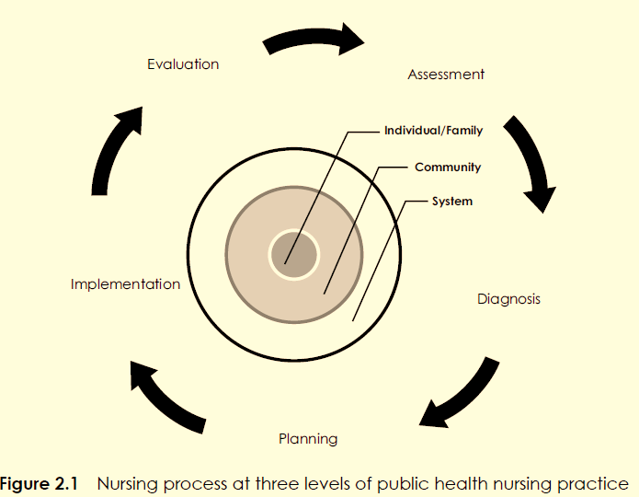
The Manual:
Applying PHN Process at all Levels of PHN Practice ~ A competency-based approach
Schaffer, Garcia, & Schoon, 2011, p. 24.
Minnesota Department of Health, 2001

Slide 21
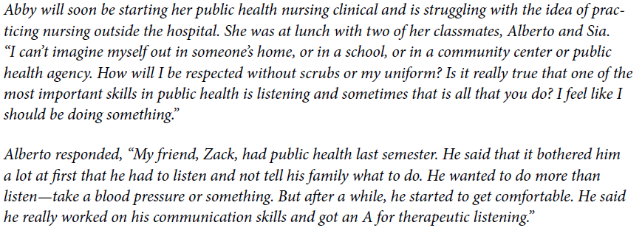
The Manual: Starts where students are, using case studies & storytelling
Chapter 1: Foundational Concepts for Public Health Nursing Practice,
Schaffer, Garcia, & Schoon, 2011, p. 3.

Slide 22
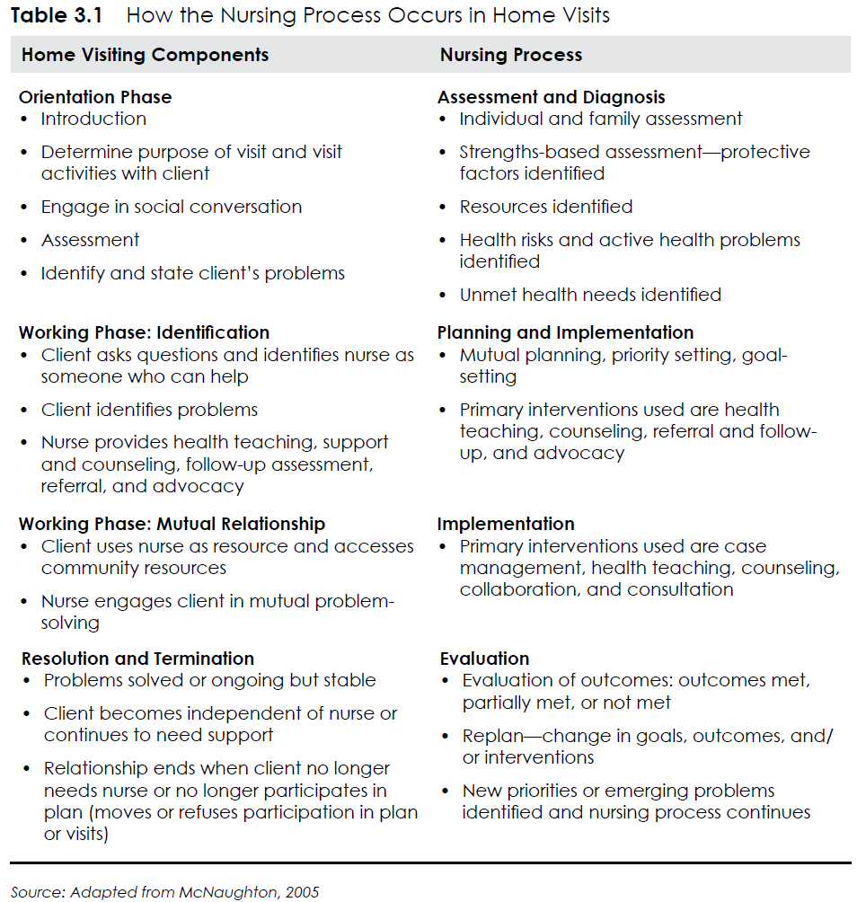
The Manual: Facilitates Linkages
Adapted from McNaughton, 2005
Competency 1: Applies the Public Health Nursing Process to Communities, Systems, Individuals, and Families Schaffer, Garcia, & Schoon, 2011, p. 59.

Slide 23
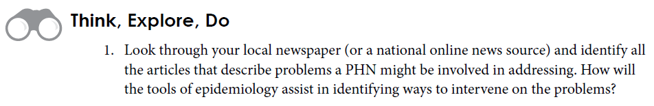

The Manual: Offers Tangible
Learning Activities
Competency 2: Utilizes Basic Epidemiological Principles (the Incidence, Distribution, and Control of Disease in a Population) in Public Health Nursing Practice, Schaffer, Garcia, & Schoon, 2011, p. 112.
Notes:
Useful for new, inexperienced faculty too!!!!

Slide 24

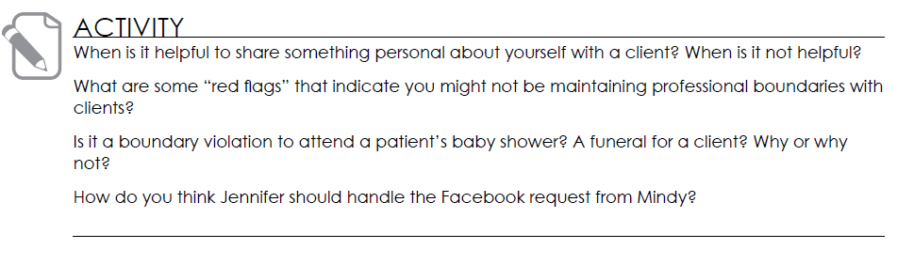
The Manual: Encourages Reflective Practice
Applying Ethical Principles
Competency 5: Practices Public Health Nursing Within the Auspices of the Nursing Practice Act, Schaffer, Garcia, & Schoon, 2011, pp. 163 and 164.

Slide 25
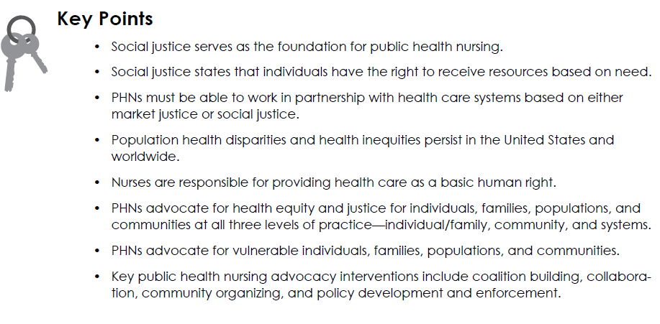
The Manual:
Encourages Synthesis
Competency 8: Shows Evidence of Commitment to Social Justice, The Greater Good, and the Public Health Principles, Schaffer, Garcia, & Schoon, 2011, p. 237.

Slide 26


Contextual competency-based clinical education engages students and provides meaning
Engaging Students in the Real Work of the Community to Improve Population Health
Facilitates Student Achievement
of Population-Based
Entry-Level PHN Competencies

Slide 27

Objective Three
Identify the benefits of an evidence-based clinical approach to educating public health nursing students

Slide 28
Effective doing is based on knowing, which starts with curiosity.
Use of evidence facilitates the process of translation of evidence to practice.
Awareness of evidence demonstrates that public health nurses can make a difference.
Evidence provides a scientific foundation for selection, use, and evaluation of interventions.
Using evidence facilitates use of the nursing process.

Slide 29
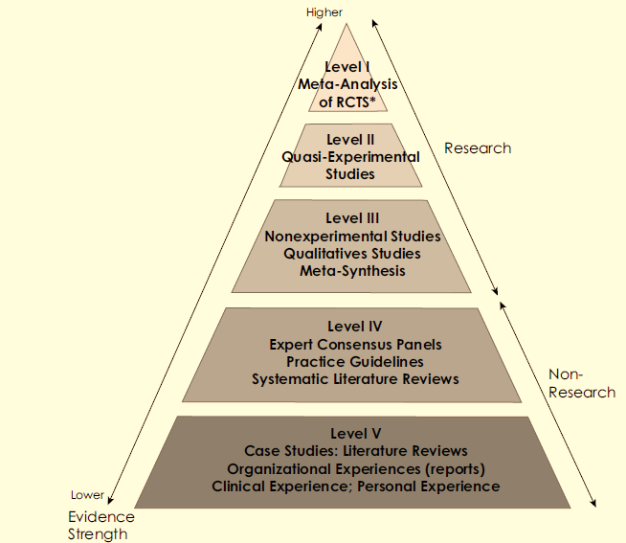
Manual: Uses all Levels of Evidence
Research Evidence
- Levels I, II, III
Practice Guidelines
- Level IV
Case Studies, PHN Agency
Experiences & Reports,
Student & PHN Clinical
Experiences
- Level V
Figure 2.3 Modified from Johns Hopkins Nursing Evidence-Based Practice Model and Guidelines, Newhouse et al., 2007; Keller & Strohschein, 2009; by Schaffer, Garcia, & Schoon, 2011. p. 37.

Slide 30
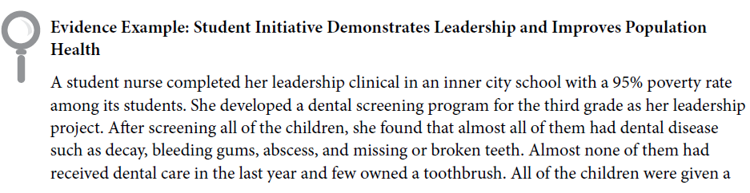
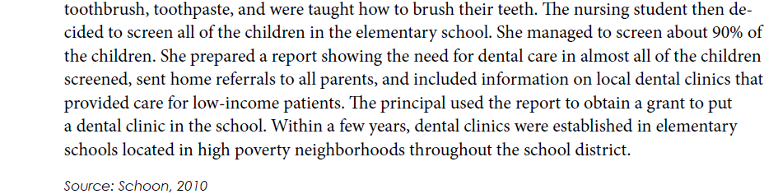
The Manual: Exposing Students to Evidence-based Practice
Showing How Students Make A Difference
Competency 11: Demonstrating Leadership in Public Health Nursing with Communities, Systems, Individuals, and Families, Schaffer, Garcia, & Schoon, 2011, pp. 291 – 292.

Slide 31
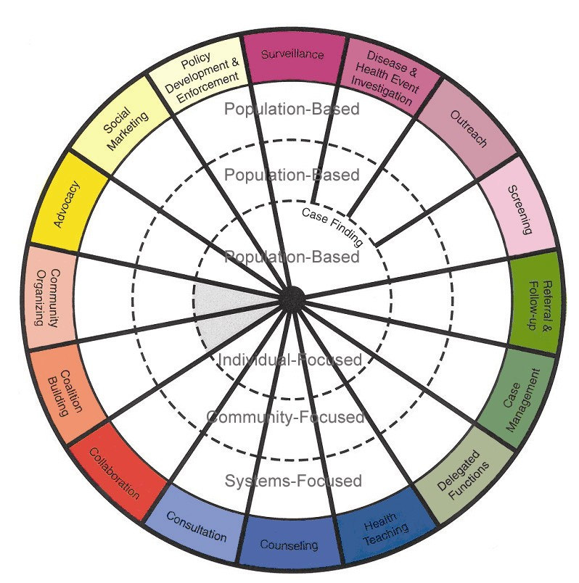
Manual: Uses Public Health Intervention Wheel
Evidence-based practice interventions at all levels of practice:
  Individual-focused
  Community-focused
  Systems-focused
Stresses both independent and collaborative practice
Minnesota Department of Health, 2001
E2 Evidence Exchange, www.publichealthnurses.org

Slide 32
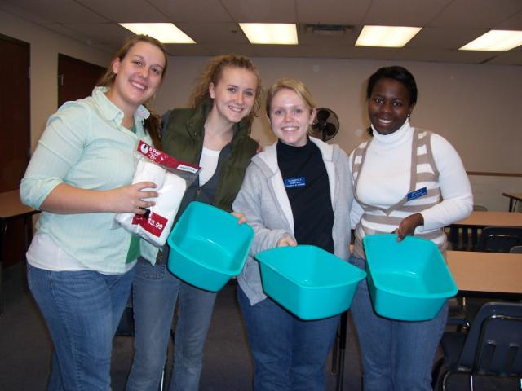
Ensure all competencies are addressed prior to graduation.
More relevant and effective preparation for entry into the PHN workforce.
Encourages practice-evidence linkages.
Facilitates identifying and addressing gaps in existing curriculum.
Benefits of Competency-Driven,
Evidence-Based PHN Education

Slide 33
PHN Clinical Education ~
Are we encouraging…
…Thinking?
…Processing?
…Thinking?
…Processing?
…Reflecting?
Thinking
Processing
Reflecting
Linking
Applying
Critiquing
Practicing
Passion?
Competency-driven,
Evidence-based,
Consistent with practice standards,
and with 21st century population health and workforce needs?
Is the curriculum…

Slide 34

Are we Preparing
Public Health Nursing Leaders
Who will Advocate for Population Health?

Slide 35
References
Keller, LO, Schaffer, MA, Schoon, PM, Brueshoff, B., & Jost, R. (2011). Finding common ground in public health nursing education and practice. Public Health Nursing, 28(3), 261-270.
Schaffer, MA, Cross, L., Keller, LO, Nelson, P., Schoon, PM, & Henton, P. (2010). The Henry Street Consortium population-based competencies for educating public health nursing students. Public Health Nursing, 28(1), 78-90.
Schaffer, MA, Garcia, CM, & Schoon, PM. (2011). Population-Based Public Health Clinical Manual – The Henry Street Model for Nurses. Indianapolis, IN: Sigma Theta Tau International.
The Henry Street Consortium. (2003). Entry Level Population-Based Public Health Nursing Competencies. Minnesota Department of Health. Retrieve from: http://www.health.state.mn.us/divs/cfh/ophp/consultation/phn/henrystreet/docs/core_competencies.pdf or search public health nursing at http://www.health.state.mn.us/index.html

Slide 36
Contact Information
Marjorie A. Schaffer, PhD, RN
Professor of Nursing
Bethel University
3900 Bethel Drive
St. Paul, MN 55112
651-638-6298
m-schaffer@bethel.edu
fax: 651-635-1965
Carolyn Marie García, PhD, MPH, RN
Assistant Professor
NIH K12/BIRCWH Scholar
School of Nursing
5-140 Weaver Densford Hall
308 Harvard Street SE
Minneapolis, MN 55455
612-624-6179
garcia@umn.edu
Patricia M. Schoon, MPH, RN, PHN
Adjunct Associate Professor
Graduate and Professional Programs
Saint Mary’s University of Minnesota
Distance Clinical Instructor
University of Wisconsin Oshkosh
871 Mendakota Court, Mendota Heights, MN 55120
651-452-5337 (home) / 651-335-5337 (cell)
patschoon@gmail.com

