Slide 1
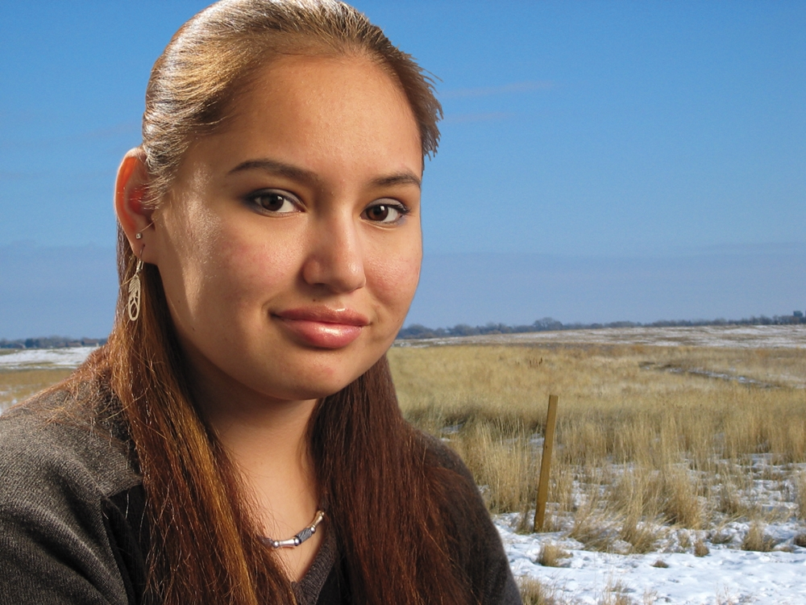
Ethical Conduct of Comprehensive Diabetes Control:
Organ Donation Education in American Indian Communities
“Through it all, I kept my
faith in Lakota.”
American Public Health Association
Session 3375, Monday, Oct. 31, 2011
Nancy L. Fahrenwald, PhD, RN
Associate Professor & Associate Dean for Research
College of Nursing, South Dakota State University
1

Slide 2
Presenter Disclosures
Nancy L. Fahrewnald
The following personal financial relationships with commercial interests relevant to this presentation existed during the past 12 months:
“No relationships to disclose”

Slide 3
Acknowledgments:
HRSA, Div. of Transplantation
#R39OT01211
#R39OT07542
NIH, NIGMS R25 GM62002
South Dakota Lion’s Eye Bank
Community Advisory Council
Woope Claymore
Cheyenne River, Lakota Sioux Tribe

Slide 4
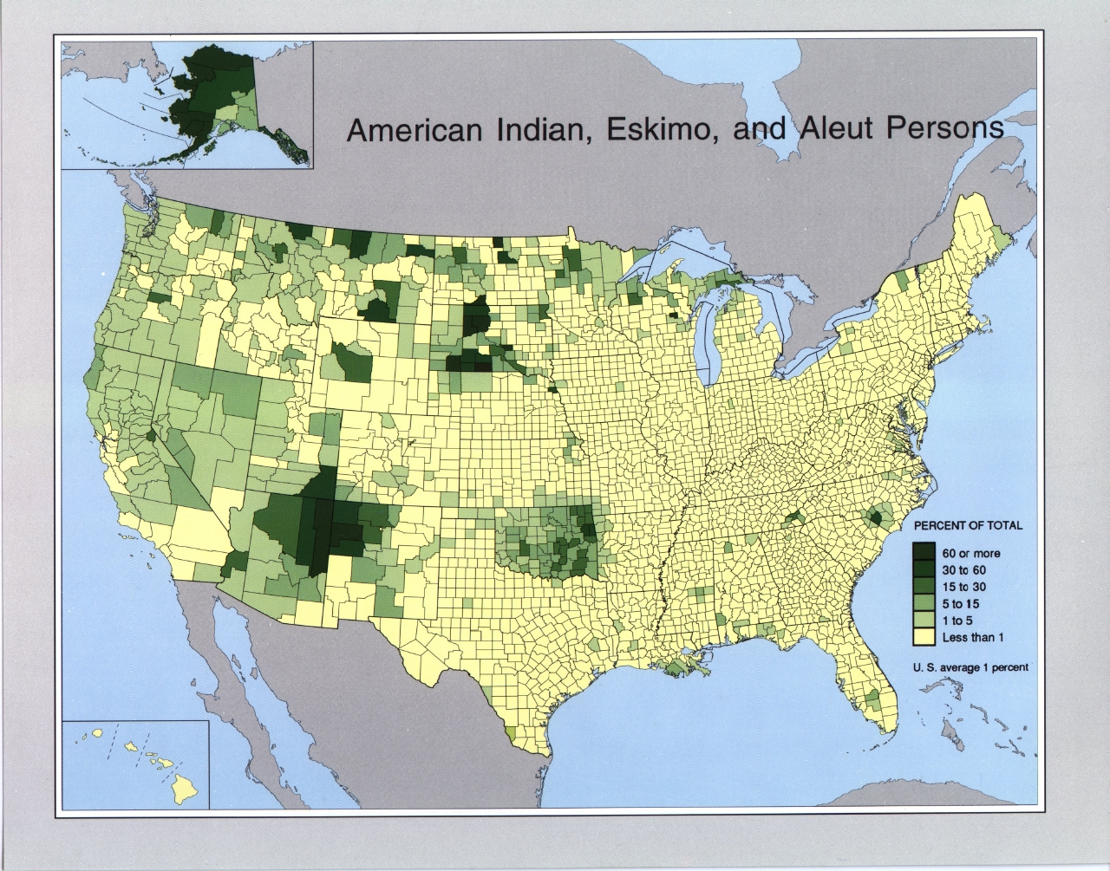
1.5% of the US population; ~4.1 million people

Slide 5
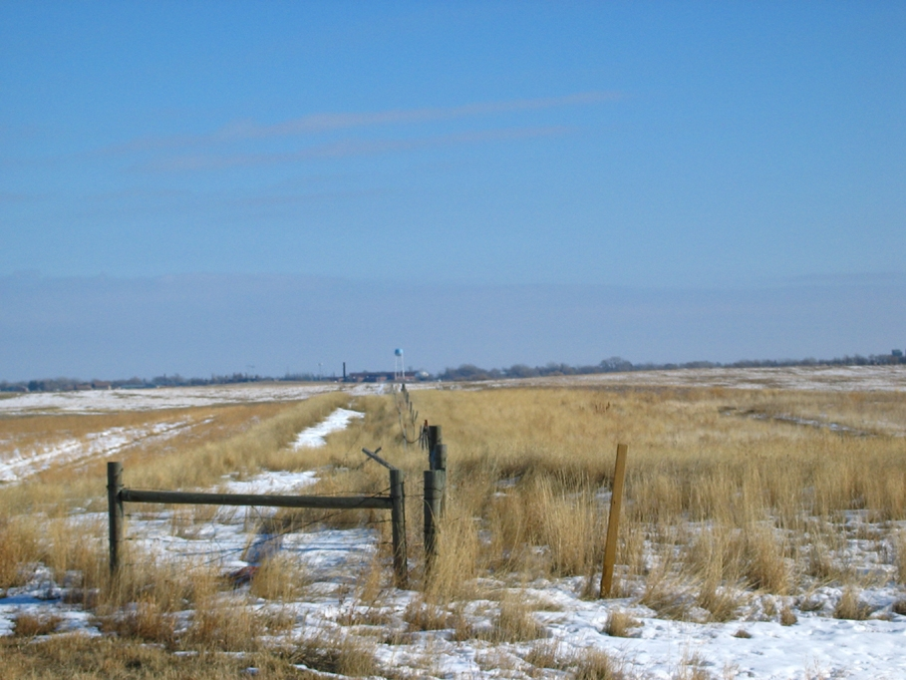
Health Disparities
Type 2 Diabetes
    4 – 8 times more common
    1 out of 3 Northern Plains adults
End Stage Renal Disease
    3.5 times more common
    Age of onset is 6 years younger
Health Care
    Indian Health Service – Comprehensive Diabetes Control
    Contract Health Services

Slide 6
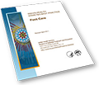
IHS Division of Diabetes Prevention
Revised Indian Health Diabetes Best Practices (2011)
Focuses on diabetes
prevention & mgmt
Does not address organ
donation

Slide 7
National Organ Transplant Data:
October, 2011:
112,000+ people on
the organ transplant waiting list
~90,000 of these people need a kidney
In 2010:
28,600+ transplants,
16,900 were kidneys
Kidney Transplant Recipient
http://optn.transplant.hrsa.gov/latestData/rptData.asp

Slide 8
Organ Transplant Needs among American Indians/Alaska Natives
account for less than 1% of patients on the organ transplant waiting list.
the # of transplants performed on AI/AN in 2009 was less than 1/4th of the number who were waiting for a transplant.
The number of transplants performed on White Americans was 35% of the number currently waiting.
http://minorityhealth.hhs.gov/templates/content.aspx?lvl=3&lvlID=12&ID=7988

Slide 9
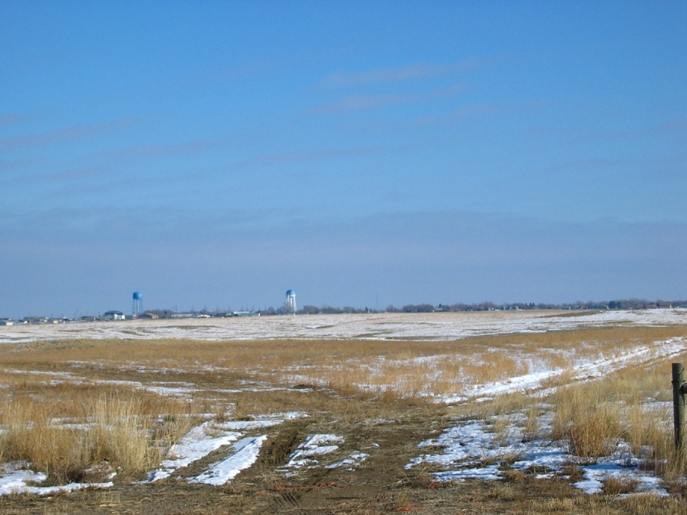
Objectives
Describe ethical issues associated with the need for organ donation and the prevalence of chronic disease in American Indian communities.
Relate the perspective of American Indian communities regarding the messages and strategies to provide education about organ donation within the context of diabetes prevention and control.

Slide 10
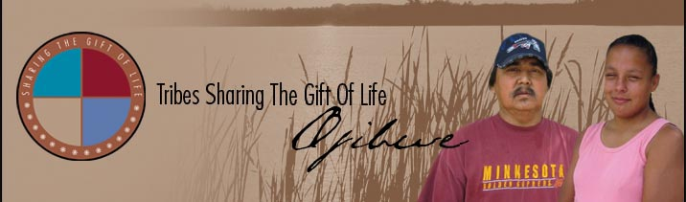
Ethical Issues
Spiritual beliefs about the body
Providing living organ donation education in communities with high type 2 diabetes prevalence.
Access to care issues to complete transplant eligibility protocol.
Definition of comprehensive diabetes prevention and control.

Slide 11
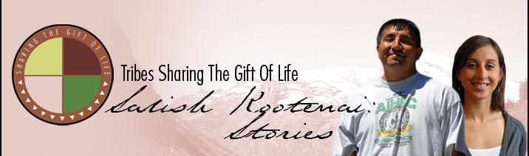
Community Outreach challenges and solutions
Tribal priorities
Trust
Values & beliefs
Sharing the message
  relate to the community
  committed presence, honesty
  respect , community benefit
  community based approach

Slide 12
Preliminary Study on Organ Donation Knowledge, Attitudes and Beliefs:
Uncertain knowledge
  “Organ & tissue donation is essential and we need it badly on the reservation.”
  “You have to match, I don’t know if it’s a blood type or that kind of stuff, don’t you?”
Diabetes Crisis
    “Basically, the only organ I am really aware of is kidney and failure. I know of this family whose father needs a kidney transplant.”

Slide 13
Cultural Transitions
    “When I leave this world, my body is intact because of my beliefs. I really can’t force my values and beliefs on others. I can’t give you my parts, but I can’t force other people not to.”
    “I guess that my traditional religious background has beliefs about the body, but nowadays, it is a good way to make a donation of yourself. I would like to be able to make that donation.”
  Outreach and Education Efforts
  “The fact is that we need this many Native American organs, and we have only XX (number) available. That is important. There are way too many people out there waiting.”
  “Knowing someone like us knowing our friend (name). We knew how sick (name) was before she had the transplant. We knew how sick she was, and now she is just bursting.”

Slide 14
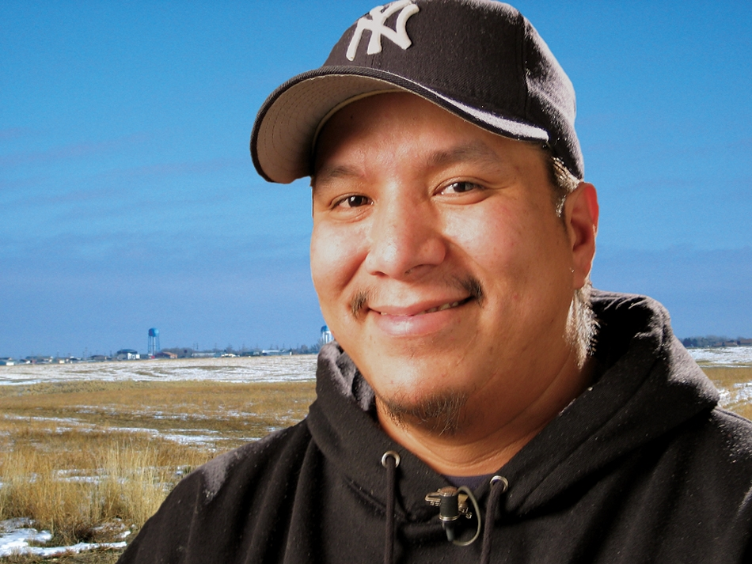
Deceased donor education: 4 Tribes
Wakic' unpi Wiconi
Sharing the Gift of Life
“If you give, you get back tenfold.”

Slide 15
Cultural basis: story telling & generosity
print, video &
media messages
education at
gathering places
programs for community
groups
Gary Bad Warrior, Jr.
Sisseton Wahpeton Oyate
Donated his kidney to his father.

Slide 16
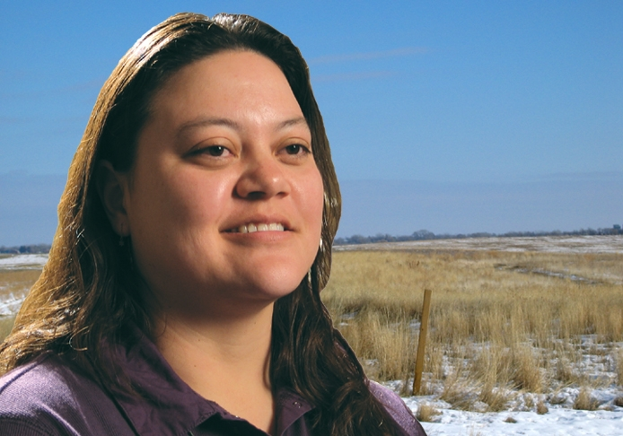
Outcomes:
Changes in deceased donation
intention
Registration as a
deceased donor
Conversations with
family members
“The giving of oneself is just the ultimate way of saying thank you for being created.”

Slide 17
Ethical Challenges:
Messages about donation
Organ donor messengers
Joining a registry without a driver’s license
Cornea Transplant Recipient, Christine Janis, Oglala Lakota
Sioux Tribe

Slide 18
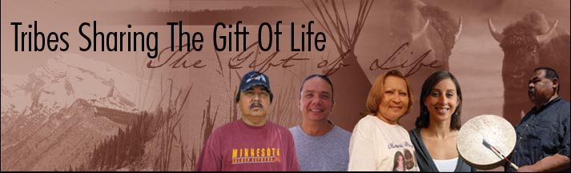
Tribes Sharing Life:
Web and classroom based education about deceased donation for Tribal College and University Students
15

Slide 19
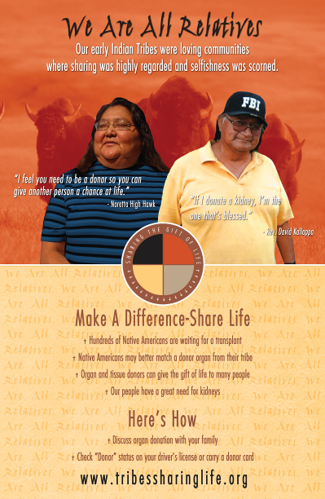
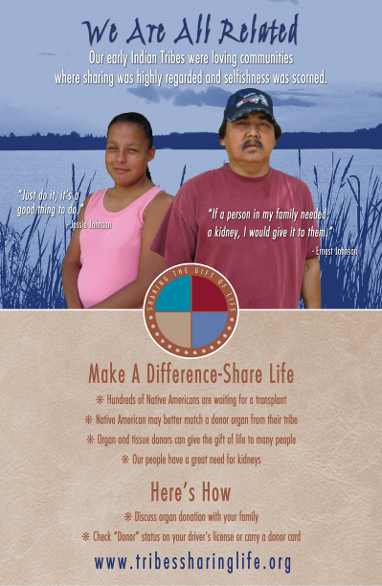

Slide 20
Lessons Learned
  Community advisors are needed to guide the ethical conduct of research and education about organ donation.
  Traditional beliefs and spirituality are critical components of organ donation education in tribal communities.
  Community values of generosity and respect for elders along with the oral tradition of story-telling are essential to include in the development of educational messages, methods of program delivery, and choice of messenger.

