Slide 1
Pharmacists as Patient-Centered Professionals: Collaborating to Ensure High Quality and Effective Patient Communication
Catherine R. Taylor, PharmD, MPH Candidate
Boston University School of Public Health

Slide 2
Presenter Disclosures
Catherine R. Taylor
(1)The following personal financial relationships with commercial interests relevant to this presentation existed during the past 12 months:
No relationships to disclose

Slide 3
Learning Objectives
Explain the unique contributions pharmacists can make to the creation of high-quality patient education pieces.
Discuss frequent mistakes pharmacists and other health care professionals make when communicating with their patient population via verbal and written material.
Compare written pieces of patient education for readability, understanding, appropriate format, and other key aspects of high-quality patient education pieces.
Identify appropriate resources available to healthcare and public health professionals when creating patient education pieces.
Notes:
You will be discussing mistakes that HCPs make, will you also be discussing how to improve these mistakes? I would say identifying mistakes AND offering solutions/steps to fix these mistakes would be the learning objective - but you can probably just speak to this

Slide 4
Health Literacy: Why Does It Matter?
Health literacy is a patient’s ability to obtain, process, and understand basic health information and services needed to make appropriate health decisions¹
Poor literacy is a “stronger predictor of a person’s health than age, income, employment status, education level, and race”²
9 out of 10 adults cannot use the health information provided to them in healthcare facilities, retail outlets, media and communities³
300 studies over 30 years: The reading level of health related materials exceed that of an average high school graduate⁴
Centers for Disease Control and Prevention
Nielsen-Bohlman L, et al. Health literacy: a prescription to end confusion free executive summary.

Slide 5
What Does High Quality Really Mean?
Both appropriate written and verbal presentation is key
    A mother pours a drug into her baby's ear, when it should have been given by mouth, leading to a perforated eardrum because the prescription label did not include “by mouth” in the directions⁵
Education level ≠ health literacy level⁶
CDC recommendations for quality communication⁷
  Keep your message clear and simple
  Fonts and font sizes are important
  Incorporate pictures or graphics
  Layout and format really matters
  Utilize the teach back method
7. Centers for Disease Control and Prevention. Simply Put.
Notes:
A college graduate with a degree in physics does not understand that taking multiple over-the-counter medications at the same time can be harmful versus
A single mother with less than a 6th grade education understands how to manage her daughter's diabetes and ask specific questions about her most recent blood sugar tests

Slide 6
The Unique Role of the Pharmacist
Direct patient-provider interaction in community and ambulatory settings, potentially hospital setting
As recognized by American Public Health Association (APHA)⁸
  “The pharmacist’s centralized placement in the community and clinical expertise are invaluable.”
  Pharmacists can increase access to care by offering rare accessibility
  Collaboration between pharmacists and the public health work force can meet health care needs and lessen the burden of public health professionals

Slide 7
Common Errors When Communicating With Patients⁷
Written Communication
Verbal Communication
Not enough white space
Using hard to read fonts
Too many bullet points
Too much underlining or use of bold fonts
Patient might not know what to ask
Uncomfortable environment
Forgetting the ‘Teach Back Method’
Speaking too quickly
Using medical jargon
Not using plain language
Not using
an active voice
Notes:
Ask Me 3
Script your future

Slide 8
Case Study
Multidisciplinary team headed by Patient and Family Education Manager
  Includes nurses, physicians, ambulatory care pharmacists
  Meets twice/quarter
  Identify existing “problem pieces” or a need for patient education piece development
Goal: Improve health communication between patient and provider to ultimately improve health outcomes
  According to JCAHO, failure to provide patients with information about their care in ways they can understand will continue to undermine other efforts to improve patient safety⁹

Slide 9
Case Study
Editing existing pieces and creating needed pieces
  Pre and post operation patient education pieces
  Diabetes education
  Vaccination education
  Outpatient procedure patient education pieces
Moving towards a model where all written pieces are first approved by the team prior to use by hospital staff
  Utilization of institution intranet for access to approved pieces
Handling resistance
  “These statistics don’t apply to my patients”
  Development of online training module for all staff regarding appropriate communication with patients
  Patient Education Tip of the Month in internal newsletter

Slide 10
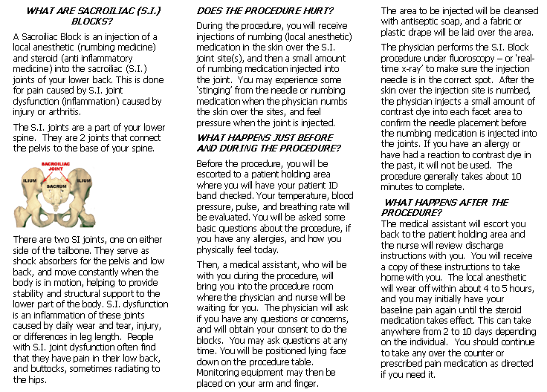

Slide 11
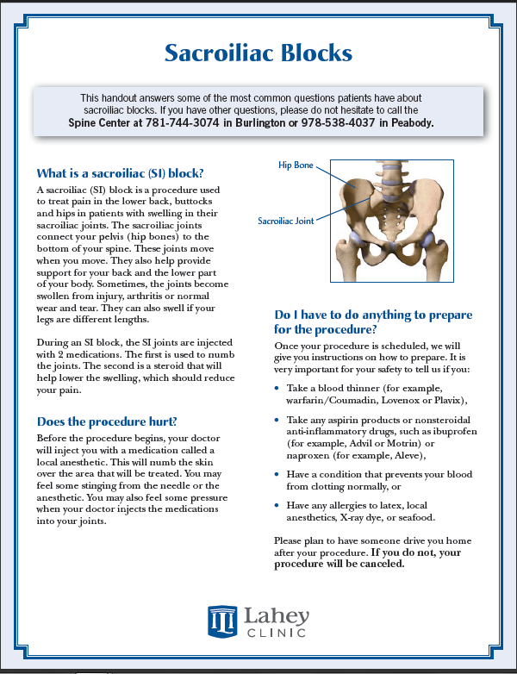
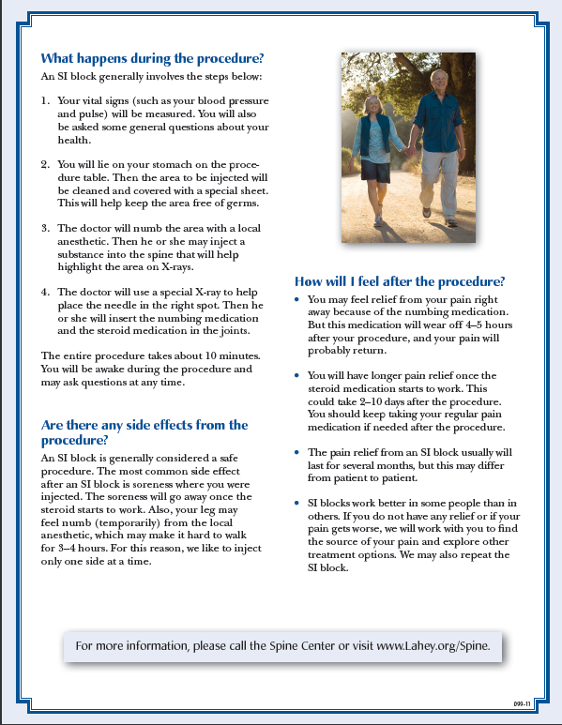
SAMPLE
SAMPLE

Slide 12
Appropriate Techniques⁷
Clearly state desired actions in a positive manner
  Wear your seatbelt in the car
Use familiar terms
  A lump the size of a pea
Avoid using symbols
Use headings, subheadings, and bullet points
Text
  Use Serif Fonts, size 12-14
  AVOID USING ALL CAPITAL LETTERS
  Use italics or bold text to highlight the most important information
Test for readability?

Slide 13
Integrating Health Literacy into Practice
Not recommended by the American Medical Association to screen patients in clinical setting for health literacy¹⁰
  Physicians should increase their own awareness of the nation’s low health literacy and incorporate this into practice
Debate surrounding screening patients for health literacy
  Do physicians have the time?¹¹
  Unknown patient response to sensitive topic
    2010 study finds >99% of patients did not feel shame when asked health literacy assessment questions¹²
    2007 study finds >22% of patients were embarrassed to have health literacy results documented in medical record¹³
    2007 study finds majority of patients answered health literacy questions with no satisfaction difference¹⁴
Wolf, M, et al. J Health Commun 2007;12(8):721-32.
Ryan J, et al. Health Educ Res 2008;23(4):603-11.
Notes:
Sick patients want easiest information to understand regardless of health literacy
10- Newest vital sign campaign by Pfizer (ice cream label)… takes less than 3 min to complete

Slide 14

Integrating Health Literacy into Practice
Center for Disease Control and Prevention (CDC)
  Simply Put (http://www.cdc.gov/HealthLiteracy/pdf/Simply_Put.pdf)
Health Resources and Services Administration (HRSA)
  Health literacy training and materials (http://www.hrsa.gov/publichealth/healthliteracy/index.html)
Agency for Healthcare Research and Quality (AHRQ)
  Health Literacy Universal Precautions Toolkit (http://www.ahrq.gov/qual/literacy/)
Helen Osborne
  Osborne H. Health literacy from A to Z: practical ways to communicate your health message. Jones & Bartlett Learning 2005. ISBN 0763745502.
  www.healthliteracy.com
Scriptyourfuture
  scriptyourfuture.org/
Ask Me 3
  http://www.npsf.org/askme3/
1. What is my main problem?
2. What do I need to do?
3. Why is it important for me to do this?
Notes:
Helen osborne is who??
Ask me 3
Script your future
Newest vital sign
Pros and cons (rewording) assessing health literacy
Tools when creating pieces

Slide 15
Acknowledgements
Rosanne Guerriero, MPH
  Patient and Family Education Manager, Lahey Clinic
  Boston University MPH Practicum Preceptor
Natalie DiPietro, PharmD, MPH
  Assistant Professor of Pharmacy Practice, Ohio Northern University
Patient and Family Education Committee,
Lahey Clinic, Burlington MA

Slide 16
References
American Medical Association. Health literacy. 2011. Available at http://www.ama-assn.org/ama/pub/about-ama/our-people/member-groups-sections/medical-student-section/community-service/health-literacy.shtml. Accessed 23 October 2011.
American Medical Association. Report on the council of scientific affairs, ad hoc committee on health literacy for the council on scientific affairs. JAMA 1999;281(6):552-7.
Centers for Disease Control and Prevention. Health marketing: health literacy. October 2010. Available at http://www.cdc.gov/ healthliteracy/. Accessed 23 October 2011.
Nielsen-Bohlman L, Panzer A, Kindig, D. Health literacy: a prescription to end confusion free executive summary. Washington, DC: The National Academies Press; 2004.
Boodman S. Many Americans have poor health literacy. Washington Post. http://www.washingtonpost.com/wp-dyn/content/article/2011/02/28/ AR2011022805957.html. Published February 28, 2011. Accessed 23 October 2011.
US Department of Health and Human Services Health Resources and Services Administration. Unified health communication: addressing health literacy, cultural competency, and limited English proficiency. Available from: http://www.hrsa.gov/public health/healthliteracy/index.html. Accessed 13 October 2011.
Centers for Disease Control and Prevention. Simply Put. Available at: http://www.cdc.gov /HealthLiteracy/pdf/Simply_Put.pdf. Accessed 11 October 2011.

Slide 17
References continued
American Public Health Association. Policy number 200614: The role of the pharmacist. November 2006. Available at: http://www.apha.org/advocacy/ policy/policysearch/default.htm?id=1338. Accessed 11 October 2011.
The Joint Commission. “What did the doctor say?:” improving health literacy to protect patient safety. Oakbrook Terrace Illinois: The Joint Commission; 2007.
American Medical Association. Health literacy program. Available at: http://www.ama-assn.org/ama/pub/about-ama/ama-foundation/our-programs/public-health/health-literacy-program.page. Accessed 11 October 2011.
Johnson K, Weiss B. How long does it take to assess literacy skills in clinical practice? J Am Board Fam Med 2008; 21:211-14.
VanGeest J, Welch V, Weiner S. Patients' perceptions of screening for health literacy: reactions to the newest vital sign. J Health Commun 2010;15(4):402-12.
Wolf, M, Williams M, Parker R, Parikh N, Nowlan A, Baker D. Patients' shame and attitudes toward discussing the results of literacy screening. J Health Commun 2007;12(8):721-32.
Ryan J, Leguen F, Weiss B, Abury S, Jennings T, Velez F, Salibi N. Will patients agree to have their health literacy skills assessed in clinical practice? Health Educ Res 2008;23(4):603-11.

