Slide 1

Geographic Variation in the Rates of Chiropractic Manipulation Treatment in Northern New England
APHA Session 3222.0: Public Health & Chiropractic Care
Karl Finison, Director of Analytic Services
Amy Kinner, Health Services Researcher
Proprietary and Confidential
1
1
Notes:
1

Slide 2
Presenter Disclosures
The following personal financial relationships with commercial interests relevant to this presentation existed during the past 12 months:
No relationships to disclose.
Geographic Variation in the Rates of Chiropractic Manipulation Treatment in Northern New England
2

Slide 3
Overview of APCDs
A Powerful, State-Mandated Tool for Understanding Healthcare
What’s in the data?
  Medical and pharmacy claims (numerator)
  Enrollment data (denominator)
  ICD-9 diagnosis, ICD-9 procedure, CPT/HCPCS, NDC codes
Who supplies the data?
  All commercial payers (e.g., insurers, TPAs, PBMs)
  In some states, Medicaid and Medicare
What they offer — A centralized repository to measure disease prevalence, effective and preventive care, utilization, and payments
Geographic Variation in the Rates of Chiropractic Manipulation Treatment in Northern New England
3

Slide 4
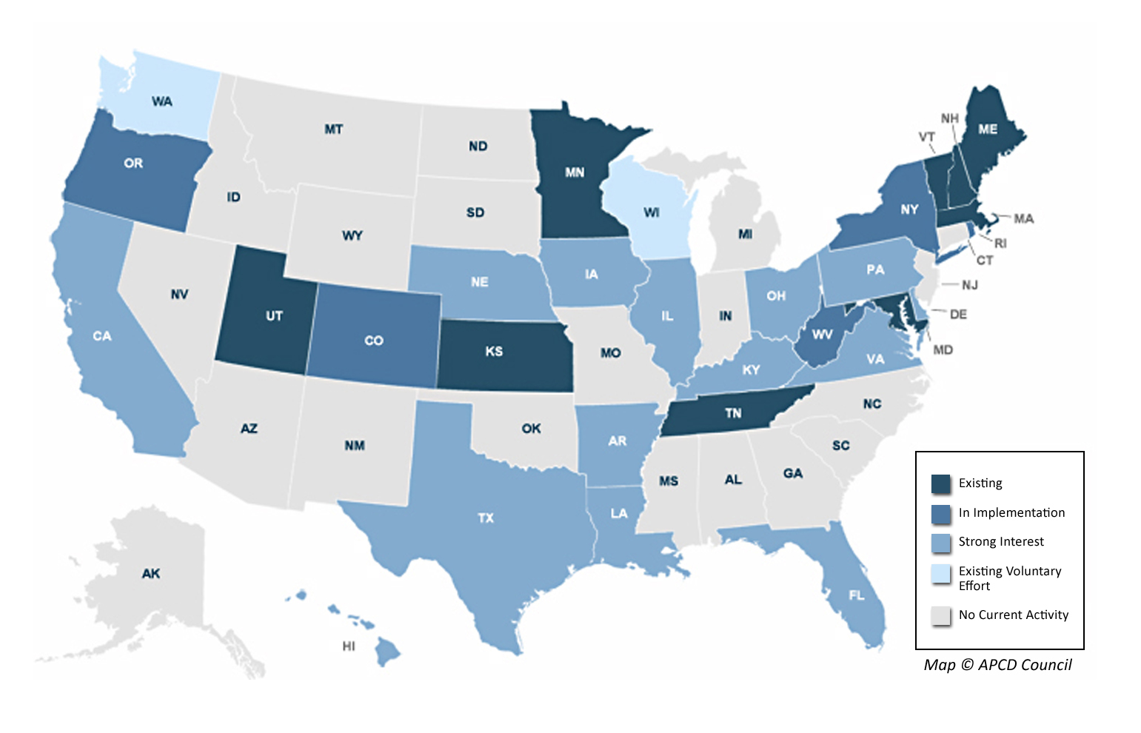
States with All-Payer Claims Databases
Source APCD Council
Geographic Variation in the Rates of Chiropractic Manipulation Treatment in Northern New England
4

Slide 5

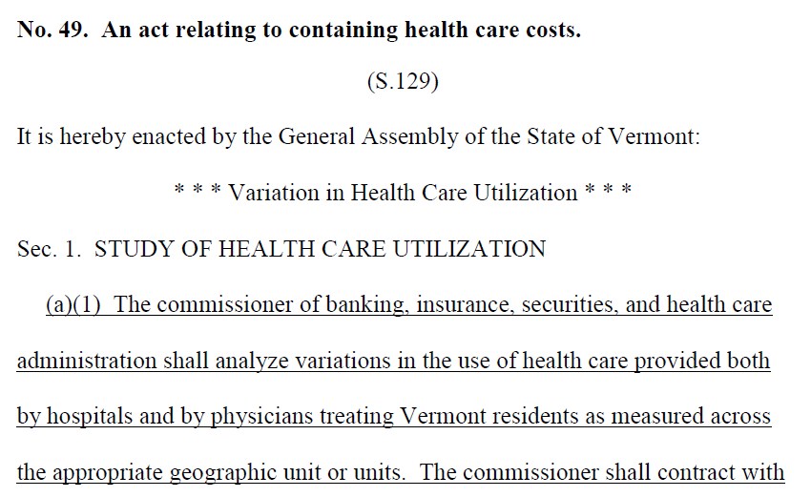

Regional Comparisons
Geographic Variation in the Rates of Chiropractic Manipulation Treatment in Northern New England
5
Notes:
5

Slide 6
Background & Methods
Chiropractic & Osteopathic Manipulation
First multistate evaluation of health services utilization using state-mandated, all-payer commercial claims data
  Enrollment and claims data, ages 0–64
  67 hospital service areas in ME, NH, and VT
  Population-based rates adjusted for age and gender
Chiropractic manipulation: CPT 98940–98943
Osteopathic manipulation: CPT 98925–98929
Geographic Variation in the Rates of Chiropractic Manipulation Treatment in Northern New England
6

Slide 7
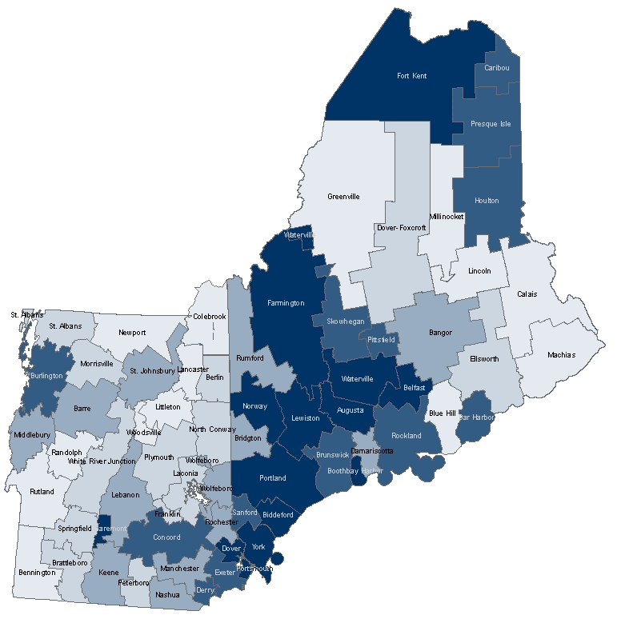
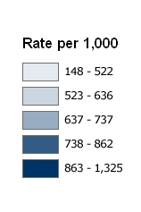
Chiropractic/Osteopathic Manipulation
Commercial, Ages 0–64; Rates Adjusted for Age & Gender
Augusta
(1,325)
Newport
(148)
Geographic Variation in the Rates of Chiropractic Manipulation Treatment in Northern New England
7
Notes:
7

Slide 8
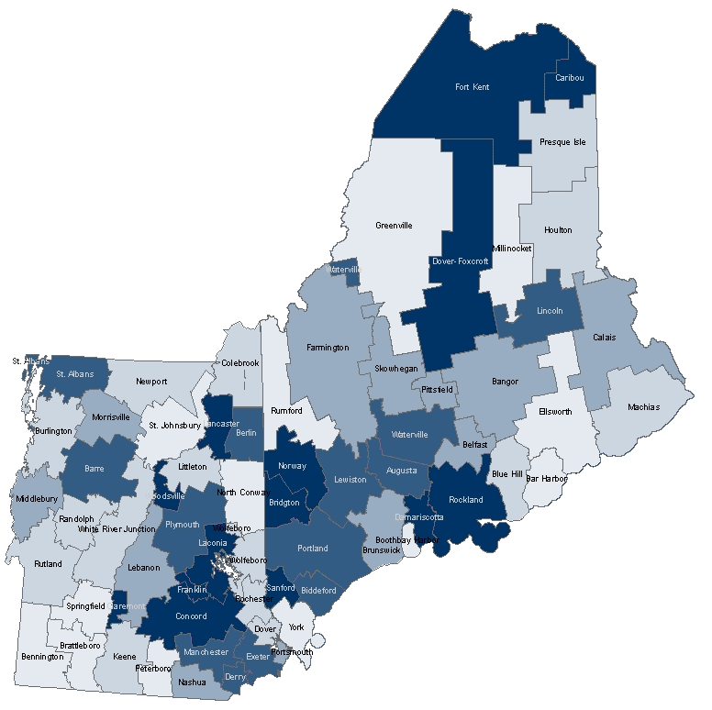
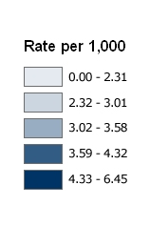
Back Surgery
Commercial, Ages 20–64; Rates Adjusted for Age & Gender
Bridgton
(6.45)
Ellsworth
(1.48)
Geographic Variation in the Rates of Chiropractic Manipulation Treatment in Northern New England
8
Notes:
8

Slide 9
Episodes of Care
Commercial, Ages 0–64
Description | Spine Degeneration
 | With Surgery | Without Surgery
Episodes | 802 | 15,830
MRI | 84% | 26%
CT-Scan | 12% | 2%
Standard imaging | 82% | 36%
Chiropractic manipulation | 20% | 50%
Osteopathic manipulation | 12% | 10%
Physical medicine | 61% | 54%
272 episodes with spinal fusion; 530 laminectomy/diskectomy
Geographic Variation in the Rates of Chiropractic Manipulation Treatment in Northern New England
9
Notes:
9
Already and will continue to evaluate impact of your hospital tiered benefit. Ex. 1 hospital

Slide 10
Spine Degeneration
Commercial, Ages 0–64
Category | Area A | Area B | Area C
Non-Surgical Episodes | 7,984 | 3,007 | 3,357
Average Payment | $1,506 | $1,589 | $1,556
Surgical Episodes | (5.1%) 428 | (4.4%) 137 | (3.3%) 114
Average Payment | $14,085 | $19,198 | $16,001
Geographic Variation in the Rates of Chiropractic Manipulation Treatment in Northern New England
10
Notes:
A

Slide 11
Measuring Geographic Variation
Northern New England, Commercial, Ages 0–64
Measure (* = Adjusted Rates) | Coefficient of Variation
Potentially avoidable outpatient ED visits* | 43.3
Chiro-/osteopathic manipulation* | 32.5
Back surgery (ages 45–64) | 24.9
Inpatient ACS admissions* | 24.3
Inpatient days* | 18.5
Advanced Imaging* | 12.2
Payments* | 8.5
Primary care visits* | 7.1
Breast cancer screening (ages 52–69) | 5.2
Appropriate use of imaging (low back pain) | 4.1
Combined effective & preventive care score | 3.4
Geographic Variation in the Rates of Chiropractic Manipulation Treatment in Northern New England
11
Notes:
11
Already and will continue to evaluate impact of your hospital tiered benefit. Ex. 1 hospital

Slide 12


