Slide 1



We Can!®:
Leveraging social media to help children, families and communities maintain a healthy weight
Melissa McGowan, MHS, CHES
Division for the Application of Research Discoveries
National Heart, Lung, and Blood Institute
National Institutes of Health
October 31, 2011
U.S. Department of
Health and Human Services
National Institutes
of Health
National Heart, Lung, and Blood Institute
National Institute of Diabetes and Digestive and Kidney Diseases
Eunice Kennedy Shriver National Institute of Child Health and
Human Development
National Cancer Institute

Slide 2


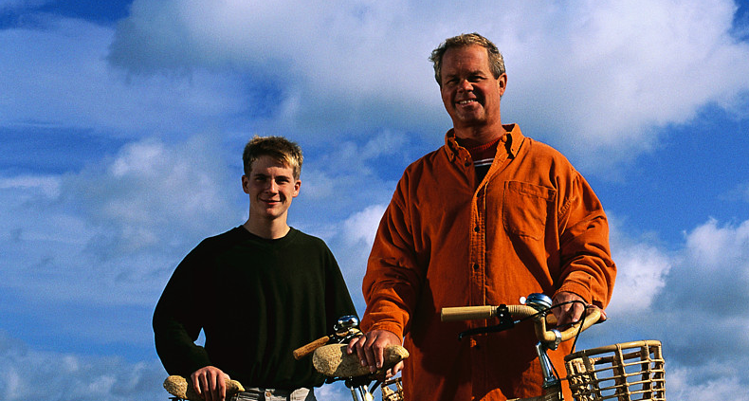


What is We Can!?
A national, science-based education program from the NIH designed to prevent childhood obesity
It targets youth, ages 8–13, and their parents and caregivers

Slide 3
What behaviors does science tell
us are important?
Improving food choices.
Increasing physical activity.
Reducing screen time.
Permanent behavior change is hard;
We Can! encourages parents to take THE FIRST STEPS to a healthier lifestyle for their families.

Slide 4




How does We Can! turn science into action?
Science on Parent Involvement & Behavior Change
Curricula for parents/youth
Additional resources and technical assistance for communities and partners
Flexible to fit different needs
NIH-funded & other
scientific studies
S.M.A.R.T.

Slide 5
Goals for Target Audiences
Goals for Parents
Increasing the availability of healthy foods
Limiting the availability of sweetened beverages and
high-fat, high-density/low-nutrient foods
Eating small portions at home and in restaurants
Supporting and enabling family physical activity
Supporting and enabling reduced screen time
Goals for Youth
Choose a sufficient amount of fruits and vegetables per day
Limit intake of high-fat foods and energy-dense foods that are low in nutrients.
Control portion sizes of foods consumed
Substitute water, fat-free milk, or low-fat milk for sweetened beverages
Engage in at least 60 minutes of moderate physical activity on most, preferably all, days of the week.
Reduce sedentary activity by limiting screen time to no more than 2 hours per day

Slide 6
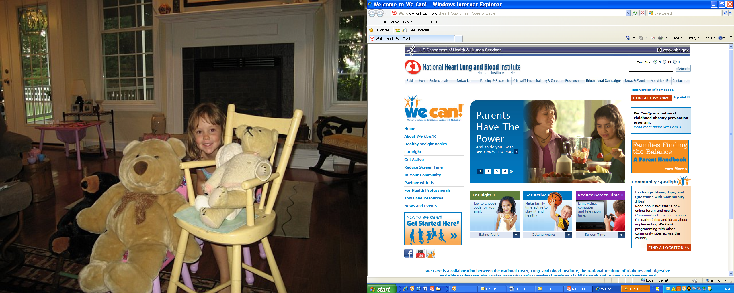
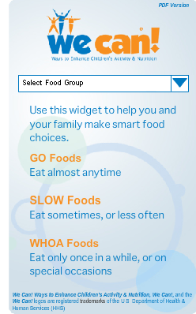
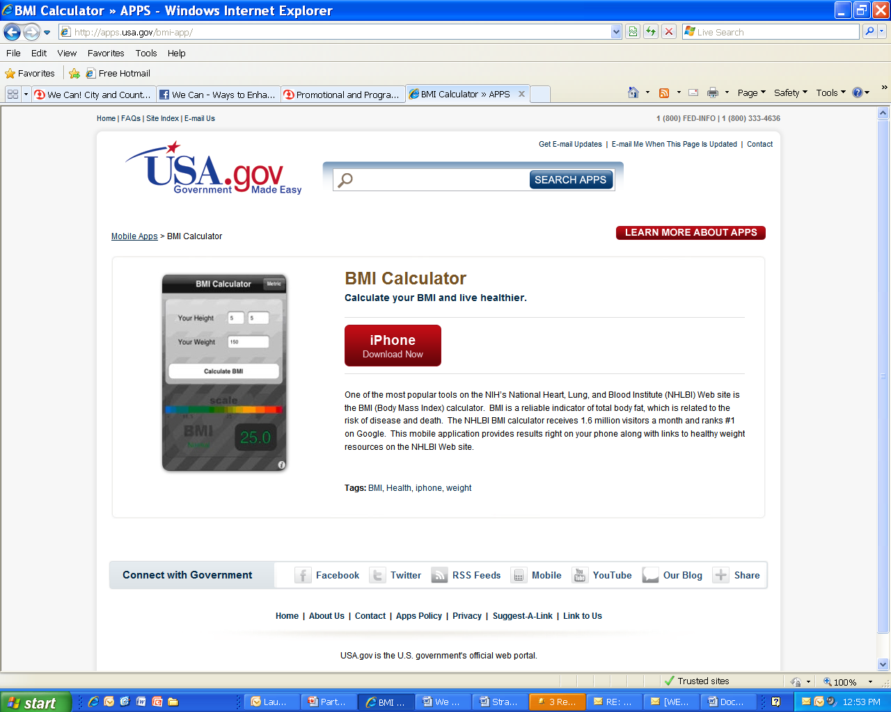
Social Media Platforms
http://wecan.nhlbi.nih.gov
Online BMI Calculator and iPhone App
Go, Slow, Whoa Widget

Slide 7
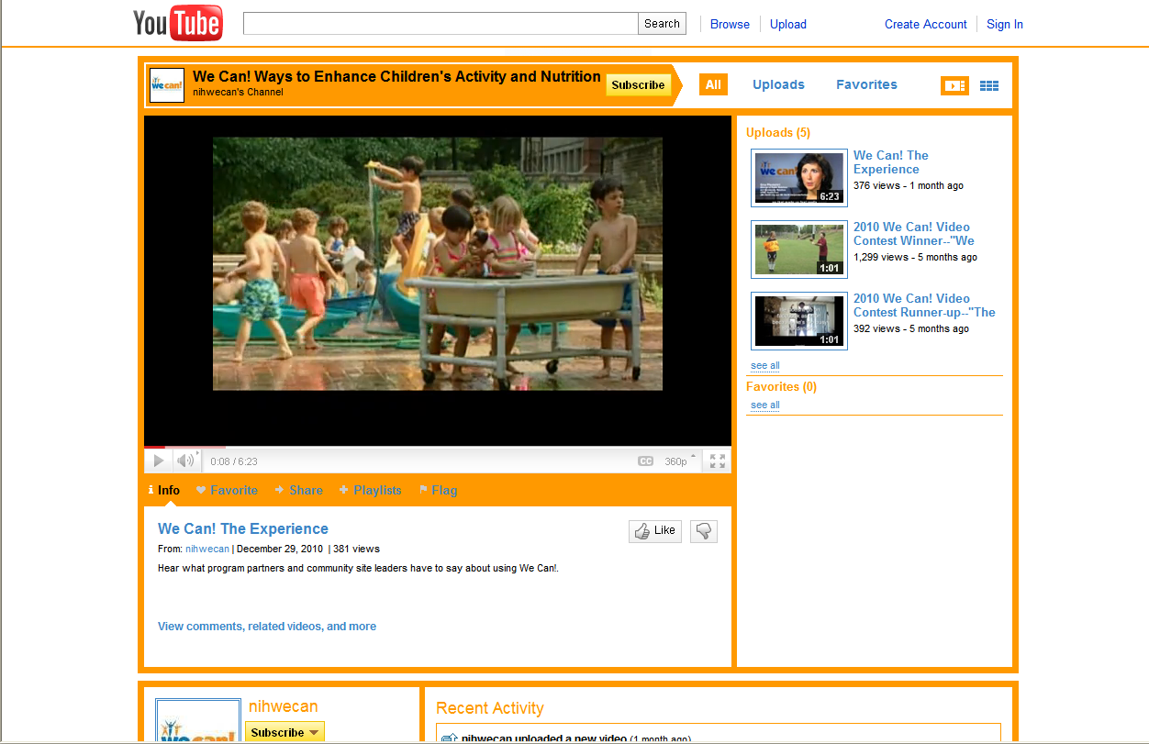
Social Media Platforms: YouTube
www.youtube.com/nihwecan

Slide 8
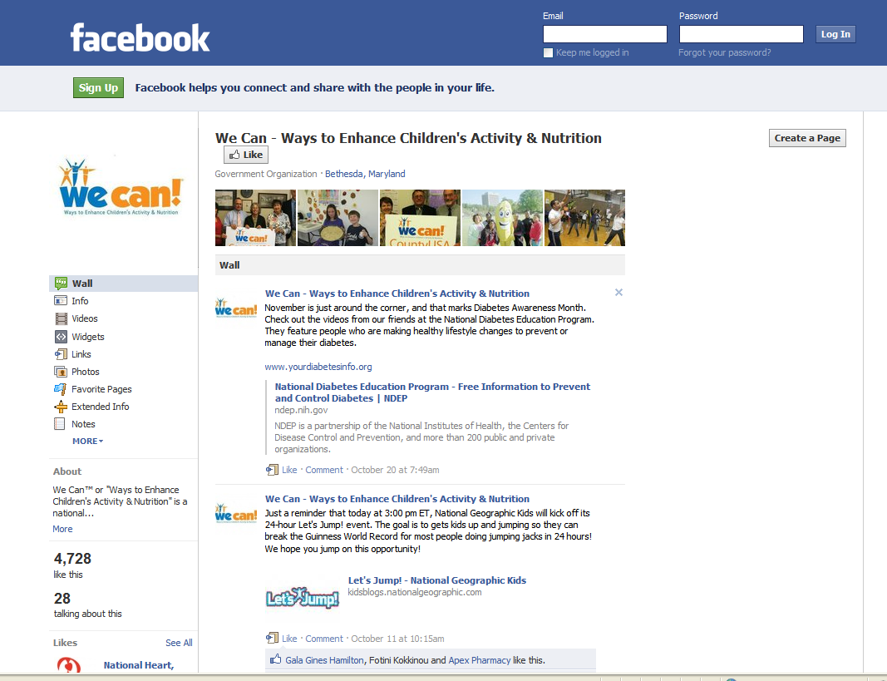
Social Media Platforms: Facebook
www.facebook.com/nihwecan

Slide 9
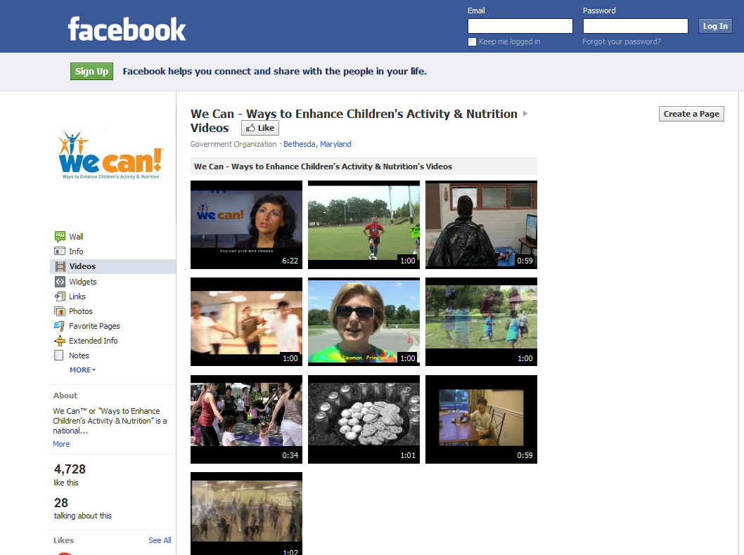
Leveraging SM Platforms to Engage Community Efforts
We Can! Community Site Video Contest

Slide 10
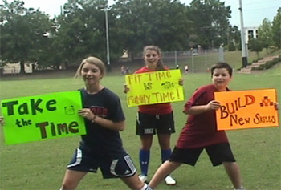
We Can! Community Site Video Contest
We Can!’s community sites and partners (working with sites) were asked to submit 15, 30 or 60-second videos highlighting one or more of We Can!’s three key behaviors:
Improving food choices ■ Increasing physical activity ■ Reducing screen time
The winner was chosen by a public vote on Facebook.
Congratulations to the University of South Carolina Norman J. Arnold School of Public Health in Columbia, South Carolina for their video entitled,
      “We Can MOVE IT!”
The school received $1,500 to help facilitate additional programming.
View ALL of the videos submitted on
www.facebook.com/nihwecan
Notes:
10

Slide 11
We Can! Community Site Video Contest: Lessons Learned

Slide 12
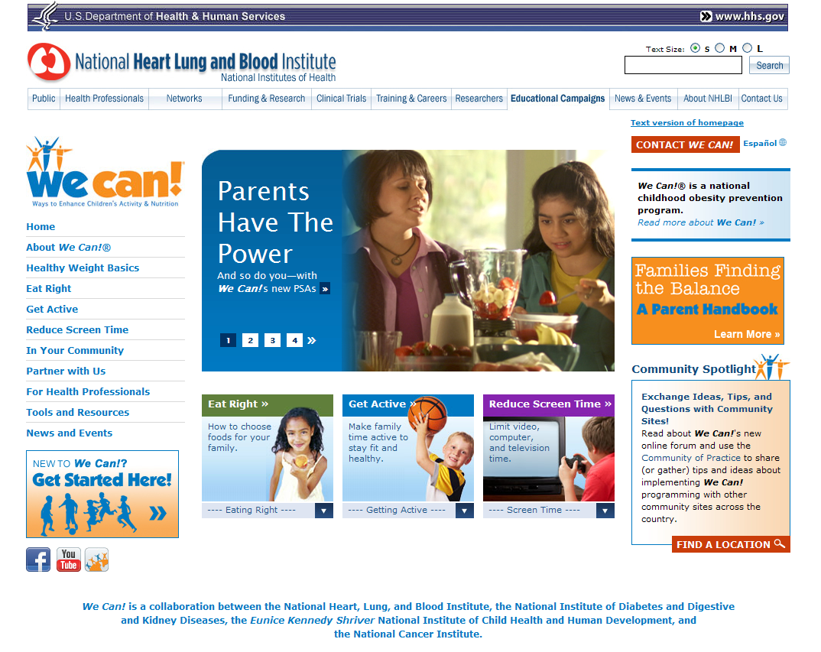
We Can! Web Site Topics
About We Can!
Healthy Weight Basics
Eat Right
Get Active
Reduce Screen Time
In Your Community
Partner With Us
For Health Professionals
Tools and Resources
News and Events
Facebook link
Community of Practice link
http://wecan.nhlbi.nih.gov

Slide 13
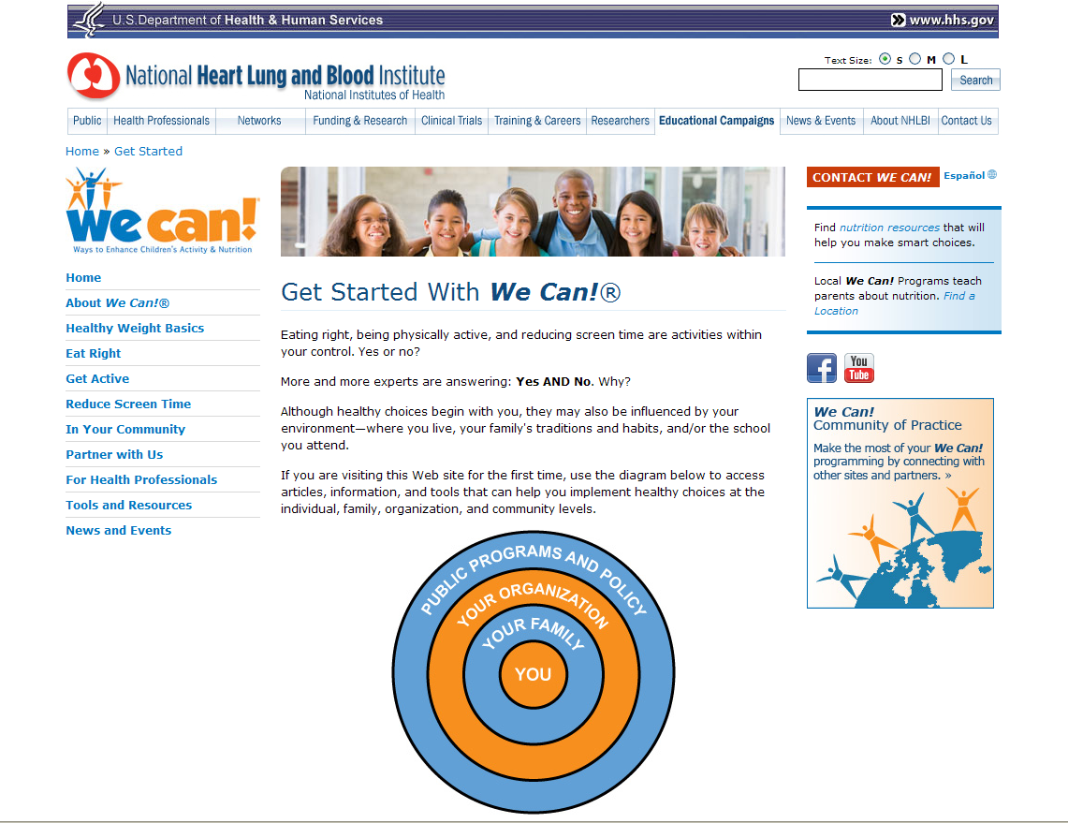
Getting Started on the We Can! Web Site
Click here
Basic links and resources for different types of community sites
Great first steps for new programming efforts
http://wecan.nhlbi.nih.gov

Slide 14

The Let’s Move! Nationwide Campaign
Launched in February 2010 by the White House, “to solve the epidemic of childhood obesity within a generation.”
Involves a federal task force and the development of an interagency plan – released in May 2010.
Includes four major areas of focus:
  ensuring access to healthy, affordable food;
  increasing physical activity in schools and communities;
  providing healthier food in schools; and
  empowering parents with information and tools to make good choices for themselves and their families.
We Can! referenced in Let’s Move! Toolkit for Faith-based and Neighborhood Organizations
Adapted several We Can! resources on healthy eating, physical activity, and screen time for the http://www.letsmove.gov Web site.

Slide 15
More We Can! information and additional program materials available at
BOOTH 6067
Visit with NHLBI staff and researchers
Get grant and research information
Learn how to obtain NHLBI materials

Slide 16

Together…
Thank you!
Melissa McGowan: mcgowanm@nhlbi.nih.gov
Melinda Kelley: kelleym@nhlbi.nih.gov

