Slide 1

Identification of Potentially Avoidable Emergency Department Visits Using Claims Data
APHA Session 4204.0: Advances in Epidemiology Methods
Karl Finison, Director of Analytic Services
Amy Kinner, Health Services Researcher
Proprietary and Confidential
1
1
Notes:
1

Slide 2
Presenter Disclosures
The following personal financial relationships with commercial interests relevant to this presentation existed during the past 12 months:
No relationships to disclose.
Identification of Potentially Avoidable Emergency Department Visits Using Claims Data
2

Slide 3
Overview of APCDs
A Powerful, State-Mandated Tool for Understanding Healthcare
What’s in the data?
  Medical and pharmacy claims (numerator)
  Enrollment data (denominator)
  ICD-9 diagnosis, ICD-9 procedure, CPT/HCPCS, NDC codes
Who supplies the data?
  All commercial payers (e.g., insurers, TPAs, PBMs)
  In some states, Medicaid and Medicare
What they offer — A centralized repository to measure disease prevalence, effective and preventive care, utilization, and payments
Identification of Potentially Avoidable Emergency Department Visits Using Claims Data
3

Slide 4
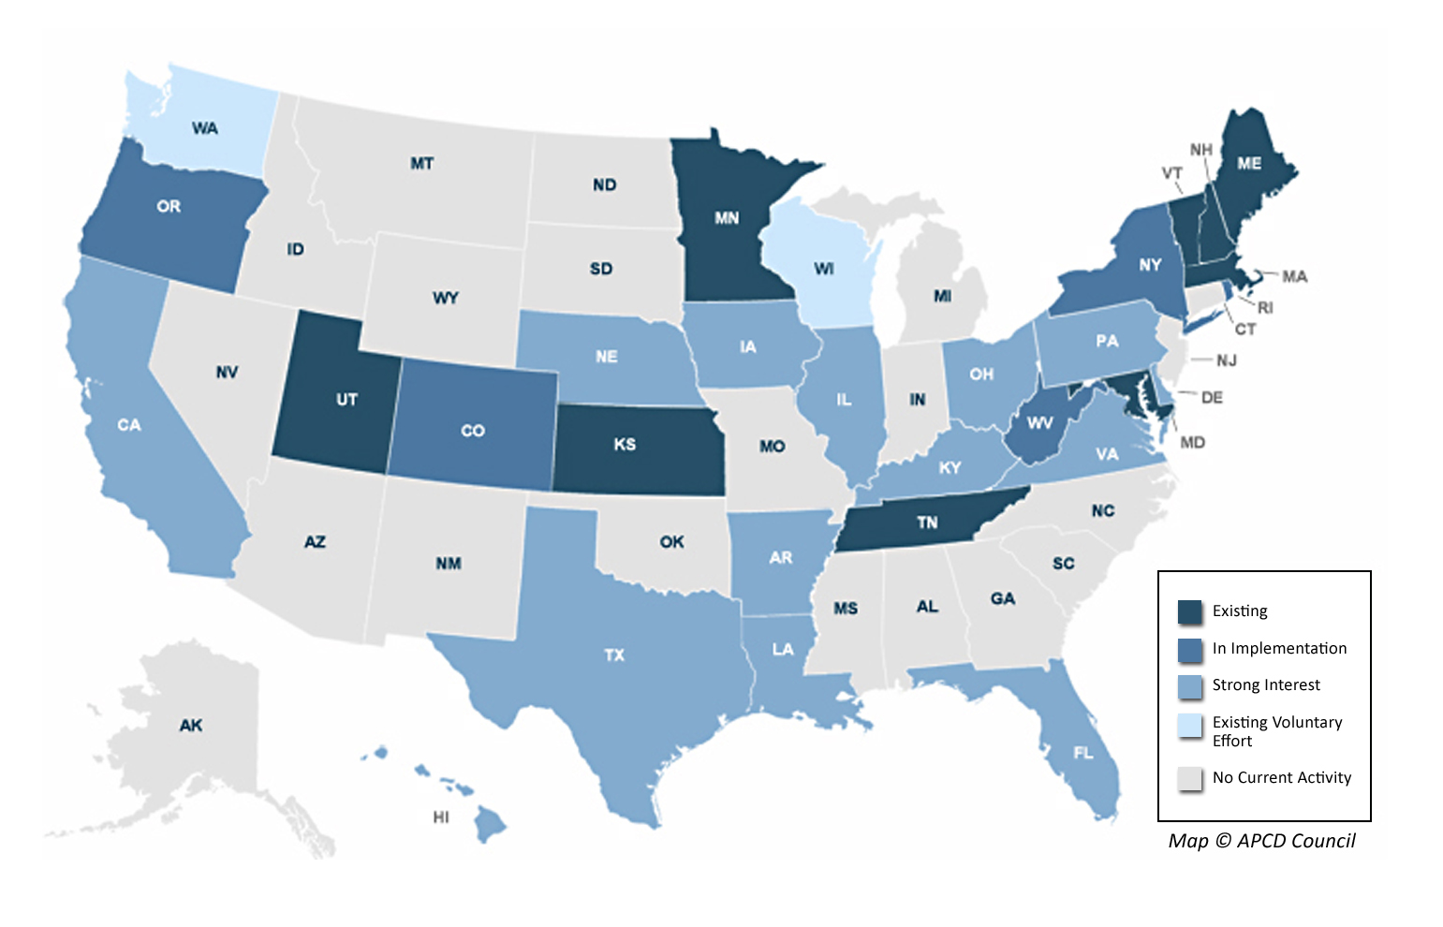
States with All-Payer Claims Databases
Source APCD Council
Identification of Potentially Avoidable Emergency Department Visits Using Claims Data
4

Slide 5
Purpose of This Presentation
Identify Potentially Avoidable Outpatient ED Visits
Need
  No national definition of potentially avoidable outpatient emergency department (ED) visits
Goal
  Identify a set of ICD-9 diagnoses for outpatient ED use where treatment can commonly be provided in another setting (i.e., physician office) and the need for hospitalization is rare
Identification of Potentially Avoidable Emergency Department Visits Using Claims Data
5

Slide 6
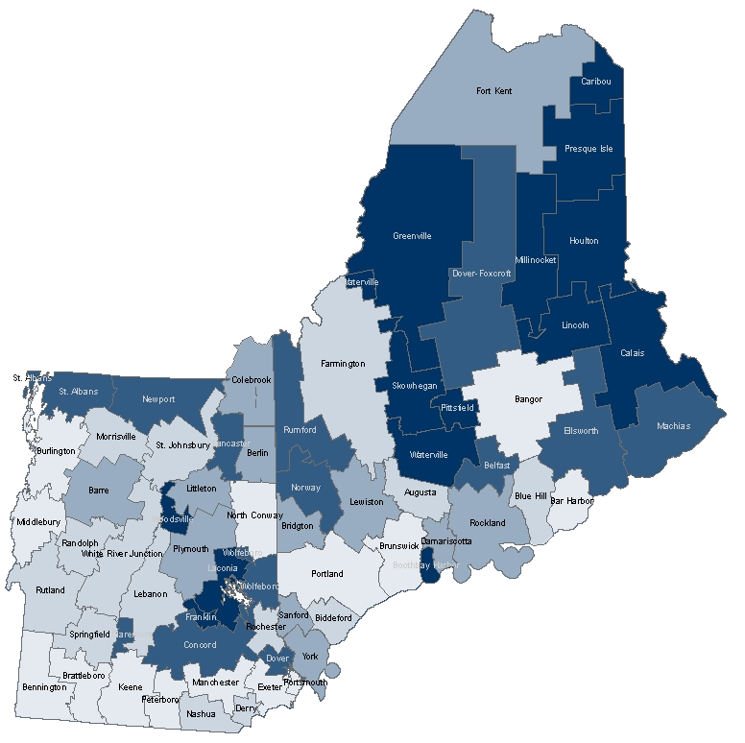
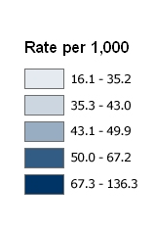
Potentially Avoidable Outpatient ED Use
Rates Adjusted for Population Age & Gender
Across 67 hospital service areas in northern New England, population-based rates varied
8-fold for the commercial population.
Caribou
(136.3)
Burlington
(16.1)
Identification of Potentially Avoidable Emergency Department Visits Using Claims Data
6
Notes:
6

Slide 7
Method
Identify Potentially Avoidable Outpatient ED Visits
Report inpatient ED, outpatient ED, office/clinic visits by principal ICD-9, excluding injury/poisoning
  Find high-volume ICD-9 (80% of total outpatient ED visits)
  ICD-9 where the proportion of ED visits resulting in hospitalization <1% and the proportion of total visits in the office setting >80%
Data sources
  Statewide Medicaid and commercial claims
  Statewide hospital inpatient and outpatient discharge data
ED visits were identified in claims by Uniform Billing (UB) revenue codes 0450–0459 and 0981 or CPT codes 99281–99285 and office visits with E&M CPT codes.
Identification of Potentially Avoidable Emergency Department Visits Using Claims Data
7

Slide 8
Method – Example
Identify Potentially Avoidable Outpatient ED Visits
ICD-9-CM | Description | % of Total ED Resulting in Hospitalization | % of Total Encounter in Office Setting
465.9 | Acute upper respiratory infection, unspecified site | 0.3% | 84%
491.21 | Obstructive chronic bronchitis with acute exacerbation | 30.4% | 35%
Potentially avoidable
Not potentially avoidable
Identification of Potentially Avoidable Emergency Department Visits Using Claims Data
8
Notes:
8
Already and will continue to evaluate impact of your hospital tiered benefit. Ex. 1 hospital

Slide 9
Results – Core Diagnostic Categories
Identify Potentially Avoidable Outpatient ED Visits
Sore throat, strep (034.0)
Viral infection, unspecified (079.99)
Anxiety, unspecified or generalized (300.00, 300.02)
Conjunctivitis, acute or unspecified (372.00, 372.30)
External & middle ear infections, acute or unspecified (380.10, 381.01, 381.4, 382.00, 382.9)
Upper respiratory infections, acute or unspecified (461.9, 473.9, 462, 465.9)
Bronchitis, acute or unspecified, & cough (466.0, 786.2, 490)
Asthma (493 – all 4th and 5th digits)
Dermatitis & rash (691.0, 691.8, 692.6, 692.9, 782.1)
Joint pain (719.4 – all 5th digits)
Lower/unspecified back pain (724.2, 724.5)
Muscle/soft tissue limb pain (729.1, 729.5)
Fatigue (780.79, 784.0)
Headache (784.0)
Identification of Potentially Avoidable Emergency Department Visits Using Claims Data
9
Notes:
9

Slide 10
Results – Other Diagnoses Considered
Identify Potentially Avoidable Outpatient ED Visits
Dental care
  Comparative dental office visit data may not be available for commercial population
  Dental caries (521 – all 4th and 5th digits)
  Dental abscess (522 – all 4th and 5th digits)
  Unspecified disorders of teeth (525.9)
Abdominal pain
  Abdominal pain, unspecified site (789.00)
Identification of Potentially Avoidable Emergency Department Visits Using Claims Data
10
Notes:
10

Slide 11
Results – Example Statewide Claims
Identify Potentially Avoidable Outpatient ED Visits
Measure | Medicaid (Non-dual) | Commercial (Age <65)
Total outpatient ED visits | 92,249 | 107,531
Potentially avoidable | (32%) 29,445 | (24%) 25,791
Total office visits | 499,380 | 784,104
With selected diagnoses | (26%) 131,536 | (48%) 375,590
Identification of Potentially Avoidable Emergency Department Visits Using Claims Data
11
Notes:
11
Already and will continue to evaluate impact of your hospital tiered benefit. Ex. 1 hospital

Slide 12
Results – Example Statewide Hospital Data
Identify Potentially Avoidable Outpatient ED Visits
Rates per 1,000 of Potentially Avoidable Outpatient ED Visits
Among 638,160 outpatient ED visits, 160,580 (25%) were classified as potentially avoidable.
Identification of Potentially Avoidable Emergency Department Visits Using Claims Data
12
Notes:
12
Already and will continue to evaluate impact of your hospital tiered benefit. Ex. 1 hospital

Slide 13
Measuring Geographic Variation
Northern New England, Commercial, Ages 0–64
Measure (* = Adjusted Rates) | Coefficient of Variation
Potentially avoidable outpatient ED visits* | 43.3
Chiro-/osteopathic manipulation* | 32.5
Back surgery (age 45-64) | 24.9
Inpatient ACS admissions* | 24.3
Inpatient days* | 18.5
Advanced Imaging* | 12.2
Payments * | 8.5
Primary care visits * | 7.1
Breast cancer screening, age 52-69 | 5.2
Appropriate use of imaging (low back pain) | 4.1
Combined effective & preventive care score | 3.4
Identification of Potentially Avoidable Emergency Department Visits Using Claims Data
13
Notes:
13
Already and will continue to evaluate impact of your hospital tiered benefit. Ex. 1 hospital

Slide 14
Current Uses
Identify Potentially Avoidable Outpatient ED Visits
Provider health systems and hospitals
  Reporting for ACO development
  Advanced Primary Care Medical Home Evaluation
State governments
  Advisory group on health systems improvement
  State Bureau of Insurance
  State Medicaid program
  Children in commercial, Medicaid, SCHIP
Employers
Identification of Potentially Avoidable Emergency Department Visits Using Claims Data
14

Slide 15


