Slide 1
Objective
Demonstrate the effectiveness of automatic notification of injury severity information in improving the survivability of motor vehicle related trauma victims
Potential Benefits of an Automatic Injury Notification System in Reducing Motor Vehicle Crash Fatalities
Dipan Bose, Jeff Crandall, Gerald McGwin, Jay Goldman, Jeff Foster, Russ Fine
Contact : dbose@virginia.edu

Slide 2
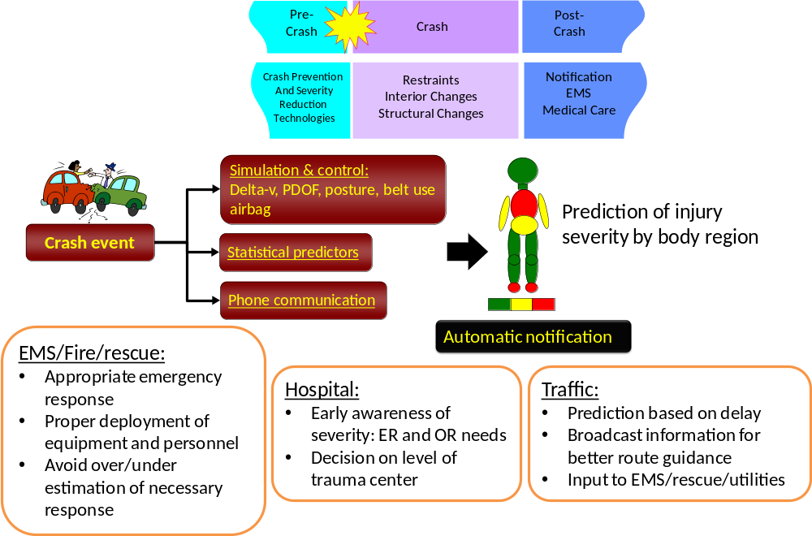
Overview
Potential Benefits of an Automatic Injury Notification System in Reducing Motor Vehicle Crash Fatalities
Dipan Bose, Jeff Crandall, Gerald McGwin, Jay Goldman, Jeff Foster, Russ Fine
Contact : dbose@virginia.edu

Slide 3
Motivation
Automatic crash notification systems (AACN) can significantly reduce notification times for motor vehicle crashes (MVC) and potentially reduce related morbidity and mortality¹
Additionally, predictions of injury severity and subsequent automatic transfer of severity data to EMS and trauma care providers is expected to improve the timeliness, appropriateness, and efficacy of emergency care provided²
Potential Benefits of an Automatic Injury Notification System in Reducing Motor Vehicle Crash Fatalities
Dipan Bose, Jeff Crandall, Gerald McGwin, Jay Goldman, Jeff Foster, Russ Fine
Contact : dbose@virginia.edu

Slide 4
Method
EMS data from sampled MVCs (weighted sample, n ~200,000 adult occupants involved in serious crashes) in the year 2002-2003 were obtained from the National Automotive Sampling System – Crash Worthiness Data System (NASS-CDS)
Crash survivability, as a function of EMS interval times was estimated using multivariate regression models while controlling for the effects of entrapment at scene, trauma care, and transportation type.
Comparison was done to estimate survivability as a function of EMS times for known injury severity to specific body regions (head, thorax, abdomen)
Potential Benefits of an Automatic Injury Notification System in Reducing Motor Vehicle Crash Fatalities
Dipan Bose, Jeff Crandall, Gerald McGwin, Jay Goldman, Jeff Foster, Russ Fine
Contact : dbose@virginia.edu

Slide 5
Dataset
Cases selected from years 2002 and 2003 (n=2,589)
Case occupant must be an adult (> 16y)
Time of crash (as estimated) & Fatality status known
Notification time less than 6 hours
Case occupant must sustain a severe injury (AIS 3+)
Potential Benefits of an Automatic Injury Notification System in Reducing Motor Vehicle Crash Fatalities
Dipan Bose, Jeff Crandall, Gerald McGwin, Jay Goldman, Jeff Foster, Russ Fine
Contact : dbose@virginia.edu

Slide 6
Descriptive Analysis
Variable | Units | mean (95% CI)
Age | (y) | 40 (38, 43)
Sex=male | (prop.) | 61 (56, 67)
Basic life support=yes | (prop.) | 67 (54,80)
Air transport= yes | (prop.) | 4 (<1, 7)
Trauma care=yes | (prop.) | 67 (54, 80)
Entrapment=y | (prop.) | 23 (16, 27)
Variable | Units | mean (95% CI)
MAIS =4+ | (prop.) | 33 (23, 42)
Fatality=yes | (prop.) | 21 (18, 23)
Fatality at scene=yes | (prop.) | 11 (9, 13)
MAIS in head | (prop.) | 37 (31, 43)
MAIS in chest | (prop.) | 34 (29, 38)
MAIS in abdomen | (prop.) | 14 (10, 17)
Potential Benefits of an Automatic Injury Notification System in Reducing Motor Vehicle Crash Fatalities
Dipan Bose, Jeff Crandall, Gerald McGwin, Jay Goldman, Jeff Foster, Russ Fine
Contact : dbose@virginia.edu

Slide 7
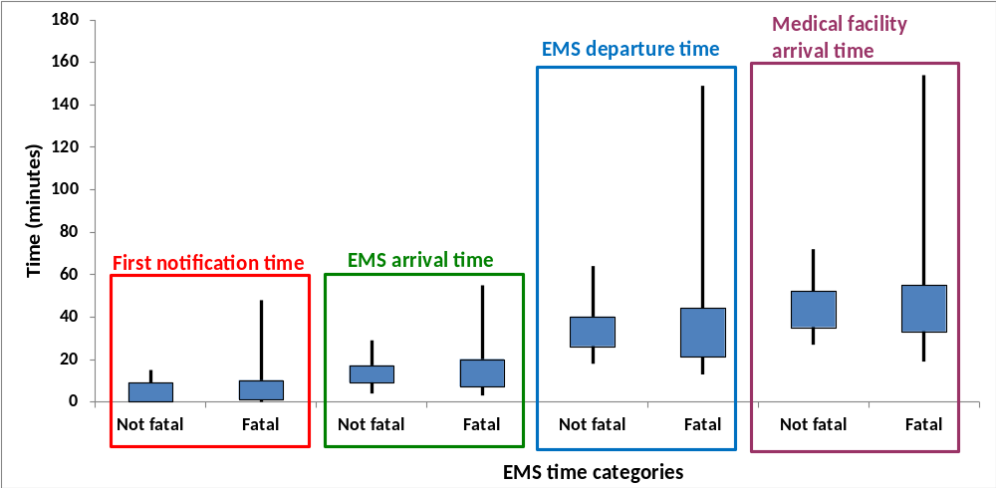
Descriptive Analysis: EMS times
Potential Benefits of an Automatic Injury Notification System in Reducing Motor Vehicle Crash Fatalities
Dipan Bose, Jeff Crandall, Gerald McGwin, Jay Goldman, Jeff Foster, Russ Fine
Contact : dbose@virginia.edu

Slide 8
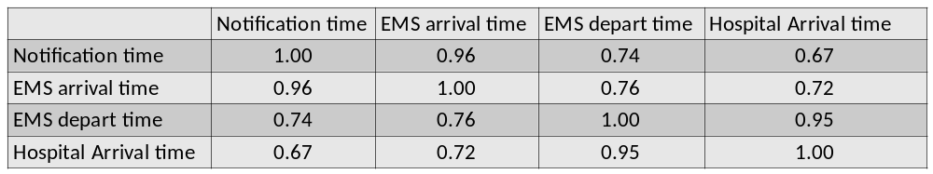
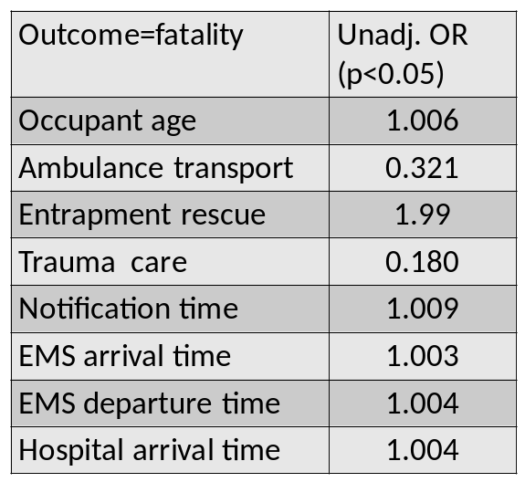
Results
Pearson’s partial correlation coefficients
(controlling for fatality, EMS by air, entrapment, trauma care)
Univariate Poisson Regression Model
Potential Benefits of an Automatic Injury Notification System in Reducing Motor Vehicle Crash Fatalities
Dipan Bose, Jeff Crandall, Gerald McGwin, Jay Goldman, Jeff Foster, Russ Fine
Contact : dbose@virginia.edu

Slide 9
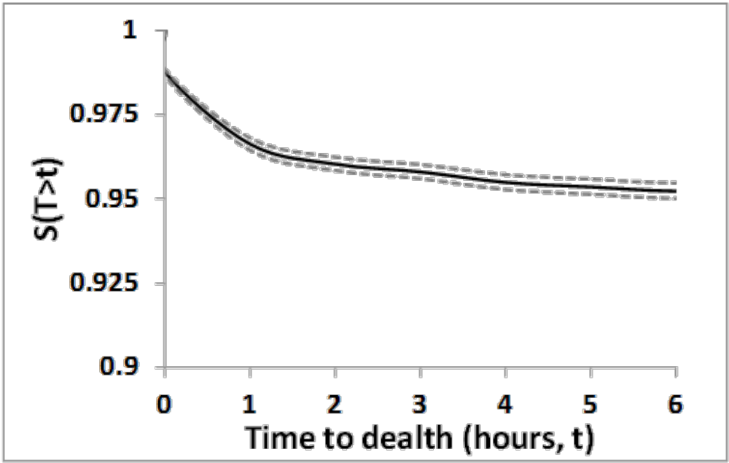
Results
Cox’s Proportional Hazard Survival model
Predicted survival for a male victim not entrapped, ground transported via ambulance taking 40 minutes to a trauma care center
Potential Benefits of an Automatic Injury Notification System in Reducing Motor Vehicle Crash Fatalities
Dipan Bose, Jeff Crandall, Gerald McGwin, Jay Goldman, Jeff Foster, Russ Fine
Contact : dbose@virginia.edu

Slide 10
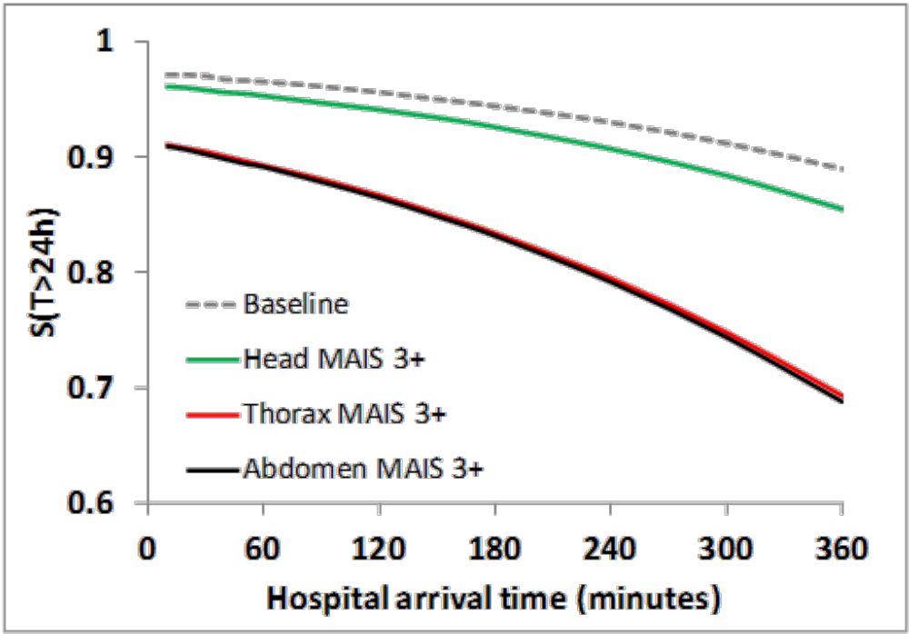
Results
Predicted probability of surviving 24 hours as a function of hospital arrival time
Potential Benefits of an Automatic Injury Notification System in Reducing Motor Vehicle Crash Fatalities
Dipan Bose, Jeff Crandall, Gerald McGwin, Jay Goldman, Jeff Foster, Russ Fine
Contact : dbose@virginia.edu

Slide 11
Conclusions
Compared to first notification time and EMS arrival time, the time to arrive at the hospital was a better predictor to estimate survival probability
Severe injury (AIS 3+) to specific body regions (e.g., thorax, abdomen) may affect the survival rate as a function of EMS times
Automatic prediction and notification of injury severity is necessary to improve overall survival of victims involved in severe motor vehicle crashes.
References:
Clark, DE, and Cushing, BM, 2002. Predicted Effect of Automatic Crash Notification on Traffic Mortality. Accident Analysis and Prevention, 34 (2002), 507-513
Champion, H. R., Augenstein, J. S., Blatt, A. J., Cushing, B., Digges, K. H., Flanigan, M. C., et al. (2005). New tools to reduce deaths and disabilities by improving emergency care: urgency software, occult injury warnings, and air medical services database. The 19th Enhanced Safety of Vehicles (ESV) conference, Washington, DC
Potential Benefits of an Automatic Injury Notification System in Reducing Motor Vehicle Crash Fatalities
Dipan Bose, Jeff Crandall, Gerald McGwin, Jay Goldman, Jeff Foster, Russ Fine
Contact : dbose@virginia.edu

