Slide 1
Aging in America
Myra G. Schneider, PhD, MSW
Natalie S. Burke
CommonHealth ACTION/
Institute for Public Health Innovation
Washington, DC

Slide 2
Presenter Disclosures
Myra G. Schneider, PhD, MSW
The following personal financial relationships with commercial interests relevant to this presentation existed during the past 12 months:
“No relationships to disclose”

Slide 3
Introduction
Aging is not ‘lost youth’ but a new stage of opportunity and strength. ˜Betty Friedan
Americans are living longer than ever before
Life expectancy rose to a record 78.2 years in 2009, up from 78.0 years in 2008 (CDC)
By 2050, over 88.5 million Americans will be over 65
How prepared are American communities for this historic demographic shift?

Slide 4
Introduction
Families have become more mobile - often unable to care for their aging family members
The challenge of geographic distance and the stress of care-giving can exact a heavy emotional, physical, and financial toll among those who provide care (44 million persons are informal caregivers)
Older adults have few choices in assisted living situations that provide more options than just home or nursing home care
Older adults have shown a growing desire to age in place

Slide 5
Introduction
Decreasing individual and familial wealth - widening gap between upper and lower income levels
Reductions in government resources will affect older people unequally
Issues of greatest concern: increasing rates of poverty and homelessness among the elderly, increasingly fragile Medicare system
Absence of comprehensive, national dialogue focused on systemic preparation for large numbers of seniors with limited economic means, expanding health needs, living alone, often at significant distances from their families
Public health efforts must be focused on addressing the social and economic determinants of risk associated with an older and less economically viable population

Slide 6
Introduction
In 2005 CommonHealth ACTION (CHA) conducted a survey that explored what Americans were thinking - and perhaps doing - to prepare for aging (N=404)
In 2010, CHA launched an expanded survey (N=1,022)*
In 2011, CHA launched a more extensive survey, including additional items on caretaking, preventive health care, and the effects of the economic downturn on health and retirement (N=2,103)
Findings will serve as the basis for public policy debate, increased advocacy efforts, increased public awareness regarding the need for aging preparedness, increased individual, public, and private sector preparedness for the growing needs of older Americans
*See Aging Report at:
http://www.commonhealthaction.org/2010AgingReport-CHA.pdf

Slide 7
Survey Design
Forty one survey items included:
Availability of aging resources in respondents’ communities
Reliance on social security
Whom they would rely on for care (e.g., spouse, family member, friend, paid professional)
Where they planned to live after age 65 (e.g., their own home with help, home of family member, nursing home)
Preventive health maintenance (i.e., routine medical care, exercise, weight maintenance, eating choices); available community resources for maintaining their health; chronic disease self-management
Overall confidence in American systems being equipped for the increasing age of the population (e.g., safety net components [Social Security, Medicare])
Qualitative questions embedded in quantitative items

Slide 8
Survey Items
To obtain a sense of their concern about the future related to aging, respondents rated their level of worry (i.e., very worried, worried, somewhat worried, not worried at all) about potential aging/retirement issues:
- Assisted living/nursing home needs
  - Preparing meals
  - Cost of food
  - Being alone
  - Getting sick
  - Health care costs
  - Home maintenance/repairs
  - Finances
  - Not being useful to/valued by others
  - Prescription medication costs
  - Property tax increases
  - Providing care/care-giving for a spouse/partner
  - Reductions in Medicare coverage
  - Social Security
  - Transportation needs

Slide 9
Survey Items
Five items explored respondents’ future retirement plans:
Whether they planned to retire
At what age
To what extent they would be prepared to provide for their personal needs in retirement (very prepared, prepared, somewhat prepared, unprepared)
How they thought they would pay for long term care
Whether they thought aging resources would be affordable in the future

Slide 10
Survey Items
Five items addressed access to and use of technology as age:
Broadband Internet connection in homes or via cell phone
Anticipate using email, social networking tools, computer technology to stay in contact with friends and family in senior years (65+)
Anticipate using the Internet and online tools to manage health in their senior years (e.g., documenting blood pressure, blood sugar, or weight loss efforts)
Anticipate using the Internet to access information and services in senior years
Identify specific barriers to Internet usage over the age 65; open-ended responses permitted

Slide 11
Survey Items
Respondents were asked to share perspectives about:
Confidence in the capacity of the federal government to support their needs as they age
Suggestions about actions the federal government could take to prepare better for larger numbers of older Americans
Entities beyond the federal government that could be involved in preparing for greater numbers of older Americans
General comments about aging in America

Slide 12
2011 Survey
Survey responses collected on CHA website July-October, 2011
Additional survey items:
  Type of health insurance
  Effects of economic downturn on retirement
  Community resources needed for aging in place
  Caretaking – policy changes needed
  Major health concerns with aging
  Self-rated physical/mental health

Slide 13
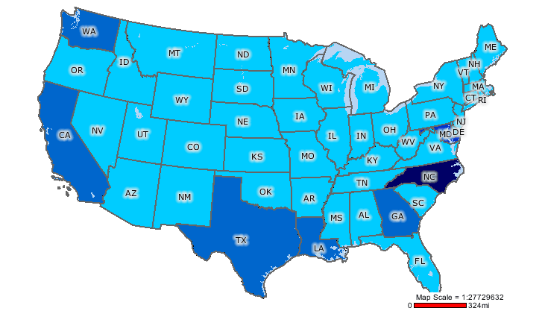
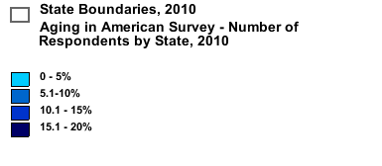
2010 Survey

Slide 14
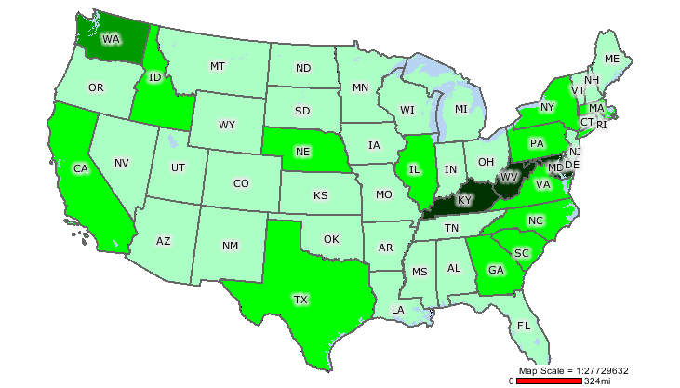
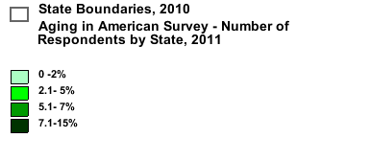
2011 Survey

Slide 15
2010 Demographics
Age | Gender | Race | Education
18-29 7.3% | Women 78.6% | White 65.8% | Elementary 0.2%
30-40 14.6 % | Men 21.4% | Black 19.6% | High School 3.3%
41-64 64% |  | Hispanic 7.0% | Technical/trade 2.6%
65-75 11.2% |  |  | College 23.8%
76-90 2.7% |  |  | Graduate 49.6%
2011Demographics
Age | Gender | Race | Education
26-35 13.5% | Women 82.8% | White 78.8% | Elementary 0.0%
36-45 13.1% | Men 17.2% | Black 12.6% | High School 3.1%
46-55 21.3% |  | Hispanic 4.7% | Technical/trade 2.3%
56-64 30.6% |  |  | College 25.7%
65-74 14.3% |  |  | Graduate 44.2%
Notes:
Left out some categories – don’t add to 100%

Slide 16
2010 Demographics
Marital Status | Living Status | Employment | Income
Single 17.9% | Alone 22.5% | Full time 75.4% | $10-35K 14.3%
Married 58.6% | Spouse 48.1% | Part time 12.4% | $35-50K 19%
Divorced 14.1% | Partner 6.5% | Unemployed 1.8% | $50-75K 27.1%
Partnership 6.5% | Family 18.2% | Retired 8.8% | $75-100K 17.5%
Widowed 3.8% | Other 4.7% |  | $100-150K 12.3%
2011 Demographics
Marital Status | Living Status | Employment | Income
Single 17.4% | Alone 22% | Full time 72.8% | $10-35k 12.9%
Married 58.1% | Spouse 46.7% | Part time 10.8% | $35-50k 15.9%
Divorced 15.2% | Partner 6.8% | Unemployed 2.4% | $50-75k 21.6%
Partnership 4.3% | Family 18.2% | Retired 12.1% | $75-100k 17.0%
Widowed 4.9% | Other 6.3% |  | $100-150k 13.3%
Notes:
Left out some categories – don’t add to 100%

Slide 17
Demographics
Education

Slide 18
Retirement

Slide 19
Retirement
More whites (81%, 85%)* than blacks (71%, 82%) or Hispanics (66%, 82% ) planned to retire
More college graduates (80%, 84%) than high school graduates (61%, 74%) planned to retire
More respondents in the middle income range ($50,000-$74,000) (84%, 84%) than in other income categories planned to retire
The highest proportion of respondents reported they planned to retire at age 65-67 (35%, 36% )
*2010, 2011

Slide 20
Retirement
 | 2010 | 2011
Retired | 15% | 17%
Receive Social Security | 13% | 17%
Rely 100% on SS check to survive (100%) | 11% | 14%
Plan to retire | 77% | 84%
Plan to retire at age 65-67 | 35% | 36%
Plan to live in own home after age 65 | 59% | 61%
Plan to care for self after age 65 | 77% | 71%
Health care costs - very worried | 37% | 42%
Thought about how to pay for long term care | 64% | 54%
Transportation needs – somewhat worried | 45% | 39%
Reductions in Medicare – very worried | 25% | 36%
Social Security – very worried | 28% | 37%
Unprepared to meet needs for retirement | 16% | 19%

Slide 21
 |  | 2010 | 2011
Unprepared to meet needs for retirement | Women Men White Black Hispanic | 16% 16% 12% 21% 31% | 20% 14% 17% 23% 25%
Plan to live at home | Women Men White Black Hispanic | 57% 65% 57% 63% 63% | 60% 67% 61% 67% 61%
Plan to care for self | Women Men White Black Hispanic | 77% 77% 79% 75% 75% | 71% 68% 73% 66% 64%
Health care costs – very worried | Women Men White Black Hispanic | 38% 32% 36% 33% 42% | 44% 35% 42% 38% 51%

Slide 22
Aging and Retirement Resources
Higher percentages of men (52%, 45%)* than women (42%, 36%) would rely on spouse for care; more women than men would rely on their children, siblings, or other family members, and would live with family members
Higher percentages of whites (12%, 8%) than blacks (5%, 5%) or Hispanics (2%, 4%) reported they would live in a nursing home
Similarly, higher percentages of whites (73% ) than blacks (66%) or Hispanics (64% ) would care for themselves or pay a professional to provide their care
Higher percentages of blacks and Hispanics than whites would rely on a family member or friend for care and would live in the homes of family members
*2010, 2011

Slide 23
Aging and Retirement Resources
 | Nothing Saved | No Health Insurance
Total | 26% | 3%
Age 46-55 56-64 65-74 | 35% 20% 14% | 4% 4% 0.7%
Gender Female Male | 27% 22% | 4% 3%
Race/ethnicity White Black Hispanic | 24% 34% 26% | 2% 8% 8%
Education High school Technical/trade College Graduate | 43% 43% 28% 20% | 2% 4% 3% 2%

Slide 24
Aging and Retirement Resources

Slide 25
Aging and Retirement Resources
Qualitative Responses
Hope to age in place - family and community support fundamental
We need “informal care systems and opportunities for seniors to contribute and feel valued, and flexible policies that allow seniors to maintain independence.”
“Put money into home health care programs and home modification programs so people can age in their own homes.”
“Adequately fund programs that support independent living and ensure services regardless of income.”
Adequate and affordable housing, transportation and services crucial to aging in place
“We must provide seniors with safe, affordable housing and improve transportation systems in rural and suburban areas.”
“We as a nation are terribly behind in addressing our growing need for services, transportation…for the coming surge of aging Americans.”
“There needs to be a new vision of aging with services in place to support independent living as opposed to nursing home care... increase in community health programs..”

Slide 26
Aging and Retirement Resources - 2011
Respondent selections for community resources for aging in place
  87% - Safe/secure community
  84% - Affordable/available transportation
  84% - Affordable/appropriate housing options
  81% - Affordable/available home based services
  80% - Opportunities for walking/bicycling/other forms of physical activity
Respondent selections for policy changes needed for caretakers
  89% - Available/affordable in home health/support services
  79% - Dependent care tax credit
  78% - Business policies to aid working caregivers
  72% - Social security credit
  70% - Change in Americans with Disabilities Act to protect people with AD

Slide 27
Policy Changes Needed for Caretakers
Qualitative responses
“It is hard to hold a full-time job and take care of someone...“
“The most important thing caregivers need is a helping hand, assistance with the task of care-giving. This requires flexibility on the part of businesses to give their employees the time necessary when circumstances are dynamic at home. It also requires an economic policy that offsets the expenditures families must make to provide care for their elderly family members.”
“Family members will be the number one care providers for elderly relatives. Services, policies and programs should be developed now to enable those caregivers to provide safe and affordable care to family members while continuing to work.”

Slide 28
Internet Access and Use of Technology 2010
(58%, 52%)* anticipated no barriers to use after 65
(75% , 61%) retired respondents anticipated no barriers to Internet use
(47%, 46%) of Hispanics selected cost of broadband as a deterrent to Internet use as compared to (36%, 30%) blacks and (30%, 37%) whites
More women (35%, 39%) than men (25%, 27%) reported cost of broadband as a barrier to use
More divorced people (46%, 44%) would be deterred by cost than single (33%, 36%) or married (31%, 36%) people
(55% , 55%) of high school graduates as compared with (28%, 29%) with graduate degrees considered cost a deterrent
Lower percentage would use Internet to manage their health in senior years (60%, 56%), compared to using the Internet for social networking (93%, 90%), or to access information/services (93%, 86%)
* 2010, 2011

Slide 29
Barriers to Internet Access and Use of Technology - 2011
Demographic characteristics | Cost | Availability | Cost/ computer | Unskilled in using computer | Don’t trust security | Nothing would prevent
Total | 37% | 13% | 19% | 6% | 18% | 52%
Age 46-55 56-64 65-74 | 43% 37% 28% | 17% 12% 11% | 22% 21% 17% | 4% 5% 12% | 16% 22% 19% | 47% 50% 57%
Gender Women Men | 39% 27% | 14% 11% | 20% 16% | 6% 5% | 18% 16% | 50% 60%
Race/ethnicity White Black Hispanic | 37% 30% 46% | 13% 9% 14% | 19% 16% 21% | 6% 4% 6% | 17% 14% 17% | 52% 59% 46%
Education High school Technical/ trade College Graduate | 55% 49% 41% 29% | 18% 11% 16% 12% | 34% 34% 22% 14% | 13% 9% 7% 4% | 21% 28% 19% 16% | 34% 40% 46% 60%

Slide 30
Internet Access and Use of Technology
Qualitative Responses
Concern about security of electronic information, especially medical records
Reluctance about using email, social networking tools: concerns about privacy, potential for identity theft
Concern that telemedicine might replace a personal, face-to-face relationship with health care providers
Concerns about keeping up with technological innovations
Physical impairments that often accompany aging (e.g., reduced visual acuity, arthritic conditions) potential barriers
Potentially positive role of technology in improving the management of aging in place; time to keep up with computer technology as age

Slide 31
Health
Practice preventive health measures
    2010 Yes 93%
2011 Yes 92%
Diseases/conditions of most concern
  50% - Cancer
  49% - Alzheimer’s
  43% - High blood pressure
  42% - Dementia
Self rated health
  Physical health - Very Good 37%
  Mental health - Very Good 33%

Slide 32
Confidence in Government’s Ability to Support Aging Population
Decreasing capacity of individuals to afford retirement has intensified concerns about federal government’s capacity to support its growing aging population, and about allocation of increasingly scarce resources

Slide 33
Confidence in Government’s Ability to Support Aging Population
Over half 54%, 66%)* not confident at all that the federal government would support their needs as they aged
(46% 32%) of blacks somewhat confident, while (56%, 66%) of whites and (60%, 66%) of Hispanics not confident at all
Blacks rated the government as being somewhat prepared on more items than did whites or Hispanics
Significantly more women (57%, 68%) than men (46%, 54%) not confident that federal government would support their needs as they aged
Higher proportion of respondents with lower educational attainment and income not confident at all about government’s capacity to support their needs as they aged
*2010, 2011

Slide 34
How prepared is the federal government to address these needs?
 |  | Somewhat prepared | Not Prepared
Affordable assisted living facilities | 2010 2011 | 30% 23% | 53% 62%
Affordable nursing home facilities | 2010 2011 | 30% 24% | 53% 62%
Affordable health care | 2010 2011 | 36% 32% | 49% 56%
Affordable home health care | 2010 2011 | 31% 25% | 51% 61%
Affordable transportation | 2010 2011 | 32% 35% | 46% 46%
Affordable options for physical activity and exercise | 2010 2011 | 32% 32% | 35% 47%
Adequate senior centers | 2010 2011 | 36% 36% | 33% 45%

Slide 35
Confidence in Government’s Ability to Support Aging Population
Qualitative Data
Individual not governmental responsibility to provide for aging needs
Seniors will have increased influence on legislation and federal programs due to growing numbers - baby boomers will push for better programs and services: “Baby boomers will change the face of aging.”
On other hand, growing size of aging population and diminished government capacity over time due to the numbers
Current recession will undermine government’s ability to provide resources for aging population. “The current state of the economy makes me unsure and uneasy.”
“I feel somewhat confident the government will not let the aging population go without any assistance; however, how much assistance will be provided will be the question moving forward. “
Potential for emerging conflict between the generations due to shrinking resources

Slide 36
Confidence in Government’s Ability to Support Aging Population
Particular challenges facing low income and rural seniors:
“The federal government does not understand the plight of low-income seniors nor do they understand the lack of resources for seniors in small rural communities.”
“The rich keep getting richer and the gap continues to grow.”
Majority did not think the federal government alone could adequately prepare for the vast numbers of an aging population:
Solicit help from: individual communities, state, local governments, health care professionals, public health professionals, pharmaceutical companies, social service agencies, aging services, employers , faith community, educational institutions, policymakers

Slide 37
Limitations
Higher levels of income and education relative to general US population
Notwithstanding higher SES, a more representative group of respondents would likely report similar, if not higher levels of concern about retirement resources
Numbers of retired and oldest age respondents relatively small
Respondents age 41-64 represented largest number of survey participants, likely attributable to outreach strategies for the survey
Members of this age group likely to express concerns and provide insights most relevant/ informative on aging and retirement preparedness, given they are approaching the latter end of aging continuum
Despite limitations, survey responses created a sufficient sample size to examine responses by ethnicity and gender

Slide 38
Conclusions
Pervasive uncertainty and apprehension about the government’s ability to support an aging population, the future cost and availability of health care, and the availability of affordable housing and transportation
Respondents hoped to remain independent and age in place but continue to be concerned about resources available to support their needs
Worried about impact of struggling economy on current and future resources
Women reported lower preparedness ratings than men to provide for their personal needs
Based upon existing economic and social challenges, women and older members of historically disadvantaged groups will be particularly vulnerable to reductions in government resources

Slide 39
Policy Implications
Make recommendations for public policy to support community-based preparedness strategies
Leverage international research and evidence-based strategies and models to develop effective models for the US
Develop effective measures of aging preparedness and quality of life for seniors, identify gaps/areas for improvement, identify effective policies, models, practices
Work collaboratively to develop and pilot local community based models of aging preparedness that support healthy aging
Advocate for comprehensive resource allocation to advance aging in place
Conduct research to inform the development of effective public policy that supports healthy aging and improves the economic viability of the aging population

