Slide 1
Finding opportunities for program refinement:
An Evaluation of an Education Initiative Regarding HIV Vaccine Research Involving Key Influencers in Communities Impacted by HIV/AIDS
American Public Health Association
Annual Conference
October 31, 2011
Caroline McLeod, PhD
Dan Eckstein, MA
Lisbeth Jarama, PhD
Paul Young, MBA, MPH
NOVA Research Company
Notes:
We are external evaluators, contracted by NIAID to provide a different perspective on what is working in the Initiative, what could be improved.

Slide 2
Presenter Disclosures: Caroline McLeod
The following personal financial relationships with commercial interests relevant to this presentation existed during the past 12 months:
No relationships to disclose

Slide 3
Introduction
National Institute of Allergy and Infectious Disease (NIAID) HIV Vaccine Research Education Initiative (NHVREI)
Key Influencers
Lessons from the Evaluation
Notes:
NHVREI was sponsored by NIAID

Slide 4
NIAID HIV Vaccine Research Education Initiative (NHVREI)
Goals
Increase awareness of need for an HIV vaccine
Improve knowledge of and positive attitudes toward HIV vaccine research
Enhance partnership between community & researchers
Create support for current and future HIV vaccine trials
Focus
Populations highly impacted by HIV/AIDS
  African American
  Hispanic/Latino
  Men who have Sex with Men (MSM)
Notes:
NHVREI goals are to build knowledge and positive attitudes regarding HIV vaccine research, with a particular focus on AA, HL, and MSM.
We’re using the term men who have sex with men to include gay men, bisexual men, and men who do not self-identify as either of these.
The program was implemented by a company with a background in HIV prevention and relationships to members of communities highly impacted by HIV/AIDS.
NOVA is an external evaluator of the project.

Slide 5
NHVREI Simplified Logic Model
Program Activities
Intermediate Objectives
Long-Term Objectives
Goal
National Partnerships
Increase support through key influencers/ community leaders.
Disseminate accurate HIV vaccine messages through formal and informal media channels.
Local Partnerships
Increase support at multiple levels:
Individual
Social Networks
Communities.
Increase support for HIV vaccine research among populations most affected by the epidemic.
Media & Message
Development & Dissemination
Advisory Groups
Notes:
Here is a simplified version of the logic model for NHVREI.
Key Influencers are central to NHVREI activities, in their roles as funded National and Local Partners and members of Advisory Groups.
Intermediate project objectives were the focus of the evaluation

Slide 6
Environment
Wide distrust of clinical trials and health care providers in communities highly impacted by HIV/AIDS
  Distrust founded on actual historical events
  Inaccurate information/myths abound
Results of HIV vaccine trials
Notes:
HIV vaccine research is being conducted in communities that have been disenfranchised in the past. Distrust is rampant based on historical facts (Tuskegee and Guatemala) and present experiences of discrimination.
In addition, inaccurate information and myths abound.

Slide 7
Overview of NHVREI Evaluation
Program Implementation (1)
Key
Influencers (2)
Target
Populations (3)
Document Review
Stakeholder Interviews
Staff Interviews
Focus Groups
KI Survey
Highly Impacted Population Survey
Notes:
There are three parts to the evaluation. I will talk about parts of the evaluation that examined information from Key Influencers.

Slide 8
Qualities of Key Influencers
Act as trusted evaluators of information
Influence lay persons’ knowledge, attitudes, and behaviors
Impact policymakers’ and researchers’ understanding of community concerns and priorities
Exert influence via social networks
  Facilitate adoption of accurate knowledge
  Can catalyze positive attitudes within the community
Notes:
8
We refined definition based on our observations of Partners in action during NHVREI.
(Not passive conduits)
Bidirectional nature of the relationship.
We observed Partners informing NHVREI, particularly in development of materials and methods for communicating complex ideas.

Slide 9
Stakeholder Interviews
Challenges
  Translation of scientific language to lay community
  Deep-rooted societal problems
Key Influencers
  Defined differently in different communities; need for flexibility
Notes:
Clinical trial results complex and hard to understand for persons without specific applicable background knowledge in virology, biology, clinical trails
Encounter Racism, homophobia, health disparities, and immigration issues
Partners collaborate with a range of influential peers defined differently in different communities

Slide 10
Partner Focus Groups
Work to create dialogue with the community
Address myths and misperceptions at all levels
Tailor materials for maximum effect
Local collaborations build permanent improvement in organizational capacity
Improve KI scientific knowledge
  Content
  Analysis
  Communication
Notes:
Six focus groups with ## Partners funded by NHVREI to assist in development and dissemination of vaccine research education
Dialogue rather than hard sell.
Repeated contact with accurate message, be open to hearing disagreement.
Materials tailor made for community, but also need “one size fits all”. Materials used in different creative ways, dissemination of the right message critical
Local collaborations increase organizational capacity, a real attraction to organizations with tight funding. Collaborative relationships remain after funding leaves.
Increase in scientific knowledge among Key Influencers, including specific content, but more importantly the ability to analyze scientific information and communicate it to the community in accessible language.

Slide 11
Creating Support for HIV Vaccine Research
Awareness
Action
Awareness of HIV Vaccine Research
Willingness
to
Take Action
Supportive
Actions
Personal
Work-Related
Attitudes
Knowledge
Social Networks
Notes:
11
Awareness is not enough.
Social networks mediate attitudes and knowledge, and finally action.
Relationships needed to allow accurate information to be considered
Development of instrument.
Need to understand the full continuum of attitudes and knowledge that lead to action in order to understand where intervention is necessary.

Slide 12
Key Influencer Survey
Online survey
Respondents were individuals associated with influential organizations (N=546)
Recruitment by mail, email, telephone
Incentive
  $25 amazon.com link
Response rate of 69%

Slide 13
Key Influencer Survey
Collaborators
  Contact with NHVREI or Partners
Matches
  No direct contact reported with NHVREI
  From cities without local partner or clinical trials site
  Matched for type of org, target population, similar organizational position
Notes:
Collaborators did not include the NHVREI Local and National Partners, who received significant funding to conduct NHVREI-related activities. Be sure to explain “HVTN site.”

Slide 14
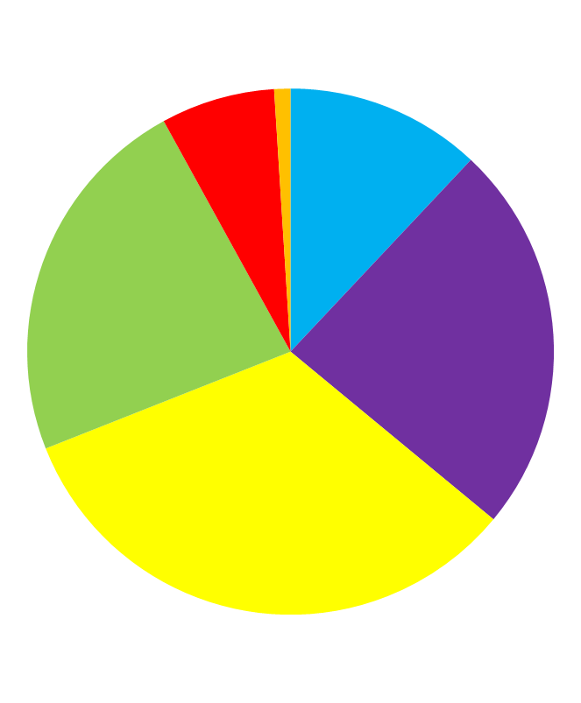
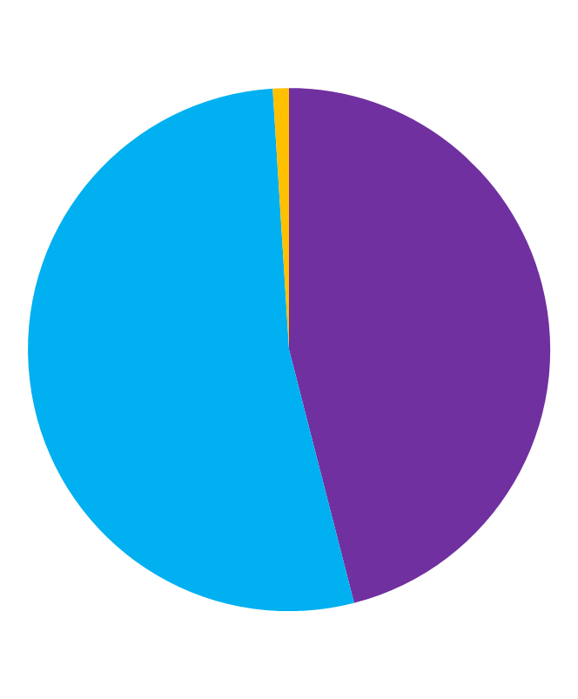
Sample Characteristics
Over 70
1%
Transgender
1%
71-70 years
7%
21-30
years
12%
51-60 years
23%
Male
46%
31-40 years
24%
Female
53%
41-50 years
33%
(N=543)
(N=542)
Age
Gender
Notes:
Most respondents are over 40
Even male and female

Slide 15
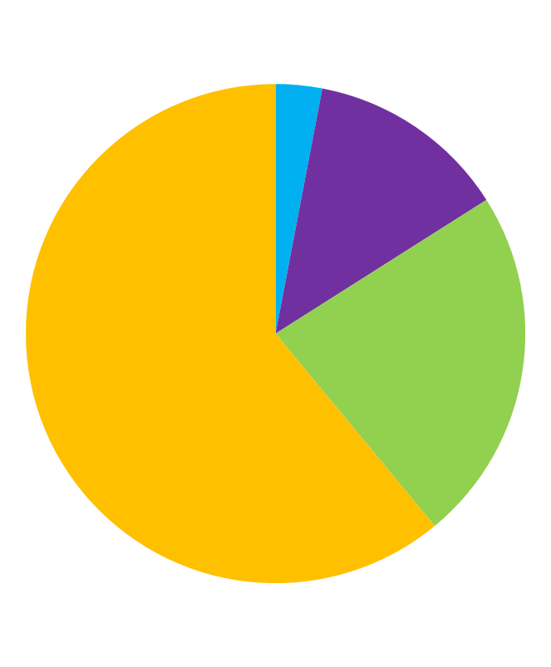
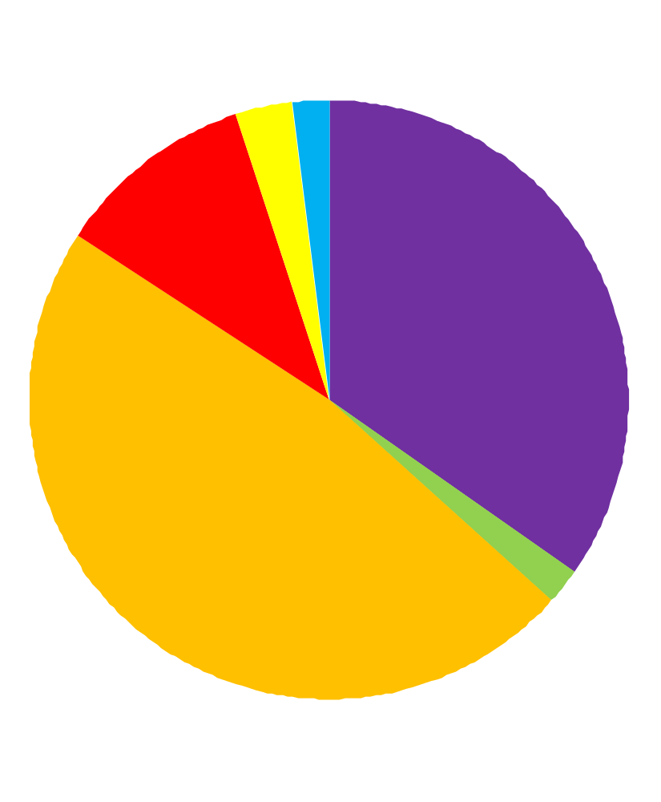
Sample Characteristics
HS Grad/GED
3%
American Indian/
Alaska Native/
3%
Asian/Other
2%
Some
College
13%
White
(Hispanic)
11%
Black/AA
(Non-Hispanic)
35%
Beyond
College
61%
College
Graduate
23%
White
(Non-Hispanic)
48%
Black/AA
(Hispanic)
2%
(N=543)
(N=543)
Education
Race/Ethnicity
Notes:
61 percent have been to grad school.
Half white, presumably most serving MSM communities
Asian and other 2%
Black/African American Non-Hispanic 35%
Hispanic Black/African-American Hispanic 2%
White Hispanic 11%
White Non-Hispanic 48%
American Indian/Alaska Native and Other 3%

Slide 16

Respondents by Organization Target
N=543
Notes:
A bit more than one third of the sample work for organizations serving African Americans and men who have sex with men. About one quarter serve Hispanic Latinos

Slide 17
Key Influencer Survey
Partners
(n=47)
Funded to work on NHVREI
Collaborators
(n=258)
Not funded
Matches
(n=241)
City without partner
Contact with NHVREI staff or Partners
Similar organization
Similar organizational position
Notes:
17
Three groups. Is there evidence for positive attitude and support moving from partners and NHVREI staff to collaborators? If so, collaborators should show signs of greater support for vaccine research then matches who have had no contact.

Slide 18
Differences in Support for
Vaccine Research
Items Related to Support for HIV Vaccine Research | Coll. (%) | Match (%)
Have heard about HIV vaccine research | 100 | 99
Very or extremely relevant to the community | 93 | 87
Have opportunity to spread the word | 77 | 67
Very or extremely willing to initiate conversation with client | 78 | 58
Have confidence in ability to increase support in community | 74 | 66
Confident that an HIV vaccine will be developed | 64 | 62
Have knowledge necessary to spread the word | 69 | 43
Have resources necessary to spread the word | 47 | 25
Initiated conversation at least 3 times in the last 3 months | 31 | 10
Awareness
Action
Notes:
Both groups aware. Awareness does not translate to action.
No differences between communities in attitudes or knowledge
Good consensus that HIV vaccine is relevant to the community, but after that, there are considerable differences between the groups.

Slide 19
Which Items Best Predict
Willingness to Take Action?
Forward Stepwise Regression 21 items
  Assessment of need for skills, knowledge, opportunity, resources, and materials
  Confident that vaccine will be developed
  Confidence in ability to increase support
  Safety concerns
  Factual knowledge about clinical trials
  Conspiracy (an HIV vaccine is being withheld as part of discrimination against certain groups)
  Social consequences
  Personal importance for increasing support
All items significantly correlated to willingness to speak to client about HIV vaccine research
19

Slide 20
Items Predicting
Willingness to Speak to Client
Important to me to increase support for… | β=.21
I have the opportunity to increase support for… | β=.19
Confident able to increase coworkers’ support for… | β=.21
Confident able to increase community’s support for... | β=.17
CT volunteers counseled to avoid risky behaviors | β=.22
Awareness
of HIV
Vaccine
Willing
to
Speak to
Client
20
Notes:
What factors are most important in building willingness to take supportive action?
Forward stepwise regression to identify items.
Five items that independently predicted willingness.
Beta coefficients indicate strength of independent relationship.
CT volunteers highly correlated to concerns of risk and knowledge of clinical trials.
20

Slide 21
Predicting Willingness to Speak to Client:
Interaction Between Conspiracy Belief and Community Served
“Vaccine is being unfairly withheld
related to discrimination against certain groups”
Extremely
Org Serves AA
r = -.07
Org Serves Other
r = -.25*
Not at all
Strongly
Disagree
Strongly
Agree
N=516
21
Notes:
We found no statistically significant differences in attitudes or beliefs between key influencers by the communities they served.
We did find a few interactions, one of which is shown here. It appears that if the Key Influencers serves the AA community, belief in a conspiracy is unrelated to willingness to speak to a client about vaccine research. For everyone else, if you believe that there is a conspiracy, you are less willing to take action.
The SAS System 10:13 Friday, May 27, 2011 545
The REG Procedure
Model: MODEL1
Dependent Variable: WILLINT Willing: Initiate a conversation with cl
Forward Selection: Step 1
Parameter Standard
Variable Estimate Error Type II SS F Value Pr > F
Intercept 4.10399 0.16705 607.58290 603.53 <.0001
* AAorg 0.16926 0.19319 0.77283 0.77 0.3813
* AGRDISB -0.30033 0.08568 12.36926 12.29 0.0005
aaoxadb 0.23006 0.09939 5.39416 5.36 0.0210
* Forced into the model by the INCLUDE= option

Slide 22
Summary
High levels of awareness do not translate into action
Information moving along social networks can address distrust and suspicion that otherwise undermine consideration of accurate or compelling messages
Key Influencers have similar attitudes across communities highly impacted by HIV/AIDS
  Except for issues of trust
More information needed about effect of NHVREI on Key Influencers over time to differentiate impact from selection effects
More information needed about “lay” Key Influencers
(i.e., those who are not professional educators)
Notes:
This slide in progress

Slide 23
Contact Information
Caroline McLeod, PhD
NOVA Research Company
cmcleod@novaresearch.com
Dan Eckstein, MA
NOVA Research Company
deckstein@novaresearch.com

