Slide 1
Where is My Doctor? Human Resources for Health - Gender and Reproductive Rights Perspectives.
By
Olufunke (Funke) Akiyode
Shout Global Health

Slide 2
Who are Health Workers?
The World Health Organization (WHO) defines a health care worker (HCW) as anyone whose focus or activity is to improve health. They are people engaged in the promotion, protection or improvement of the health of the population. This includes “family caregivers, patient-provider partners, part-time workers, health volunteers and community workers”
HCW can also be classified into three groups providers, technicians and managers¹. (World Health Organization. World health report 2000: health systems: improving performance. Geneva: WHO; 2000)

Slide 3
Who are Health Workers?
The WHO also classified health workers into the following categories:
Physicians
Nurses and Midwives
Dentists and dental assistants
Pharmacists
Laboratory scientists and technicians
Environment and public health workers
Community health workers and traditional healers
Other health care providers
Health managers and support workers²

Slide 4
Doctor - Patient Ratio (DPR)
The number of doctors per patient is known as the Patient Doctor ratio.
It is also referred to as doctor population ratio, and patient - doctor ratio.
The WHO recommended doctor – patient ratio is 1:600 (one doctor per 600 patients)³

Slide 5
Why are Doctor – Patient Ratio/ HCW Issues important?
India – during the bird flu pandemic – “It got media attention recently, when the bird flu broke out in different part of our country. It also grabs media attention in complicated/emergency situations, when the rural doctors ask the about-to-collapse patients to rush for trauma centers in the city hospitals. And many patients die on their way to the Intensive Care Unit (ICU) of the sophisticated hospitals located in the urban areas” ⁴

Slide 6
Why are Doctor – Patient Ratio/ HCW Issues Important?
Low patient doctor ratio will reduce the general health status
It increases the waiting time to see a doctor
Less time spent with a doctor
Errors in diagnosis
Patient not receiving medical care
All these can increase both maternal and infant mortality rates

Slide 7
Facts about Doctor Patient Ratio
It varies within countries and between countries
Usually there is a lower Doctor patient ratio in urban areas than in rural areas For example ratio of doctor to patient in the urban area in India is 1:1700 and for the rural population it is as high as 1:30,000⁵
Doctor to patient ratio is lower in high income countries compared to low income countries. For example the ratio is 1:50,000 in Tanzania and 1:320 in Netherlands⁶

Slide 8
Facts about Doctor Patient Ratio/ HCW
In 15 countries in sub-Saharan Africa, there are five or fewer physicians per 100,000 people – below the recommended 20 physicians per 100,000
Countries with less than 2.5 HCWs per 1,000 people were unable to provide 80% coverage for measles immunizations and deliveries by skilled birth attendants ⁷
World Health Report from 2006 estimates that Africa and Asia together lack more than 4 million health workers⁸

Slide 9
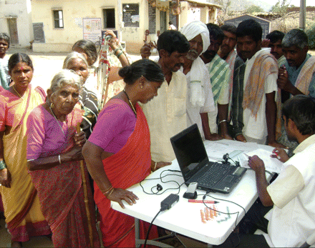
Crowds gathering around a mobile health station in India⁹

Slide 10
Global Variation in Doctor – Patient Ratio
High Income Countries | DPR | Low Income Countries | DPR
Great Britain | 1: 440 | Ethiopia | 1: 33,500
United States | 1:390 | Tanzania | 1: 50,000
Netherlands | 1:320 | Burundi | 1: 33,500
Japan | 1: 500 | Mali | 1: 12, 500
Canada | 1: 470 | Haiti | 1: 4, 000

Slide 11
High DPR and General Health Status Indicators (MMR, IMR, MR)
Country | DPR | Infant Mortality Rates | MMR | MR
Ethiopia | 1: 33,500 | 101 / 1,000 | 470/ 100,000 | 11.04/1000
Tanzania | 1: 50,000 | 66.93/ 1000 | 578/ 100,000 | 12.09/1000
Burundi | 1: 33,500 | 70.4 / 1000 | 1000/ 100,000 | 13.89/1000
Mali | 1: 12, 500 | 111.34/ 1000 | 580/ 100,00 | 14.29/ 1000
Haiti | 1: 4, 000 | 74 /1000 | 520/ 100,000 | 8.21/ 1000^{10,11}

Slide 12
Low DPR and General Health Status Indicators (MMR, IMR, MR)
Country | DPR | Infant Mortality Rate | MMR | MR
Great Britain | 1: 440 | 4.62/1000 | 7/100,00 | 10.2/1000
United States | 1:390 | 6.06/1000 | 8/ 100,000 | 8.03/ 1000
Netherlands | 1:320 | 10.37/ 1000 | 7/100,000 | 8.74/1000
Japan | 1: 500 | 3.28/ 1000 | 8/100,000 | 9.54/ 1000
Canada | 1: 470 | 4.82/1000 | 5/100,000 | 7.74/ 1000¹¹

Slide 13
Analysis of DPR and General Health Status
Countries with high DPRs have high infant mortality , maternal mortality and crude death rates
Countries with low DPRs have low infant mortality, maternal mortality and crude death rates

Slide 14
Global Variation in HCW and Burden of Disease
Africa carries 25% of the global burden of diseases but has 3% of the global health care workers
Americas and Europe both carry 10% of the global burden of disease but 28% and 37% of the global health care workers respectively¹².
Thus, we may conclude that the higher the health care workers, the lower the burden of diseases
Notes:
3rd point – less people to perform preventative care, immunization and so on

Slide 15
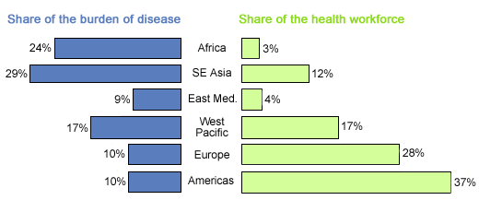
Global variation in HCW and Burden of Disease
7

Slide 16
Doctor to Patient Ratio and Maternal Mortality
“Pregnancy is not a disease, a woman should not die of pregnancy…it doesn’t need a new drug…it doesn’t need research – we just need skilled workforce at different levels,” Seble Frehywot of GWU ¹³

Slide 17
Doctor to Patient Ratio and Maternal Mortality
Increased access to skilled health workers during pregnancy and delivery, including midwives and other practitioners, can significantly reduce maternal mortality in developing countries
Many healthcare systems are faced with shortage of anesthesiologists, surgeons and obstetricians ¹⁴
Maternal mortality reduction shows the greatest sensitivity to the presence of skilled maternal health providers ¹⁵

Slide 18
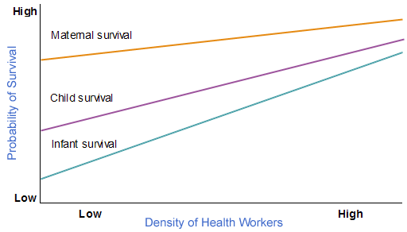
⁷
Notes:
http://www.globalhealth.org/health_systems/health_care_workers/

Slide 19
Doctor to Patient Ratio and Maternal Mortality
The higher the density of health workers , the higher the probability of infant survival, child survival and maternal survival.
Thus the lower the DPR, the lower the maternal mortality rates and vice versa

Slide 20
Gender and Doctor to Patient Ratio
The low number of health workers places a burden on women as the traditional care givers in many countries
The girl child might be denied basic needs like education, and social life in order to take care of the sick and elderly

Slide 21
Doctor to Patient Ratio and Reproductive Health
Reproductive Health has been defined according to the International Conference on Population and Development as a ‘state of complete physical, mental and social well being and not merely absence of disease or infirmity in all matters relating to the reproductive system and to its function and processes’
In countries and places where there is a shortage of HCW, women will lack access to full sexual and reproductive health care for example family planning services, and so on.

Slide 22
Doctor Patient Ratio and Reproductive Health Rights
Reproductive health right as defined in the Beijing Platform of action are certain human rights recognized in the national and international legal and human rights documents, including the basic rights of all couples and individuals to decide freely and responsibly the number and spacing of their children, and to have information, education and means to do so; the right to make decisions concerning reproduction free of discrimination, coercion and violence

Slide 23
Doctor Patient Ratio and Reproductive Health Rights
Low HCW will reduce access to reproductive health information and education
Thus violating RHR
Low access to family planning service, a violation of their RHR

Slide 24
Conclusions and Recommendations
To improve women’s RH and RHR, it is obvious that the density of HCW in many places in the world needs to be drastically increased
Some of the suggested ways include:
Short run
Move jobs from one sector to another and from urban areas to rural areas with incentives
Long run
Admit more qualified students into the medical schools
Employ Physician Associates

Slide 25
Bibliography
World Health Organization. World health report 2000: health systems: improving performance. Geneva: WHO; 2000
World Health Organization. Global Atlas of Global Health Care. Geneva internet accessed http://apps.who.int/globalatlas/docs/HRH/HTML/Dftn.htm, July 2010
MSNBC; Niger to double number of Doctors; internet accessed at http://www.msnbc.msn.com/id/42922300/ns/health, July 2010
Merrinews; High patient doctor ratio needs attention; internet accessed at < http://www.merinews.com/article/high-patient-doctor-ratio-in-india-needs-attention/133351.shtml>, July 2010
Unknown Authors; The Doctor patient ratio problem in India; internet accessed at < http://knowaboutvivek.blogspot.com/2011/03/doctor-patient-ratio-problem-in-india.html>, July 2010
Frank Jacobs; The patient per doctor ration map of the world; internet accessed at http://bigthink.com/ideas/21237 July 2010
Global Health Council; Health care workers; internet accessed at < http://www.globalhealth.org/health_systems/health_care_workers/#5>, July 2010
Ghana Business news; Doctor-patient ratio in Ghana to worsen as financial crisis deepens; internet accessed at < http://www.ghanabusinessnews.com/2009/02/10/doctor-patient-ratio-in-ghana-to-worsen-as-financial-crisis-deepens/>, June 2006
Natalie Alcoba; Canadian Medical Examination Journal; Hitting the road to alleviate India’s rural doctor shortage; internet accessed at < http://www.cmaj.ca/content/180/10/E34/F1.expansion.html> June 2011
The World Bank; Country and Lending Groups ; internet accessed < http://data.worldbank.org/about/country-classifications/country-and-lending-groups#Low_income> June 2010
Nation Master; Health Statistics by country; internet accessed at < http://www.nationmaster.com/graph/hea_mat_mor-health-maternal-mortality>, August 2010
World Health Organization. World health report 2006: working together for health. Geneva: WHO; 2006
Calyn Ostrowsk; Human Resoyrces for Maternal care; internet accessed < http://www.newsecuritybeat.org/2010/01/human-resources-for-maternal-health.html>, August 2011
Karl Krupp and Purnima Madhivanan; Leveraging human capital to reduce maternal mortality in India: enhanced public health system or public-private partnership?.; internet accessed at http://www.ncbi.nlm.nih.gov/pmc/articles/PMC2662781/}
Joint Learning Initiative: Human Resources for Health. [http://www.globalhealthtrust.org] website
Overcoming the Crisis Harvard University Press, Cambridge; 2004

