Slide 1

The Conversemos Model
Handout
MARCIA BAYNE-SMITH, PhD
Queens College, CUNY
Queens, NY

Slide 2
The “Conversemos” Model
Funded by Ford Foundation
A multi-component pilot study of a transnational HIV/AIDS prevention intervention that targeted Diasporan Africans in Latin America and the Caribbean (LAC)
Implemented in four sites: the Dominican Republic, Panama, and two communities in New York City
Served a total of 283 people over a 3 month period
In DR | In Pan | DR-NY | Pan- NY
82 | 69 | 72 | 60
Analysis:
Post cross tab analysis between
Knowledge variables and program
Participation. Changes in communication re HIV/AIDS, stigma and condom use were assessed using paired T-test analysis

Slide 3
Conversemos Results (partial listing)
Conversemos Program participants:
Increased knowledge
Reduced stigma
Increased condom use
Knowledge Items re Contracting HIV/AIDS | Pre | Post | Sig.
Only by having sex w/ gay or bi-sexual person | 0.18 | 0.08 | .00*
Healthy people do not get HIV/AIDS | 0.20 | 0.11 | .00**
Stigma Items
Person w? HIV can not care for children | 3.34 | 3.77 | .00**
Only hire people who do not have HIV/AIDS | 3.72 | 4.15 | .00**
Condom Use items
Only women who sleep around want condoms | 3.36 | 1.83 | .00**
Asking partner to use condoms=unfaithful | 3.37 | 3.74 | .00***

Slide 4
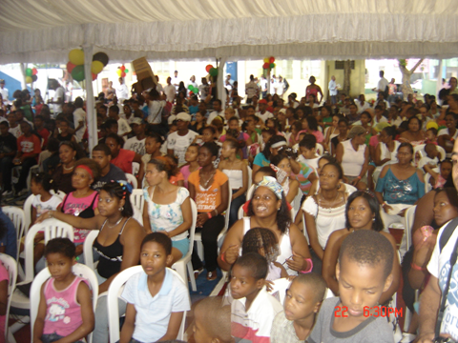
Graduation Ceremonies in
Guachupita, Santo Domingo, DR

Slide 5
Develop / Implement New Social Networking Techniques
The social networks developed in LAC to implement the “Conversemos” program, were critical in implementing a new social networking technique, based on two critical activities:
Community residents = Connected to contact staff at clinics, CBOs, hospitals, government agencies who also participated in the “Conversemos” training curriculum.
Program participants: community residents + agency staff- trained to: deliver prevention, health promotion messages to broad constituency, conduct deep community penetration and grassroots sustainability.

Slide 6
Conclusion
The results of this study of a transnational sample of people from Panama and the Dominican Republic living in country and in the US provide some statistically significant pre to post changes, specifically in terms of increased pre-to-post HIV knowledge by age (p<.05).
In addition, paired T tests illustrate that the statistically significant changes in the responses between the pre and post surveys are most likely a strong indication that the “Conversemos” Model may have contributed to reducing HIV/AIDS related stigma, and increasing condom use over the 3-4 month duration of the program.

