Slide 1

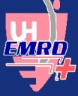

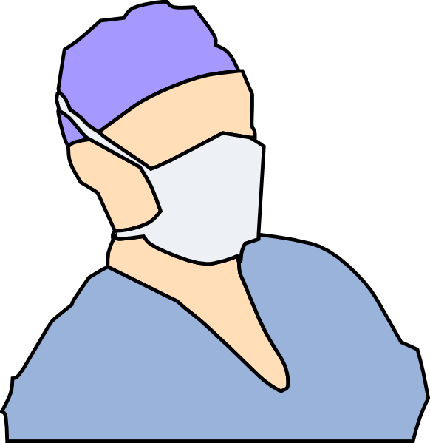
Facemasks in the Emergency Room
What do patients think?
Ramya Raman¹ BA; Apoorva Chandar¹ MBBS, MPH (2012); Meera Thakkar¹ BA/MPH (2012); Hilary Mohs¹ BS (2012); Scott Frank^{1,2} MD, MS; Vicken Totten² MD, MS
1. Case Western Reserve University, Cleveland, Ohio 2. University Hospitals Case Medical Center, Cleveland, Ohio
Background
Results
Results
Results (continued)
The use of facemasks during the medical encounter, continues to be a topic of debate and discussion.
Facemasks could potentially help in preventing transmission of airborne infections from patient to provider or other patients.
Facemasks may also provide psychological reassurance to both the parties concerned.
Facemasks might interfere with establishing a rapport between the patient and the physician.
Absence of a strong and clear Public Health policy regarding the use of facemasks.
Renewed interest in facemasks following the 2009 H1N1 pandemic.
Demographic Characteristics (Total N: 162)
Gender
Male: 45 (30%)
Female: 105 (70%)
Age
Young Adults: 63 (41.4%)
Adults: 58 (38.2%)
Elderly: 31 (20.4%)
Demographic Characteristics (Total N: 162)
Race
White: 47 (31.5%)
Non-White: 102 (68.5%)
Educational status
High School: 68 (46.3%)
Some College: 35 (23.8%)
Bachelor Degree: 20 (13.6%)
Graduate/Professional: 24 (16.3%)
Positive facemask attitudes were significantly more likely among non-white (p=.006) and less educated (p=.039) patients.
Fear of infection was significantly lower among men (p=.011) and the elderly (p=.066).
89.7% of patients with positive attitudes towards facemasks felt it was important for ED staff to wear them (p=.002).
71.2% with negative attitudes towards facemasks felt it was important for ED staff to wear them (p=.039).
Patients with fear of infection were more likely to believe that facemasks provided adequate protection (93.3% vs. 80.2%, p=.043).
Even patients with negative attitudes about facemasks believed them to be effective in preventing infection (p=.039).
Factor Analysis Table with Percent Responses to Individual Questions
Question/Variable | Positive attitudes towards Facemasks | Negative attitudes towards Facemasks | Fear of acquiring Infection | Attitudes towards Prevention Control | Agree (%) | Disagree (%)
I would be willing to wear a facemask in public to protect myself from illness | .506 |  |  |  | 72 | 28
Patients should wear facemasks in the ED if they are sick | .614 |  |  |  | 86.9 | 13.1
It is okay for people to wear facemasks at work or school if they are sick | .566 |  |  |  | 83.4 | 16.6
I would wear a facemask in the ED if I were to be sick | .710 |  |  |  | 88.1 | 11.9
I would wear a facemask at work or school if I were to be sick | .829 |  |  |  | 72.6 | 27.4
I would wear a facemask in public to protect ‘OTHERS’ from getting infected | .598 |  |  |  | 89.2 | 10.8
When I see a doctor or a nurse wearing a facemask, I feel afraid |  | .500 |  |  | 9.4 | 90.6
If the doctor comes into my room wearing a facemask, it means the doctor is sick |  | .729 |  |  | 87.4 | 12.6
If the doctor comes into my room wearing a facemask, it means I am sick |  | .667 |  |  | 34 | 66
I don’t want my doctor to wear a facemask while talking to me |  | .557 |  |  | 28.5 | 71.5
I worry about catching the seasonal flu |  |  | .752 |  | 56.5 | 43.5
I worry about catching swine flu (H1N1 influenza) |  |  | .731 |  | 50.3 | 49.7
It is unsafe to breathe the air in the ED |  |  | .565 |  | 56.5 | 43.5
A facemask will protect ‘ME’ from breathing in the germs in the air |  |  |  | .731 | 84.5 | 15.5
A facemask will protect ‘OTHERS’ from germs I cough or breathe out |  |  |  | .717 | 93.1 | 6.9
Facemasks are an effective method of preventing spread of infection |  |  |  | .636 | 78.8 | 21.2
Eigenvalue | 4.150 | 2.293 | 1.672 | 1.523
% of Total Variance | 18.862 | 10.424 | 7.601 | 6.924
Total Variance | 43.81
Objectives
Conclusions
Describe patient perspectives on facemask usage during an epidemic.
Analyze demographic differences in attitudes towards facemasks.
Identify relationships between infection fears and perceptions regarding facemasks, if any.
Patient acceptance of facemasks is high and they endorse the use of the same to prevent the spread of infection during an epidemic.
The elderly can be better convinced that facemasks are an effective protection against infection.
Fear of infection is influenced by gender, but its influence is minimal in determining attitudes towards facemasks.
Race is an important factor that influences perceptions of facemasks.
Future directions:
Survey tool needs to be retested with a larger sample size to increase validity.
Future surveys should focus on obtaining data from both physicians and patients.
Policy decisions enhancing the use
of facemasks need to be formulated.
Methods
Design: Descriptive study using a novel 22 item survey.
Setting: Emergency Department (ED) of a large urban Midwestern teaching hospital.
Sample: A convenience sample of 162 patients.
Analysis: Factor analysis using principal component analysis (PCA) with Varimax rotation yielded 4 factors explaining a total of 43.81% of the variance for the entire set of variables. Based on the loading, these 4 factors were labeled as “positive attitudes about facemasks” (6 items), “negative attitudes about facemasks” (4 items), “fear of acquiring infection” (3 items) and “prevention control attitudes” (3 items).

