Slide 1

How many California school children are exposed to high school-level rates of personal belief exemptions from childhood vaccines?
Alison Buttenheim
University of Pennsylvania School of Nursing
Malia Jones
UCLA School of Public Health
Yelena Baras
Perelman School of Medicine at the University of Pennsylvania
APHA Annual Meeting
October 31, 2011
Washington, DC

Slide 2
Presenter disclosures
No relationships to disclose

Slide 3
Annual measles cases (US) and Personal Belief Exemptions from school immunization mandates
Annual measles cases, US
Oregon
Personal belief exemptions/ 1,000 kindergarteners
California
Arkansas

Slide 4


Slide 5
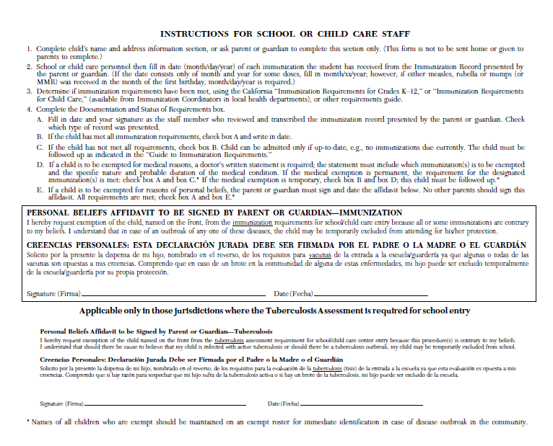

Slide 6
Research goal
Quantify the exposure of California kindergarteners to Personal Belief Exemptions (PBEs) at school
Assess trends statewide (2008-2010) and by county (2010)

Slide 7
Data
Publically available Kindergarten Assessment data for school years 2008-09, 2009-10, 2010-11 from California Department of Public Health
Includes all public/private schools offering kindergarten with kindergarten enrollment ≥ 10
Each school reports K enrollment and # of Ks who are:
    Up-to-date
    Conditional accept
    1+ PBE
Caveat: Not all children with PBEs are unvaccinated.

Slide 8
PBE exposure measures
Prevalence
Crude PBEs: # of Kindergarteners with 1+ PBE
PBE rate: Crude PBEs per 100 Kindergarteners per year

Slide 9
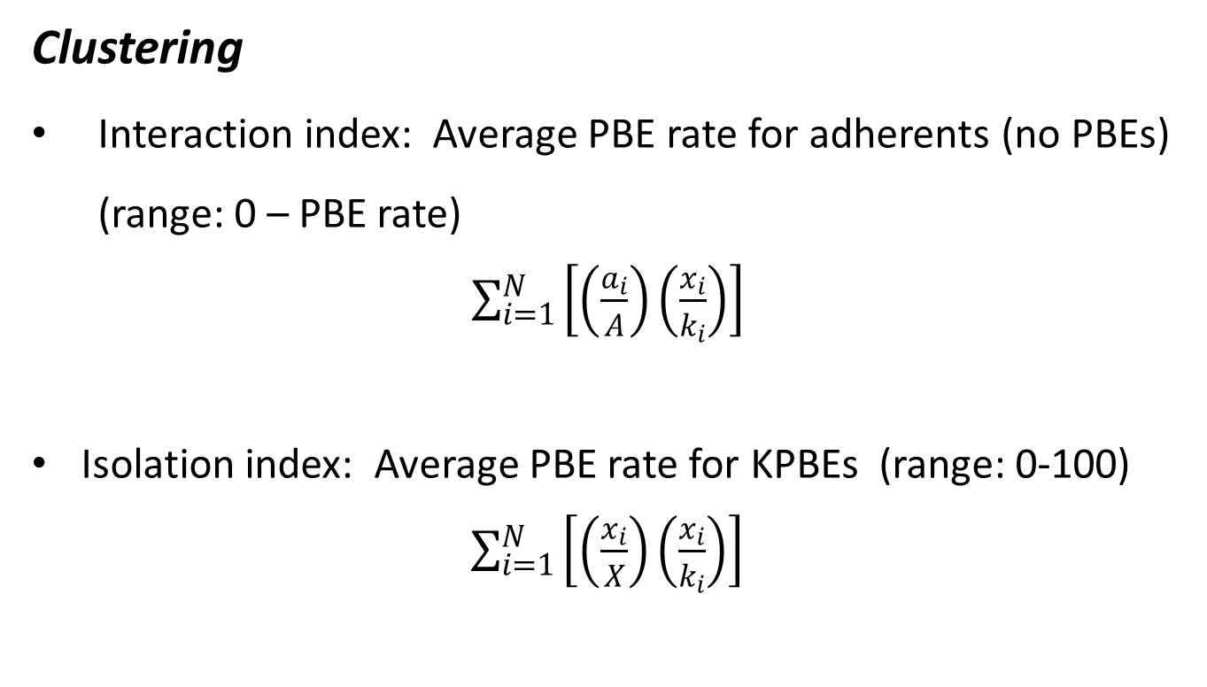
PBE exposure measures
Clustering
Interaction index: Average PBE rate for adherents (no PBEs) (range: 0 – PBE rate)
$\sum_{i=1}^{N}{\left[\left(\frac{a_{i}}{A}\right)\left(\frac{x_{i}}{k_{i}}\right)\right]}$
Isolation index: Average PBE rate for KPBEs (range: 0-100)
$\sum_{i=1}^{N}{\left[\left(\frac{x_{i}}{X}\right)\left(\frac{x_{i}}{k_{i}}\right)\right]}$
a_{i} = # adherents in school i
A = total # of adherents
x_{i} = # of KPBEs in school i
K_{i} = # of Ks in school i
N = number of schools

Slide 10
PBE exposure measures
Vulnerability
High-PBE schools (#/%):
  Crude PBEs > 20
  PBE rate > 20 per 100
K enrollment at high-PBE schools (#/%)
KPBE enrollment at high-PBE schools (#/%)

Slide 11
Statewide results (1)
 | SY2008-09 | SY2009-10 | SY2010-11 | % ∆ 2008-2010
Schools (n) | 7,173 | 7,174 | 7,163 | -0.2
Kindergarteners (n) | 496,027 | 502,286 | 505,015 | 1.8
Prevalence
Crude PBEs | 9,201 | 9,916 | 11,503 | 25.0
PBE rate per 100 | 1.9 | 2.0 | 2.3 | 22.8
Clustering
Interaction index | 1.6 | 1.7 | 2.0 | 25.0
Isolation index | 14.7 | 14.6 | 15.6 | 6.1

Slide 12
Statewide results (2)
 | SY2008-09 | SY2009-10 | SY2010-11 | % ∆ 2008-2010
Vulnerability
Schools
Crude PBEs > 20, n (%) | 26 (0.4) | 29 (0.4) | 35 (0.5) | 34.6
PBE rate > 20, n (%) | 159 (2.2) | 163 (2.3) | 187 (2.6) | 17.6
Kindergarteners at schools with
Crude PBEs > 20, n (%) | 1,937 (0.4) | 2,675 (0.5) | 3,675 (0.7) | 89.7
PBE rate > 20, n (%) | 5,322 (1.1) | 5,728 (1.1) | 7,251 (1.4) | 36.2
KPBEs at school with
Crude PBEs > 20, n (%) | 887 (9.6) | 1,055 (10.6) | 1,416 (12.3) | 59.6
PBE rate > 20, n (%) | 2,044 (22.2) | 2,170 (21.9) | 2,715 (23.6) | 32.8

Slide 13
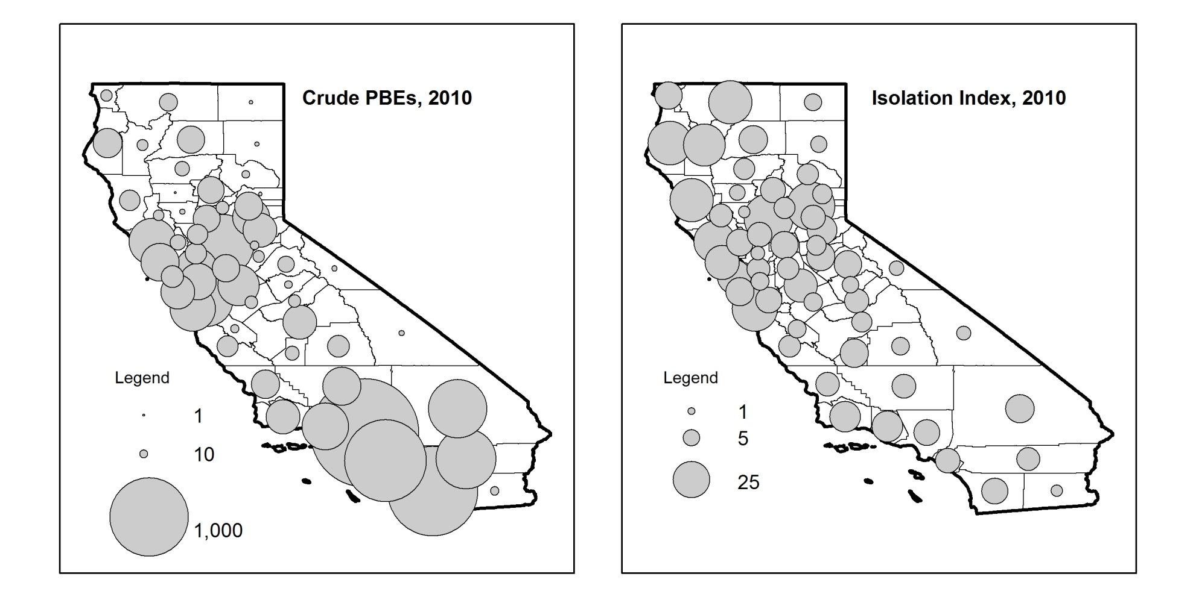
County results (1)

Slide 14
Implications: How to increase the cost of exemptions?
Policy interventions:
  Increase time costs:
    Stricter exemption requirements (Salmon et al. Arkansas case).
    Make exemptions more costly than conditional acceptance.
  Increase financial costs:
    Escrow fund for exemptors to cover outbreak costs (paid by parents or by school).
    Bonuses for schools with low exemption rates

Slide 15
Implications: How to increase the cost of exemptions?
Program interventions:
  Increase social costs:
    Increase awareness of exposure risk through public awareness campaigns (PTAs/HSAs)
    Publicize disease outbreaks
    Training and incentives for school gatekeeper (e.g., school nurse)

Slide 16
Acknowledgements
Funding for this study was provided by the Robert Wood Johnson Foundation Health & Society Scholars Program at the University of Pennsylvania.

Slide 17
County results (2)
Kindergarteners with PBEs
enrolled in schools with PBE rate > 20
County | N
Los Angeles | 369
San Diego | 285
Sacramento | 185
Santa Cruz | 170
Sonoma | 160
Riverside | 131
Orange | 125
Ventura | 121
San Bernardino | 108
Stanislaus | 105
County | %
Sutter | 79.2
Mendocino | 68.6
Nevada | 62.1
Humboldt | 62.0
Santa Cruz | 52.1
Trinity | 50.0
Kings | 48.5
Siskiyou | 48.1
Sonoma | 45.2
San Francisco | 42.3

Slide 18
County results (2)
Kindergarteners with PBEs
enrolled in schools with PBE rate > 20
County | N
Los Angeles | 369
San Diego | 285
Sacramento | 185
Santa Cruz | 170
Sonoma | 160
Riverside | 131
Orange | 125
Ventura | 121
San Bernardino | 108
Stanislaus | 105
County | %
Sutter | 79.2
Mendocino | 68.6
Nevada | 62.1
Humboldt | 62.0
Santa Cruz | 52.1
Trinity | 50.0
Kings | 48.5
Siskiyou | 48.1
Sonoma | 45.2
San Francisco | 42.3

Slide 19
Conclusions
Increasing exposure of California kindergarteners to PBEs on all measures.
Variation in prevalence, clustering, and vulnerability across counties.
Exposure metrics provide health and education officials with means of targeting policy and program interventions.
Importance of clustering of PBEs within schools:
  Rising interaction and isolation indices:
    + epidemiological exposure to disease risk
    + social exposure to exemption norms

