Slide 1



Developing standard names and codes for lysosomal
storage disorders detectable by newborn screening Abstract 244234
Standards and Interoperability in Health IT: Part II
Session 5182.0
American Public Health Association (APHA) Annual Meeting
November 2, 2011
Washington, DC
Rebecca M. Goodwin, JD ¹, Michael Watson, PhD, FACMG², Dietrich Matern, MD, FACMG³, J. Gilbert Hill, MD, PHD⁴, Carla Cuthbert, PhD, FCCMG, FACMG⁵, Swapna Abhyankar, MD¹ Sara Copeland, MD⁶, Tiina Urv, PhD⁷, Deboshree Sarkar, MPH⁶, Clement McDonald, MD¹
¹National Library of Medicine (NLM), ²American College of Medical Genetics (ACMG), ³Mayo Clinic College of Medicine, ⁴The Hospital for Sick Children, electronic Child Health Network, ⁵Centers for Disease Control and Prevention (CDC), ⁶Health Resources and Services Administration (HRSA), ⁷Eunice Kennedy Shriver National Institute of Child Health and Human Development (NICHD)
    Rebecca.Goodwin@nih.gov
Project Manager and Advisor to the Director
Lister Hill National Center for Biomedical Communications,
U.S. National Library of Medicine

Slide 2
Presenter Disclosures
Rebecca Goodwin
(1) The following personal financial relationships with commercial interests relevant to this presentation existed during the past 12 months:
No relationships to disclose

Slide 3
Overview of Newborn Screening

Slide 4
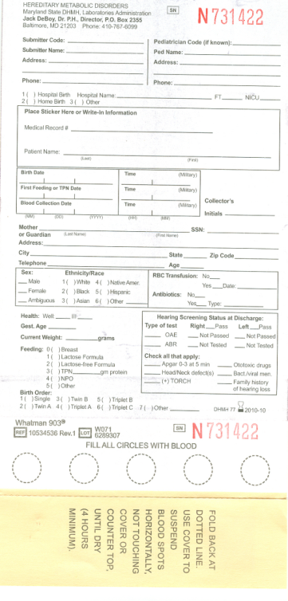
What is newborn screening?
Universal screening of infants for potentially life-threatening but treatable conditions
Most programs screen for 29 of 31 conditions on the SACHDNC’s* Recommended Uniform Screening Panel
Currently, except for hearing screening, tests are run on dried blood spots (DBS) taken from the infant’s heel, where specimen collection device is also data collection form
  SCID, the 30th condition, was added in 2010, and most programs have not implemented SCID screening yet
  Critical Congenital Heart Disease, the 31st condition, was added Sept 2011, and will be a point of care screen like hearing
*Secretary’s Advisory Committee on Heritable Disorders in Newborns and Children

Slide 5
Reporting results of newborn screening
A positive newborn screening (NBS) result usually must be transmitted rapidly to allow follow-up, diagnosis and intervention before the baby suffers significant morbidity or mortality.
Different programs report results in a variety of ways:
  Quantitative values or qualitative interpretation (normal, out of range)
  Variations in condition names

Slide 6
standardizing nbs result reporting

Slide 7
Benefits of standardizing
Simplify and speed up reporting
  Multiple recipients could receive results at the same time
  Make data sharing across state boundaries easier (e.g. baby born in MD who lives in VA)
  Disaster preparedness/emergency backup (one program could take over for another program without a delay in reporting)
Allow cross-referencing with other data sources (e.g. birth certificates, hearing screen results, immunization registries)
Facilitate maintenance of registries and follow-up data
Support quality assurance and lab performance measures
Allow pooling and comparison of data across programs to achieve larger sample sizes and enable better research
Enable clinical decision support and quality improvement by using SNOMED CT codes to standardize EHR problem lists

Slide 8

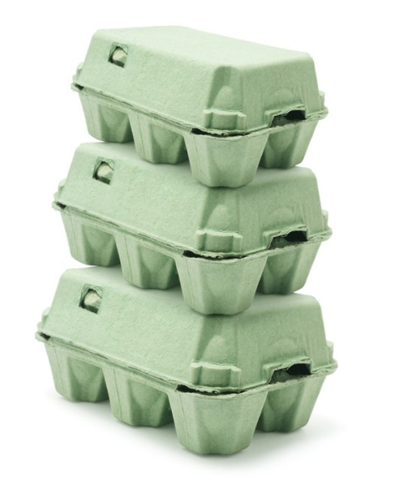

What has to be standardized?
Messaging format
  (the “egg carton” container)
  Standard messaging format to convey the content electronically
  HL7
Content
  (the “eggs”)
  Standard codes for test names, analytes, conditions screened and other categorical answers
  LOINC and SNOMED CT

Slide 9
  HRSA/NLM guidance for reporting NBS results http://newbornscreeningcodes.nlm.nih.gov/HL7
Vocabulary coding standards – recommended by Office of the National Coordinator for Health Information Technology Standards Committee*
  LOINC® codes (Logical Observation Identifiers Names and Codes) for lab tests, test results and card variables
  SNOMED CT codes (Systematized Nomenclature of Medicine – Clinical Terms) for NBS conditions
  UCUM© (Unified Code for Units of Measure) for quantitative results
HL7 message template for reporting NBS data and test results using above codes
  Collaborative effort with input from federal agencies and states
Guidance approved by the SACHDNC Laboratory Standards and Procedures subcommittee
*Health IT Standards Committee recommendations to ONC on the assignment of code sets to clinical concepts [data elements] for use in quality measures. [Letter] 9 Sept 2011.
http://healthit.hhs.gov/portal/server.pt/gateway/PTARGS_0_12811_955546_0_0_18/HITSC_CQMWG_VTF_Transmit_090911.pdf

Slide 10
STANDARDIZING REPORTING OF Lysosomal storage disorders

Slide 11
Lysosomal Storage Disorders
Genetic mutations cause specific enzyme deficiencies.
  These enzymes are normally responsible for catalyzing breakdown of waste material in cells, so in people with LSDs, waste materials accumulate in the lysosomes.
Symptoms include muscle damage, respiratory difficulties, bone abnormalities, joint stiffness, burning sensations, enlarged liver or spleen, seizures and loss of learned skills.
No known cure; mostly therapeutic management.
Emerging therapies for LSDs include enzyme replacement therapy (ERT) and hematopoietic stem cell transplantation (HSCT) using bone marrow or umbilical cord blood as a source of healthy stem cells.
Early detection is vital.

Slide 12
Lysosomal Storage Disorders
Several states have started pilot studies or implemented screening for these 5 lysosomal storage disorders:
  Fabry disease
  Pompe disease
  Gaucher disease
  Krabbe disease
  Niemann-Pick disease types A and B

Slide 13
Krabbe disease
Degenerative disorder that affects the central nervous system
GALC gene mutations cause Galactocerebrosidase enzyme deficiency, leading to loss of myelin that covers many nerves.
  Impedes the conduction of nerve signals from the brain to the rest of the body.
  As the myelin degrades, it causes physical disabilities.
Synonym:
  Globoid cell leukodystrophy

Slide 14
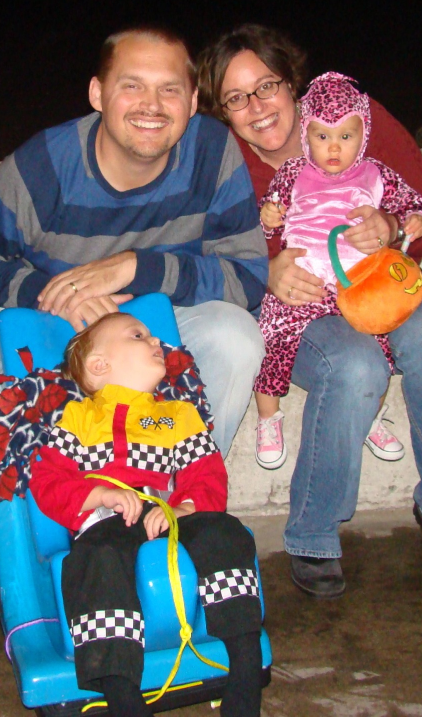
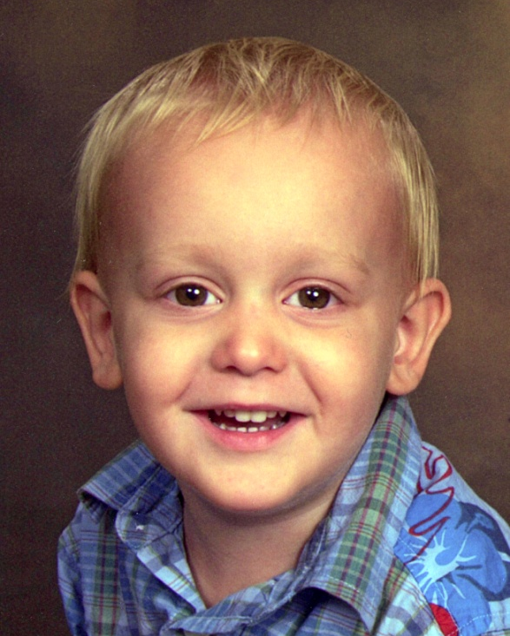
Story of Judson: born with Krabbe disease
(not part of the newborn screening panel in his state)
“Out of the blue, at the end of May 2007, when he was 29 months old, Jud began stumbling...
Just five months later, on November 7, 2007, after rapidly becoming paralyzed, blind, and mute, Drake and Christina held their almost 3-year-old son as he breathed his last breaths.”
http://www.StoryOfJudson.com
Story and photos shared with permission from Judson’s mom, Christina Levasheff.
Notes:
“out of the blue, at the end of May 2007, when he was 29 months old, Jud began stumbling...
Just five months later, on November 7, 2007, after rapidly becoming paralyzed, blind, and mute, Drake and Christina held their almost 3-year-old son as he breathed his last breaths.”

Slide 15

Story of Judson: born with Krabbe disease
http://www.StoryOfJudson.com Video shared with permission from Judson’s mom.
Notes:
"out of the blue, at the end of May 2007, when he was 29 months old, Jud began stumbling...
Just five months later, on November 7, 2007, after rapidly becoming paralyzed, blind, and mute, Drake and Christina held their almost 3-year-old son as he breathed his last breaths.”

Slide 16
Newborn Screening for LSDs
New York:
  statewide NBS for Krabbe disease since 2006
  MS/MS followed by GALC sequencing
  many “patients-in-waiting,” lots of frustration, high cost
Illinois:
  Nov 2010: Chicago-wide NBS for Pompe, Fabry, and Gaucher diseases
  2011: screening stopped due to technical problems with assay. To be resumed as a pilot study.
Missouri: state law requires NBS for 5 LSDs by 2013
New Mexico: state law requires NBS for 5 LSDs by 2013
Washington: NICHD pilot study testing new MS/MS technologies;
  MS/MS followed by molecular testing to reduce false positive rate
Taiwan:
  screening for Pompe and Fabry disease
  False positive rate 0.64% (0.09% for Pompe, 0.55% for Fabry disease)
  most patients have late-onset variant of Fabry disease

Slide 17
Objective
Develop standard condition names, test names, and codes to standardize electronic reporting for the LSDs detectable by newborn screening.
Challenges:
  Each lysosomal storage disorder can have multiple names based on researchers' names, related genes, and affected enzymes.
  No consensus on naming conditions and tests, reporting screening results, or screening method.
  Special characters (Greek letters in enzyme names and units of measure) may not be computer-readable.

Slide 18
Methods
A workgroup of LSD experts analyzed variations in naming LSDs and the tests used for screening.
  Part of larger evidence review and guideline development process on the diagnosis and management of the presymptomatic LSD patient.
  Included geneticists, biochemists, neurologists, laboratory specialists, pediatricians, and patient advocates.
  Organized by American College of Medical Genetics (ACMG), with funding from NIH NICHD.
  Part of the Newborn Screening Translational Research Network.
NLM and HRSA collaborated with the WG plus other LSD and NBS experts to standardize names of LSD tests and conditions, and method for reporting LSD NBS results.

Slide 19
Results
ACMG LSD expert workgroup published guidelines for diagnostic confirmation and management of presymptomatic individuals with lysosomal storage disorders.
  Wang RY, et al. Genet Med. 2011 May;13(5):457-84. PMID 21502868
HRSA and NLM developed a hierarchy of LOINC codes and SNOMED CT coded answer lists for LSDs detectable by NBS, and
Updated the annotated example HL7 message to include guidance for reporting LSD screening results.

Slide 20
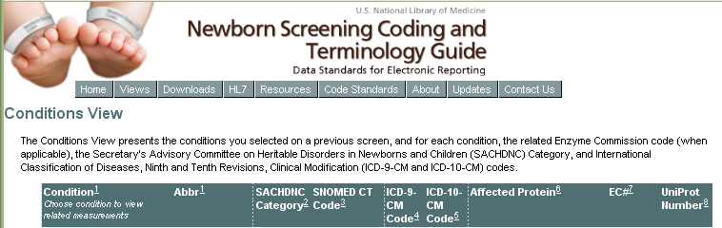
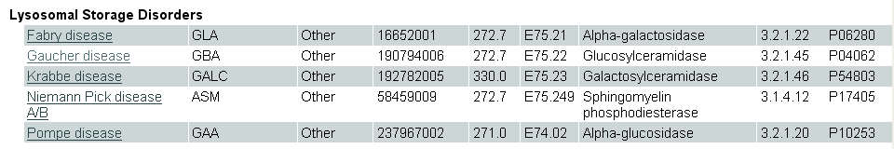
http://newbornscreeningcodes.nlm.nih.gov

Slide 21
Condition/Disorder Names are often derived from one or combination of sources:
The name of a physician or researcher, often the first person to describe the disorder
  (for example, Marfan syndrome, which was named after Dr. Antoine Bernard-Jean Marfan);
The basic genetic or biochemical defect that causes the condition
  (for example, alpha-1 antitrypsin deficiency);
One or more major signs or symptoms of the disorder
  (for example, sickle cell anemia);
The parts of the body affected by the condition
  (for example, retinoblastoma);
A geographic area
  (for example, familial Mediterranean fever, which occurs mainly in populations bordering the Mediterranean Sea); or
The name of a patient or family with the condition
  (for example, amyotrophic lateral sclerosis, which is also called Lou Gehrig disease after a famous baseball player who had the condition).
NLM Genetics Home Reference. “How are genetic conditions and genes named?” Published October 24, 2011. http://ghr.nlm.nih.gov/handbook/mutationsanddisorders/naming

Slide 22
Pompe disease – condition name variants
Pompe disease – after Dutch pathologist Dr Joannes Cassianus Pompe who first recognized Pompe disease
Acid alpha glucosidase deficiency – enzyme affected
Acid maltase deficiency – synonym for the enzyme affected
Glycogen Storage Disease Type II – glycogen is the material that accumulates in the lysosome as a result of the enzyme deficiency
GAA – gene mutation that causes Pompe disease
  Wang RY, et al. Genet Med. 2011 May;13(5):457-84. PMID 21502868

Slide 23
Name Variants for the Enzyme Affected by
GBA gene mutation in Gaucher Disease
Source | Enzyme Name
American College of Medical Genetics (ACMG) LSD Workgroup | acid β-glucosidase
Scriver’s Online Metabolic and Molecular Bases for Inherited Disease (OMMBID) | Acid β-glucosidase
LOINC (14 terms existing Oct 30, 2010) | Beta glucosidase
OMIM 606463 | Glucosidase, beta, acid (GBA) (alternative titles” include: Acid beta-glucosidase, glucocerebrosidase, and glucosylceramidase)
E.C. 3.2.1.45 | Glucosylceramidase - accepted name (12 “other names” include acid β-glucosidase and glucocerebrosidase)
UniProt P04062 | Glucosylceramidase - recommended name (5 alternative names include Acid beta-glucosidase and Beta-glucocerebrosidase)

Slide 24
LOINC Name Selected for Newborn Screening Assay to Detect Activity of the Enzyme Affected in Gaucher Disease
Acid beta glucosidase
Computer-readable version of “Acid β-glucosidase” -- the name from ACMG and Scriver’s Online Metabolic and Molecular Bases for Inherited Disease (OMMBID).
  “beta” instead of Greek letter symbol “β” to ensure that electronic message recipients properly display the name.
Scriver’s OMMBID rationale:
  “The enzymatic defect in Gaucher disease was shown to be due to impaired glucosylceramide hydrolysis …Because glucosylceramide (glucocerebroside), glucosylsphingosine, and potentially other β-glucosides are natural substrates for this enzyme, the more general terms acid β-glucosidase or lysosomal β-glucosidase are preferred to glucocerebrosidase. Acid β-glucosidase (EC 3.2.1.45) will be used in this chapter.”
  Scriver. “Gaucher Disease, Chapter 146, page 2 (revised July 2010 by Gregory A. Grabowski, Gregory A. Petsko, Edwin H. Kolodny). Online Metabolic and Molecular Bases for Inherited Disease (OMMBID).

Slide 25
Information needed to create new LOINC codes for LSD lab tests
Name for the lab test (for LSDs, based on enzymatic activity measured)
  Also name for associated condition, related names (synonyms), abbreviations, and associated gene
Brief description of the condition and test
Unit of measure (we encourage using UCUM standard for electronic messaging)
  http://www.unitsofmeasure.org/
Typical normal range

Slide 26
LOINC Coding Information
Required LOINC Elements | LSD Assays | Comments
Components | Alpha galactosidase A Acid Alpha glucosidase Acid Beta glucosidase Galactocerebrosidase Acid Sphingomyelinase | Enzymatic activity for Fabry Disease (GLA) Enzymatic activity for Pompe Disease (GAA) Enzymatic activity for Gaucher Disease (GBA) Enzymatic activity for Krabbe Disease (GALC) Enzymatic activity for Niemann Pick A & B (ASM)
Property | CCnc | Catalytic concentration Reported as umol/L/hour
Timing | Pt | Sample taken at a specific moment in time
Sample | Bld.dot | Dried Blood Spot Filter Paper
Scale | Qn | Quantitative assay
Method | [Created methodless LOINC terms. Some NBS programs use Tandem Mass Spectrometry (MS/MS); others Fluorometry. Units are the same.]
Units (UCUM) | umol/L/hr | micromole per liter per hour

Slide 27
New Codes for 5 Lysosomal Storage Disorders Detectable by NBS
Condition Name (and Abbreviation) | SNOMED CT code
Fabry disease (GLA) | 16652001
Gaucher disease (GBA) | 190794006
Krabbe disease (GALC) | 192782005
Pompe disease (GAA) | 237968007
Niemann Pick disease A/B (ASM) | 58459009
LOINC Name for quantitative NBS analyte associated w/ each condition | LOINC Code
Alpha galactosidase A [Enzymatic activity/volume] in Dried blood spot | 55908-8
Acid beta glucosidase [Enzymatic activity/volume] in Dried blood spot | 55917-9
Galactocerebrosidase [Enzymatic activity/volume] in Dried blood spot | 62310-8
Acid alpha glucosidase [Enzymatic activity/volume] in Dried blood spot | 55827-0
Acid sphingomyelinase [Enzymatic activity/volume] in Dried blood spot | 62316-5

Slide 28
62311-6 Gaucher disease newborn screening panel
LOINC Code | LOINC (Analyte) Name | Data Type | Units
62312-4 | Gaucher disease newborn screen interpretation | CE
62313-2 | Gaucher disease newborn screen comment-discussion | TX
55917-9 | Acid beta glucosidase [Enzymatic activity/volume] in Dried blood spot | NM/ ST | umol/L/h

Slide 29
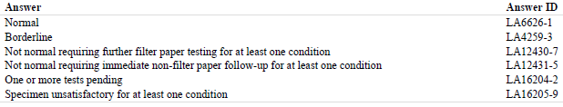
LOINC answer codes for reporting Gaucher disease newborn screen interpretation (62312-4)

Slide 30
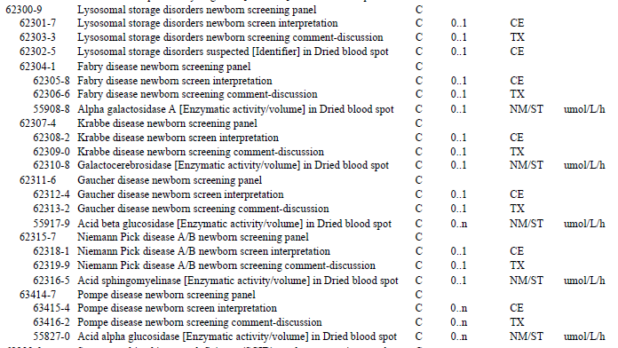
Lysosomal Storage Disorders – LOINC codes

Slide 31
HL7 standard for sending electronic message

Slide 32
HL7 Electronic Messaging – Brief overview
Health Level Seven – international standard language for sending messages that computers can understand, translate, and potentially use in clinical decision support
Messages can be sent from laboratory to hospital, health information exchange, clinician Electronic Health Record (EHR), etc
HL7 version 2.x messages consist of “records” called segments; represented as ASCII Text – with data fields and sub-fields separated by delimiters.
Example annotated HL7 newborn screening results message
  http://newbornscreeningcodes.nlm.nih.gov/HL7

Slide 33
Example HL7 OBX (observation) segment:
Quantitative screening result for Gaucher disease
OBX|3|NM|55917-9^Acid beta glucosidase [Enzymatic activity/ volume] in Dried blood spot^LN^4231^Glucocerebrosidase ^L||
1.3|umol/L/h|> 4.1|L|||F
Notes:
Segments always begin with a 3-character designation ID type (e.g. OBR, OBX, MSH, PID, NK1) that indicate segment type
OBR segment – Order Report Header
OBX segment – Observation segment
The fields in a segment are identified by counting delimiters. The first field in the OBX segment, OBX-1, begins after the first field delimiter (the vertical bar). The second one (OBX-2) follows immediately after the second delimiter, and so on.
OBX-1 - sequence number
OBX-2 data type of the test result (e.g. ST = string, NM = numeric, CE = coded entry).
OBX-3 observation ID –code, print text and code system –variable or “question.” Example shows HL7 message can include both the universal LOINC code (in orange) and the local code (in turquoise) as follows: LOINC Code^Print Text^LN^Local Code^Print Text^L
OBX-5 contains the observation value (“answer”) or test result/impression (in green). Depending upon the data type it is:
Numeric – e.g. TSH results.
Coded -- e.g. Conditions with positive markers.
As indicated above, both a standard code set, such as SNOMED CT or LOINC,
and a local code set may be used.
Narrative text – e.g. the discussion/ description variables
OBX-6 Units of Measure (red) - UCUM
OBX-7 Reference Ranges (purple)
OBX-8 Abnormal Flags: HL7 v 2.5.1 table 0078
(N for normal, A for abnormal (when the observation is a code), H for high, L for low, AA for critically abnormal, HH for critically high and LL for critically low).
OBX-11 Observation Result Status. HL7 table 0085.
(F = Final results, I = Specimen in lab, results pending, C = Corrected result that replaces a prior final result, and P = Preliminary results).
OBX-14 Date/Time of the Observation.
It is not necessary to include the date/time of the observation in each OBX segment since the receiving application will use the value in OBR-7 for all OBX segments included under that test or panel.

Slide 34
Legend for Example OBX (observation) segment
OBX|3|NM|55917-9^Acid beta glucosidase [Enzymatic activity/ volume] in Dried blood spot^LN^4231^Glucocerebrosidase ^L||1.3|umol/L/h|> 4.1|L|||F
OBX-1 - sequence number
OBX-2 data type of the test result (e.g. ST = string, NM = numeric, CE = coded entry).
OBX-3 observation ID –code, print text and code system –variable or “question.” Example shows HL7 message can include both the universal LOINC code (in orange) and the local code (in turquoise) as follows: LOINC Code^Print Text^LN^Local Code^Print Text^L
OBX-5 contains the observation value (“answer”) or test result/impression (in green). Depending upon the data type it is:
  Numeric – e.g. TSH results.
  Coded -- e.g. Conditions with positive markers.
  As indicated above, both a standard code set, such as SNOMED CT or LOINC,
  and a local code set may be used.
  Narrative text – e.g. the discussion/ description variables
Notes:
Segments always begin with a 3-character designation ID type (e.g. OBR, OBX, MSH, PID, NK1) that indicate segment type
OBR segment – Order Report Header
OBX segment – Observation segment
The fields in a segment are identified by counting delimiters. The first field in the OBX segment, OBX-1, begins after the first field delimiter (the vertical bar). The second one (OBX-2) follows immediately after the second delimiter, and so on.
OBX-1 - sequence number
OBX-2 data type of the test result (e.g. ST = string, NM = numeric, CE = coded entry).
OBX-3 observation ID –code, print text and code system –variable or “question.” Example shows HL7 message can include both the universal LOINC code (in orange) and the local code (in turquoise) as follows: LOINC Code^Print Text^LN^Local Code^Print Text^L
OBX-5 contains the observation value (“answer”) or test result/impression (in green). Depending upon the data type it is:
Numeric – e.g. TSH results.
Coded -- e.g. Conditions with positive markers.
As indicated above, both a standard code set, such as SNOMED CT or LOINC,
and a local code set may be used.
Narrative text – e.g. the discussion/ description variables
OBX-6 Units of Measure (red) - UCUM
OBX-7 Reference Ranges (purple)
OBX-8 Abnormal Flags: HL7 v 2.5.1 table 0078
(N for normal, A for abnormal (when the observation is a code), H for high, L for low, AA for critically abnormal, HH for critically high and LL for critically low).
OBX-11 Observation Result Status. HL7 table 0085.
(F = Final results, I = Specimen in lab, results pending, C = Corrected result that replaces a prior final result, and P = Preliminary results).
OBX-14 Date/Time of the Observation.
It is not necessary to include the date/time of the observation in each OBX segment since the receiving application will use the value in OBR-7 for all OBX segments included under that test or panel.

Slide 35
Legend for Example OBX (observation) segment (2)
OBX|3|NM|55917-9^Acid beta glucosidase [Enzymatic activity/ volume] in Dried blood spot^LN^4231^Glucocerebrosidase ^L||1.3|umol/L/h|> 4.1|L|||F
OBX-6 Units of Measure (red) - UCUM
OBX-7 Reference Ranges (purple)
OBX-8 Abnormal Flags: HL7 v 2.5.1 table 0078
  (N for normal, A for abnormal (when the observation is a code), H for high, L for low, AA for critically abnormal, HH for critically high and LL for critically low).
OBX-11 Observation Result Status. HL7 table 0085.
  (F = Final results, I = Specimen in lab, results pending, C = Corrected result that replaces a prior final result, and P = Preliminary results).
OBX-14 Date/Time of the Observation.
  It is not necessary to include the date/time of the observation in each OBX segment since the receiving application will use the value in OBR-7 for all OBX segments included under that test or panel.
Notes:
Segments always begin with a 3-character designation ID type (e.g. OBR, OBX, MSH, PID, NK1) that indicate segment type
OBR segment – Order Report Header
OBX segment – Observation segment
The fields in a segment are identified by counting delimiters. The first field in the OBX segment, OBX-1, begins after the first field delimiter (the vertical bar). The second one (OBX-2) follows immediately after the second delimiter, and so on.
OBX-1 - sequence number
OBX-2 data type of the test result (e.g. ST = string, NM = numeric, CE = coded entry).
OBX-3 observation ID –code, print text and code system –variable or “question.” Example shows HL7 message can include both the universal LOINC code (in orange) and the local code (in turquoise) as follows: LOINC Code^Print Text^LN^Local Code^Print Text^L
OBX-5 contains the observation value (“answer”) or test result/impression (in green). Depending upon the data type it is:
Numeric – e.g. TSH results.
Coded -- e.g. Conditions with positive markers.
As indicated above, both a standard code set, such as SNOMED CT or LOINC,
and a local code set may be used.
Narrative text – e.g. the discussion/ description variables
OBX-6 Units of Measure (red) - UCUM
OBX-7 Reference Ranges (purple)
OBX-8 Abnormal Flags: HL7 v 2.5.1 table 0078
(N for normal, A for abnormal (when the observation is a code), H for high, L for low, AA for critically abnormal, HH for critically high and LL for critically low).
OBX-11 Observation Result Status. HL7 table 0085.
(F = Final results, I = Specimen in lab, results pending, C = Corrected result that replaces a prior final result, and P = Preliminary results).
OBX-14 Date/Time of the Observation.
It is not necessary to include the date/time of the observation in each OBX segment since the receiving application will use the value in OBR-7 for all OBX segments included under that test or panel.

Slide 36
NBS HL7 Message (excerpt) – Lysosomal Storage Disorders Panel
OBX|1|CE|62301-7^Lysosomal storage disorders newborn screen interpretation^LN||LA12431-5^Not normal requiring immediate non-filter paper follow-up for at least one condition^LN|||A|||F
OBX|2|CE|62302-5^Lysosomal storage disorders suspected [Identifier] in Dried blood spot^LN||LA14039-4^GBA^LN^190794006^Gaucher’s disease^SCT^LA14039-4^GBA^LN|||A|||F
OBX|3|TX|62303-3^Lysosomal storage disorders newborn screening comment-discussion^LN||Abnormal result indicates possible Gaucher Disease and immediate referral to a Metabolic
Geneticist is indicated to confirm the diagnosis and
begin treatment.|||A|||F
*Please note – for purposes of simplicity, the entire HL7 OBR/OBX structure is not shown.
For more details, see http://newbornscreeningcodes.nlm.nih.gov/HL7

Slide 37
HL7 Message Panel for Gaucher NBS Results
OBX|1|CE|62312-4^Gaucher disease newborn screen interpretation^LN||LA12431-5^Not normal requiring immediate non-filter paper follow-up for at least one condition ^LN|||A|||F
OBX|2|TX|62313-2^Gaucher disease newborn screening comment-discussion^LN||Abnormal result indicates possible Gaucher Disease and immediate referral to a Metabolic Geneticist is indicated to confirm the diagnosis and begin treatment|||A|||F
OBX|3|NM|55917-9^Acid beta glucosidase [Enzymatic activity/ volume] in Dried blood spot^LN^4231^Glucocerebrosidase ^L||1.3|umol/L/h|>4.1|L|||F
*Please note – for purposes of simplicity, the entire HL7 OBR/OBX structure is not shown.
For more details, see http://newbornscreeningcodes.nlm.nih.gov/HL7

Slide 38
HL7 Message Panel for Krabbe NBS Results
OBX|1|CE|62308-2^Krabbe disease newborn screen interpretation^LN||LA6626-1^Normal^LN|||N|||F
OBX|2|TX|62309-0^Krabbe disease newborn screening comment-discussion^LN||Any baby with clinical features suggestive of a metabolic disorder requires clinical and diagnostic follow-up regardless of whether the NBS result is normal or abnormal.|||N|||F
OBX|3|NM|62310-8^Galactocerebrosidase [Enzymatic activity/ volume] in Dried blood spot^LN^4100^Galactosylceramidase ^L||2.4|umol/L/h|>0.5|N|||F
*Please note – for purposes of simplicity, the entire HL7 OBR/OBX structure is not shown.
For more details, see http://newbornscreeningcodes.nlm.nih.gov/HL7

Slide 39
On the horizon, coding and messaging for…
Additional LSDs detectable by newborn screening:
  Illinois Legislature and Governor recently mandated screening for Mucopolysaccharidosis (MPS) I (Hurlers disease), MPS II (Hunters)
  Missouri mandate will also incorporate MPS I and MPS II
Follow up and confirmatory testing

Slide 40
Conclusions
Standard codes and names will enable researchers, clinicians and public health surveillance efforts to exchange and aggregate NBS results from all of the states screening for LSDs.
  This is critical for research, quality assurance (QA), and disaster preparedness.
These data are essential for creating case definitions and providing effective follow-up care.
Notes:
*Learning Objectives:* By the end of the session, the participant will be able to: 1. Explain the public health benefits of using health IT standards for reporting all newborn screening. 2. Describe the information about lysosomal storage disorders that is represented by a LOINC or SNOMED CT code. 3. Interpret the fields of an HL7 message segment used to report lysosomal storage disorder screening results.

Slide 41
Acknowledgments
Newborn Screening Translational Research Network (NBSTRN) is funded by contract HHSN27520080001C from the Eunice Kennedy Shriver National Institute for Child Health and Human Development, National Institutes of Health, HHS
NNC/RCs are funded by cooperative agreement MCO3957 from the Maternal and Child Health Bureau of the Health Resources and Services Administration, HHS
Mayo Clinic comparative assessment studies of LSD NBS technologies
  Newborn screening and LSD pilot programs in New York, Minnesota, Missouri, and Washington
  HRSA
  CDC
  NICHD
  NNSGRC
  ACMG
  APHL
  NLM Genetics Home Reference
  NBS lab system vendors

Slide 42
Resources
NLM’s NBS Coding and Terminology Guide website includes:
  LOINC NBS panel and annotated sample HL7 message for download
  Lists of conditions, associated analytes and their LOINC codes, as well as UCUM and SNOMED CT codes where appropriate
  http://newbornscreeningcodes.nlm.nih.gov
Wang RY, Bodamer OA, Watson MS, Wilcox WR; ACMG Work Group on Diagnostic Confirmation of Lysosomal Storage Diseases. Lysosomal storage diseases: diagnostic confirmation and management of presymptomatic individuals. Genet Med. 2011 May;13(5):457-84. PMID 21502868
  http://journals.lww.com/geneticsinmedicine/Fulltext/2011/05000/Lysosomal_storage_diseases__Diagnostic.15.aspx
Please contact us with comments or questions at: newbornscreeningcodes@nlm.nih.gov

