Slide 1
Using Predictive Modeling to Identify Pregnant Members to Increase Enrollment in a Maternity Disease Management Program
American Public Health Association
10/31/2011

Slide 2

I have nothing to disclose
I have nothing to disclose
I have nothing to disclose
I have nothing to disclose
I have nothing to disclose
I have nothing to disclose
I have nothing to disclose
Disclosure

Slide 3
Objective/Background
Objective: to increase enrollment in a maternity disease management (DM) program
Prior to analysis DM program enrolled 23% of known pregnant women through
  Internal referrals (from CM or Customer Service)
  ER and census reports
  NurseLine triage report
  Community outreach events
  Presumptive Eligibility reports from the State
Notes:
Post-hoc retrospective analysis

Slide 4
Methods
Expanded identification search to administrative claims data from managed care organization:
  pregnancy tests: (i.e. V72.42, V72.40)
  Ultrasounds: (i.e. 76801-76828)
  prenatal vitamins: (list of NDC drug script codes)
  maternity authorizations: (i.e. 59400, 59426 with V23.xx)
  other diagnoses and procedures suggesting a member may be pregnant (e.g. V23, V22, 640-649, 80055)
Used SAS Enterprise Miner data mining software to build a predictive model to
Notes:
Performed rules logic analysis on claims data to identify best (and worst) combinations
Constructed a predictive model that scores members on the probability of being pregnant
Extracted 21 months of medical and pharmacy claims data for 2 groups:
“Pregnant” - women having a delivery claim in December 2008 and no other evidence of a delivery during the study period
“Not Pregnant” - women having no evidence of a delivery during the study period
Created a predictive ensemble model consisting of a classification and regression tree combined with a logistic regression model using a data mining software

Slide 5
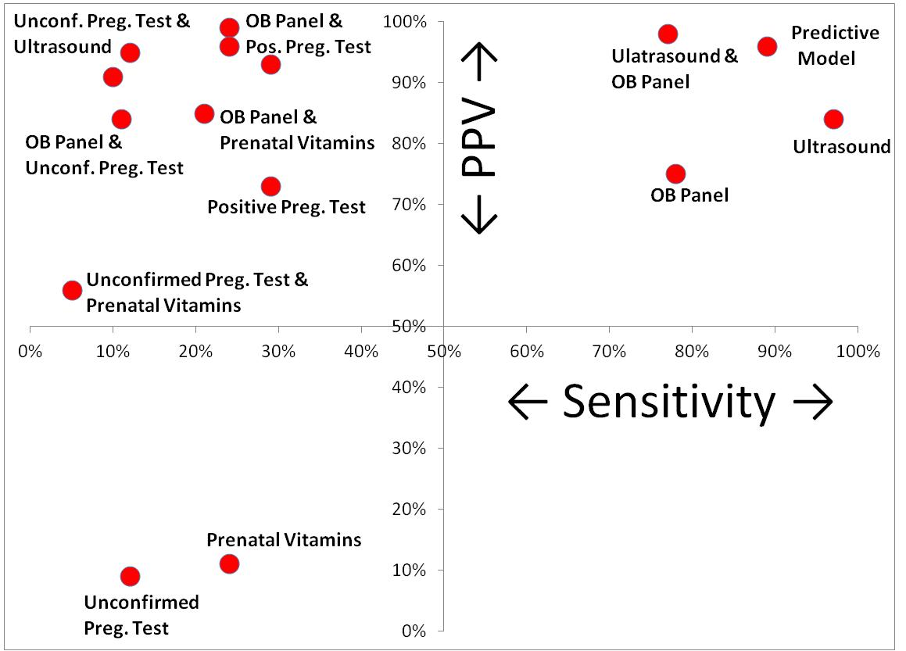
Comparing Sensitivity and PPV across Methods
Notes:
X- Axis → Sensitivity = The ability of the algorithm to identify women who are pregnant out of the entire population of pregnant women . That is, how sensitive is the test at finding these women
Y-Axis → Positive Predictive Value (PPV) – The ability of the algorithm to correctly classify a woman as pregnant given a set of information.
Compared to the simple rules logic, the predictive model was the most accurate with 89% sensitivity and 96% PPV
Must look at PPV and Sensitivity b/c offer different information.
A classifying event with high sens but low PPV means almost everyone who delivered has the classifying event but so do many people who didn’t deliver, suggesting it may be a claim that is common among all women.
A high PPV with low sensitivity could indicate not many people who delivered had this event, but of those that did, most were pregnant.
Ideal to have high sensitivity and PPV. Although, high PPV is more important for our efforts bc we want to be sure about who we contact
No single claims event or combination had sensitivity and PPV both above 90%.
Unpaired ultrasounds had highest sensitivity at 97% and PPV of 84%
Prenatal vitamins and unconfirmed preg. tests had lowest sensitivity and PPV
Prenatal vitamins and unconfirmed preg. tests should not be used independently or in combination with each other

Slide 6
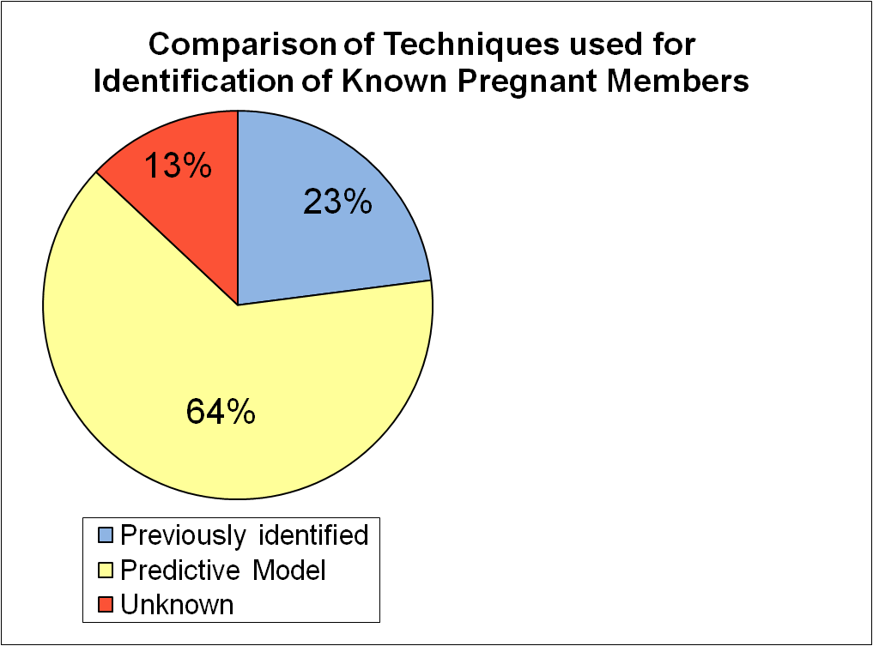
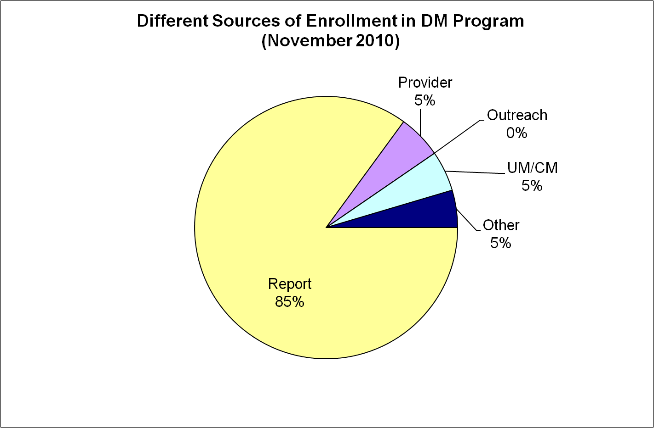
Model Performance Compared to Previous Methods
64% (predictive model)
+23% (previously identified)
87% Total identified
Notes:
The 23% was determined when we looked at women who delivered in 2008, how many of them were ever enrolled in CaringStart. The 87% was determined by running our algorithm for these women.
The expanded search of claims data increased identification of known pregnant women from 23% to 87%
Through a weekly report, those with at least a 70% probability of being pregnant are contacted by DM staff and encouraged to participate in the program
85% of enrollment is coming from weekly report

Slide 7
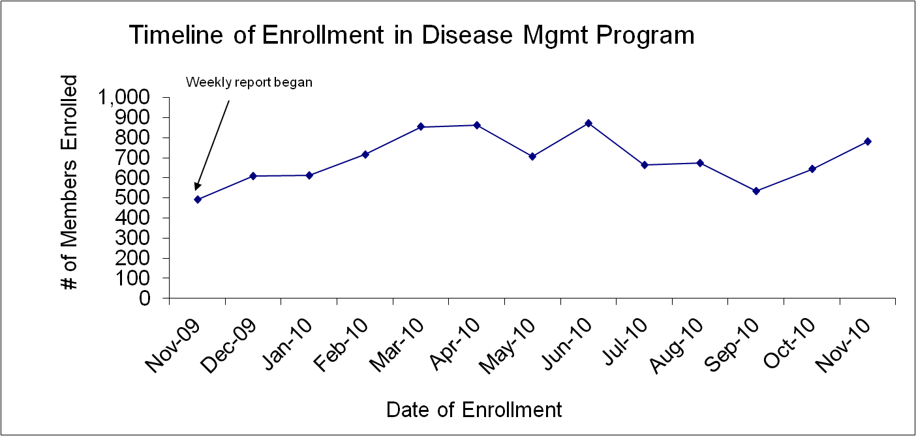
Enrollment Success Since Model Inception
Notes:
Avg. weekly enrollment in the maternity disease management increased by 44%

Slide 8
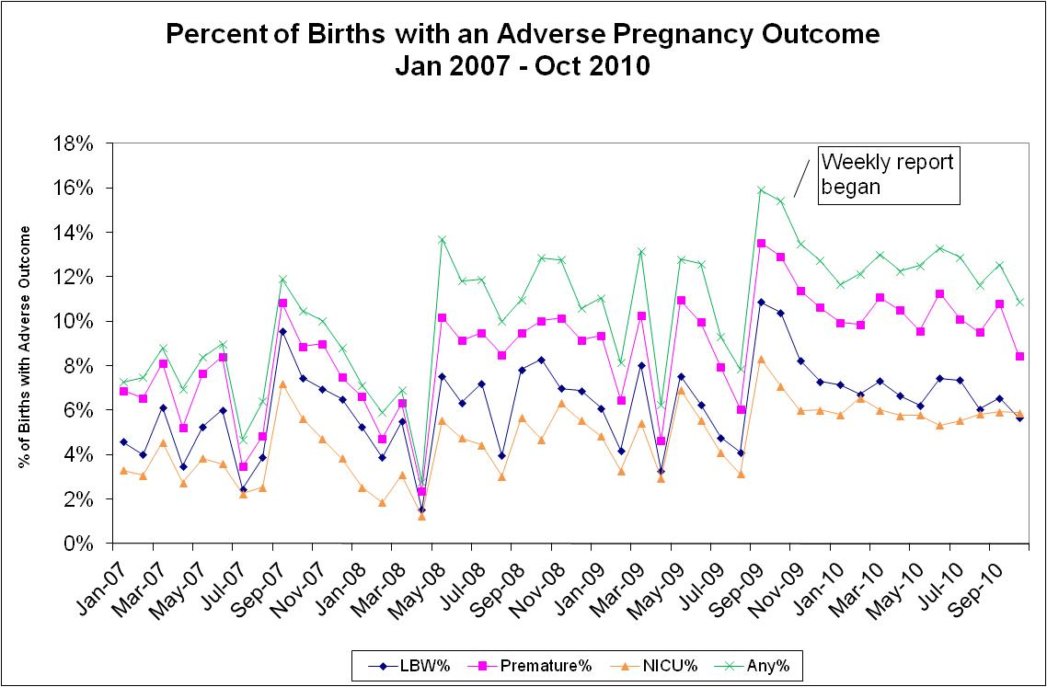
Impact of Model on Adverse Outcomes
Notes:
Although not the specific goal of our analysis, the goal of DM is to reduce adverse pregnancy outcomes
Initial analysis of adverse outcomes suggest adverse outcomes have been increase over time, but since the inception of the weekly report it has slowed and may be on the decline

Slide 9
Questions??
Stephen G. Jones, PhD
Biostatistical Research Scientist
BlueCross BlueShield of Tennessee
Stephen_Jones@BCBST.com
Notes:
Spatial factors associated with medically diagnosed cases of zoonoses agree with other literature using actual CDC reported cases
Possible that suitable habitat features are overlapping for the different tick vectors between the 2 diseases
Both diseases have similar clinical presentations, thus cases may be misdiagnosed between the two diseases
Areas higher in disease prevalence were not necessarily the same areas having high predicted risk of disease infection.
This supports our original project intent to illustrate the need to build spatially explicit models.

