Slide 1
The old is stronger than the young: Age-specific incidence/fatality of novel (swine) influenza during the 2009 epidemic in Japan
Etsuji Okamoto
(National Institute of Public Health, JAPAN)

Slide 2
Purpose
On 28th April 2009, WHO announced the outbreak of novel (swine) influenza (A/H1N1) in Mexico and raised the alert level to phase 4 (it later further raised the alert level to phase 6 on 12 June). Many countries including Japan strengthened the surveillance and quarantine to keep the disease at bay.
Unfortunately Japan’s strengthened quarantine (bay-side tactics) was escaped by the disease and the entire country was plagued with the epidemic. The outbreak started from a high school and quickly spread to the entire country despite large-scale school closures suggesting high susceptibility and transmissibility among the young, school-age population.
In the article, the author analyzes the age-related epidemiologic pattern of the influenza outbreak in Japan in 2009 based on the mandatory reporting surveillance data and illustrate the “reverse ageism” of its incidence, admission rate and relative fatality.

Slide 3
Data and method
The daily data of mandatory reporting of confirmed novel (swine) influenza cases between 19th May and 24th July 2009 in Japan were analyzed.
A cumulative total of 4986 confirmed cases were reported by 24th July and a total of 17640 hospitalized cases were reported between 16th July 2009 and 23rd March 2010.
Ten-year age-specific number of reported cases was available on a daily basis (the report was not released on weekends except in the early phase) but no age-sex breakdown was available, hence the analysis was limited to age-specific incidence.

Slide 4
Result1: incidence
Age-specific incidence was calculated by dividing the number of reported cases with age-specific population. The result is shown in [Table.1].
A total of 4,986 cases were reported between 16th May and 24th July 2009 or 39.1 cases per 100,000 population. By far the highest incidence was observed in teenagers (10-19 years old):195/100000 population and the lowest among the elderly >=60yo: 1.3/100000.
After the mandatory reporting was discontinued after 24th July, reporting was required only for hospitalized cases but with more detailed patient information such as the presence of underlying conditions. The hospitalization surveillance was continued to 23rd March 2010 whose results are summarized in [Table2].

Slide 5
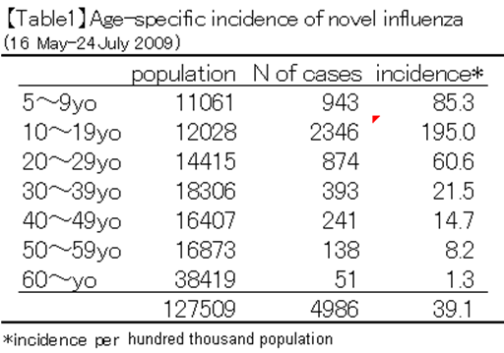

Slide 6
Result2: hospitalization
Admission rate was highest among 0-9 yo: 1.03/1000 population followed by teenagers: 0.26. Remarkably, the admission rate of the elderly was lower than high teenagers (0.05 for >=80yo vs. 0.26 for 10-19 yo). As for fatality of admitted patients, after excluding those with underlying diseases, the middle age (40-49 yo) showed the highest case-fatality (8 deaths/406 admissions or 19.7 per thousand admissions) followed by 30-39 and 50-59 yo groups (12.3, 12.4 per thousand admissions respectively). However no fatalities were observed with 60-69 and >=80 yo groups and only 4 per thousand admissions for 70-79 yo group (2 deaths/505 admissions).
Although it appears that middle age hospitalized patients had the highest fatality, one should compare inter-age fatality considering age-specific mortality. Since older people have higher mortality than young people, one should compare by relative fatality (the ratio between crude fatality [deaths/admissions] and age-specific mortality). Ten-year age-specific mortality (both men and women) was obtained from Japan’s 2009 life table.
When compared with relative fatality, a different pattern emerged: children aged 0-9 years showed the highest relative fatality during hospitalization (5.694) followed by people aged 20-49. Teen agers showed high hospitalization rate but their relative fatality was low. What was noteworthy was that the elderly over 60 yo showed lower relative fatality than younger generation.

Slide 7
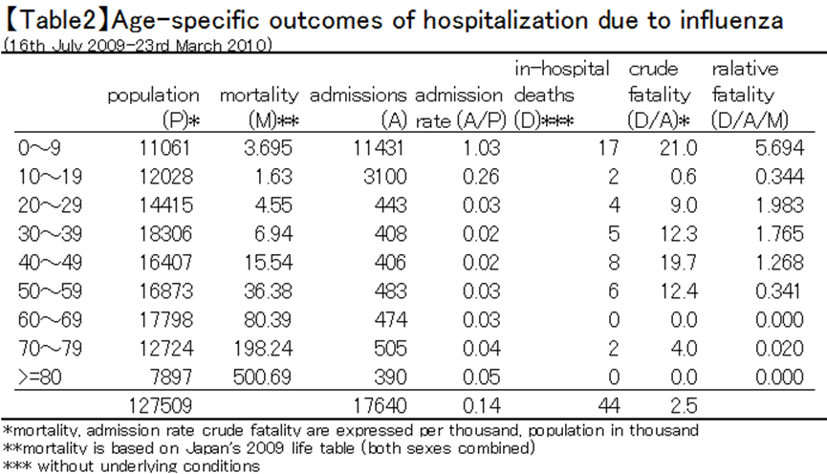

Slide 8
Discussions
Influenza is a serious health threats to those with underlying conditions and the elderly. This is a prime reason why influenza vaccination is recommended for the elderly.
However, when measured by age-specific incidence, the elderly shows lower incidence than the young. When compared between the age group [15-59yo] and [>=60], the elderly consistently showed lower incidence than the young in both men and women.
The ratio between the elderly and the young appears to be declining over time but the incidence of the elderly is nearly half of the younger generation.

Slide 9
Discussion (cont’d)
The epidemic of novel influenza in 2009 showed a far larger age difference in every measure of severity of the epidemic, incidence, admission rate and relative fatality, in which the young people around teen agers showed more than ten-fold higher indices than the elderly over 60 years old.
These findings are consistent with those based on the surveillance of the U.S., in which researchers found that contacts 18 years of age or younger were twice as susceptible as those 19 to 50 years of age (relative susceptibility 1.96), and contacts older than 50 years of age were less susceptible than those who were 19 to 50 years of age (relative susceptibility 0.17).
The high transmissibility among the young is also supported by applying three mathematical models to Japan’s surveillance data. These age-related epidemiologic patterns suggest that the influenza A (H1N1) was literally “novel” strain different from the existing “seasonal” influenza although the severity of the illness did not differ much.

Slide 10
Conclusions
The elderly showed stronger resistance against novel influenza than young population in terms of incidence, hospital admission rate and relative fatality, an age-related epidemiological pattern different from the traditional seasonal influenza.
Preventive and precautionary measures targeted to the young and vulnerable population will be necessary to combat the recurrence of the pandemic in the future.

