Slide 1
Presenter Disclosures
Ronald Wiewora, MD, MPH
Anne Hedges, RN, MSN, NCSN
(1) The following personal financial relationships with commercial interests relevant to this presentation existed during the past 12 months:
No Relationships to Disclose

Slide 2
Chronic Disease Trends in Palm Beach County Schools
Ronald Wiewora, MD, MPH.
Anne Hedges, MSN, RN, NCSN.
Health Care District of Palm Beach County Florida

Slide 3
Palm Beach County
Located in South East Florida, Palm Beach County is the largest county in the state of Florida with a total of 2,386.33 square miles and the third in population estimated at 1,320,134
Palm Beach County was Florida’s wealthiest county with a per capita personal income of $44, 518 in 2004. since the current recession the county has lost this title

Slide 4
Palm Beach County School District
The School District is the 5th largest District in Florida and 11th largest District in the continental United States
Schools
  187 schools public schools
  175,004 students

Slide 5
Student Grades
The goal of the program is to keep children healthy and ready to learn in school reflected in student grades below:
The School District has earned an “A” rating from the Florida Department of Education for the last 7 years, here are the grades:
  89 schools earning A’s
  22 schools earning B’s
  Remaining schools earned C’s and D’s
  No schools earned “F’s

Slide 6
Department of Exceptional Student Education (ESE)
The ESE program assists schools by providing a free and appropriate public education for all students with disabilities, ages 3-21
34,246 ESE students are designated as ESE students including 8,541 students in the Gifted program
Many of the ESE students are mainstreamed into regular classes with accommodations made in the classroom
School Nurses work together with ESE staff to assist in providing accommodations for health conditions in schools

Slide 7
History of the Health Care District’s School Health Program
August 1998 – Health Care District and Partners funded 17 nurses
December 1998 – Program increased to 127 school nurses
2011/2012 school year there are 211 Registered Nurses and 5 Licensed Practical Nurses providing health care for students countywide

Slide 8
Annual Funding for Nurses
Health Care District $11,666,562
School District $ 2,550,000
funds 34 Nurses
School District $ 79,396
supplies
Total $14,295,958

Slide 9
School Nurses Triage Students to Identify Problems
School nurses triage students upon entry into the health room to assess current and new health conditions
Nurses are trained in First Aid, Cardio Pulmonary Resuscitation and aspects of International Trauma Life Support
Nurses are skilled in the nursing assessment of the school age child, including the implementation of a plan of care for the student
Nurses are also sensitive to cultural issues, working with students of many ethnicities

Slide 10
Chronic Disease Trends - Five Years of Identified Data
Indentified Student's Health Condition | 2006-07 | 2007-08 | 2008-09 | 2009-10 | 2010-11
Asthma | 6,435 | 6,906 | 6,511 | 6,667 | 7,946
Allergies | 4,367 | 5,189 | 5,177 | 5,370 | 7,444
ADD/ADHD | 2,704 | 2,752 | 2,455 | 2,413 | 2,844
Epilepsy / Seizures | 595 | 556 | 594 | 611 | 677
Psychiatric Conditions | 611 | 522 | 573 | 495 | 552
Cardiac Conditions | 415 | 429 | 428 | 468 | 532
Diabetes | 285 | 337 | 343 | 348 | 351
Sickle Cell Disease | 132 | 132 | 168 | 167 | 167
Bleeding Disorder | 120 | 131 | 143 | 144 | 177
Kidney Disorders | 109 | 109 | 99 | 111 | 141
Cancer | 64 | 68 | 67 | 76 | 65
Cystic Fibrosis | 24 | 30 | 26 | 30 | 31
Other | 427 | 589 | 706 | 808 | 795
Total | 16,288 | 17,750 | 17,290 | 17,708 | 21,722

Slide 11
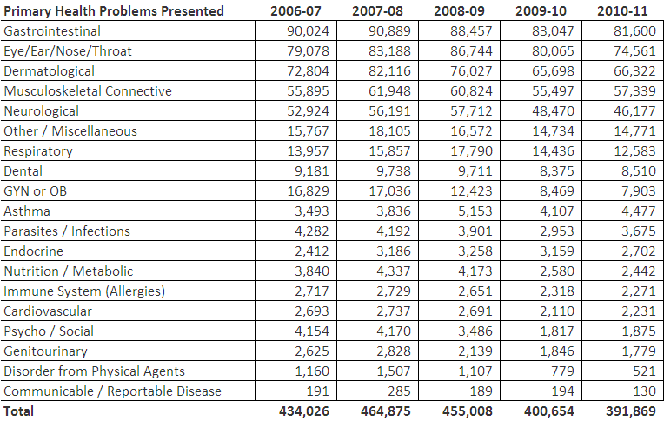
Primary Health Problems Presented

Slide 12

Health Room Visits - Return to Class
Including Health Screenings
Returned to Class after Treatment | 79% | 80% | 80% | 79% | 79%
Individual Health Care Plans Developed | 1,904 | 1,776 | 1,879 | 1,771 | 2,163
Immunization Record Reviews | 10,040 | 13,566 | 9,153 | 45,080 | 34,635
Health Record Reviews | 41,320 | 44,625 | 43,603 | 86,138 | 95,025
Health Screenings | 2006-07 | 2007-08 | 2008-09 | 2009-10 | 2010-11
Vision Screenings | 60,189 | 59,702 | 60,269 | 58,173 | 58,782
Hearing Screenings | 60,520 | 59,896 | 60,398 | 58,020 | 58,551
Scoliosis Screenings | 10,315 | 10,559 | 11,227 | 10,260 | 10,946
BMI Screenings | 33,452 | 37,902 | 35,815 | 36,381 | 35,484
Total | 164,476 | 168,059 | 167,709 | 162,834 | 163,763

Slide 13
Health Care Planning
Individual health care plans are developed for students with acute and chronic health conditions at the beginning of each school year with updates throughout the school year
Student health information is shared with the school principal, classroom teachers and other staff as appropriate and with parental consent
Designated school staff are trained to assist the school nurse as needed providing medication administration and first aid for students

Slide 14
School Based Teams
School Nurses are an integral part of the school based team meeting regularly with school staff to discuss academic accommodations for students
This method of collaboration in schools ensures that the student health condition does not impair academic success
Staff from the exceptional student education program provide academic interventions with the regular classroom environment to ensure students remain with their classmates

Slide 15
Parent Participation
Parents/guardians remain a critical component for student success.
Parents provide student health information and data for school nurses on a regular basis
Parents are most likely to alert nurses if any changes occur in the student health condition
These collaborative partnerships within the school setting work to ensure the health and wellbeing of all students

