Slide 1



got the hookup:
Evaluating a Text-Message-Based Sexual Health Information and Clinic Referral Service for Youth
Rebecca Braun, California Family Health Council
APHA Washington DC. Oct 30 – Nov 2, 2011.

Slide 2
PRESENTER DISCLOSURES
The following personal financial relationships with commercial interests relevant to this presentation existed during the past 12 months:
No relationships to disclose.

Slide 3
hookup background
In April 2009, the California Family Health Council (CFHC) and ISIS launched the Hookup, a statewide text-message-based sexual health information and clinic referral service for California youth
The program is the first statewide service of its kind, and builds on the success of ISIS’ SexINFO program in San Francisco
Funding through the Centers for Disease Control and Prevention

Slide 4
hookup system design
Shared short code -- key word driven
  To subscribe, text ‘HOOKUP' to 61827
Each message contains:
  A weekly sexual health message on a wide variety of topics
  A prompt to use the clinic locator
  A link to CFHC’s sexual health website: www.teensource.org
Subscribers can opt-out at any time by texting ‘STOP’

Slide 5
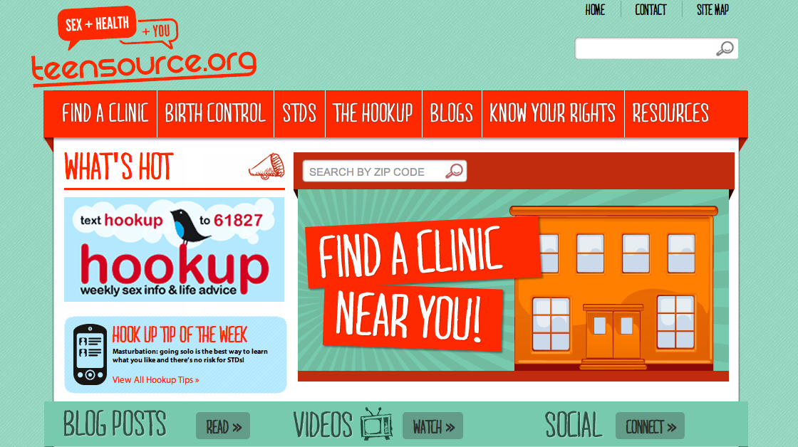
hookup on teensource.org

Slide 6
hookup text development
160 character limit
Language considerations: text-speak vs. common abbreviations
Developed by health educators with youth input, Reviewed by clinical and health department staff
Sample topics:
  STD Screening & Prevention
  Contraceptive Options
  Communication Skills
  Substance Abuse
  Parental Involvement
  Consent & Confidentiality

Slide 7
hookup text examples
Many STDs don’t have symptoms. If ur having sex, get tested to know. Txt CLINIC +ur zipcode 4 clinics. www.teensource.org
Scared to talk to ur parents about sex? It might not be so bad. Some ideas on how to start at www.teensource.org
Condom broke? EC can prevent pregnancy if used w/in 5 days - ASAP is best. Txt CLINIC + ur zipcode 4 clinics. www.teensource.org

Slide 8
hookup evaluation – methods
Ongoing monthly subscriber metrics
SMS-based program evaluation survey
Focus groups
School-based study

Slide 9
hookup evaluation – metrics
Over 6000 unduplicated subscribers to date
About 2600 subscribers have opted out over time
2500 clinic requests from over 400 zip codes

Slide 10
hookup evaluation – text survey
Jan 2011: text survey in place of weekly msg to 3000 subscribers
4 questions: age/gender, zip code, how subscriber learned about the Hookup, change associated with subscription to the Hookup
User participation was voluntary; incentive offered for completion
Response rates ranged from 27% (Q1) to 16% (Q4)
Received 33% of responses within 10 minutes; 98% within 24 hours

Slide 11
hookup evaluation – text survey
Survey Questions:
Purpose | Text
Introduction | No tip this week. Your turn to help the Hookup! 4 questions coming your way. Answer all and you can win prizes.
Age, Gender | 1st a little about u. Text back GUY or GIRL then ur age. Like ‘GIRL 16’ or 'GUY 20'.
Zip Code | We want to know if we’re reaching youth all over CA. Text back ZIP then ur zipcode to tell us where ur at! Like ‘ZIP 94117’.
Promotion Point | How’d u get hooked up with the Hookup? A friend tell u? Teacher? Saw a poster? Text back HOOKED and ur reason, like ‘HOOKED my bff’.
Associated KAB Change | How has the Hookup changed u? Text back CHANGE then ur change or something new, like ‘CHANGE STD test last week’.
Conclusion | Thx 4 helping us make Hookup better 4u! Stay tuned 2 learn if u won our raffle 2 win $50 Target card. Back 2 ur regular tips next week!

Slide 12
hookup evaluation – text survey
DEMOGRAPHICS
80% female, 20% male
87% in target population
  5% Under 15
  47% 15 to 17
  22% 18 to 19
  14% 20 to 24
Broad geographic range within California
  57% southern, 33% northern, 10% central

Slide 13
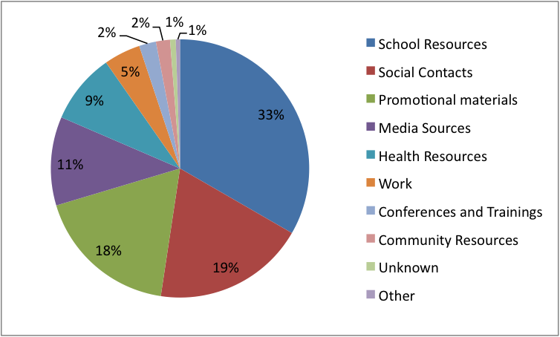
hookup evaluation – text survey
PROMOTION POINT

Slide 14
hookup evaluation – text survey
KNOWLEDGE, ATTITUDE, & BEHAVIOR CHANGE
more 411 on how to love n take care of myself
condoms im not weirded out by buying them
currently sitting in clinic to get on bc
considering iud instead of birth control pills
learned that the pill only protects from pregnancy not stds
more aware of the truth on how stds are actually easily attained
i found a clinic right down the street from my house
i got addresses to clinics near me where i was able to pick up plan b emergency contraceptive yesterday

Slide 15
hookup looking forward
Complete analysis of program evaluation data
Increase opportunities for youth involvement
Expand geographic reach of clinics in referral system
Partner with youth-serving CBOs outside of the health field
Expand marketing strategy to better incorporate new media

Slide 16
hookup conclusions
Since its launch, the Hookup has effectively provided low-cost sexual health information to many users and has resulted in a high proportion of clinic referrals across California
Evaluation is necessary to ensure we reach our target audience and assess potential impact on sexual health
The programmatic platform can be translated for adoption by other organizations considering implementing text-based projects
Ultimately the Hookup is an excellent model of a low-cost program using health communication and mobile technology to facilitate youth access to sexual health information and services

Slide 17

Questions?
Rebecca Braun, Lead Program Manager, CFHC
Email: braunr@cfhc.org
(510) 486 – 0412 x 2327

