Slide 1


Using a Health Equity Lens to Community Health Planning for Policy, System and Environmental changes
MARY THOMAS M.B.& B.S., M.P.H.
San Antonio
Metropolitan Health District

Slide 2

San Antonio’s efforts to reduce obesity related health disparities: Strategic planning to improve community access to healthy food options and opportunities for physical activity
Communities Putting Prevention to Work
San Antonio
Metropolitan Health District

Slide 3
Presenter Disclosures
Mary Thomas
The following personal financial relationships with commercial interests relevant to this presentation existed during the past 12 months:
“No relationships to disclose”

Slide 4
VISION
Maximizing Health Equity in Bexar County
by promoting
active living and healthy eating in disparity areas to reduce obesity

Slide 5
LEARNING OBJECTIVES
Describe the community planning process for selection of strategies
Discuss development and implementation of system and environmental changes to provide healthy eating options
Describe implementation of policy and environmental changes to increase access for free physical activity in their neighborhoods (Shared Use)

Slide 6
Community planning process
Reviewed demographic features
Considered the health determinants
Recruited partners
Identified target areas
Identified other resources

Slide 7
San Antonio
Council Districts 1-10

Slide 8
Demography of San Antonio
Population 1.35 million
Multicultural :57% Hispanic 32% non-Hispanic 7% Afro Americans3% Asians
South & Westside population-80% Hispanic
Northeast & North central- 30% Hispanic
Persons below 45 years- 79%
Some population have greater burden of health problems

Slide 9
High obesity rates
Adults- 68% obese or overweight
Hispanic -80% obese or overweight
Higher in South and west San Antonio
South -85% Northcentral-53%
Obesity in children-over 34%

Slide 10
Health determinants
House-hold income:
Families: 20% below poverty line
Below 18 years:27% below poverty line
Above 65 years:14% below poverty line
Caused by many determinants –
socio-economic factors, low level of education
10-12 zip codes have highest burden of disease and poor health outcome

Slide 11
Access to healthy food
Limited grocery stores-0.102 per1000 residents (includes corner stores, farmers markets superstores)
Plenty fast food restaurants-0.736 per 1000 residents

Slide 12
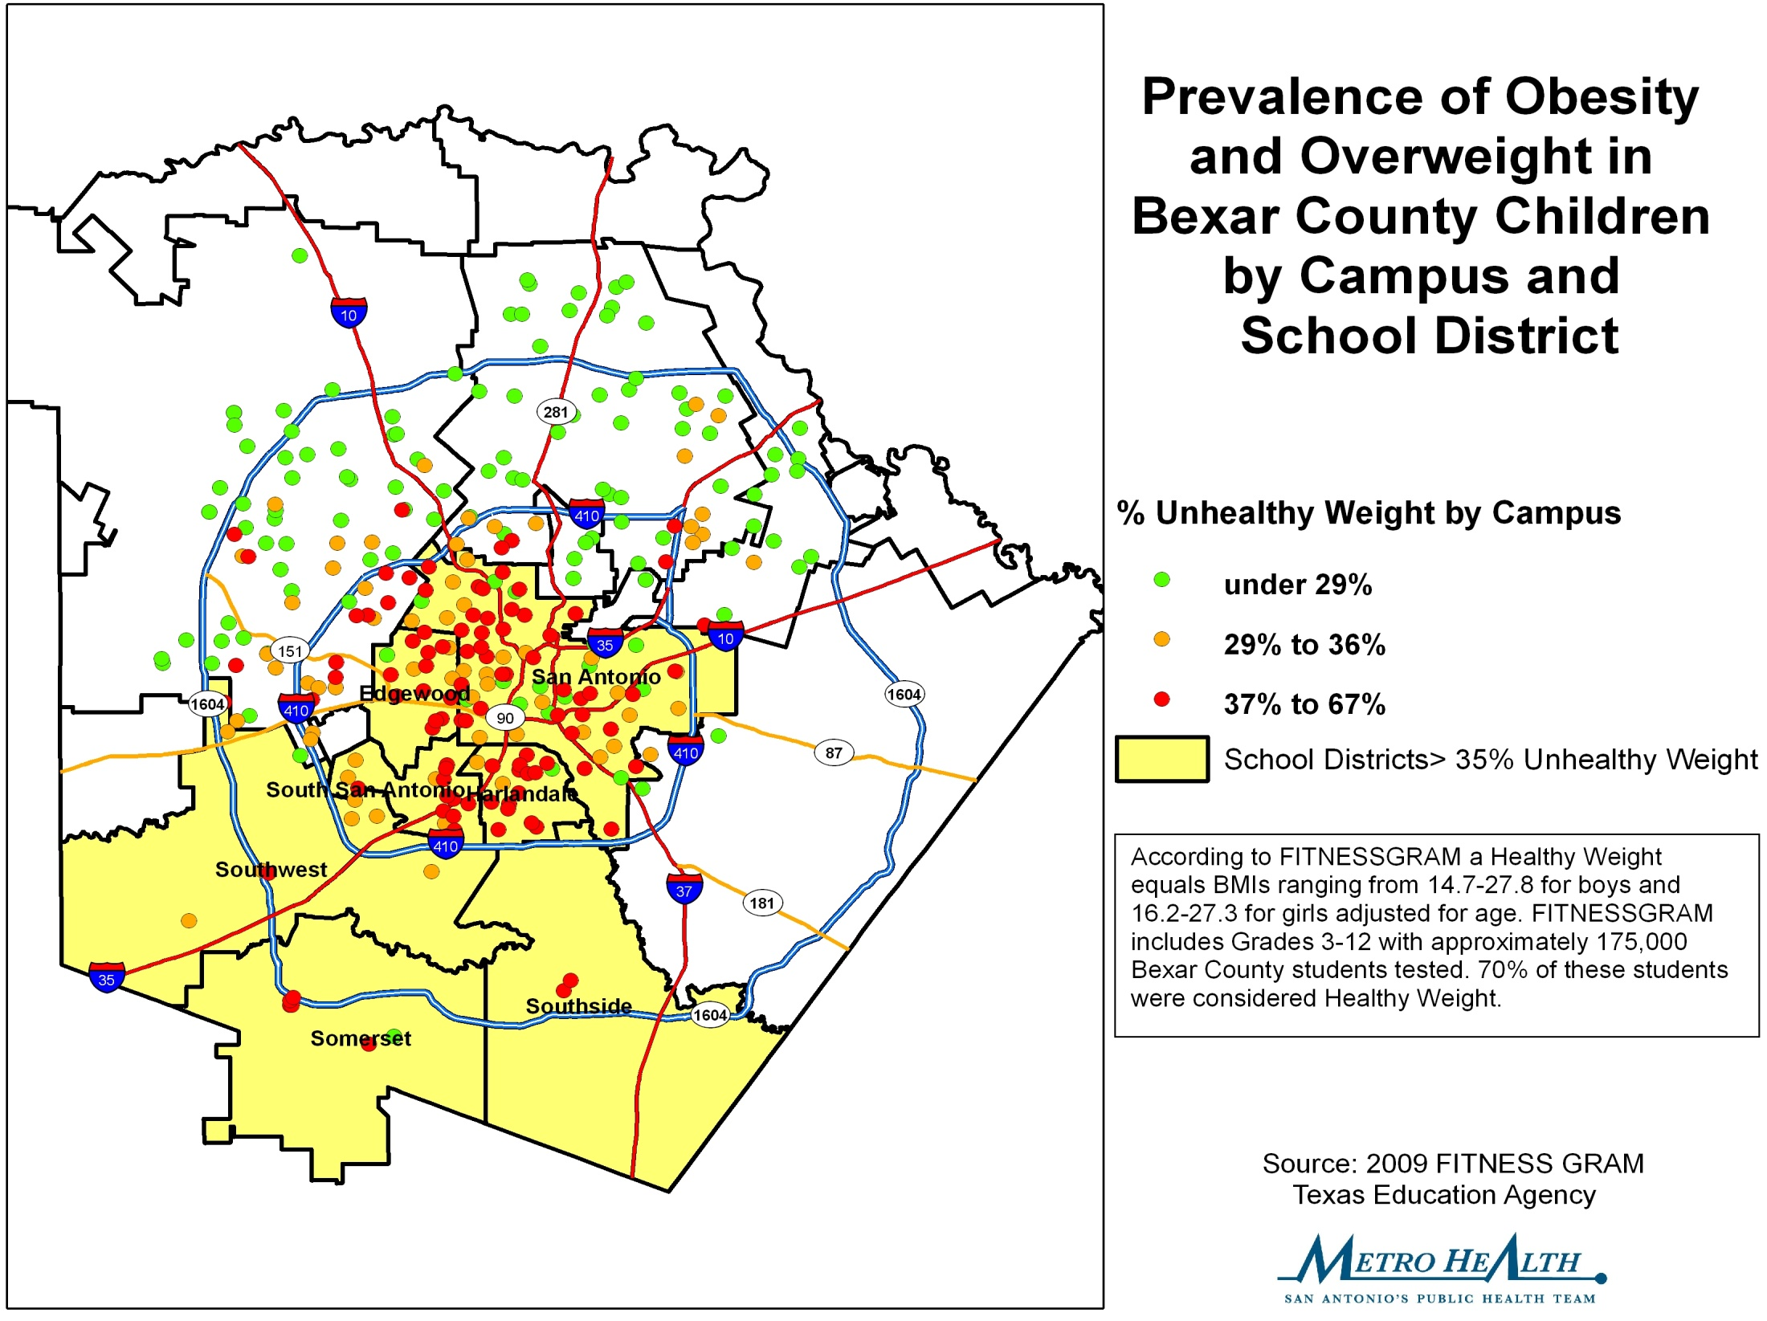
OBESITY IN SCHOOL CHILDREN

Slide 13
Mechanism used by CPPW
Identify target areas-Council districts1-5 (Westside, Eastside and Southside)
Assess the needs (built environment, Educational attainment, Income level, Density of minority population)
Finalize the initiatives

Slide 14
Identify target areas
DATA SOURCES USED:
BRFSS
FITNESSGRAM results from Independent School Districts.
CDC map by census tract of median household income, Hispanic and Black populations, density of mothers with a BMI greater than 30, Educational attainment, Density of minority population

Slide 16
Identify Partnerships
Contracts with non health sectors city partners- Library, Parks
Local partners-MPO, Interlex, YMCA
Work with other agencies-SAHA, Food Bank
Net work with Independent School Districts

Slide 17
Finalize the initiatives
Some initiatives in all Council Districts (10) – All ISDs
Specific initiatives in the disparity Council Districts (1-5) –Fitness stations, SRTS. Community centers
Work to advance policy, system and environmental changes

Slide 18
NUTRITION INITIATIVES
Increase healthy food options in target areas – Access to healthy food choices in corner stores

Slide 19
Healthy Corner Stores
Goal: Promote access to fruits, vegetables and healthy food options in corner stores in target areas
Target areas: Food deserts in West SA
Development: Formation of Healthy Coalition for Corner Stores
Established criteria and educated the store owners
Network with Healthy Kids Healthy Communities project of Metro Health

Slide 20
Implementation of Healthy Corner Stores
Recruited two interested corner stores in West side ( as a pilot )
Base line survey done in the community
Consumers identified list of desired fruits/veg
Consumers make up-to 6 visits per week
Memorandum for agreement with corner stores
Coolers supplied to provide access to fruits and vegetables ( Fresh and frozen)

Slide 21

Implementation of Healthy Corner Stores
Logo developed
Coolers purchased
List of suppliers identified
Promotional mural in one corner store
Flyers for promotion

Slide 22
Challenges- Corner Stores
Pricing: affordable by the consumers
Profitable for Storeowners
Purchase and maintain supply/stock
Promoting the sale of fruits and Veg
Promoting healthy eating habits in the residents

Slide 23
II.PROMOTE ACTIVE LIVING
Goal :Changes in built environment to provide access to physical activity through Shared Use agreement
Method: Walking trails and fitness stations in housing units in disparity areas

Slide 24
Process in implementation of Walking trails
Shared Use Agreement: CPPW with San Antonio Housing Authority- SAHA
Goal is to provide access to physical activity options in disparity areas
SAHA provides public housing for low income residents at low or subsidized rental rates
Five in target areas identified out of the total of 61 locations in San Antonio
Seniors and disabled accommodated

Slide 25
Implementation
Shared use agreement with CPPW so sustainable
Baseline survey: Identify needs and locations
Local neighborhood residents included
Identified 5 locations / 2215 units (residents- 5430)
Identified initiatives
a) Farmers Market -1 location (with SA Food Bank)
b) Walking trails - 5 locations length 15.900’
c) fitness stations - 3 locations -21 stations
Residents in the neighborhoods also have access
Work started in Oct 2011 Will complete Jan 2012

Slide 26
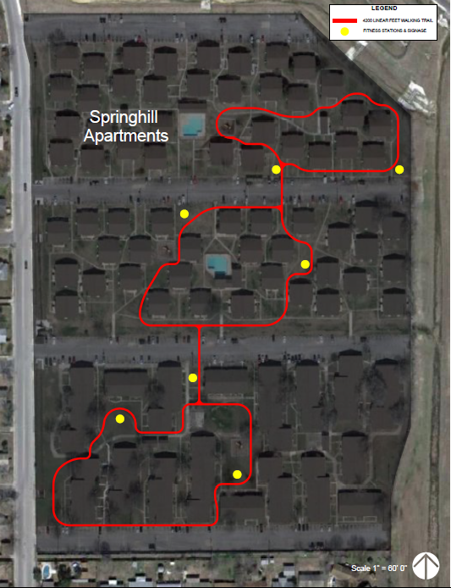
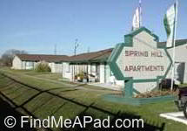
Spring Hill

Slide 27
Increase access in target areas
Walking trails are in housing units in target areas with low income, senior and residents with disability
Safe environment for free physical activity and walking and biking options
Provides access to easy to use method of physical activity for the whole family open all 24 hours
Walking groups can be organized-social marketing
Possible to motivate, encourage and monitor by managers using various group activities
Ride To Own (1000) bike program in SAHA locations

Slide 28
Challenges for walking trails
Selection of housing units with adequate open space
Community participation in utilization
Need to promote and motivate residents to engage in regular physical activity
Weather conditions and expenditure for maintenance

Slide 29
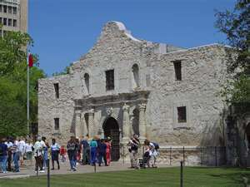
Any questions ?

