Slide 1


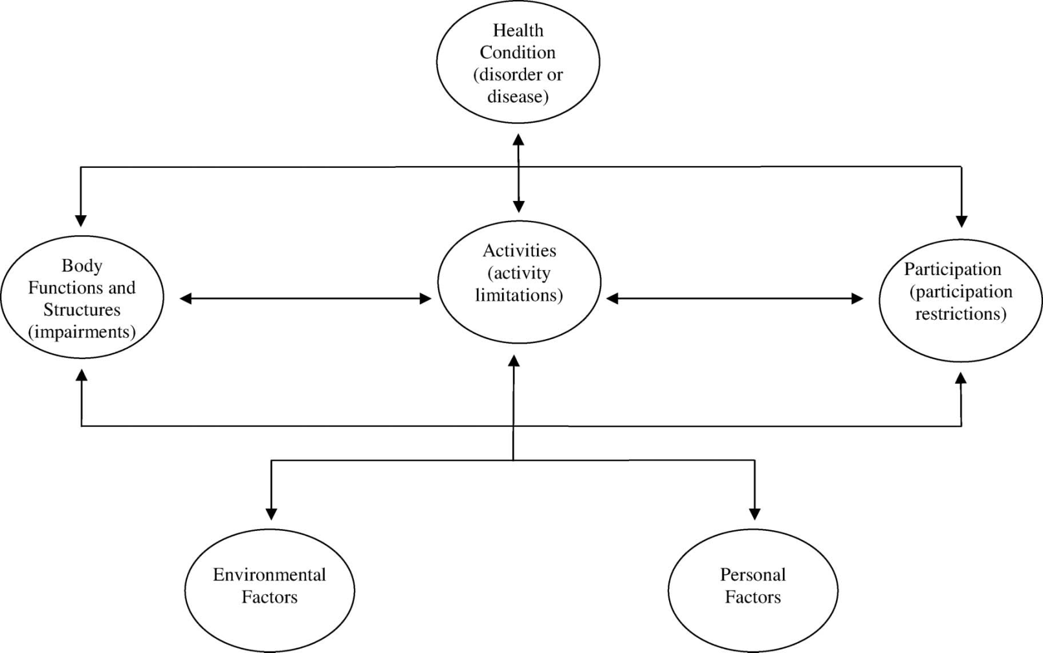
International Classification of Functioning, Disability and Health for Children and Youth A Systematic Literature Review of Adoption
Weaver PA, Frey GC, Smith SL, McCormick BP Indiana University-Bloomington, Department of Kinesiology & Recreation, Park, and Tourism Studies
Introduction
Methods
Results
The purpose of this study is to present a systematic literature review on the utilization of the International Classification of Functioning, Disability and Health for Children and Youth (ICF-CY). The ICF-CY is derived from the International Classification of Functioning, Disability and Health (ICF). The rapid growth and changes that occur in children were not sufficiently captured in the ICF leading to the publication of the ICF-CY in 2007 by the World Health Organization (WHO).¹ It is the first published internationally agreed upon classification code for assessing the health of children and youth.¹ The classification builds on the ICF conceptual framework and provides a common language and terminology for recording problems involving functions and structures of the body, activity limitations and participation restrictions manifested in infancy, childhood and adolescence.² It was created to assist clinicians, educators, researchers, administrators, policy makers and parents with documentation and measurement of health and disability in child and youth populations.² Cerniauskaite et al.³ presented a systematic literature review on the utilization of the ICF, but the ICF-CY was excluded from this study. Therefore, it is unclear how the ICF-CY has been used in public health-related disability research.
World Health Organization. International classification of functioning, disability and health-child and youth version, Internet. Electronic citation. http://www.who.int/classifications/icf/training/icfbeginnersguide.pdf. Last accessed October 21, 2011.
References identified through database searching – Academic Search Premier, CINAHL, Health Source Nursing/Academic Edition, MEDLINE, PsycARTICLES, SPORTDiscus, Web of Knowledge
Total (n = 259); Duplicates removed (n = 79)
Keywords: ICF-CY; “International Classification of Functioning, Disability and Health for Children and Youth”
Final Search Date: October 10, 2011
 | Year of Publication
Categories | 2005 | 2006 | 2007 | 2008 | 2009 | 2010 | 2011 | Total (%)
Conceptual papers | 1 |  | 1* | 1 | 3 | 1 | 2 | 13%
Development of ICF & ICF related instruments |  |  |  |  |  |  | 2 | 3%
Clinical and/or rehabilitation contexts |  | 1 | 1 | 6* | 16** | 8* | 4 | 53%
Non clinical contexts |  |  |  |  | 1 |  | 2 | 4%
Linking papers | 1 |  |  | 1* | 3 | 2 | 5 | 18%
ICF-CY only mentioned |  |  | 2 |  | 1 | 1 | 1 | 7%
Proceedings |  |  |  |  | 1^ |  |  | 1%
Total (%) | 3% | 1% | 4% | 12% | 37% | 18% | 24% | 100%
*1 Abstract; **2 Abstracts; ^1 Foreword
Inclusion:
English language
ICF-CY in title, abstract, or body of the paper
Exclusion:
Commentaries, news reports
ICY-CY not explicitly mentioned
Categorization Method:
4 researchers reviewed abstracts or full-text papers
Independent categorization then comparison of results between two researchers to establish reliability
Disagreements or questions discussed amongst all researchers
Categories:
Conceptual papers
Development of ICF-CY and ICF-CY related instruments
Clinical contexts
Non-clinical contexts
Linking papers
ICF-CY only mentioned
Foreword
References Screened: (n = 81)
79 from database search
2 additional articles located
Conclusion
References
References Excluded: (n = 13)
News report (n = 1)
Non-English language (n = 3)
ICF-CY not mentioned (n = 8)
Commentary (n = 1)
The ICF-CY was created to assist in the documentation and measurement of health and disability in youth, yet the utilization and dissemination is limited in public health-related research. The ICF-CY has most often been used in research in a clinical or rehabilitation context. The vast majority of the references were found in the Disability and Rehabilitation journal. While 48% of the author’s originated from Italy and Sweden, only 13% were published from the United States. This review raises further questions on the international support of the objectives of the ICF-CY.
1. World Health Organization. http://www.who.int/mediacentre/news/releases/2007/pr59/en/. Accessed October 21, 2010.
2. World Health Organization. The International Classification of Functioning, Disability and Health-Children and Youth Version: ICF-CY. Geneva: WHO; 2007.
3. Cerniauskaite M, Quintas R, Boldt C, et al. Systematic literature review on ICF from 2001 to 2009: its use, implementation and operationalisation. Disability and Rehabilitation. 2011;33(4):281-309.
** 68 references available online for APHA attendees**
References Included: (n = 68)
Peer-reviewed journal articles (n = 61)
Abstracts (n = 6)
Foreword (n = 1)

