Slide 1


Resource Allocation and Technical Support for Emergency Preparedness in Native American Tribes
Bliss, J., Randhawa, M., Long, R., Adam, A., Dengel, F., Bliss, W., Mann, S.
Background
In 2009 the University of California at Los Angeles (UCLA), in collaboration with Loma Linda University, was awarded by the Center for Disease Control and Prevention (CDC) as a Preparedness and Emergency Response Research Center (PERRC). Under this collaboration, Loma Linda University proposed a pilot study looking at emergency preparedness and response in Native American communities, building on Loma Linda University’s long-standing relationship with the Native American tribes of the surrounding region. This 2009-2010 study assesses emergency preparedness achievements and gaps as a result of current mechanisms among federally recognized Native American tribes throughout California.
Preparedness needs can vary between regions and among diverse populations within those regions (Johnson, et. al. 2007). This is often the case for Native American tribal communities by virtue of their geographic location and self-governing status. Earthquakes threaten communities throughout California to varying degrees; drought and flash floods are widespread; and hazardous materials spills and technological accidents are a concern along the state’s transit corridors. In addition, according to the Native American Alliance for Emergency Preparedness, most Native American populations living on tribal lands are faced with geographic isolation, increased exposure to livestock and rural landscapes, and greater risk of wildfires. Despite the increased risk, the alternate systems of funding and governance among tribal nations create unique challenges to receiving and allocating emergency preparedness funds, and integrating plans and response with surrounding communities. Studies on emergency preparedness specific to tribal nations are needed to ensure access to funds and resources to foster tribal resilience in the face of disasters.
Goals
Little research is available that moves beyond assessing the risks and barriers faced by tribal nations to actual measurements of disaster preparedness efforts. This pilot project seeks to bring preliminary data by surveying key indicators of disaster preparedness among Native American tribes of California. This study investigates four aspects of emergency preparedness:
  Perception of preparedness levels;
  funding mechanisms;
  resource availability; and
  plans for future preparedness efforts.
Examination of the funding mechanisms includes the topics of compliance to the National Incident Management System (NIMS) and Standardized Emergency Management System (SEMS), including the incorporation of the Incident Command System (ICS) and Federal Emergency Management Agency (FEMA) approved disaster mitigation plans. This study aims to be a springboard for disaster preparedness planning and further research among Native American tribes.
Methods
Cross-sectional descriptive survey
Developed in collaboration with the Native American Environmental Protection Coalition (NAEPC)
Offered to the 102 federally recognized tribes of California that were listed by the Bureau of Indian Affairs in October 2010
By email and phone, fax, and mail
Participation was offered to the chairperson, fire chief, environmental director, and emergency services manager
October to December 2010
$25 Visa card incentive

Slide 2
Outcomes
40% of the CA tribes represented in the response
91% of respondents placed their tribe below the adequately prepared level
Over 40% of California tribes do not have emergency preparedness funds
Over 50% have yet to incorporate ICS
Only 40% of the tribes represented have a disaster mitigation plan that has been approved by FEMA and updated within the last five years
71% of the emergency preparedness resources accessed by tribes are only available externally
Only 9% of tribes work with local colleges and universities to provide emergency preparedness training, but 83% are interested in developing such relationships
Emergency Preparedness Resource Availability
Does your Tribal/Band work with local Colleges and Universities to provide Emergency Preparedness training for your workforce and community members?

Slide 3
Analysis/Discussion
60% of the tribes are unable to apply for federal and state funds because they are not yet compliant with NIMS/ICS
Increased partnership, communication, and formal agreements are recurrent themes for each of the strategies proposed to meet these gaps
Action steps need to be prioritized at the local level
Challenges/Lessons Learned
Budget too small to conduct follow-up or mixed methods surveys
  Key informant interviews and focus groups would clarify study findings
  Study findings could be used in workshops to discuss priorities and strategies for overcoming disaster preparedness gaps.
Study topic created many barriers to receiving the tribes’ participation
  Concerns of survey relevance for tribes who do not receive emergency preparedness funds
  Fear of disclosure
  Escalation in the complexity and expectations for emergency preparedness in the past decade
  Participants’ knowledge of the topic
  Perceived barriers all biases the results away from those tribes who are not meeting funding regulations and/or do not feel prepared for disasters.
Survey fatigue among tribal nations
Previous negative experiences among the tribal communities with outside institutions
Next Steps
2011 Governmental Partnerships survey
Publication of study findings
Academic/Tribal partnerships to address gaps
  Training
  Grant writing
  Exercise planning and evaluation
Acknowledgments
The investigators are grateful to the 45 tribal participants for providing insight into the process of emergency preparedness among the California tribal nations. This study represents a significant step forward in the emergency preparedness process, offering preliminary data to drive further research for the resilience of tribal nations.
References
Johnson, V., Bashir, Z., Leep, C., Troutman, N., Brown, D., & Briggs, E. (2007). Federal Funding for Public Health Emergency Preparedness: Implications and Ongoing Issues for Local Health Departments. National Association of County and City Health Officials, August 2007.
Native American Alliance for Emergency Preparedness (NAAEP; n.d.). Indian Health Program: Emergency Preparedness Public Private Partnership California. Retrieved May 13, 2011 from http://www.fema.gov/pdf/privatesector/ca_ps_tribal.pdf

Slide 4
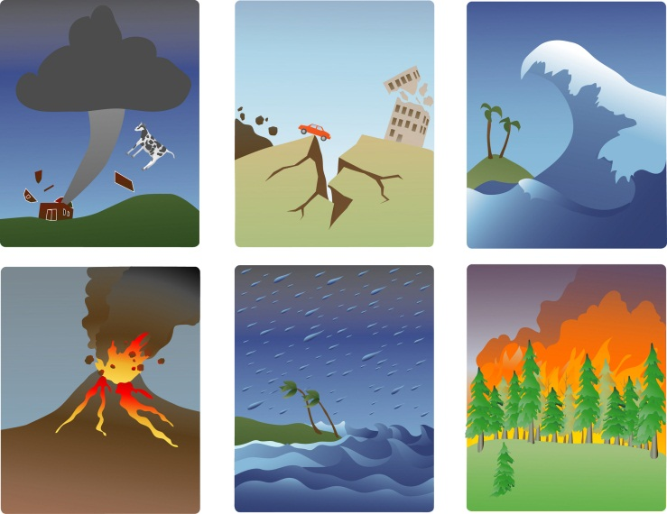

Who We Are
The Loma Linda University School of Public Health, Office of Public Health Practice is part of the Loma Linda University Adventist Health Sciences Center, a faith-based organization comprised of seven professional schools and affiliated medical institutions. The Office of Public Health Practice and Workforce Development unites the academic expertise and research its faculty and staff with applied practice to deliver community engaged public health education.
Our Mission
The Office of Public Health Practice and Workforce Development seeks to enhance the knowledge and practice of the current public health workforce, to facilitate interagency collaboration, and to cultivate healthy communities through population-specific, culturally-cognizant, public health practice.
Native American Health Initiative
Over the past seven years, the Office of Public Health Practice has been committed to serving the needs of Tribal Nations throughout the Southwestern United States. Through its Regional Center for Excellence in Environmental Health, tribal specific public health practice activities have been delivered. A strong commitment to maintaining a consistent presence, strengthening existing relationships, assessing needs, and developing appropriate resources has continued to extend this initiative within Native American communities.
Tribal Specific Training Activities Include:
Environmental health capacity-building
All-hazards preparedness and response training
Geographic Information Systems (GIS)
Academic program development and instruction
10970 Parkland St. Loma Linda, CA 92350
(909) 558-8382, lluophpreception@llu.edu
4

