Slide 1

Crossing Boundaries for Health:
Effective Planning and Policy Development for Active Living
139th American Public Health Association Annual Meeting
S. Elizabeth Ford, M.D., M.B.A.
District Health Director, DeKalb County
Andrew A. Baker, AICP
Interim Director for Planning & Sustainability, DeKalb County
November 1, 2011

Slide 2
DeKalb County’s GOAL
Create sustainable improvements in physical activity and nutrition through policy, systems, and environmental changes, which reduce the risk factors of childhood and adult obesity

Slide 3
BACKGROUND
“OBESITY IN DEKALB”

Slide 4
FACTS/NEED
According to the Board of Health, DeKalb County’s Top ten leading causes of death:
  Cardiovascular disease (CVD),
  Diabetes
  Stroke
  Hypertension
  Cancer
  Source: Status of Health Report, 2010
By decreasing obesity, we decrease the risk for the some of the leading causes of death in DeKalb

Slide 5
FACTS/NEED
The Growing Trend for Obesity
Between 1997 & 2006, the rate of obesity has doubled
Source: 2007 Obesity Data Summary, GA Department of Community Health
24% of DeKalb County residents are obese
Source: 2009 BRFSS report
53% of DeKalb County adults do not get the recommended level of physical activity
  57% do not believe there are adequate sidewalks
  49% report they cannot walk to a grocery store
  Source: 2007 BRFSS
Notes:
.
(Increased from 15% to 30%)
These numbers warrant a rapid response, given that the Healthy People 2010 national goal is 15%

Slide 6
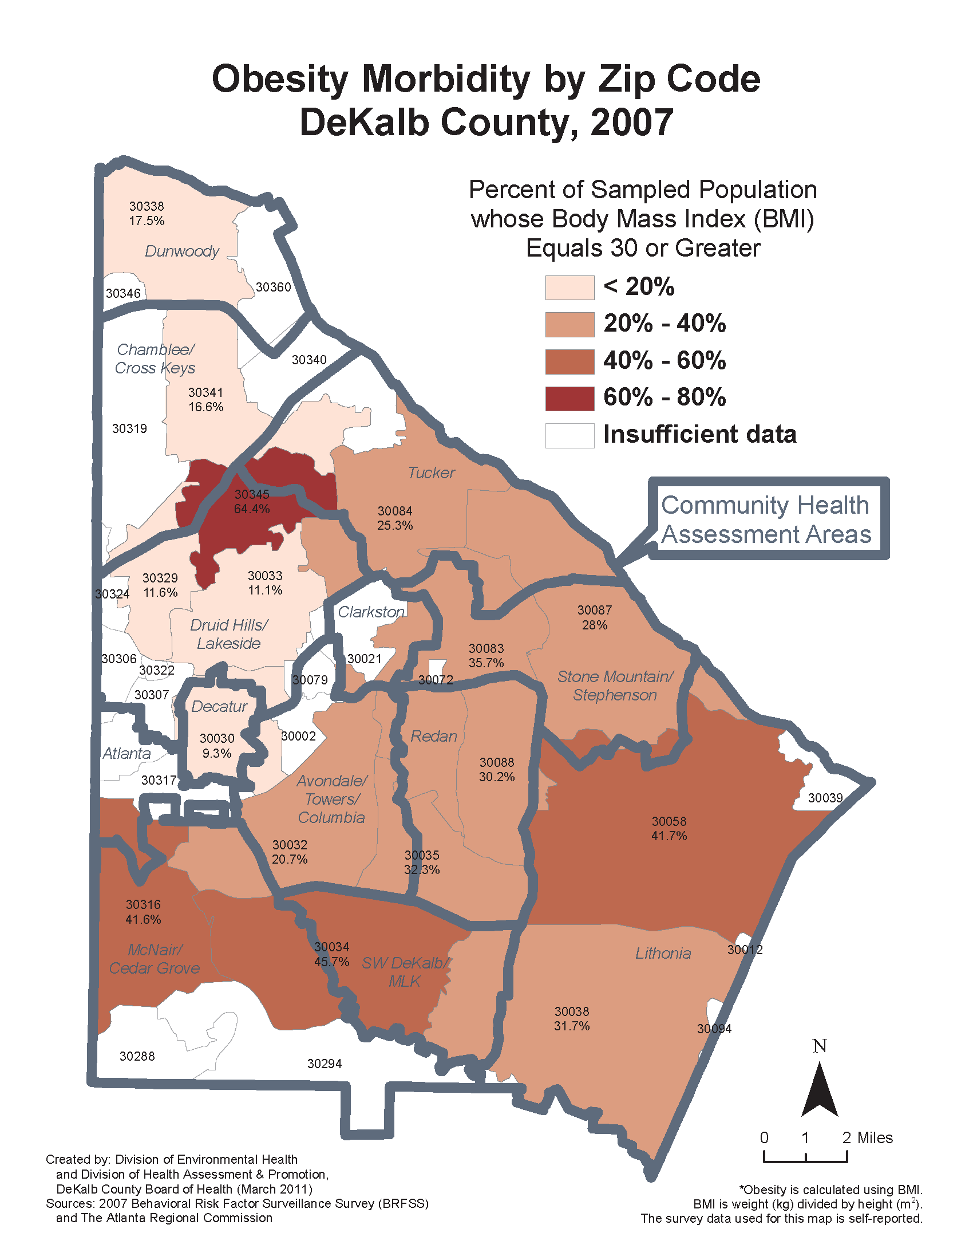
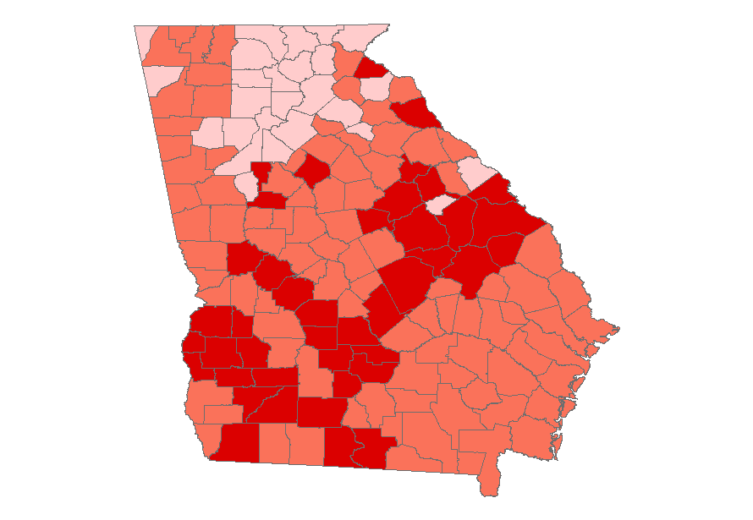
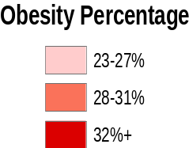
See For Yourselves…
GEORGIA OBESITY - 2008

Slide 7
The CPPW A Obesity Grant
Affordable Care Act (Healthcare Reform) – to reduce obesity through the promotion of physical activity and good nutrition throughout the county with Policy, Systems, and Environmental changes.
41 funded sites around the US. Only one in the state of GA to receive both CPPW A & B (Tobacco and Obesity) funding
$2.66 million
24-Month Time Line
Notes:
The 2010 Patient Protection and Affordable Care Act
(now 12 months)

Slide 8
SOLUTIONS???
Community’s suggestions were short term
DeKalb County needed Long Term Answers
MASTER ACTIVE LIVING PLAN
  Links destinations with the residents
  Builds upon a foundation of physical activity
Notes:
COOKING CLASSES? AEROBICS CLASSES? HEALTH FAIRS?
LIFESTYLE & BEHAVIORIAL CHANGES that were EASY AND READILY AVAILABLE

Slide 9
Components of MALP
Partnerships
Board of Health
DeKalb County Government
DeKalb County schools
Community-based organizations
Merchant associations
Neighborhoods
Notes:
We recognize that this is a huge undertaking in a very small amount of time – therefore, we partner

Slide 10
Components of MALP
Three Main Interventions
  Master Active Living Plan (Planning Department)
  Safe Routes to School (School System)
  Master Agriculture and Urban Farm Plan (various)

Slide 11
Components of MALP
Two Supporting Interventions
  Media
  Evaluation

Slide 12
Master Active Living Plan
Countywide Plan affording residents easy access to:
  Parks, community gardens, recreation centers
  Schools, libraries, senior facilities, clinics
  Mixed use activity centers/shopping, MARTA
Through pedestrian friendly linkages such as:
  Sidewalk, Pedestrian Paths, Safe Routes
  Bicycle paths and lanes
  Trails, PATH
“Making the healthy choice the easy choice”
Notes:
We have been working very closely with the Planning Department and the Community Development Department to develop the concept and objective. I would like Andrew Baker to talk about our vision for the Master Active Living Plan…

Slide 13
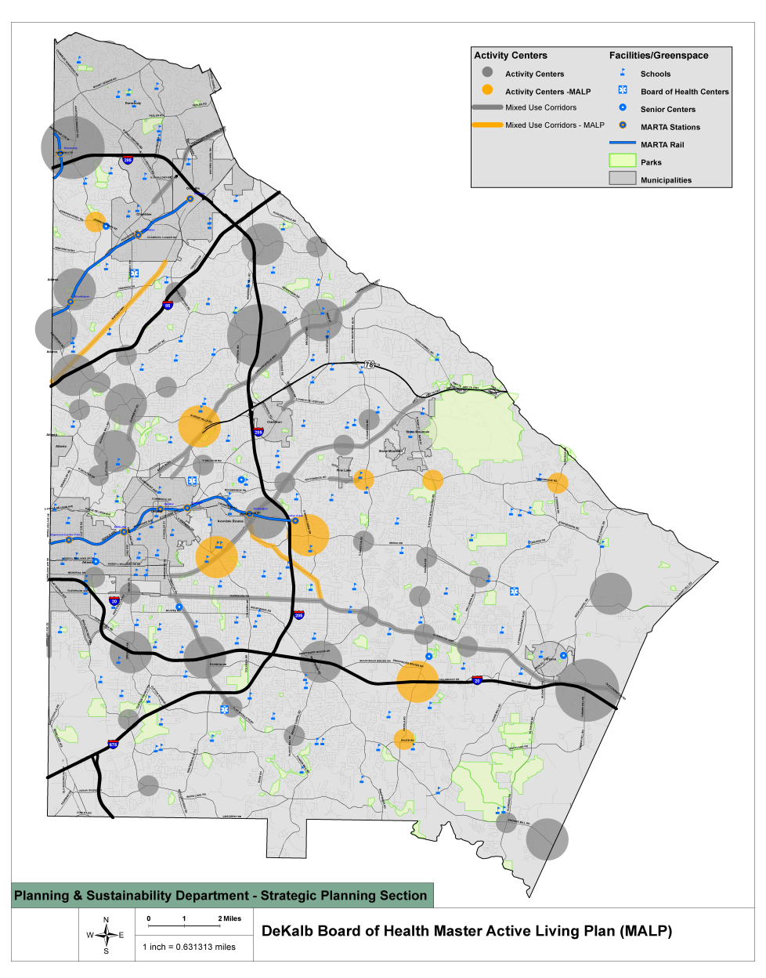
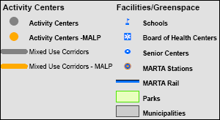
Conceptual Land Use Map

Slide 14
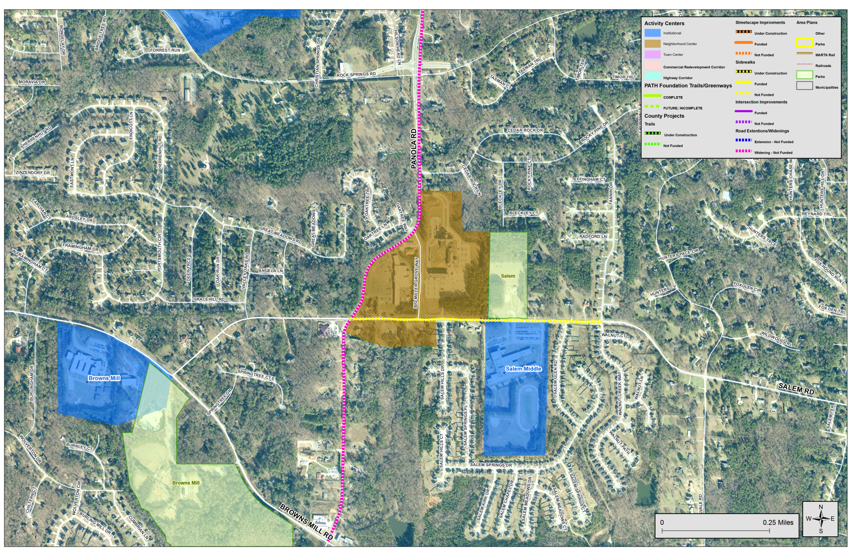
Graphic Example – Zoom View

Slide 15
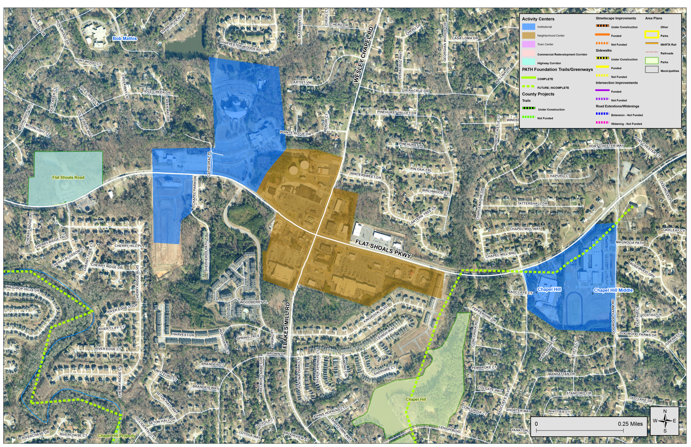
Graphic Example – Zoom View

Slide 16
Master Active Living Plan
Will create a countywide system that integrates a system of walking/biking connections
Provide healthy options and alternatives that encourage people to walk, thereby decreasing obesity in the county
Promote healthy eating and healthy lifestyles
Encourage movement away from cars to alternative modes of transportation

Slide 17
Intervention – Board of Education
Start with schools where community residents have limited or no access to safe, accessible places for physical activity.
Limit unhealthy food/drink availability
Allow neighborhoods/community residents access to recreational facilities (outdoor tracks, fields, playgrounds, and trails) outside of school hours in a phased approach.
Capitalize on Safe Routes to Schools

Slide 18
Master Agriculture and Urban Farms
  Board of Commissioners
  Countywide ordinance for community gardens in county owned parks.
  Gardens in Parks Ordinance will increase healthy food availability through community gardens
  Increase fresh food opportunities in the Zoning Code Update (honey bees, poultry, gardening in residential districts)
Board of Health
Facilitate the creation and/or expansion of three model Farmer’s Markets and create two model Urban Farms in the county
Develop toolkits and implementing guides to be used to replicate the programs

Slide 19
Supporting Intervention - Media
  Promote healthy lifestyle through awareness/education and community events
  Various Outlets – TV, radio, newspaper, billboards, social networking outlets and public transportation vehicle ads
  Message “branding” – integrated/complementary messaging of physical activity and nutrition campaign
  A “Community Campaign: Physical Activity” toolkit and Implementation Guide
  A “Community Campaign: Healthy Food and Drink Choices”
  Picture DeKalb Healthy
Notes:
Culturally and linguistically appropriate
(transferability)

Slide 20
BREAKING DOWN
“SILOS”

Slide 21
New Partnerships
“Think out of the box” -First time (DeKalb County) has tried to directly link:
  Health (living, lifestyle, exercise, nutrition)
  Land Planning (sustainability, land use, neighborhoods, mixed use activity centers, parks, schools)

Slide 22
Health/Land Use
DeKalb County developed as a bedroom community to the City of Atlanta (suburban)
Researchers found the people living in sprawling places were likely to weigh more, walk less, and have a greater prevalence of hypertension than people living in communities with more compact development patterns
-Source: (Measuring the Health Effects of SPRAWL, McCann & Ewing)
  Dependency on automobile
  Fast-paced lifestyle
  Fast food restaurants, microwave, instant gratification

Slide 23
PROCESS
INTERNAL
  Core team representatives
  Determination of study areas
  Determination of Demonstration Projects
ADMINISTRATION
  Development of job description
  Development of Request for Proposals
PROFESSIONAL SERVICES
  Follow procurement process
  Launch studies simultaneously
  Community Outreach/Education
Notes:
(CDC, school board, planning, community development, parks, health department)
Leverage
Time limited coordinator positions—describe fxn

Slide 24
DeKalb County’s GOAL
Create sustainable improvements in physical activity and nutrition through policy, systems, and environmental changes, which reduce the risk factors of childhood and adult obesity.

Slide 25
Questions???
S. Elizabeth Ford, M.D., M.B.A.
seford@dhr.state.ga.us
www.dekalbhealth.net
Andrew A. Baker, AICP
aabaker@dekalbcountyga.gov

