Slide 1
Competencies to Practice Toolkit:
A Repository of Workforce Development Resources for Public Health
Janet Place, MPH
APHA 139th Annual Meeting
Washington, DC
October 31, 2011

Slide 2
Presenter Disclosures
Janet Place, MPH
(1) The following personal financial relationships with commercial interests relevant to this presentation existed during the past 12 months:
No relationships to disclose

Slide 3
Overview
Core Competencies for Public Health Professionals
Competencies to Practice Toolkit
Get Involved!

Slide 4
Council on Linkages Between Academia and Public Health Practice
To improve public health practice, education, and research by:
  Fostering, coordinating, and monitoring links among academia and the public health and healthcare community;
  Developing and advancing innovative strategies to build and strengthen public health infrastructure; and
  Creating a process for continuing public health education throughout one’s career.
19 National Public Health Organizations:
  American College of Preventive Medicine
  American Public Health Association
  Association for Prevention Teaching and Research
  Association of Accredited Public Health Programs
  Association of Public Health Laboratories
  Association of Schools of Public Health
  Association of State and Territorial Health Officials
  Association of University Programs in Health Administration
  Centers for Disease Control and Prevention
  Community-Campus Partnerships for Health
  Health Resources and Services Administration
  National Association of County and City Health Officials
  National Association of Local Boards of Health
  National Environmental Health Association
  National Library of Medicine
  National Network of Public Health Institutes
  National Public Health Leadership Development Network
  Quad Council of Public Health Nursing Organizations
  Society for Public Health Education
Funded by CDC and HRSA
Staffed by PHF
.

Slide 5

Core Competencies for Public Health Professionals
Are a set of skills desirable for the broad practice of public health
Reflect characteristics that staff of public health organizations may want to possess as they work to protect and promote health in the community
Are designed to serve as a starting point for academic and practice organizations to understand, assess, and meet training and workforce needs
Notes:
Aim to help strengthen public health workforce development
Guide public health practice

Slide 6
Who Uses the Core Competencies?
>50% of State Health Departments (ASTHO, 2009)
~30% of Local Health Departments (NACCHO, 2010)
>90% of Academic Public Health Programs (Council on Linkages, 2006)
Core Competencies are also used by:
  CDC
  HRSA’s Public Health Training Centers
  TRAIN affiliates
Notes:
CDC – developing discipline-specific competencies and guiding training
HRSA – needs assessments and training programs offered by PHTCs
Learning Management Systems for public health

Slide 7
Uses of the Core Competencies
Developing
  Job descriptions
  Performance objectives
  Workforce competency assessments
  Workforce development plans
  Training plans
  Discipline-specific competencies
  Curricula
Conducting
  Performance reviews/evaluations
  Curricula review and development
Preparing for accreditation
  PHAB Standards and Measures Domain 8

Slide 8

Competencies to Practice Toolkit
Purpose: To help public health practitioners meet their workforce development needs
Tools under development:
  Crosswalks
  E.g.s to clarify competencies
  Examples that demonstrate attainment of competence
  Job descriptions
  Prioritization matrix
  Competencies assessment
  Examples of Core Competencies use

Slide 9
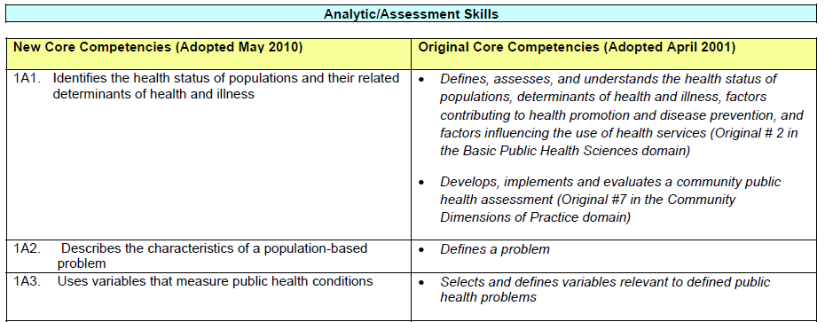
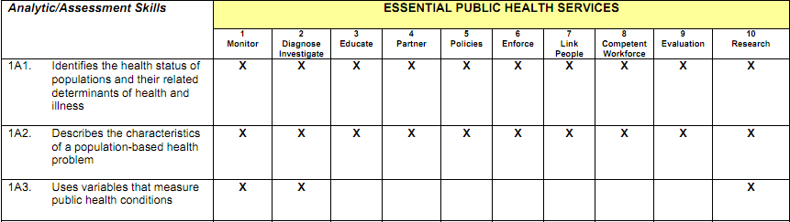
Tool: Crosswalks
Crosswalk of the Core Competencies with the 10 Essential Public Health Services
Crosswalk of the revised, tiered Core Competencies with the original Core Competencies
Notes:
Status: Complete and available online

Slide 10
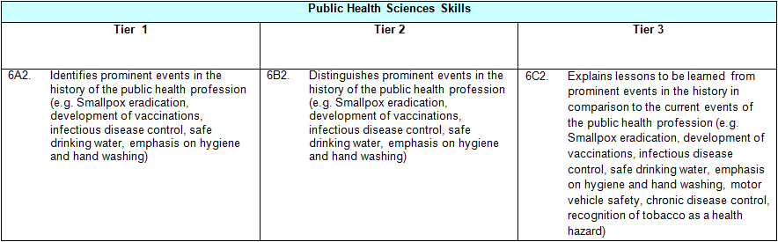
Tool: E.g.s
Examples to clarify the wording of individual competencies
Notes:
Status: Initial draft under review

Slide 11
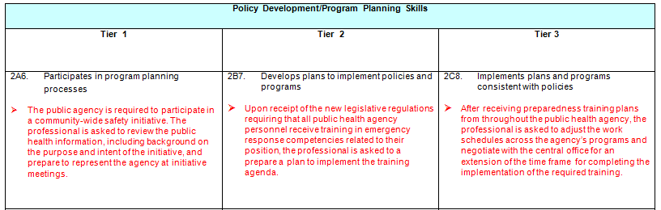
Tool: Examples that Demonstrate Attainment of Competence
Illustrations of how public health professionals can show competence in a specific area
Notes:
Status: Initial draft available online for comments

Slide 12


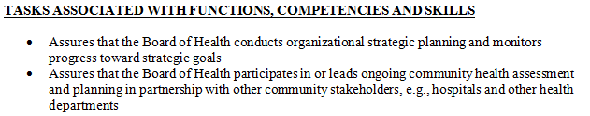
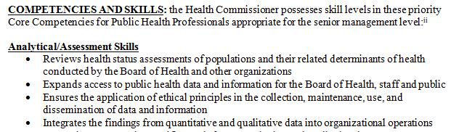
Tool: Job Descriptions
Sample job descriptions that incorporate the Core Competencies as key qualifications
Notes:
Status: Development of drafts to begin shortly

Slide 13
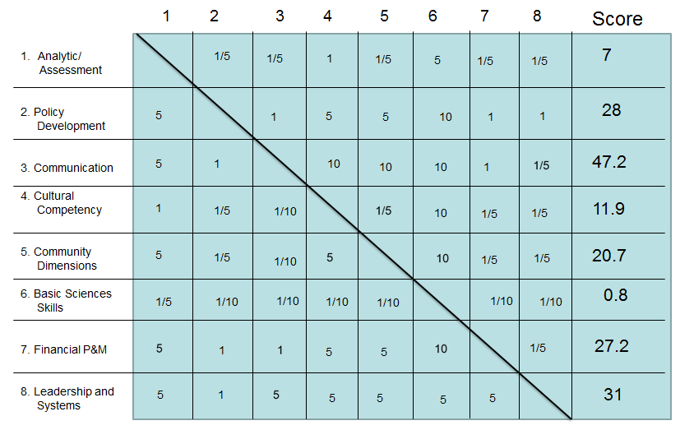
Tool: Prioritization Matrix
Quality improvement tool to identify Core Competencies domains on which to focus attention and resources
Notes:
Status: Field demonstrations at NACCHO, NALBOH, and APHA annual meetings

Slide 14
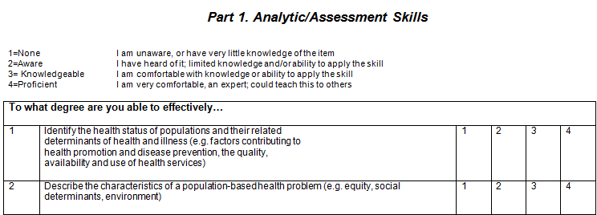
Tool: Competencies Assessment
Tool to help assess gaps in skills and knowledge related to the Core Competencies and identify training needs
Notes:
Initiative to link the competency self-assessments to TRAIN

Slide 15
Examples of Core Competencies Use
CDC: To articulate quality improvement competencies for Performance Improvement Managers being hired by health departments with Affordable Care Act funding
West Virginia and Rhode Island: Using Three Tier Assessment for statewide training needs assessment
Minnesota: Use of the Tier 3 Core Competencies recommended for the Community Health Services Administration by the State Community Health Services Advisory Committee

Slide 16
Examples of Core Competencies Use
Southwest Regional Public Health Training Center: To develop a knowledge-based needs assessment to be incorporated into a new learning management system
Indiana: Crosswalk of the Tier 2 Core Competencies and the Essential Public Health Services included in an “Education and Training Toolkit” distributed to local health departments

Slide 17

Summary of Tools
Competencies to Practice Toolkit will contain:
  Crosswalks
  E.g.s to clarify competencies
  Examples that demonstrate attainment of competence
  Job descriptions
  Prioritization matrix
  Competencies assessment
  Examples of Core Competencies use
What other tools are needed?

Slide 18
Get Involved!
Use the Core Competencies for Public Health Professionals
Provide feedback on today’s tools or suggest new ones
Share your own tools and examples of Core Competencies use
Visit http://www.phf.org/programs/corecompetencies or contact Council on Linkages Project Manager, Kathleen, at kamos@phf.org for more information
Notes:
Thank the Core Competencies Workgroup/former Competencies to Practice Toolkit Subgroup for their work

