Slide 1



Examining the Psychosocial Impacts of Animal-Assisted Interventions on Pediatric Oncology Patients
Presented at American Public Health Association Annual Meeting
Monday, October 31, 2011

Slide 2
Presenter Disclosures
Presenter Names: Molly Jenkins, MSW and Ashleigh Ruehrdanz
The following personal financial relationships with commercial interests relevant to this presentation existed during the past 12 months:
No relationships to disclose

Slide 3

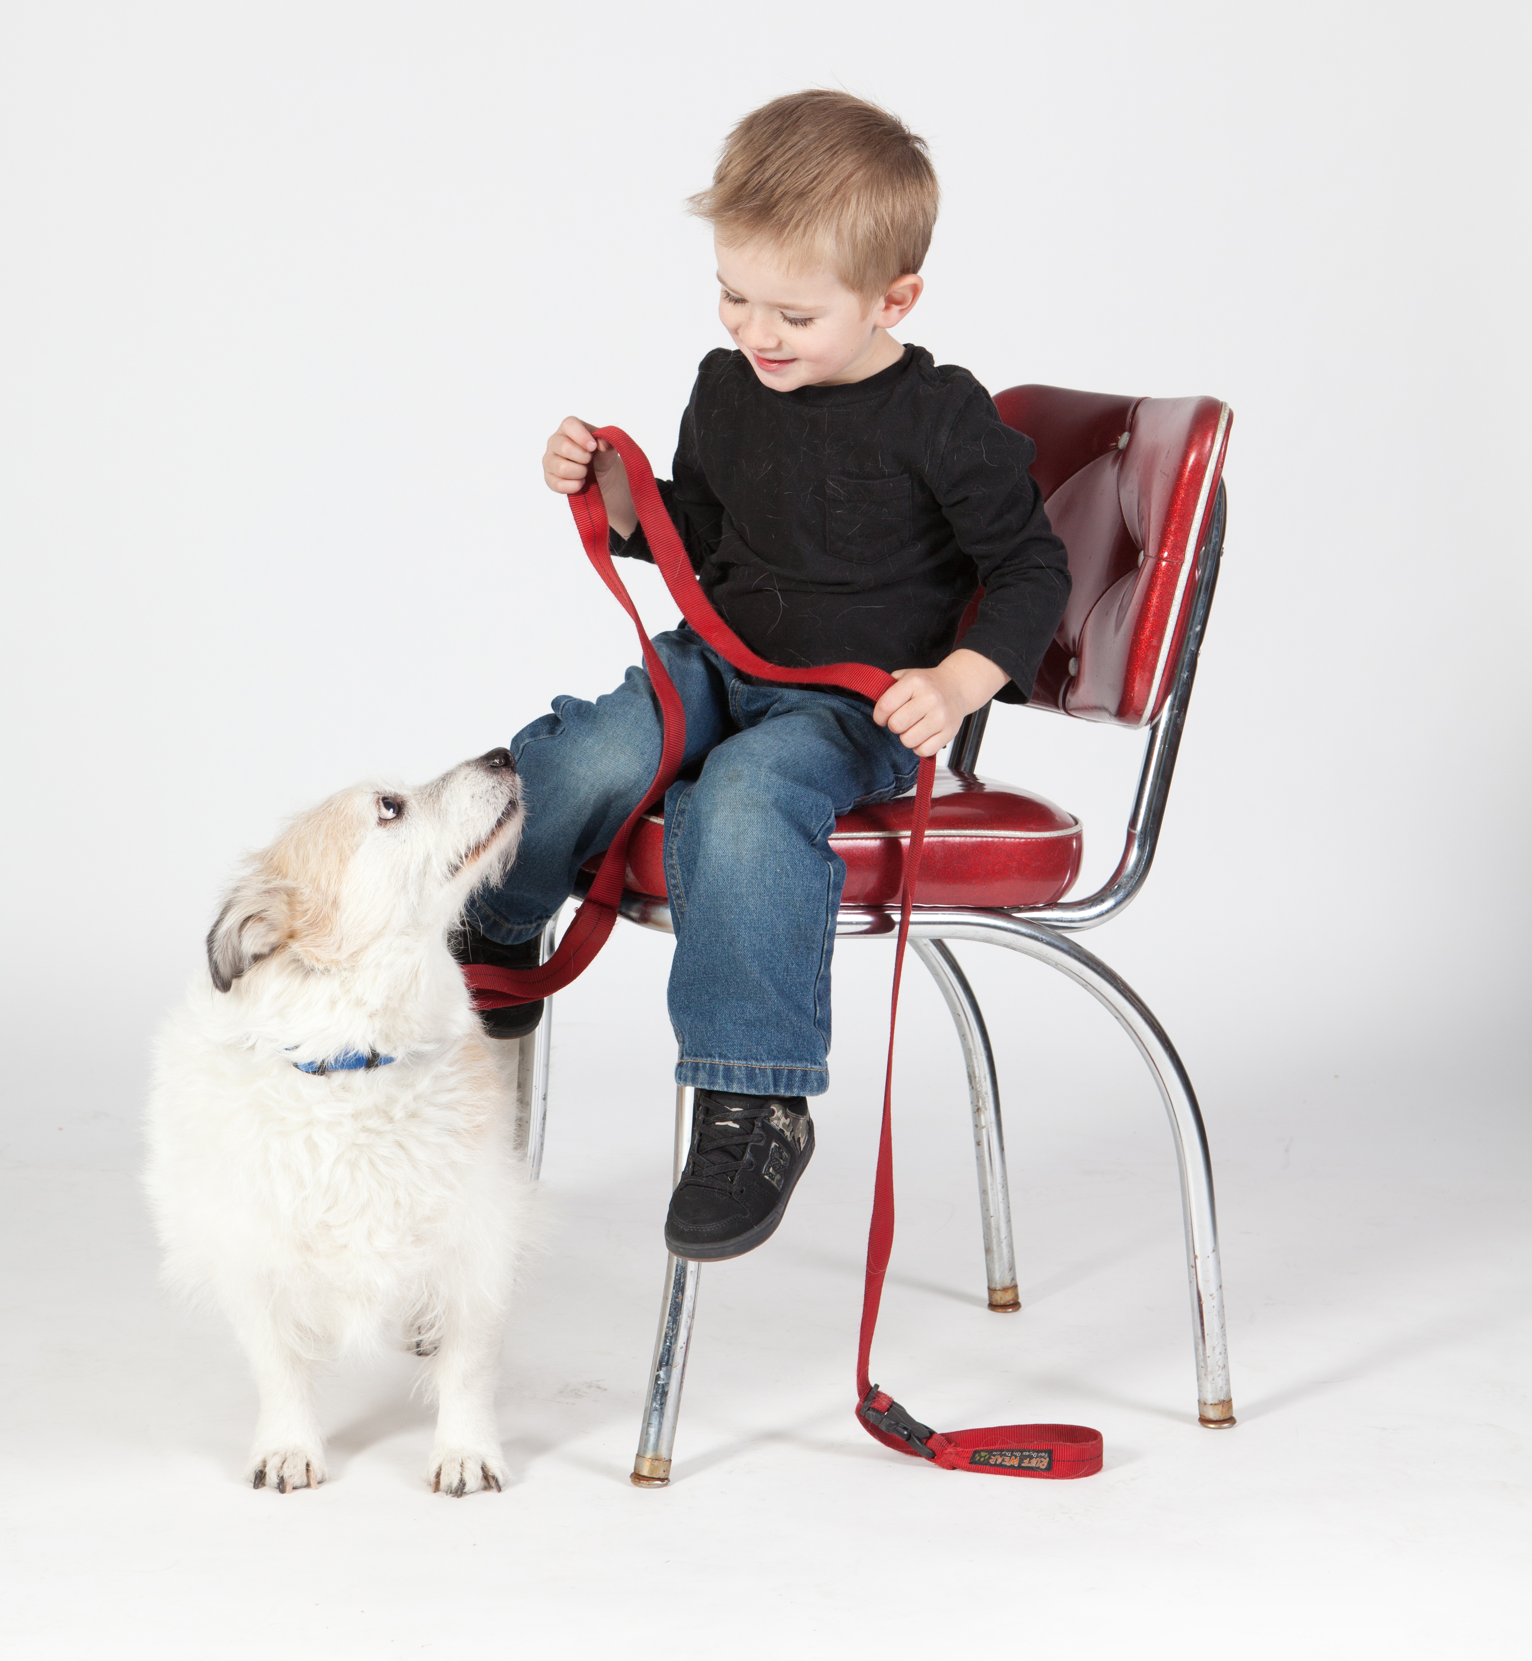
American Humane Association
Historic, national not-for-profit dedicated to the protection of society’s most vulnerable
  Children
  Pets
  Farm and working animals
Celebrated 134th anniversary in October
At the forefront of nearly every major advancement in protecting children and animals from cruelty, abuse and neglect
MISSION: to create a more humane and compassionate world by ending abuse and neglect of children and animals

Slide 4
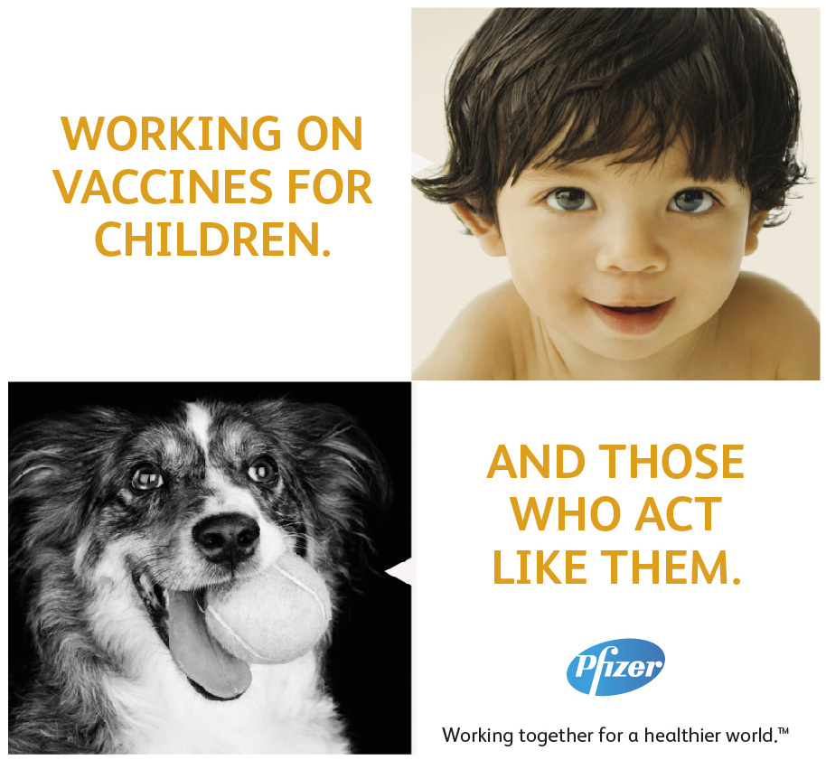
Pfizer Animal Health
A Pfizer business
A leading global animal health company
MISSION: working to ensure a safe, sustainable global food supply from healthy livestock. Helping companion animals to live longer, healthier lives

Slide 5
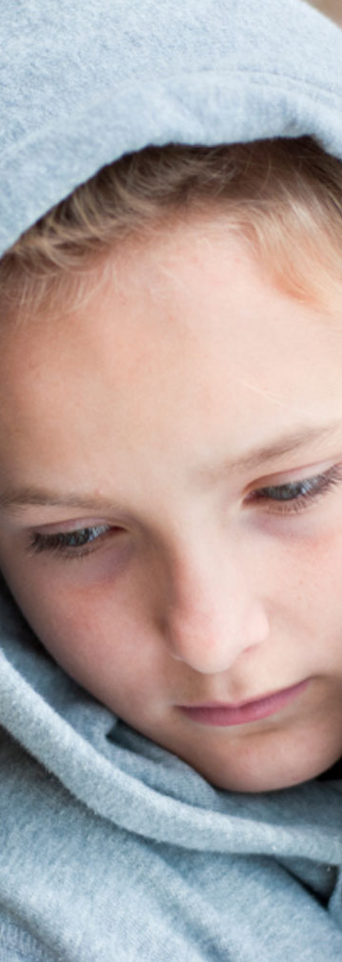
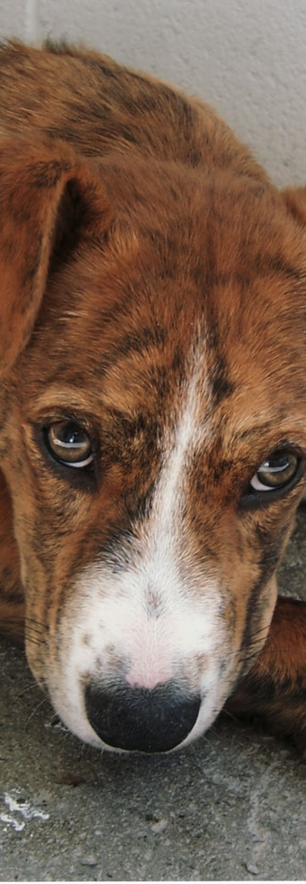
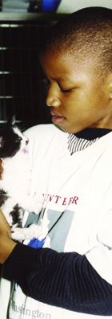
Canines and Childhood Cancer (CCC):
An Innovative Research Study
Animal-Assisted Therapy and Pediatric Oncology

Slide 6
CCC Study Overview
Childhood Cancer
Children diagnosed with cancer and their families not only cope with physical issues, but are also prone to psychosocial issues including isolation, depression, trauma, and fear.
Research Question
Empirical evidence shows that interaction with animals during therapy is beneficial. Can we document with more certainty that animal-assisted therapy can improve the health and well-being of children with cancer and their families, and/or that it has positive impacts on healthcare providers?
Study Design
Randomized control trial design to measure biological, psychological, social, and clinical outcomes among children and their families.
Multiple Site Participation
Up to five pediatric oncology centers nationwide will participate in the study.

Slide 7
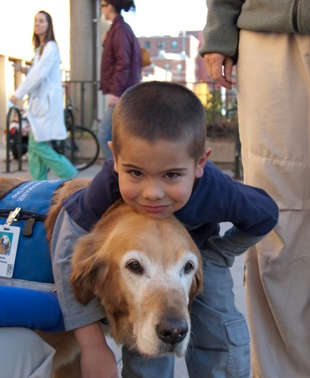
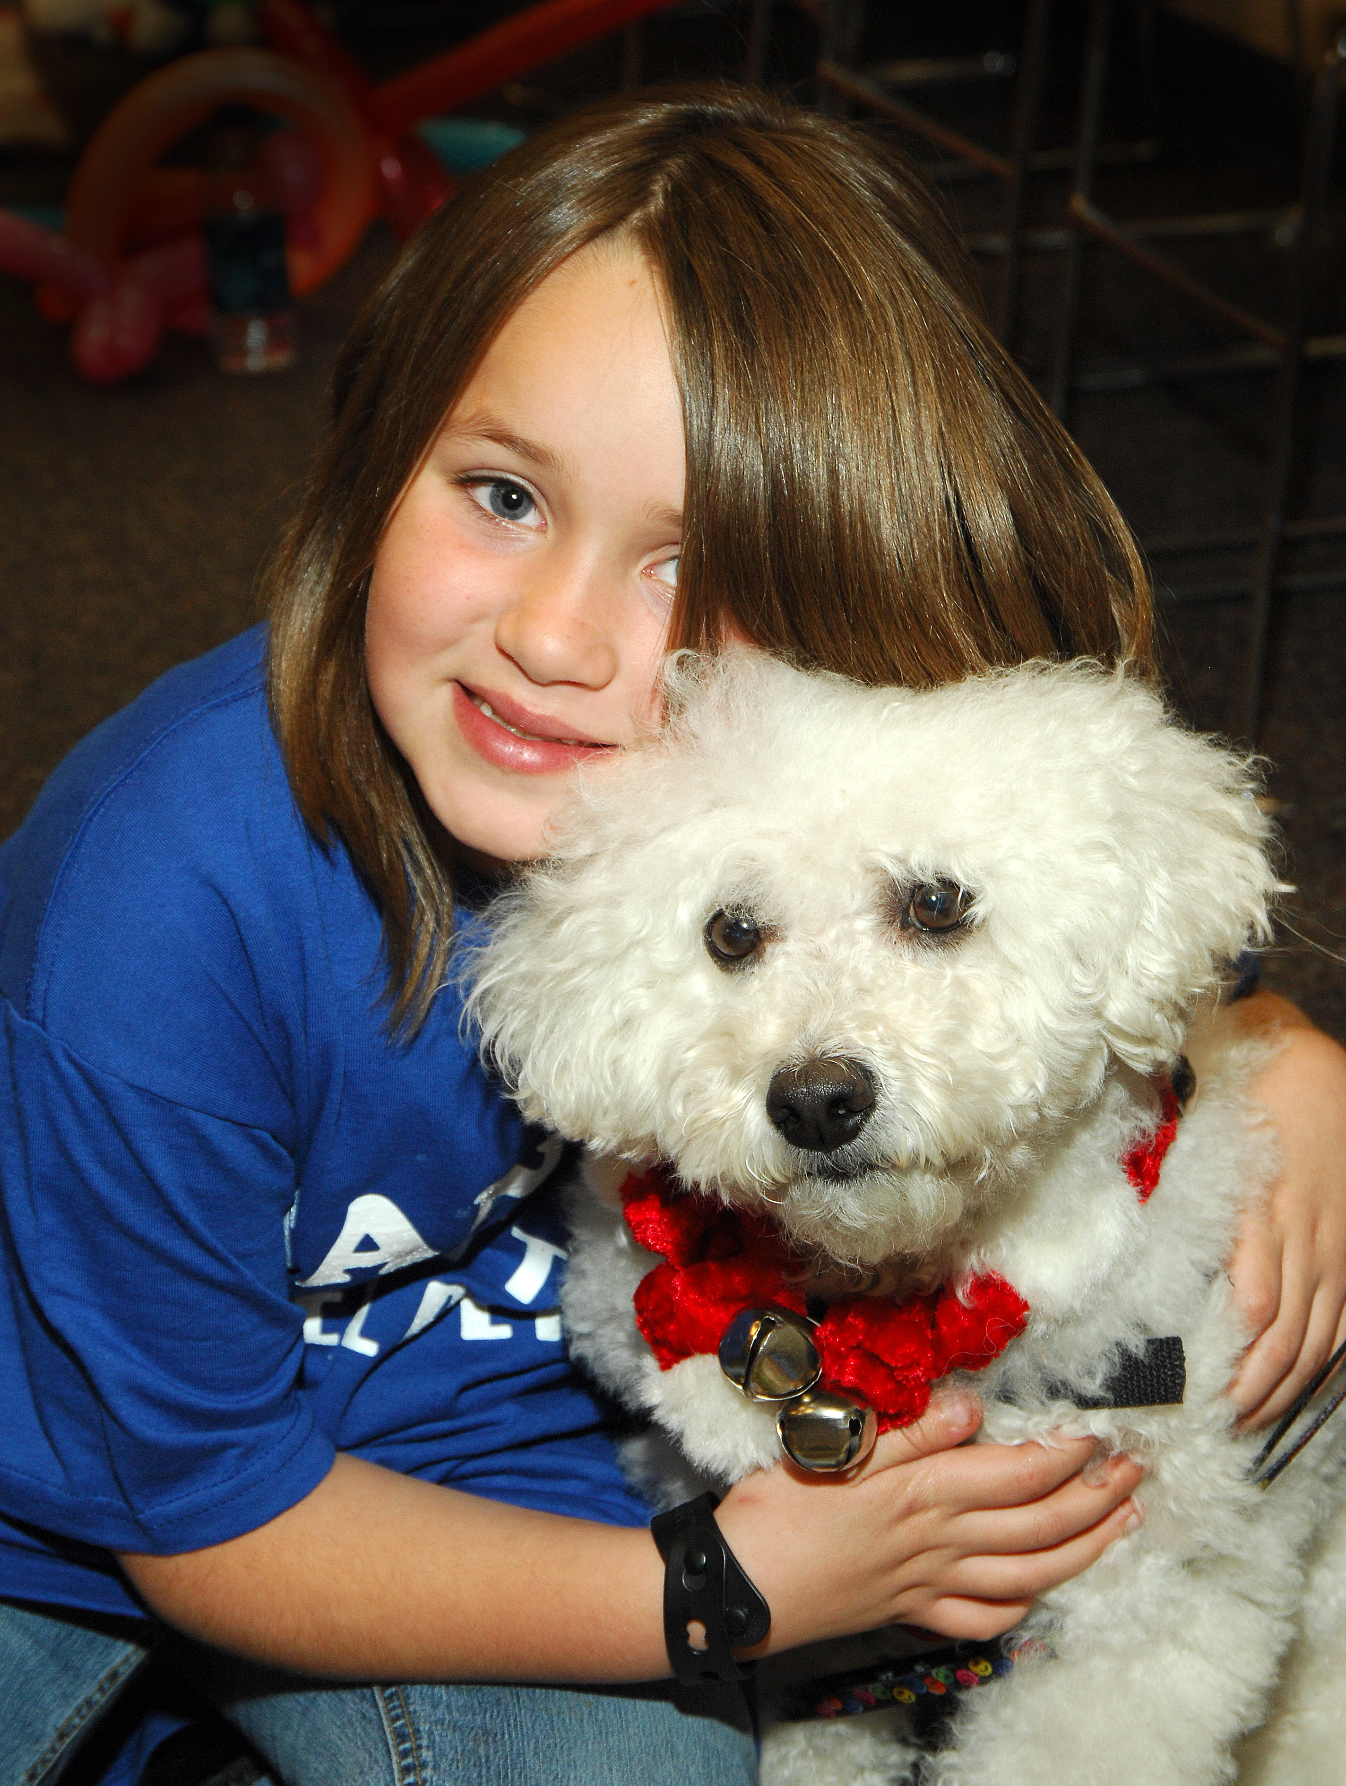
CCC Study Goals
Understand what children with cancer and their families experience
Understand how best to integrate animal-assisted therapy into pediatric cancer treatment
Design a replicable animal-assisted therapy treatment protocol with fidelity
Determine the impact of animal-assisted therapy using rigorous research methods

Slide 8
A Project in Three Phases
Phase I (January 2011-present)
  Comprehensive literature review: on pediatric oncology and human-animal interactions (HAIs)
  Site recruitment: 1). East Tennessee Children’s Hospital (Knoxville, TN); 2). Monroe Carell Jr. Children’s Hospital at Vanderbilt (Nashville, TN); and 3). St. Joseph’s Children’s Hospital (Tampa, FL)
  Focus groups and interviews: with healthcare providers, animal-assisted therapy handlers, and families at each site
Phase II
  Research design will be finalized
  Clinical sites and study participants will be selected
  Project implementation and data collection will be piloted
Phase III
  Full clinical trial with up to five sites will take place

Slide 9
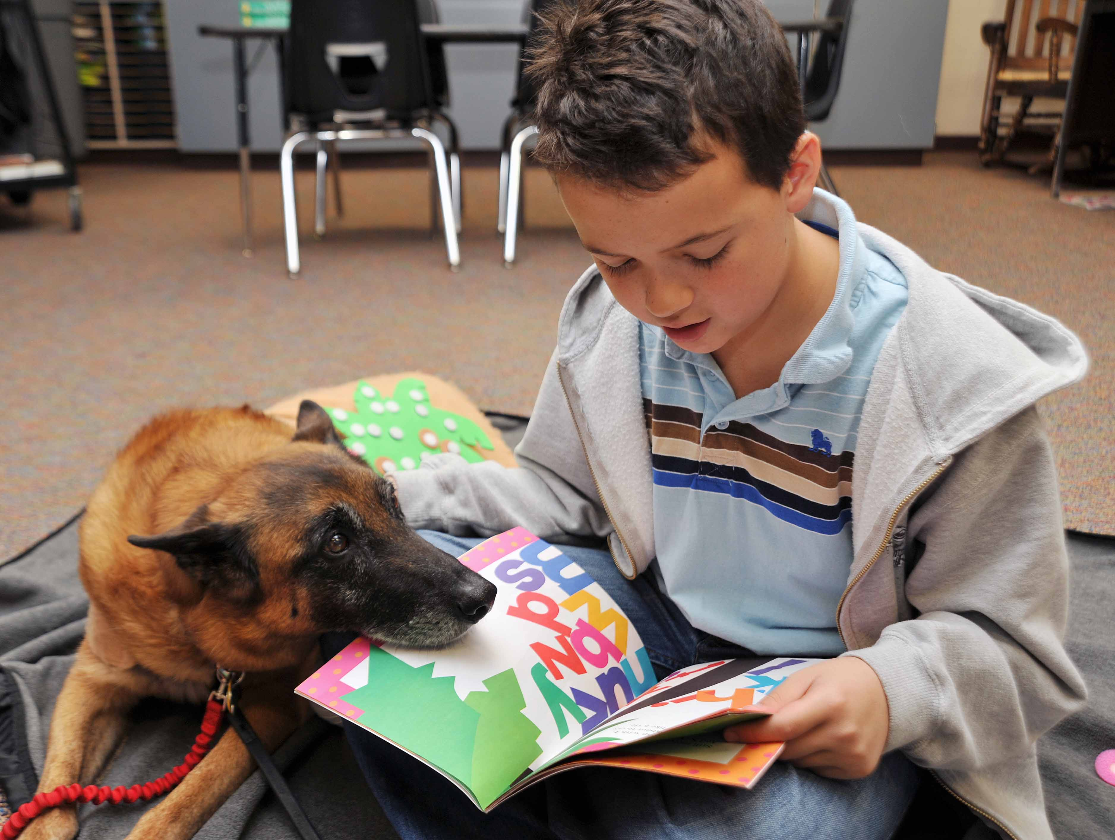
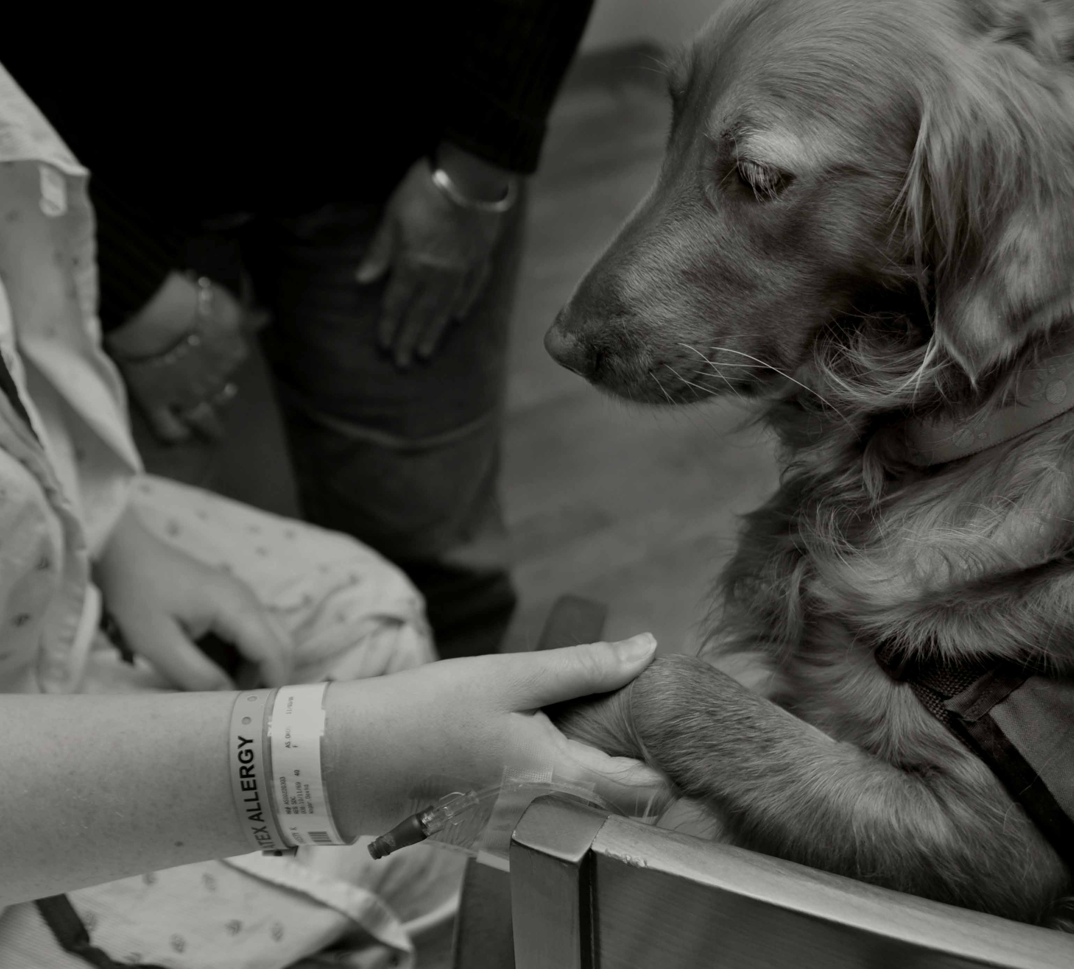
Comprehensive Literature Review
Organized to provide a background to support the development of the study’s research design and other Phase II and Phase III activities
Intended to serve as a resource to the pediatric oncology and HAI fields, documenting the status of existing research and opportunities to enhance the research base
The second draft of the review, which covers approximately 150 literature sources, is currently being reviewed by experts in pediatric medicine, animal welfare and behavior, and HAIs
The final literature review product is scheduled to be released in early 2012

Slide 10
Brief Overview of Pediatric Oncology
More than 40,000 children in the U.S. undergo cancer treatment each year [Children’s Oncology Group (COG), 2011]
Over the past 2 decades, while the incidence of cancer has increased slightly, the mortality rates from cancer have drastically decreased [National Cancer Institute (NCI), 2008]
  5-year survival rates for all childhood cancers improved by more than 20% between 1975/1977 and 2001/2007 (Howlander, et al., 2011)
Infants (0-4 years of age) and adolescents (15-19 years of age) are more likely to be diagnosed with cancer than youth in between those age groups (COG, 2005)
It is slightly more common for boys to be diagnosed with cancer than it is for girls (Li et al., 2008)

Slide 11
Brief Overview of Pediatric Oncology (cont.)
Leukemia, a cancer of the blood, is the most common form of all childhood cancers (Li, 2008; NCI, 2008)
  Most prevalent in children under the age of 10 years (CCRF, 2009; Li, 2008)
  Types of leukemia are acute lymphoblastic leukemia (ALL) and acute myelogenous leukemia (AML)
Brain tumors are the most common type of solid tumor
  Most prevalent in children under the age of 5 years (University of Minnesota, 2011)
  Most common form of cancer in infants (University of Minnesota, 2011)
  Most common type of brain tumor is neuroblastoma
Other types of childhood cancer include lymphomas, sarcomas, retinoblastomas, liver cancers, and kidney cancers

Slide 12
Needs of Children During Cancer Treatment
The following are several problematic areas, symptoms, and/or conditions commonly experienced by children during cancer treatment (Landolt et al., 1998; Moore, 2003; Poder et al., 2010; Sung et al., 2011):
  Depression
  Emotional distress
  Fatigue
  Lower Quality of Life (QoL)
  Pain
  Post-traumatic stress
  Receiving adequate nutrition
  Social stress
  Somatization
  Withdrawal
The type of cancer has been shown to have an effect on which symptoms a child experiences (Schultz et al., 2007)

Slide 13
Needs of Children Post Cancer Treatment
While physical effects tend to subside over time, many psychosocial and behavioral effects remain for the long-term (Poder et al., 2010)
Negative outcomes upon treatment completion include (Campbell et al., 2008; Henning & Fritz, 1983; Kamibeppu et al., 2010; Lahteenmaki, et al., 2002; Wakefield et al., 2010):
  Decreased liveliness, mood, motor/physical functioning, psychological well-being, and self-esteem
  Decreased coping strategies as a result of chemotherapy treatment
  Increased anxiety, problem behaviors, and sleeping difficulties
  Increased post-traumatic stress symptoms
  Increased phobias, depression, and bullying among children returning to school after the treatment process
Positive psychosocial outcomes for children upon completing their cancer treatment include (Wakefield et al., 2010):
  High self-worth
  Good behavioral conduct
  Improved mental health and social behavior

Slide 14
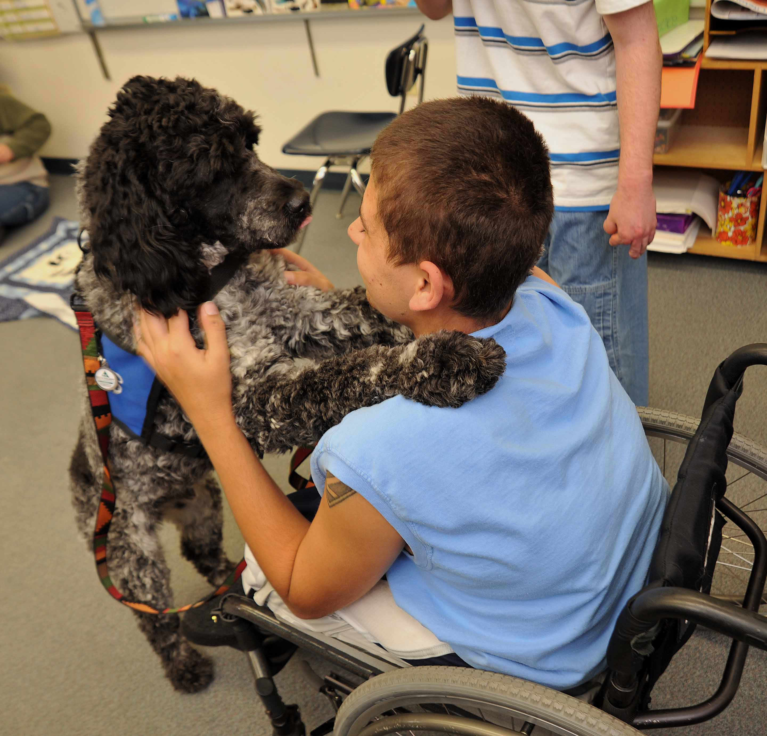
Long-term Needs of Children
Common needs that survivors of childhood cancer experience throughout their lives include (Krull et al., 2010; Michel et al., 2010; Schultz et al., 2007; Wiener et al., 2006):
Aggression
Anxiety
Antisocial behaviors
Attention deficits
Depression
Distress
Emotional and externalizing behaviors
Obesity and physical inactivity
Post-traumatic stress
Social withdrawal
Stimulant use

Slide 15
Needs of Families Coping with Childhood Cancer
Upon learning that their child has cancer, parents tend to experience the following (Al-Gamal & Long, 2010; Best, Streisand, Catania, & Kazak, 2001; Fotiadou, Barlow, Powell, & Langton, 2008; Norberg & Boman, 2008; Norberg, Poder, & von Essen, 2011; Smith et al., 2005):
  Anger
  Anxiety
  Denial or avoidance of their child’s illness
  Distress
  Grief
  Post-traumatic stress
  Sleeping problems
  Weight gain and decreased physical activity
Parental distress tends to vary as a function of time from diagnosis, with parents of more recently diagnosed patients presenting higher levels of distress than parents of children who have been living with cancer for some time (Al-Gamal & Long, 2010; Han, 2003; Norberg & Boman, 2008)
Parents are also vulnerable to distress after their child’s cancer treatment, when fears around recurrence may be heightened (Wakefield et al., 2011)

Slide 16
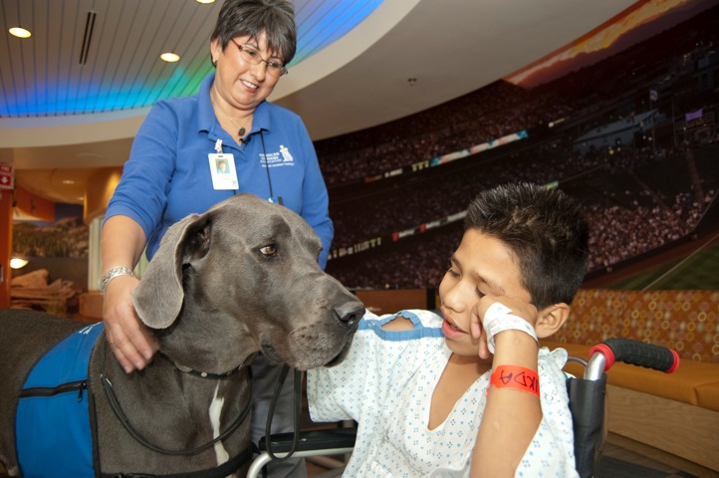
Needs of Families Coping with Childhood Cancer (cont.)
Parental distress can negatively affect the child’s physical and emotional well-being (Al-Gamal & Long, 2010; Best et al., 2001; Norberg, Poder, & von Essen, 2011; Wijnberg-Williams et al., 2006)
Lower socioeconomic status and decreased work opportunities have been shown to negatively impact parental optimism (Al-Gamal & Long, 2010; Fotiadou et al., 2008)
Some research indicates that mothers and fathers cope differently with their child’s cancer diagnosis and treatment (Hoekstra-Weebers et al., 1998; Wijnberg-Williams et al., 2006)

Slide 17
Needs of Families Coping with Childhood Cancer (cont.)
The relationship between parents is commonly impacted—both negatively and positively—by their child’s cancer diagnosis and treatment (da Sliva, Jacob, & Nascimento, 2010; Hoekstra-Weebers et al., 1998)
Parents of childhood cancer patients who no longer live together (i.e., separated or divorced) generally experience greater stress when making decisions about their child’s illness than parents who are still together and share a household (Kelly & Ganong, 2010)
Family roles and responsibilities often change when a child is diagnosed with cancer (da Silva & Nascimento, 2010)
Siblings of cancer patients also experience psychosocial effects, including (Koch, 1985; Wilkins & Woodgate, 2007):
  Acting out
  Feeling left out or less important
  Loneliness
  Maturation as a result of increased expectations and responsibilities
  Sorrow
  Worry and anxiety

Slide 18
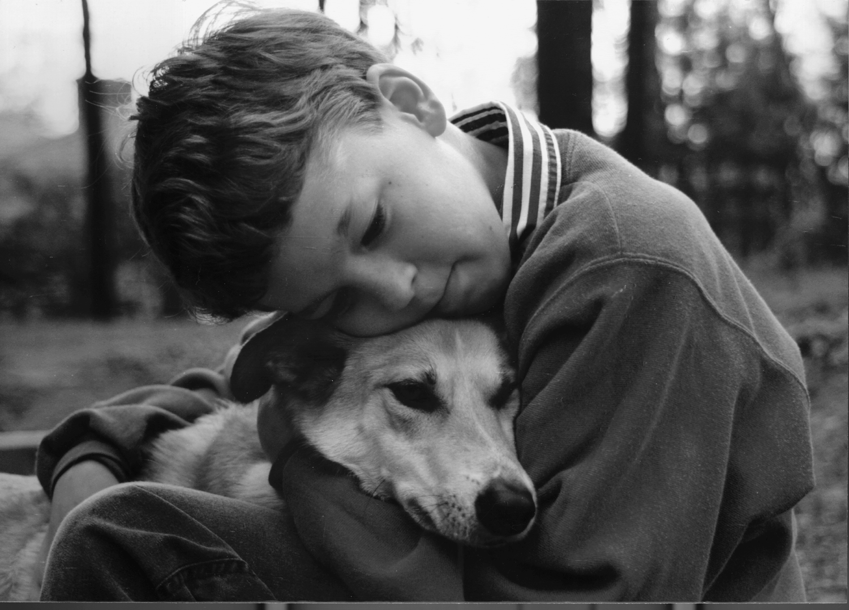
Human-Animal Interactions
Animals have long played important roles in the lives of human beings
  These roles often vary according to an individual’s personal and cultural backgrounds
According to biologist E.O. Wilson, humans have an innate need to interact with other living beings, including animals and the natural environment (Wilson, 1984)
  This is called “biophilia”
Increasingly, attention has been given to the role that animals can play in supporting the health and well-being of people in need

Slide 19
Human-Animal Interactions (cont.)
Reported benefits of human-animal interactions (HAIs) include (Fine, 2010; McCardle, McCune, Griffin, Esposito & Freund, 2011; Nimer & Lundahl, 2007; Serpell, 2006) :
  Exercise or opportunities for improved physical health and wellbeing
  Relaxation and reduced anxiety
  Decreased blood pressure and heart rate
  Distraction from pain or worry
  Unconditional support and acceptance
  Increased sensory stimulation and opportunities for physical touch
  Improved skills that lead to healthy relationships with others
  Enhanced senses of self-esteem, confidence, and mastery
  Increased motivation to actively participate in the healing process

Slide 20
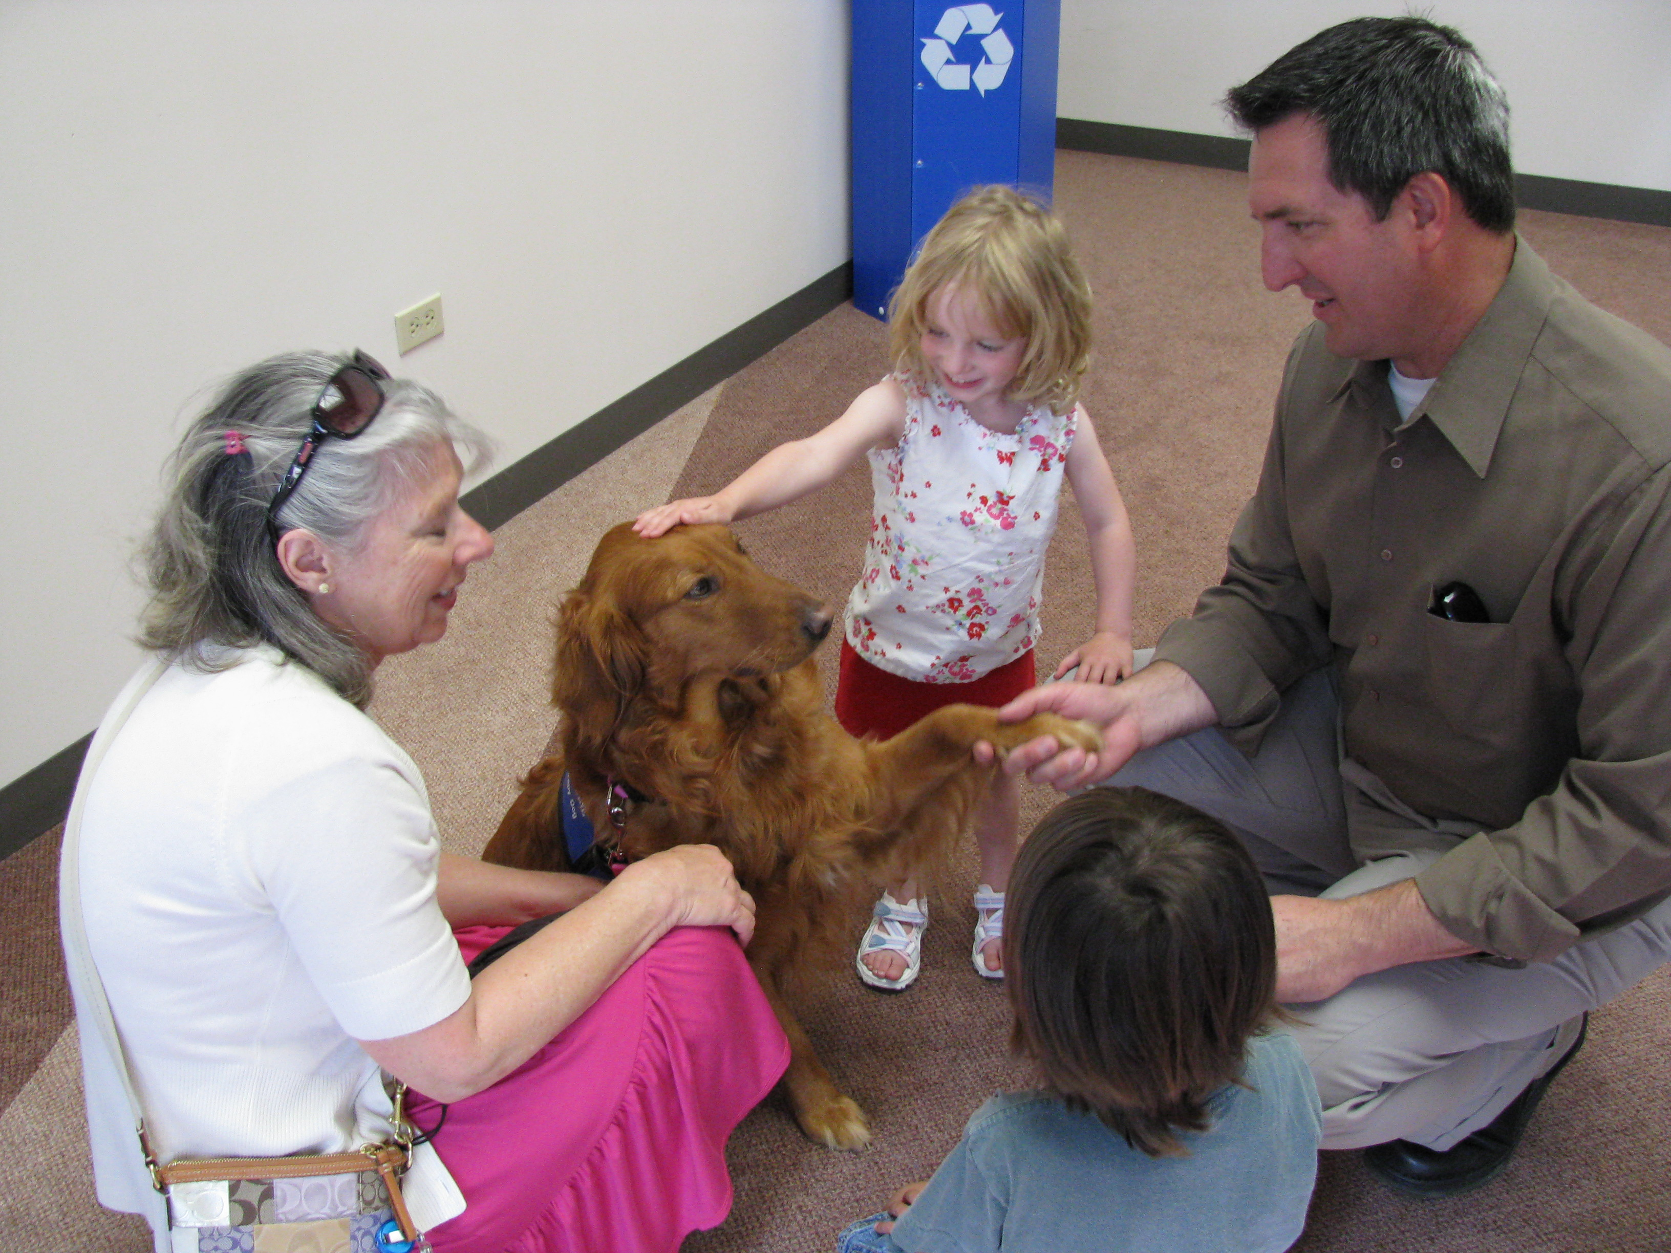
Animal-Assisted Therapy and Animal-Assisted Activities
Animal-assisted therapy (AAT) is an adjunct treatment modality that incorporates an animal into the treatment process to enhance healing for individuals and families
  AAT is a treatment goal-directed intervention
  There is a general lack of consistent, documented AAT protocol and several different definitions and terms to describe AAT have been proffered (Kruger & Serpell, 2006; Friedmann, Son, & Tsai, 2010)
Animal-assisted activities (AAA) are less formalized and more spontaneous than AAT
  AAA are not necessarily directed by the client’s treatment goals
  AAA are typically characterized by animal visits in a variety of settings, such as hospitals
  AAA do not typically match the same client and animal for every visit

Slide 21
AAT’s Role in Addressing the Needs of Children and Families Coping with Pediatric Cancer
Therapy animals have been shown to (Bardill & Hutchinson, 1997; Coleman, et al., 2008; Fawcett & Gullone, 2001; Hansen et al., 1999; Havener et al., 2001; Kale, 1992; Kaminski et al., 2002; Mallon, 1994; McNicholas & Collis, 2006; Souter & Miller, 2007; Strand, 2004; Wu et al., 2002; etc.):
  Facilitate rapport and social interaction between people, thus potentially decreasing loneliness and/or easing the treatment process
  Be a source of unconditional and non-judgmental social support
  Provide calm and relaxation for people in need
  Present opportunities for physical activity and exercise
  Increase learning, growth, and development
  Normalize the hospital experience
  Motivate active participation in the treatment process
  Offer helpful distraction from pain and worry
  Alleviate distress
  Elevate mood and decrease depressive symptoms

Slide 22
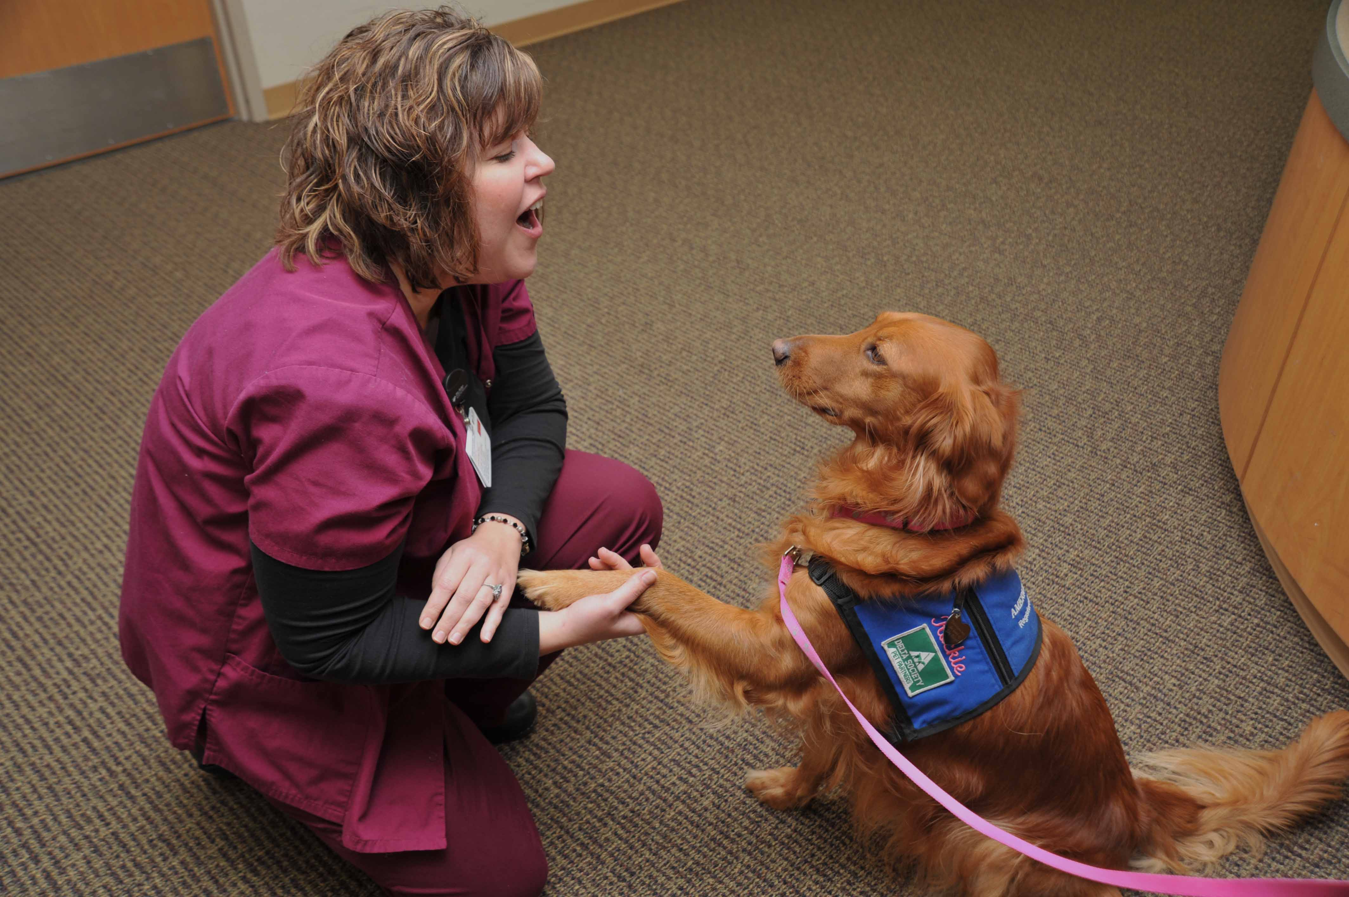
Special Considerations for Implementing
AAT in Pediatric Oncology Settings
Infectious disease control and zoonoses
  Several studies have found limited to no evidence that AAT increases transmission of zoonotic diseases (Caprilli & Messeri, 2006; Hines & Fredrickson, 1998; Yamauchi & Pipkin, 2008)
Human allergies, phobias, and physical harm
  Risks are generally minimal due to the standards and requirements associated with registering therapy dogs (Friedmann, Son and Tsai, 2010)
Ensuring animal well-being
  To date, few studies have specifically evaluated what bearing AAT may have on therapy animals
Animal-handler team selection
  Guidelines for best practice
Setting and participant selection
  Guidelines for best practice
Service delivery
  Guidelines for best practice

Slide 23
The Current State of HAI Research
Much of our understanding of the effectiveness of AAT or AAA is based on anecdotal information provided through the experiences of patients, students, staff, family members, and animal handlers
Rigorous and evidence-based research in the field of HAI continues to be lacking, with a small number of scientific studies providing limited evidence-based data (Griffin, McCune, Malholmes, & Hurley, 2011; Wilson & Barker, 2003)
  The inconsistent approach to AAT/AAA interventions has been a barrier to researching AAT/AAA effectiveness, especially because it precludes the ability to replicate the interventions
Other issues with developing and conducting HAI research may include (Johnson et al., 2002):
  Gaining access to clinical settings
  Obtaining IRB approval
  Effectively managing zoonotic and infection concerns
  Recruiting and randomly selecting large and diverse study samples
  Choosing appropriate study instruments
  Avoiding contamination of study groups and workload burden of staff

Slide 24
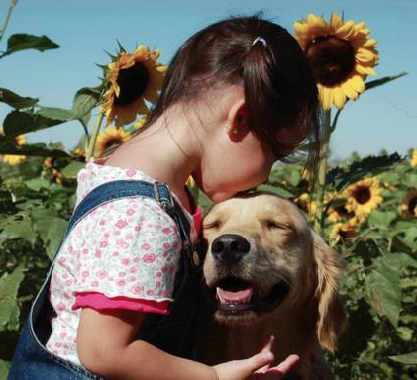
Literature Review Implications
A vast array of issues affect children with cancer and their families
Adjunct therapies are needed to address the complex psychosocial and behavioral issues affecting these patients and their families
Animal-assisted therapy provides a viable, innovative, and accessible treatment option for this unique population
The CCC study will add to the research base of the pediatric oncology and HAI fields

Slide 25
For more information, visit www.americanhumane.org
Contact:
Molly Jenkins, M.S.W.
Research Analyst
American Humane Association
Email: molly.jenkins@americanhumane.org
Phone: 303-925-9451
Ashleigh Ruehrdanz
Research Assistant & IRB Administrator
American Humane Association
Email: ashleighr@americanhumane.org
Phone: 303-925-9409
John Fluke, Ph.D.
Principal Investigator
Vice President, Child Protection Research Center
American Humane Association
Email: johnf@americanhumane.org
Phone: 720-873-6793

Slide 26
References
Al-Gamal, E., & Long, T. (2010). Anticipatory grieving among parents living with a child with cancer. Journal of Advanced Nursing, 66(9), 1980-1990.
Bardill, N., & Hutchinson, S. (1997). Animal-assisted therapy with hospitalized adolescents. Journal of Child and Adolescent Psychiatric Nursing, 10(1), 17-24.
Best, M., Streisand, R., Catania, L., & Kazak, A.E. (2001). Parental distress during pediatric leukemia and posttraumatic stress symptoms (PTSS) after treatment ends. Journal of Pediatric Psychology, 26, 299-307.
Campbell, L. K., Scaduto, M., Van Slyke, D., Niarhos, F., Whitlock, J. A., & Compas, B. E. (2008). Executive function, coping, and behavior in survivors of childhood Acute Lymphocytic Leukemia. Journal of Pediatric Psychology, 34(3), 317-327.
Caprilli, S., & Messeri, A. (2006). Animal-assisted activity at A. Meyer Children’s Hospital: A pilot study. Evidence-Based Complementary and Alternative Medicine, 3(3), 379-383.
Children’s Cancer Research Fund (CCRF). (2009). Understanding childhood cancer: Understanding acute lymphoblastic leukemia (ALL). Retrieved from http://www.childrenscancer.org/learning-center/understanding-childhood-cancer/understanding-acute-lymphoblastic-leukemia.html
Children’s Oncology Group. (2011). What is cancer? Retrieved from http://www.curesearch.org/ArticleView2.aspx?id=8507&l=8634
Coleman, K.J., Rosenberg, D.E., Conway, T.L., Sallis, J.F., Saelens, B.E., Frank, L.D., et al. (2008). Physical activity, weight status, and neighborhood characteristics of dog walkers. Preventive Medicine, 47, 309-312.
da Sliva, F.M., Jacob, E., & Nascimento, L.C. (2010). Impact of childhood cancer on parents’ relationships: An integrative review. Journal of Nursing Scholarship, 42(3), 250-261.
Fine, A.H. (2010). Incorporating animal-assisted therapy into psychotherapy: guidelines and suggestions for therapists. In A.H. Fine (Ed.), Animal-Assisted Therapy: Theoretical Foundations and Guidelines for Practice (3rd ed.). (pp. 169-191). San Diego, CA: Elsevier.
Fawcett, N.R., & Gullone, E. (2001). Cute and cuddly and a whole lot more? A call for empirical investigation into the therapeutic benefits of human-animal interaction for children. Behaviour Change, 18(2), 124-133.
Fotiadou, M., Barlow, J.H., Powell, L.A., & Langton, H. (2008). Optimism and psychological well-being among parents of children with cancer: an exploratory study. Psycho-Oncology, 17, 401-409.
Friedmann, E., Son, Heesook, & Tsai C. (2010). The animal/human bond: health and wellness. In A.H. Fine (Ed.), Handbook on Animal-Assisted Therapy: Theoretical Foundations and Guidelines for Practice (3rd ed., pp. 85-107). San Diego, CA: Elsevier Inc.

Slide 27
References
Griffin, J. A., McCune, S., Maholmes, V., & Hurley, K. J. (2011). Scientific research on human-animal interaction: A framework for future studies. In McCardle, P., McCune, S., Griffin, J.A., Esposito, L. & Freund, L.S. (Eds.), Animals in Our Lives: Human-Animal Interaction in Family, Community, and Therapeutic Settings. Baltimore, MD: Paul H. Brookes Publishing Co.
Han, H.R. (2003). Korean mothers’ psychosocial adjustment to their children’s cancer. Journal of Advanced Nursing, 44(5), 499–506.
Hansen, K.M., Messenger, C.J., Baun, M., & Megel, M.E. (1999). Companion animals alleviating distress in children. Anthrozoos, 12, 142-148.
Havener, L., Gentes, L., Thaler, B., Megel, M.E., Baun, M.M., Driscoll, F.A. et al. (2001). The effects of a companion animal on distress in children undergoing dental procedures. Issues in Comprehensive Pediatric Nursing, 24, 137-152.
Henning, J., & Fritz, G. K. (1983). School reentry in childhood cancer. Childhood Cancer, 24(3), 261-269.
Hines, L., & Fredrickson, M. (2008). Perspectives in animal assisted therapy and activities. In C. Wilson & D. Turner (Eds.), Companion animals in human health. Thousand Oaks, CA: Sage.
Hoekstra-Weebers, J.E.H.M., Jaspers, J.P.C., Kamps, W.A., and Klip, E.C. (1998). Gender differences in psychological adaptation and coping in parents of pediatric cancer patients. Psycho-Oncology, 7, 26-36.
Howlader N., Noone, A.M., Krapcho, M., Neyman, N., Aminou, R., Waldron, W., Altekruse, S.F., Kosary, C.L., Ruhl, J., Tatalovich, Z., Cho, H., Mariotto, A., Eisner, M.P., Lewis, D.R., Chen, H.S., Feuer, E.J., Cronin, K.A., Edwards, B.K. (Eds.). SEER Cancer Statistics Review, 1975-2008, National Cancer Institute. Bethesda, MD. Retrieved from http://seer.cancer.gov/csr/1975_2008/
Johnson, R.A., Odendaal, S.J.J., Meadows, R.L. (2002). Animal-assisted intervention research: Issues and answers. Western Journal of Nursing Research, 24(4), 422-440.
Kale, M. (1992). At risk: Working with animals to create a new self-image. InterActions 10(4), 6-9.
Kamibeppu, K., Sato, I., Honda, M., Ozono, S., Sakamoto, N., Iwai, T., Okamura, J., Asami, K., Maeda, N., Inada, H., Kakee, N., Horibe, K., & Ishida, Y. (2010). Mental health among young adult survivors of childhood cancer and their siblings including posttraumatic growth. Journal of Cancer Survivorship Research and Practice, 4(4), 303-312.
Kaminski, M., Pellino, T., & Wish, J. (2002). Play and pets: The physical and emotional impact of child-life and pet therapy on hospitalized children. Children’s Health Care, 31(4), 321-335.

Slide 28
References
Kelly, K.P., & Ganong, L. (2010). Moving to place: Childhood cancer treatment decision making in single-parent and repartnered family structures. Qualitative Health Research, XX(X), 1-16.
Koch, A. (1985). “If It Could Only Be Me”: The families of pediatric cancer patients. Family Relations, 34, 63-70.
Kruger, K.A., & Serpell, J.A. (2006). Animal-assisted interventions in mental health: Definitions and theoretical foundations. In A.H. Fine (Ed.), Handbook on Animal-Assisted Therapy: Theoretical Foundations and Guidelines for Practice (2nd ed.). (pp. 21-38). San Diego, CA: Elsevier.
Krull, K.R., Huang, S., Gurney, J.G., Klosky, J.L., Leisenring, W., Termuhlen, A., Ness, K.K., Srivastava, D.K., Mertens, A., Stovall, M., Robison, L.L., & Hudson, M.M. (2010). Adolescent behavior and adult health status in childhood cancer survivors. Journal of Cancer Survivorship: Research and Practice, 4, 210-217.
Landolt, M. A., Boehler, U., Schwager, C., Schallberger, U., & Nuessli, R. (1998). Post-traumatic stress disorder in paediatric patients and their parents: An exploratory study. Journal of Paediatrics and Child Health, 34(6), 539-543.
Lahteenmaki, P. M., Huostilaa, J., Hinkkab, S., & Salmia T. T. (2001). Childhood cancer patients at school. European Journal of Cancer, 38, 1227-1240.
Li, J., Thompson, T. D., Miller, J. W., Pollack, L. A., & Stewart, S. L. (2008). Cancer incidence among children and adolescents in the United States, 2001–2003. Pediatrics, 121(6), 1470-1477.
Mallon, G.P. (1994). Cow as co-therapist: Utilization of farm animals as therapeutic aides with children in residential treatment. Child and Adolescent Social Work Journal, 11(6), 455-474.
McCardle, P., McCune, S., Griffin, J.A., Esposito, L. & Freund, L.S. (Eds.). (2011). Animals in Our Lives: Human-Animal Interaction in Family, Community, and Therapeutic Settings. Baltimore, MD: Paul H. Brookes Publishing Co.
McNicholas, J., & Collis, G. (2006). Animals as social supports: Insights for understanding animal- assisted therapy. In A.H. Fine (Ed.), Handbook on Animal-Assisted Therapy: Theoretical Foundations and Guidelines for Practice (2nd ed.). (pp. 49-71). San Diego, CA: Elsevier.
Michel, G., Rebholz, C. E., von der Weid, N. X., Bergstraesser, E., & Kuehni, C. E. (2010). Psychological distress in adult survivors of childhood cancer: the Swiss Childhood Cancer Survivor study. Journal of Clinical Oncology, 28(10), 1740-1748.
Moore, I. M., Challinor, J., Pasvogel, A., Matthay, K., Hutter, J., & Kaemingk, K. (2003). Behavioral adjustment of children and adolescents with cancer: Teacher, parent, and self-report. Oncology Nursing Forum, 30(5), E84-91. doi: 10.1188/03.ONF.E84-E91

Slide 29
References
National Cancer Institute. (2008). Childhood cancers. Retrieved from http://www.cancer.gov/cancertopics/factsheet/Sites-Types/childhood
Nimer, J. & Lundahl, B. Animal-assisted therapy: A meta-analysis (2007). Anthrozoös, 20, 225-238.
Norberg, A.L., & Boman K.K. (2008). Parent distress in childhood cancer: A comparative evaluation of posttraumatic stress symptoms, depression and anxiety. Acta Oncologica, 47, 267-274.
Norberg, A.L., Poder, U., & von Essen, L. (2011). Early avoidance of disease- and treatment-related distress predicts post-traumatic stress in parents of children with cancer. European Journal of Oncology Nursing, 15, 80-84.
Poder, U., Ljungman, G., & von Essen, L. (2010). Parents’ Perceptions of Their Children’s Cancer-Related Symptoms During Treatment: A Prospective, Longitudinal Study. Journal of Pain and Symptom Management, 40(5), 661-670.
Schultz, K.A.P., Ness, K.K., Whitton, J., Recklitis, C., Zebrack, B., Robison, L.L., Zeltzer, & Mertens, A.C. (2007). Behavioral and Social Outcomes in Adolescent Survivors of Childhood Cancer: A Report From the Childhood Cancer Study. American Society of Clinical Oncology 25(24), 3649-3656.
Serpell, J.A. (2006). Animal-Assisted Interventions in Historical Perspective. In A.H. Fine (Ed.), Handbook on Animal-Assisted Therapy: Theoretical Foundations and Guidelines for Practice (2nd ed.). (pp. 3-20). San Diego, CA: Elsevier.
Smith, A.W., Baum, A., & Wing, R.R. (2005). Stress and weight gain in parents of cancer patients. International Journal of Obesity, 29, 244-250.
Souter, M.A. & Miller, M.D. (2007). Do animal-assisted activities effectively treat depression? A meta-analysis. Anthrozoös, 20(2), 167-180.
Strand, E.B. (2004). Interparental Conflict and Youth Maladjustment: The Buffering Effects of Pets. Stress, Trauma, and Crisis, 7(3), 151-168.
Sung, L., Yanofsky, R., Klaassen, R.J., Dix, D., Pritchard, S., Winick, N., Alexander, S., & Klassen, A. (2011). Quality of life during active treatment for pediatric acute lymphoblastic leukemia. International Journal of Cancer, 128(5), 1213-1220.
University of Minnesota. (2011b). Neuroblastoma treatment. Retrieved from http://www.cancer.umn.edu/cancerinfo/NCI/CDR258023.html
Wakefield, C.E., McLoone, J.K., Butow, P., Lenthen, K., & Cohn, R.J. (2011). Parental adjustment to the completion of their child’s cancer treatment. Pediatric Blood & Cancer, 56(4), 524-531.

Slide 30
References
Wiener, L., Battles, H., Bernstein, D., Long, L., Derdak, J., Mackall, C. L., & Mansky, P. J. (2006). Persistent psychological distress in long-term survivors of pediatric sarcoma: The experience at a single institution. Psychooncology, 15(10), 898-910.
Wijnberg-Williams, B.J., Kamps, W.A., Klip, E.C., and Hoekstra-Weebers, J.E.H.M. (2006). Psychological adjustment of parents of pediatric cancer patients revisited: Five years later. Psycho-Oncology, 15, 1-8.
Wilkins, K. & Woodgate, R.L. (2007). Supporting siblings through the pediatric bone marrow transplant (BMT) trajectory: Perspectives of siblings of BMT recipients. Cancer Nursing, 30(5), E29-E34.
Wilson, C. C., & Barker, S. B. (2003). Challenges in designing human-animal interaction research. The American Behavioral Scientist, 47(1), 16-28.
Wilson, E.O. (1984). Biophilia. Cambridge, MA: Harvard University Press.
Wu, A.S., Niedra, R., Pendergast, L., & McCrindle, B.W. (2002). Acceptability and impact of pet visitation on a pediatric cardiology inpatient unit. Journal of Pediatric Nursing, 17(5), 354-362.
Yamauchi, T., & Pipkin, E. (2008). Six year experience with animal-assisted therapy in a children’s hospital: Is there patient risk? American Journal of Infection Control, 11-113, p. E117.

