Slide 1
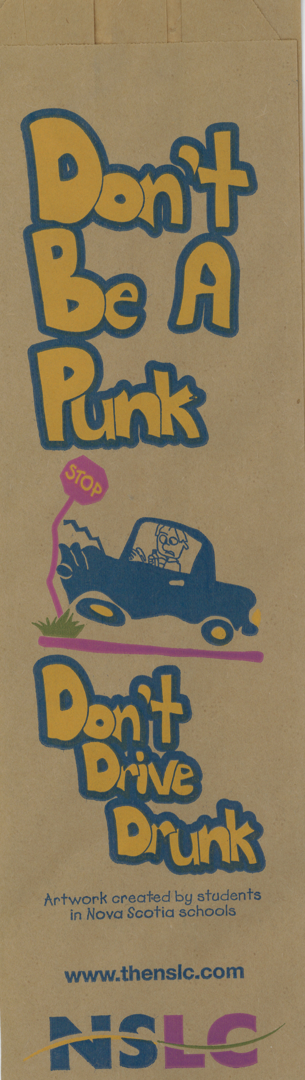


Collaboration across sectors:
A Canadian example of advocacy towards alcohol policy change
Samantha Cukier, MBA, MA¹ and Dan Steeves, MAEd²
¹Johns Hopkins Bloomberg School of Public Health; ²Addiction Prevention Treatment Services, Capital District Health Authority, Nova Scotia
Introduction
A grassroots effort initiated by concerned school administrators that included teachers, community health boards, health professionals and a cross section of government departments proved successful in ending an ineffective and inappropriate alcohol harm reduction program that had been in place in Nova Scotia elementary and junior high schools for ten years. Even though this program contained none of the benchmark factors for success, it continued in the school system because it was initiated by and had strong support from the alcohol industry, offered incentives and was never really questioned - until two years ago. At that time, it was determined that the program was in fact increasing the harms associated with alcohol use as opposed to reducing them.
Advocacy Process
  Sample of child’s drawing on paper bag to be distributed as wine bag
Grass- Roots Identify Issue
Evidence
Examined
Response
Designed
Network Activated!
Alcohol Advocacy Network Formed
Acting in concert with one of the school district’s superintendents, who had identified “Colourful Messages” as problematic and did not allow it in her schools, the five alcohol-specific prevention and health promotion staff across the province (part of NS’s Alcohol Strategy), banded together to gather the evidence and develop a research-based advocacy letter. This letter and accompanying background information extended to all heads and members of the other school boards, health organizations, health district CEOs and others and eventually to the Premier of Nova Scotia – all through network ties. This grassroots group, backed by credible evidence, asked that letters be sent to the Department of Education requesting that they not allow this non evidence-based program to continue.
Program Overview
The Program: For the last 10 years, the Nova Scotia Liquor Corporation (NSLC) had been putting on the “Colourful Messages” program, considered an alcohol harm reduction, awareness raising program in schools, asking that children in grades 4 to 8 draw “responsible use” messaging re: alcohol on paper bags to be distributed in alcohol retail outlets.
N.B. Benchmarks for Successful Programming:
Age and developmentally appropriate programming
Part of a sustained, comprehensive effort
Based on evidence
Call to Action: Network Activated!
Health Director’s Support
District Health CEO: Support!
Local School Board: Support!
Other District Directors: some
Other District CEOs: some
Provincial Superintendents: some support
NSAHO: Support!
Community Health Board: lukewarm
Alcohol Staff
Results & Conclusions
In June 2008, as a result of the grassroots effort, after a decade of programming, The Nova Scotia Department of Education decided to no longer endorse the program. The program did not match best practices nor did it support curriculum goals or learning outcomes.
At first glance, this program may have been seen as a good way to introduce alcohol to children. However, without knowledge of the research and best practices that tell us otherwise, it was contributing to the normalization of alcohol use.
Rapid expansion of the grassroots network
Program Red Flags:
“Colourful Messages” was age and developmentally INappropriate. At this young age and developmental stage, kids understand things simply: things are either right or they are wrong, there is no understanding of a grey area, i.e. an adult understanding that in certain situations it is ok to drink and in certain other situations it is not.
“Colourful Messages” was NOT part of a sustained, comprehensive effort: the program functioned as a single educational event coupled with a visit from the RCMP.
“Colourful Messages” was NOT based on evidence: The program provided children with the opportunity to start thinking about drinking at an early age so that it would seem normal and harmless by the time they reach their teens.
“Colourful Messages” encouraged students to go to the NSLC’s website, an alcohol marketing web page. Drawing kids to an alcohol marketing website and normalizing alcohol use are not appropriate for 9-year-olds.
Is there anything wrong with this?
  Children's drawings bring further attention to underage drinkers
  Encouragement to go to alcohol marketing website
  Normalization of brand: Nova Scotia Liquor Corporation (NSLC)
Acknowledgements
Thank you to all those involved in the grassroots effort in the South Shore and across the province, especially to Nancy Pynch-Worthylake at SSRSB. Thank you to then-district-CEO K McNamara and then-VP A Leverman for support and C Davison at HPP for review.
Thank you to the Center for Alcohol Marketing and Youth for continued support in similar future endeavors.
For Further Information
Please contact:
Samantha Cukier Johns Hopkins Bloomberg School of Public Health scukier@jhsph.edu | Dan Steeves Capital District Health Authority Halifax, Nova Scotia Dan.Steeves@cdha.nshealth.ca

