Slide 1




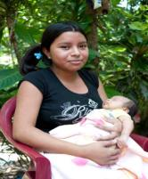
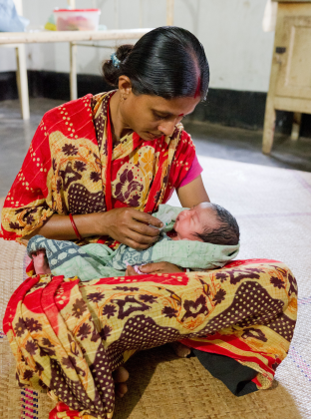
El Salvador and Bangladesh: Two models of building coalitions to improve maternal and newborn health programmes
Cees
Portela, A ; Perkins, J; Capello, C; Santarelli, C; Velasquez, L
APHA 139th Annual Meeting and Exposition
November 1, 2011

Slide 2
Presenter Disclosures
Janet Perkins
(1) The following personal financial relationships with commercial interests relevant to this presentation existed during the past 12 months:
No relationships to disclose

Slide 3
Presentation summary
Learning objective
IFC Framework
Experience of El Salvador
Experience of Bangladesh
Lessons learnt
Conclusion

Slide 4
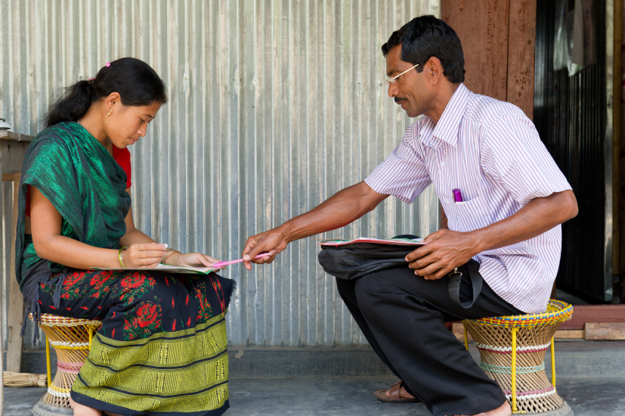
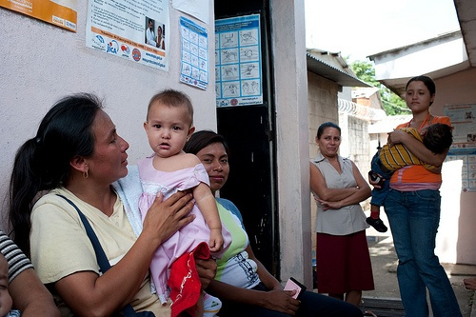
Learning objective
Compare and contrast a government-led versus an NGO-led approach to building partnerships and coalitions in international programmes

Slide 5
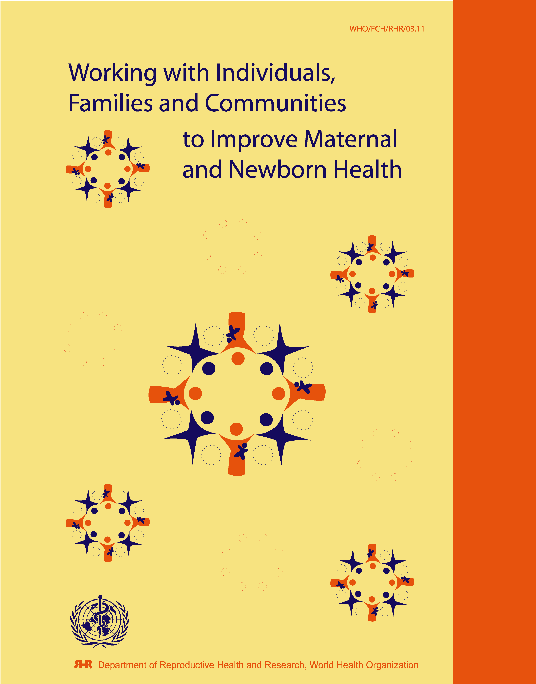
IFC framework
Framework developed by the World Health Organization for working with Individuals, Families and Communities (IFC) to improve maternal and newborn health (MNH)
Aims to empower women, men, families and communities to improve MNH and increase utilization of quality MNH services
Emphasis on interagency and inter-sectoral collaboration to reach common goals

Slide 6
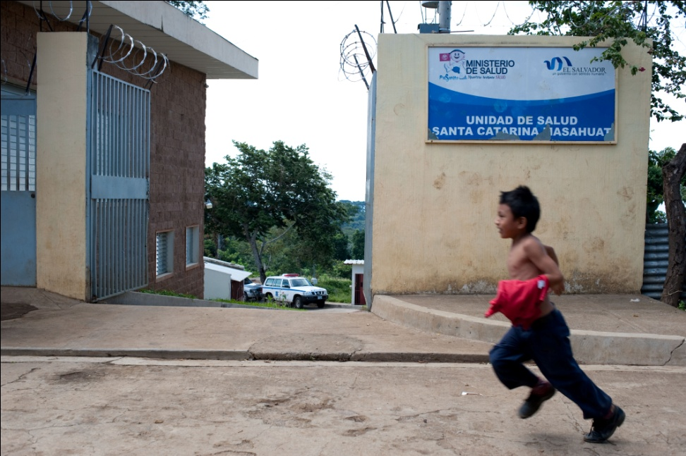
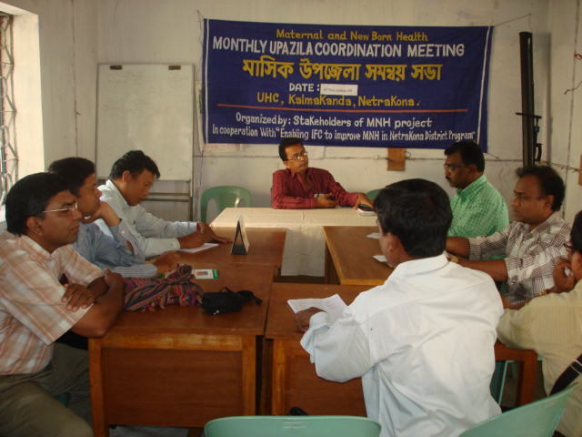
Models of partnership creation
El Salvador: National government-led approach
Bangladesh: Local NGO-led approach

Slide 7
Implementation chain in El Salvador
Other actors in MNH
NGOs
National Working Group on MNH
Other Ministries
International organisations (WHO, UNFPA, PAHO)
Ministry of Health
at national level
NGOs and other associations rapresentatives
Regional IFC
Committee
Regional MOH
Regional MOH
Other ministries
District MOH
District MOH
Health centers
Community based organisations, schools, faith based organisations
Local IFC Committee
Community leaders

Slide 8
Programme in El Salvador
2002: IFC included in Pan-American MNH regional strategy
2003: PAHO selects El Salvador for implementation
2004: EdM and WHO present IFC to local actors
MoH selects municipalities for intervention
National IFC committee: MoH, EdM, MoE, PAHO, CEES
Departmental and Municipal involvement
2005: First wave of implementation
2009: Progressive scale up to wider geographic coverage
IFC included in 2004-2009 MNH national strategy

Slide 9
El Salvador model
Strengths:
Stream-lining of government approval of programme
Programme strengthened and given legitimacy through inclusion in national strategy
Allows for close collaboration between the Ministry of Health and NGOs
Strengthened community participation with the Ministry of Health
Conducive to scale-up
Weaknesses
Requires a significant amount of time for actors to learn to work together in a collaborative manner
Lack of established processes and tools for inter-institutional and collaborative work

Slide 10
Bangladesh collaboration
2005: EdM and PARI Development trust
Other Local NGOs
Inclusion of district Health and Family Planning Dept.
Participation of Upazila health officials
Community representatives included
2007: Finalization of planning with all partners
2008: Training of CHWs and other local actors
2009: First wave of implementation
2010-2011: Involvement of national MoH

Slide 11
Bangladesh model
Strengths:
Key actors already located in working area
Requires less time to establish dialogue at local level
Possibility to utilize structures already developed and tested by NGOs at the local level
Weaknesses:
Difficulty in obtaining government recognition at national level
More challenges to obtaining widespread legitimacy, as IFC framework is not included in national maternal and newborn health strategy
More challenges in scaling-up to new regions

Slide 12
Lessons learnt
In all cases, developing inter-sectoral and interagency collaborations improves programmes through capitalizing on each organizations strengths
Commitment and consistent participation are required from key actors (especially WHO country office)
Developing collaborative partnerships is time-consuming, and this should be reflected in work plans
Most actors are more comfortable working on individually developed projects with punctual collaboration, rather than working on a common programme
As different partner agencies and groups consider the person to be involved in the programme, other demands and activities should be weighed to assure that the person has the time to dedicate
Processes and mechanisms must be established to ensure on-going communication and collaboration

Slide 13
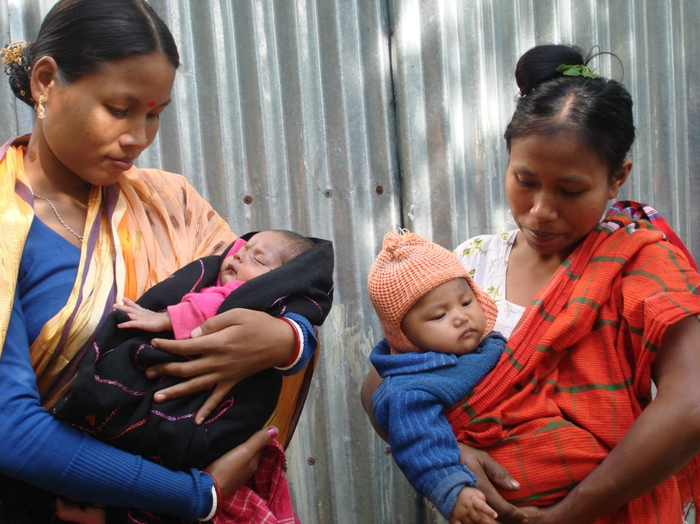
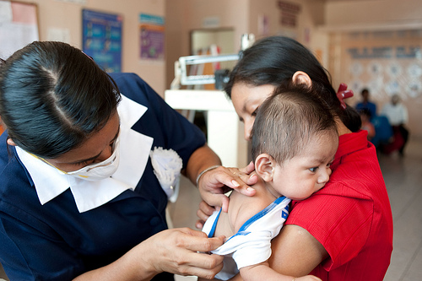
Conclusion
Each programme must adapt its model of partnership development to the context
Each model of partnership development has inherent strengths and weaknesses
Despite challenges, building coalitions strengthens programmes

Slide 14
Thank you!
Questions?

