Slide 1


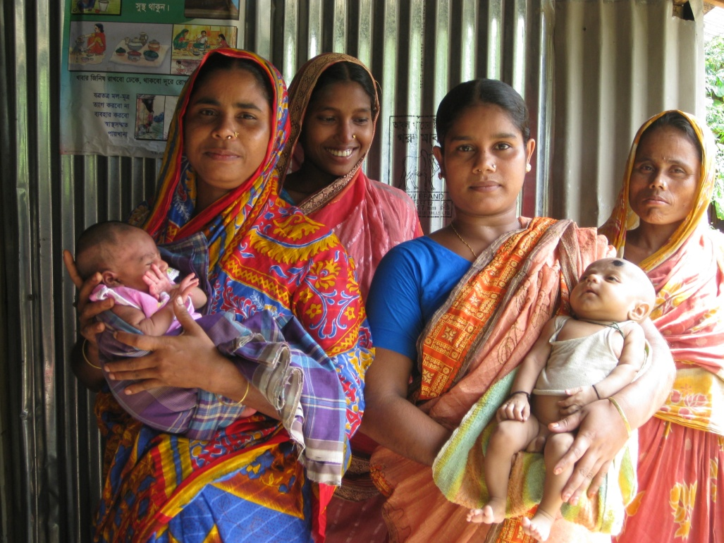
Socioeconomic determinants of maternal and newborn health in Netrokona district, Bangladesh
Ali, M; Rozario, G; Perkins, J; Capello, C; Portela, A; Santarelli, C
APHA 139th Annual Meeting and Exposition
October 31, 2011

Slide 2
Presenter Disclosures
Janet Perkins
(1) The following personal financial relationships with commercial interests relevant to this presentation existed during the past 12 months:
No relationships to disclose

Slide 3
Presentation summary
Learning objectives
Background
Poverty and maternal and newborn health (MNH)
Women’s status and MNH
Recent developments
Conclusion

Slide 4
Learning objectives
Identify various socioeconomic determinants affecting maternal and newborn health (MNH) in rural Bangladesh
Analyze the socioeconomic determinants that may play a role in affecting MNH in diverse developing regions.

Slide 5
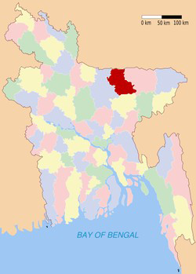
Netrokona District
Located near the Himalayan border
Flooding for 8 months out of the year
Population: 134,524
Characterized by low socioeconomic status, a paucity of local health services and poor infrastructure to reach health facilities

Slide 6
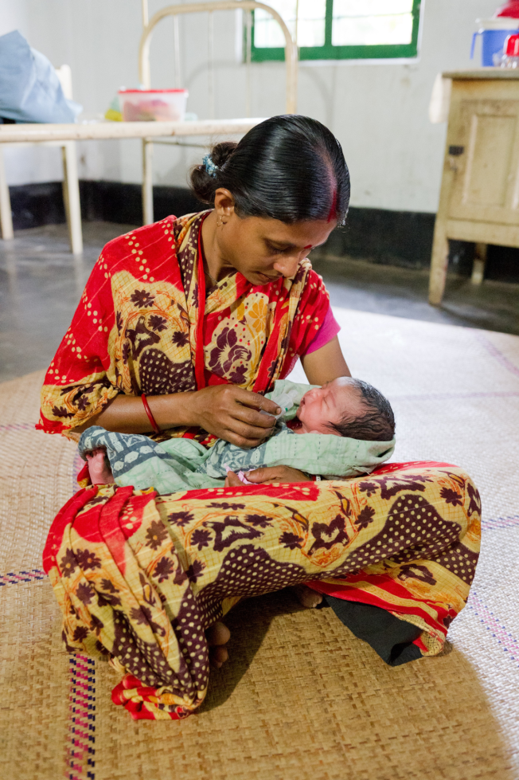
MNH Background
Bangladesh:
Maternal mortality ratio: 194/100,000 (BMMS 2010)
Neonatal mortality rate: 27/1,000 (UNICEF 2010)
Intervention area (PARI Baseline Study 2008):
12% of births take place with a skilled birth attendant
7.1% of women attend one antenatal care visit
4.4% of women attend four or more antenatal care visits

Slide 7
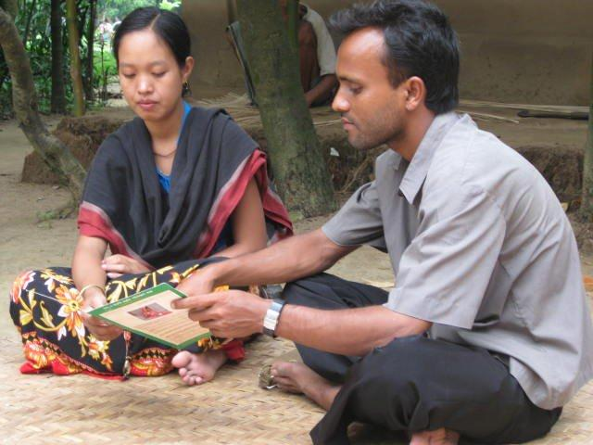
MNH Programme
Based on WHO’s framework for working with Individuals, Families and Communities (IFC) to improve MNH
Focus on underlying causes of poor MNH
Underlying causes identified through:
  Situation analysis (2005)
  Baseline study (2008)
Sample: pregnant women, women having given birth in during the previous year, husbands of these women, influential family members of these women (mothers, mothers-in-law, grandmothers), community leaders, health workers

Slide 8
Poverty in Netrokona district
Household characteristics
Overall average income Bangladesh: Tk. 11,480 (2010)
Rural average income: Tk. 9,648 (2010)
Intervention area: 88% of the households have a monthly income less than Tk. 6,000 (2008)
Source: Bangladesh Household Income and Expenditure Survey (2010); PARI Baseline Study (2008)

Slide 9
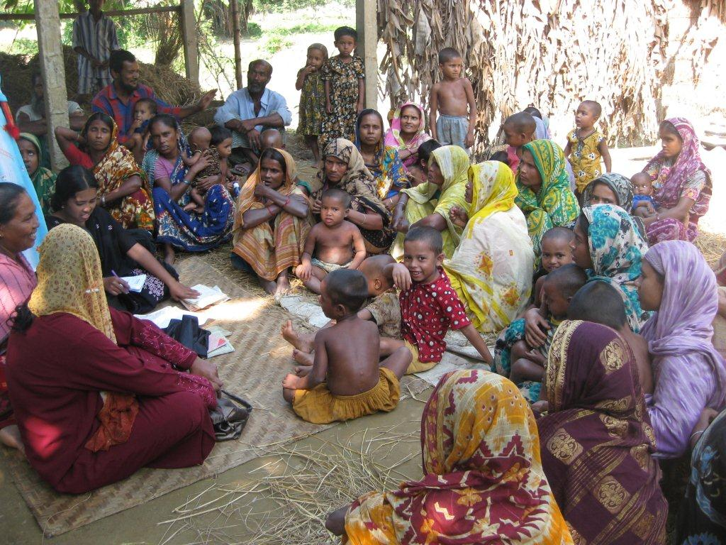
Poverty and MNH
Difficulty affording health services
  Cost of allopathic vs. traditional services
Families rarely save for emergencies related to pregnancy and birth
  Exacerbates delay in reaching care
Difficulty affording appropriate food for pregnant women
  Women suffer from anaemia and malnutrition with few exceptions

Slide 10
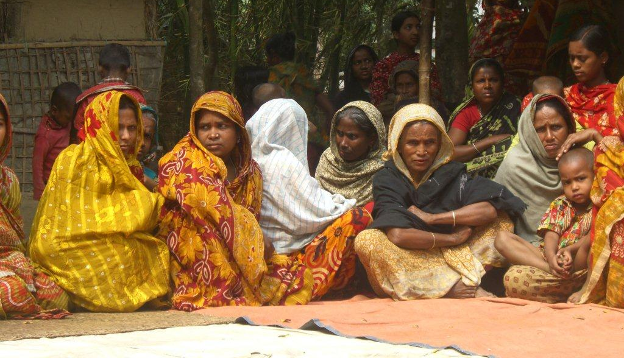
Power
Status of women is low
Factors contributing to low status:
  Low levels of education
  Low levels of women’s participation in income generating activities

Slide 11
Education and MNH
  Contributes to low status of women
  Low education an independent risk factor for poor maternal health outcomes
  Women in Bangladesh completing at least secondary education are 3.1 times more likely to seek MNH services in health facilities (BMMS 2010)
Source: PARI Baseline Study (2008)

Slide 12
Women’s occupation
Lower value place on household work compared to income generating activities outside of the home
Women tend to be economically dependant on male breadwinners
Women have little control over families’ economic assets
Source: PARI Baseline Study (2008)

Slide 13
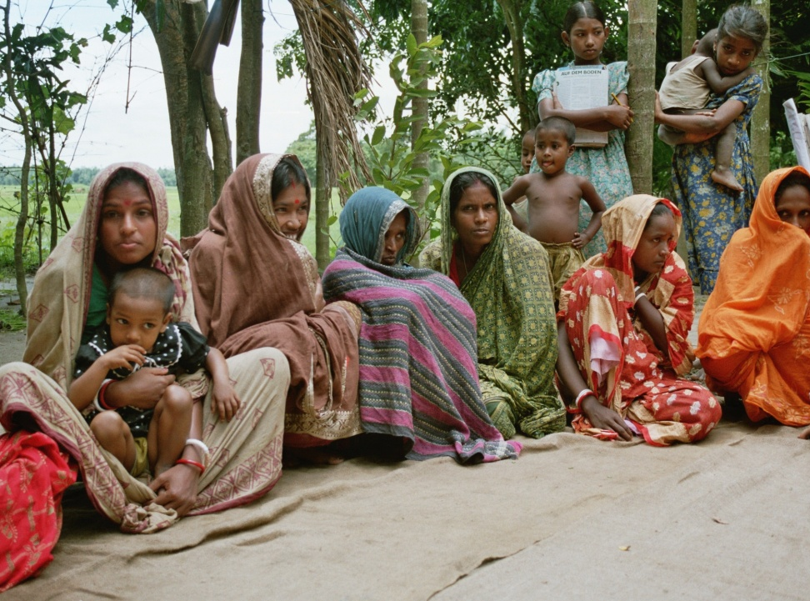
Social status and MNH
Early marriage
  Families fear risk of pregnancy
  Girls viewed as “extra mouth to feed”
Early marriage leads to early childbearing
  Married adolescent girls more likely to report unwanted pregnancies
Low decision making ability of women
  Pregnancy and childbirth are considered exclusively the woman’s domain
  MNH issues not a priority
Poor nutrition during pregnancy
  Traditionally women eat after men

Slide 14
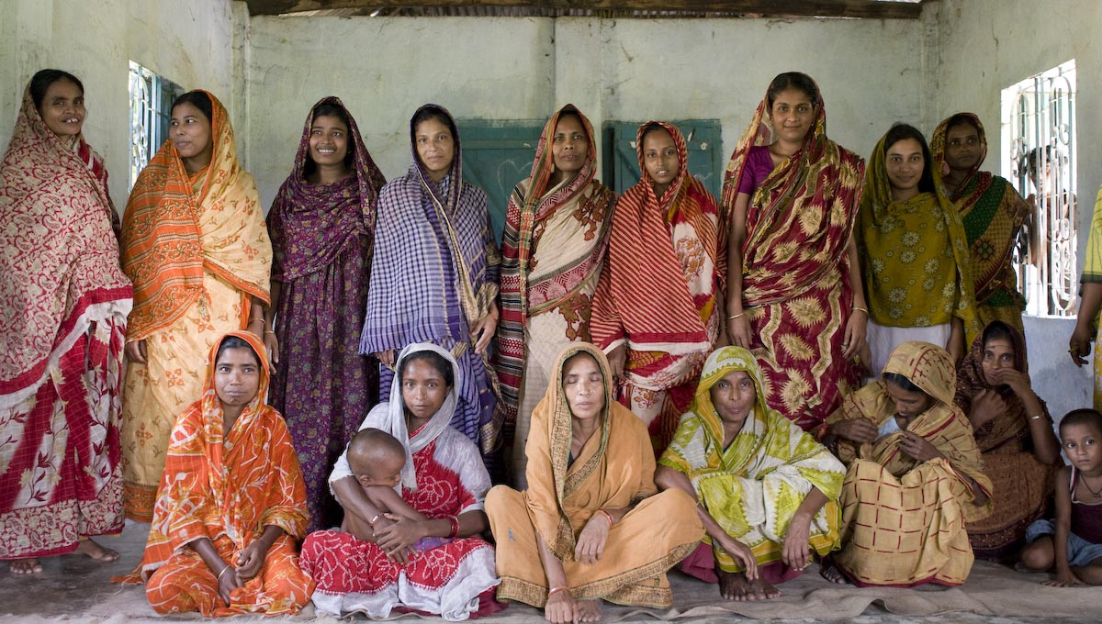
Hope for the future
Women’s education in Bangladesh since 2001 has increased significantly (BMMS 2010)
  Women with no education has fallen from 45% to 23%
  Women having completed some secondary education or higher has increased 26% to 45%
Community members are increasingly aware of the importance of delaying marriage and childbearing for girls
As a result of the programme, the broader community is becoming increasingly involved in MNH

Slide 15
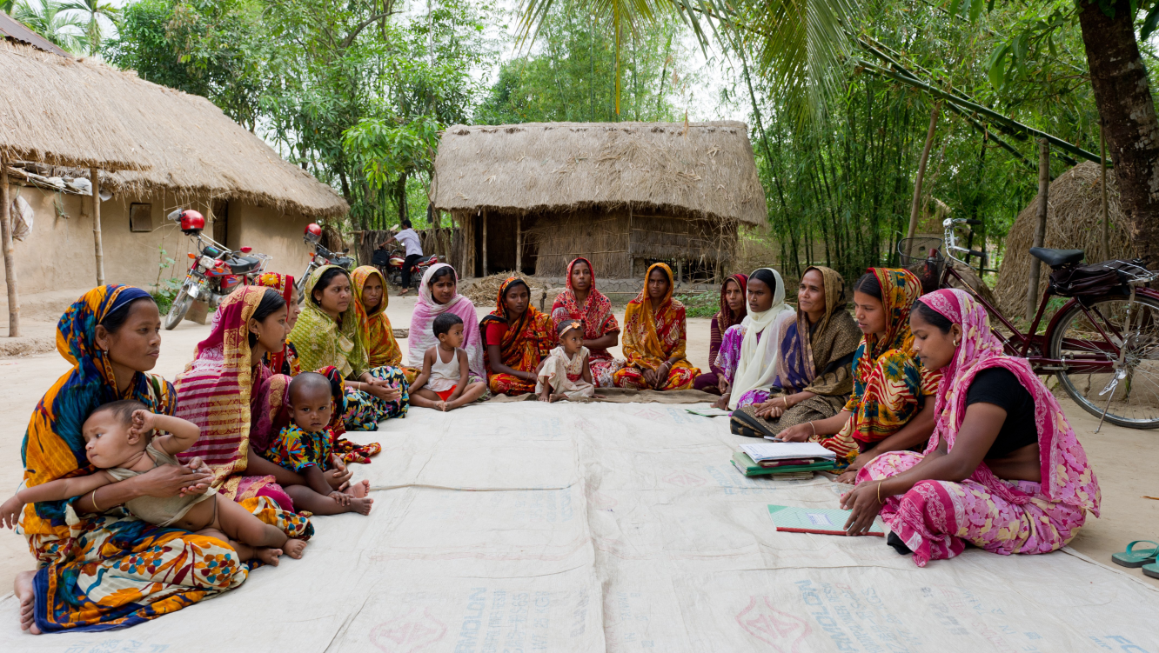
Conclusion
Multiple socioeconomic factors contribute to substandard MNH in Netrokona district
Addressing poverty and empowering women is essential to improving MNH

Slide 16
Thank you!
Questions?

