Slide 1
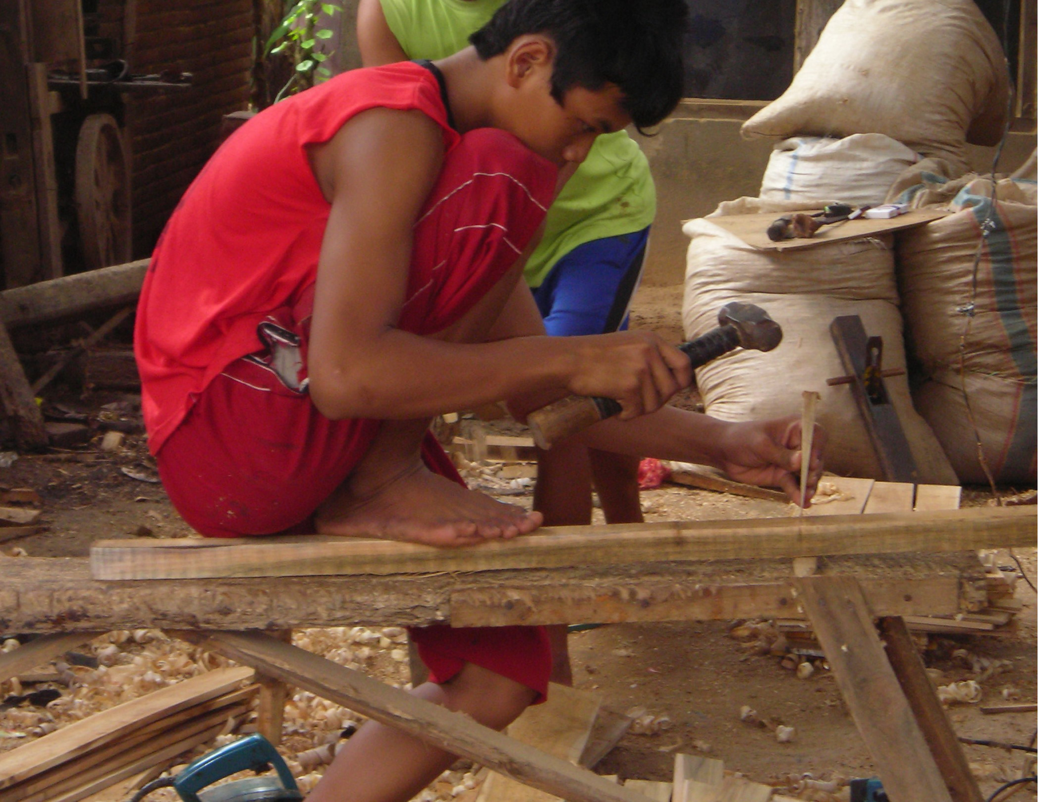
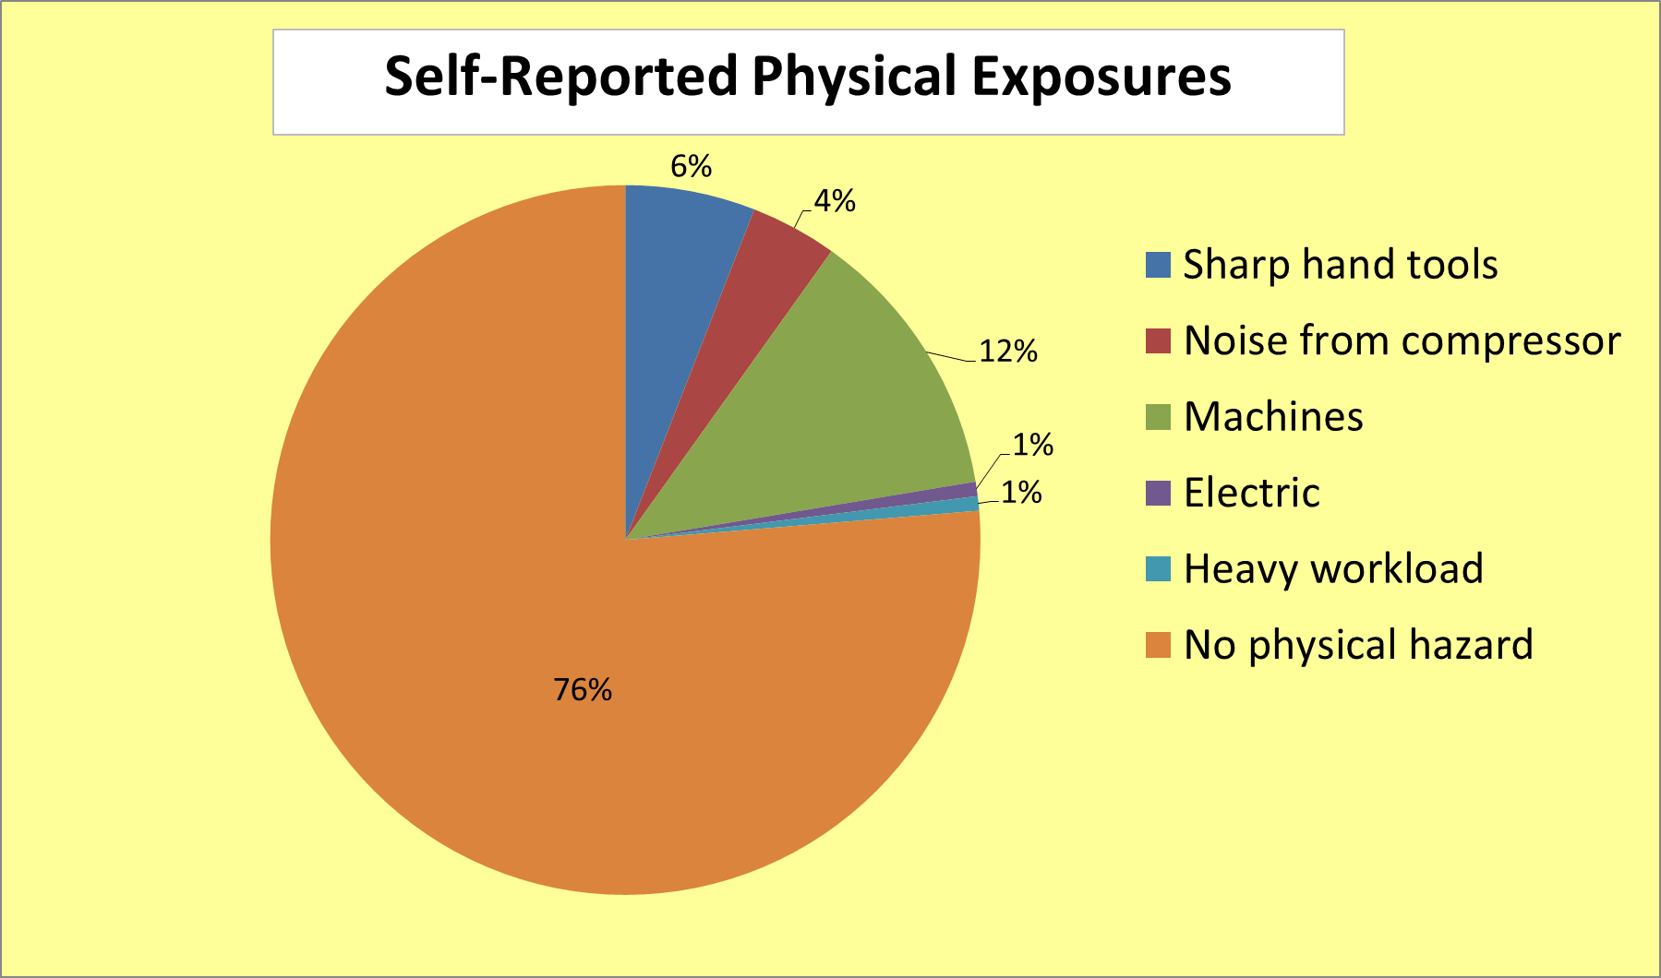
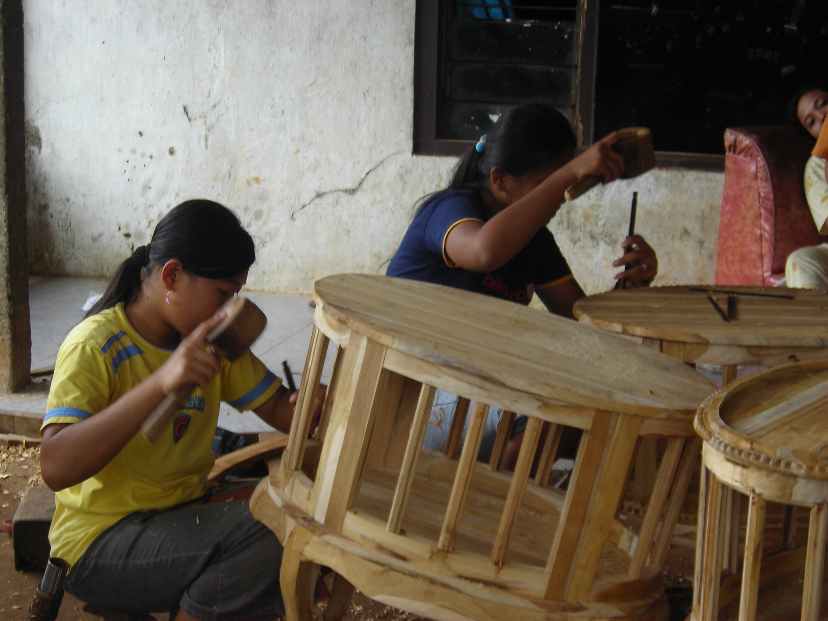
Working Conditions and Health Problems among Child and Young Workers in the Furniture and Woodworking Home Industries in Central Java, Indonesia
Hanifa M. Denny (1& 4), Cahya T. Purnami (1), Wieke D. Anjarini (1), Muktiati (2), Abdul Hakim (3), Annemarie Reerink (3), Norbert L. Wagner (4)
(1) Diponegoro University, Semarang Indonesia; (2) Office of Manpower, Jepara Regency; (3) ILO, Jakarta, Indonesia; (4) University of South Florida, Tampa, USA
Background: In 2008, around six million child workers were working in Indonesia. Approximately 2000 child and young workers worked in furniture and woodworking industries in four districts in Jepara regency.
Outsourcing furniture productions to the informal sectors is a business for as for bigger companies.
Goal: The study, funded by ILO-IPEC Program-Jakarta, aimed to explore working conditions and health problems of child and young workers in the furniture and woodworking sector in 2008.
Method(s): The study utilized convenient sampling based on home industries, which were running during the study period. Respondents who agreed to participate in the study were interviewed using structure interview.
Researchers interviewed 75 child workers, 77 young workers, 15 employers, and 15 workers’ guardians who agreed to participate in the study. The study covered 15 home industries in four districts as central of furniture and woodworking home industries in Jepara Regency.
Definitions: child worker is defined as a person before turning 18. A young worker is a person at the age of 18 to 29.
Results: We interviewed nine (6%) child worker between age of 11 and 14, 66 (43%) between age of 15 and 18 and 77 young workers over the age of 18 years.
Motivation: Twenty one percent respondents were forced by their family to engage in the wage job, while 30.9% said that they just wanted to work without persuader, but 48.1% respondents informed that they were persuaded either by their employer or relative or friend or neighbor. “Support of family” was cited as major reason to work by 73% of interviewees.
Starting age of work: Forty five (29%) had started working before the age of 14 years.
Education levels: Elementary school 32, 9%, junior high school (49.3%), senior high school 17% and one respondent with diploma.
Accidents: Child workers reported a higher percentage of hand tools accident (20%) as compared to young workers (16.8%). The type of accidents are injury due to saw machine, injury due hand equipment, injury due to sharp equipment electric shock, injury due to hammer.
Absence from work: Child workers reported higher absence from work due to illness (20%) than young workers (15.6%).
Type of illness: Fever, cold, flu, muscle dislocation, flu, sore throat, headache, toothache, typhus, and Dengue Hemorrhagic Fever (DHF) Symptom..
Hazardous exposures among child workers : Wood dust, particles, enamels, lacquers, epoxies, alkyds, acrylics, repetitive motion, prolonged working hours, and awkward work postures .
Observed risks were sanding of wood (10%) and painting (6%) and handling sharp tools for carving (25%).
Risk perception: Unfortunately, 93.3% parents’ respondent said that there was no hazard in their children workplaces. The interviewed workers reports only in 24% physical hazards, only in 29% chemical hazards and in 24% stress, mostly monotony.
Self-reported ergonomic hazards were repetitive motion (6%) and lifting loads (2%). A surprisingly 90% reported no ergonomic stressors.
Risk control: Around fifty percent respondents did not put effort to reduce hazard, while the rest who claimed that they put effort to reduce hazard said that they
Worked cautiously (33.5%)
Wearing a mask (2.0%)
Drink milk before or during or after working (8.0%)
Good housekeeping (5.9%)
No unit implemented workplace hygiene measures or sanitation as well as other Occupational Safety and Health Services.
Conclusions: In Indonesia, it is common in the wood working industry that children start working before the age of 14 years. Child workers and their parents/guardians are mostly unaware of workplace hazards. They are left alone and use miscellaneous and ineffective measures to protect themselves.
Future Directions: There is a need for Indonesian Government and related agencies to encourage and to send child workers back to school and to improve health and safety at work among young workers.
Key words: Child workers, Young Workers, Child labour, woodworking, furniture, occupational safety and health
Acknowledgements :
Gratitude thank goes to Jim Keogh Scholarship 2011 and Dept. of Environmental & Occupational Health, College of Public Health, USF, Tampa for the additional financial support to attend this APHA Annual Meeting
Special thank to Indonesian Government for the Fellowship of main author’s Doctorate Program at COPH USF Tampa, Florida, USA.

