Slide 1
Promoting Community Engagement in Genomic Research and Practice
Toby Citrin
E. Hill De Loney
Ella Greene-Moton
Stephen Modell

Slide 2
Presenter Disclosures
None of the four presenters (Toby Citrin, E. Hill De Loney, Ella Greene-Moton and Stephen Modell) have had personal financial relationships with commercial interests relevant to this presentation during the past 12 months.

Slide 3


Slide 4

Chief Planning Partners
Center for Public Health and Community Genomics
  See www.sph.umich.edu/genomics
Goals: ELSI, community engagement and addressing health disparities

Slide 5

Chief Planning Partners
Prevention Research Centers
Research Agendas
  Interventions
  Disparity reduction
  Ecological framework
  CBPR
  Emphasis on social & environmental determinants
  Little if any genetics
See: http://www.cdc.gov/prc/

Slide 6

Chief Planning Partners
National Community Committee (NCC)
  Ms. Ella Greene-Moton will describe

Slide 7
Other Planning Partners
CDC’s Office of Public Health Genomics
National Human Genome Research Institute
St. Louis University
Washington University St. Louis
Use of CBPR process in planning and implementation

Slide 8
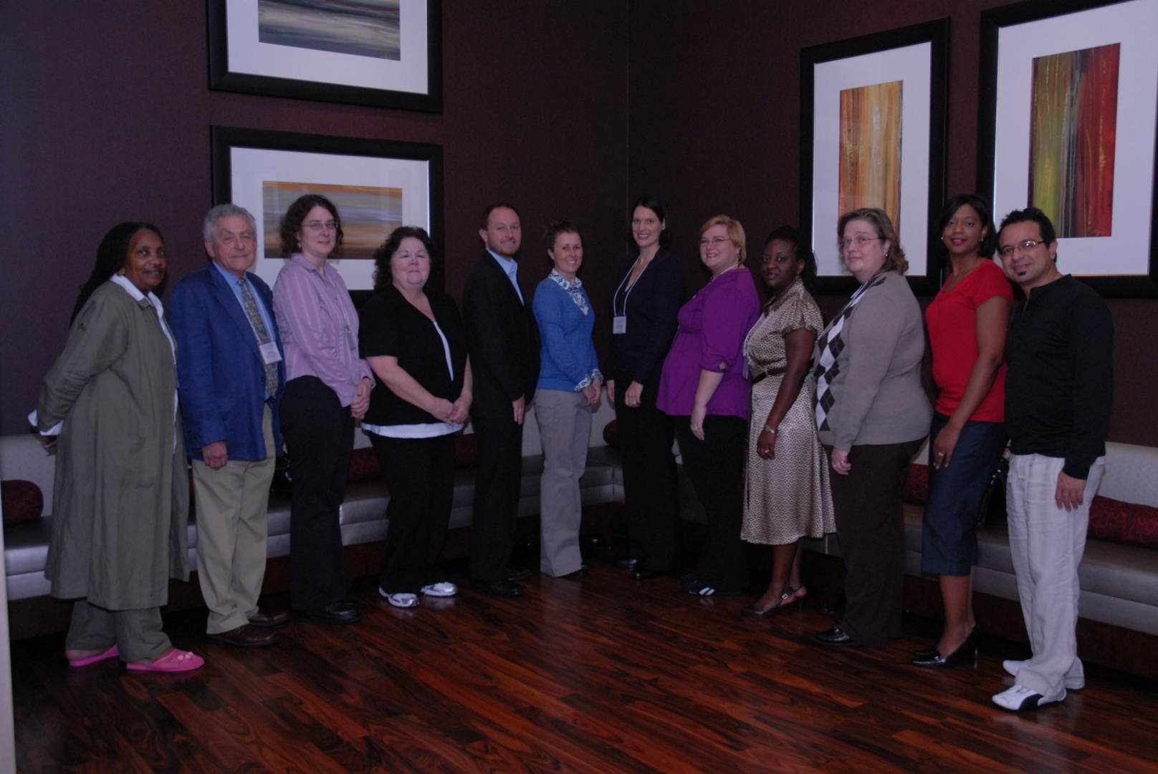
Our Planning Committee

Slide 9

Meeting Goals
Share best practices and strategies for
  community engagement in genomics
  incorporating genomics in PRC agendas using CBPR
  Incorporating genomics in public health practice in partnership with communities

Slide 10
Meeting Goals (Cont’d)
Explore funding availability
Identify policy issues involving community interests in genomics
Form NCC Special Interest Group on Genomics
Expand GenoCommunity Web Site

Slide 11
Who Came?
125 attendees
  50-50 from community organizations and academic institutions
  Several from public health practice
20 prevention research centers represented
Most community-based attendees were from communities of color

Slide 12
Subsequent Presenters
Mrs. E. Hill De Loney
  “The Intervention Before the Intervention”
Ms. Ella Greene-Moton
  NCC/SPIG
Dr. Stephen Modell
  Data
Toby Citrin
  Lessons Learned

Slide 13
“The Intervention Before the Intervention”
Preparation is needed before communities can participate mutually in partnership with universities and health departments
  “Prime the wall before you paint it”

Slide 14
Stages of Partnership-Building
Dependence
  Communities depend on universities and health departments
Independence
  Communities coalesce around their table just as universities and health departments
Joint Ownership
  Mutual Trust
  Recognition of each other’s expertise

Slide 15
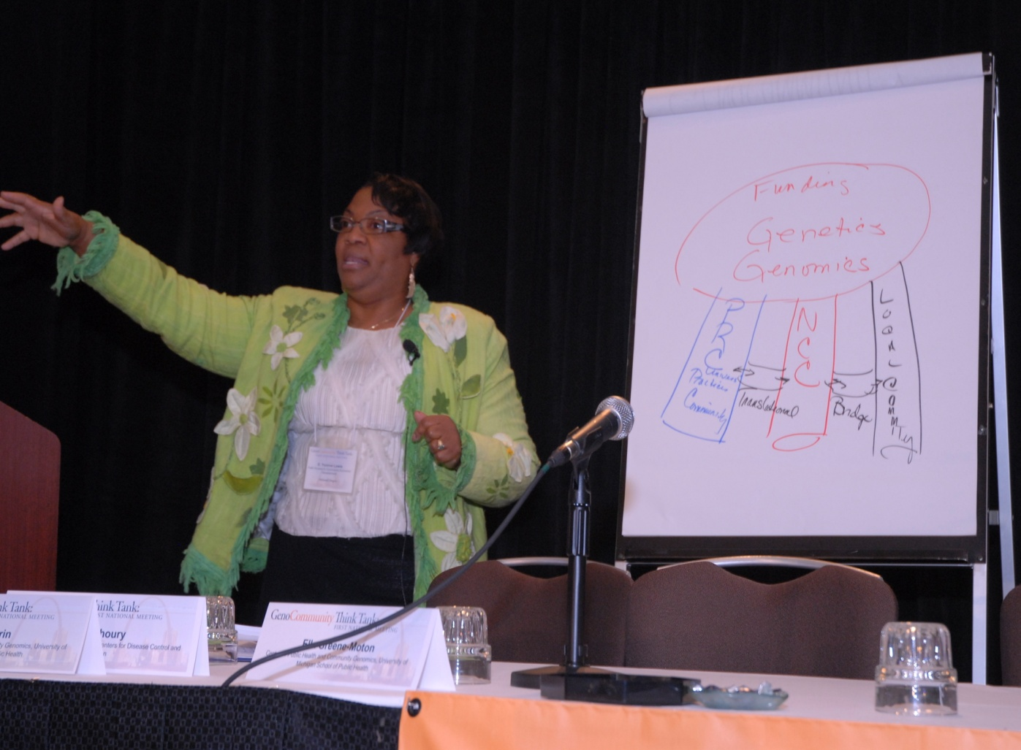
The 3-Legged Stool

Slide 16
Why Must Communities get Invested in Genomic Research?
Genomics can widen or narrow health disparities
If communities are not at the table in research, communities can be harmed
Genomics has much to offer communities of color
  e.g., family health history and chronic disease

Slide 17
The National Community Committee (NCC)
Commissioned in 1999…
  Introduced by the National PRC Steering Committee leadership and supported by the majority of the Steering Committee Chairs, the PRC Directors, and the National Program Office, the NCC became one of six standing committees of the National PRC Program
Notes:
The Rationale
The establishment of NCC gave voice to community representatives working within the PRCs at the national decision making level, provided direct access to the National Program Office, as well as strengthened the local involvement of the community within the PRC.
The NCC Structure
The Leadership Team
Chairs
Regional Directors
Special Interest Groups (SPIG)

Slide 18
The National Community Committee (NCC)
Formally established in 2000
Represents the community component of the 37 Prevention Research Centers (PRCs)
Provides a national platform for identified communities engaged in research partnerships with academic institutions
Responds to gaps in research agendas both at the local and national level

Slide 19
The National Community Committee (NCC)
Introduction to Genetics/Genomics
  Initial Invitation - 2005:
  Funding Opportunity - 2006:
  The 2007 Midwest Forums
Notes:
Initial Invitation - 2005:
An invitation to attend the Genetics Equity Network Workshop
Funding Opportunity - 2006:
The RFA from the National Genome Institute
The Midwest Forums
Award:
The 2007 Midwest Forums
Genomics, Community and Equity: a Continuing Dialogue

Slide 20
The NCC Special Projects Interest Group
Background:
  Discussed initially during the 2007 Midwest Genomics Forums
  Discussed as one of the 2010 Think Tank Goals
  Approved during the 2010 NCC Annual Meeting
  Purpose adopted in 2010
Notes:
(Insert SPIG purpose)

Slide 21
The NCC Special Projects Interest Group
Next Steps:
  Developing an informed national voice on Genomics
  Serving as a national resource
  Advocating for the integration of genomics in existing PRC programs
  Facilitating the development of genomics focused activities at the local level

Slide 22
THINK TANK BREAKDOWN
131 people registered; 125 attended
[N=74 questionnaire respondents]
38 from community organizations (30 PRC; 8 non-PRC)
30 academic (13 PRC; 17 non-PRC)
3 public health practice (1 PRC; 2 non-PRC)

Slide 23
Q.: What new community activities for your organization are you interested in, based on the meeting? (N=74)
50 (67.6%) - Community Dialogues
50 (67.6%) - Community Genetics Education
48 (64.9%) - Community-based Participatory Research, e.g., involving genetic testing and family history
45 (60.8%) - Establishing new collaborations

Slide 24
BREAKDOWN OF THOSE INTERESTED IN FUTURE GENOMICS ACTIVITIES
Future interest in participating in genomics community dialogue –
  54% community organization attendees
  38% academic attendees
  6% from public health practice
Future interest in participating in community genetics education –
  52% community organization attendees
  42% academic attendees
  4% public health practice

Slide 25
BREAKDOWN OF THOSE INTERESTED IN FUTURE GENOMICS ACTIVITIES
Future interest in participating in community-based genomics research –
  52% community organization attendees
  42% academic attendees
  4% from public health practice

Slide 26
Q.: What thematic areas might you include in future activities? (N=74)
59 (67.6%) – Family health history
56 (75.7%) – Genomics and health disparities
48 (64.9%) – Chronic disease prevention
36 (48.6%) – Genetic testing
35 (47.3%) – Gene-environ. interaction

Slide 27
OTHER GENOMICS ACTIVITIES VOICED BY PARTICIPANTS
Communicating genomics information
  e.g., establishment of “information clearinghouses,” social marketing
Family history
  Sharing family health history models and materials with the community
Community health workers
  Training for assorted projects
Professional education
  Further education of physicians, nurses, community leaders

Slide 28
Q.: Rate the meeting’s impact on your desire to promote conference objectives
Engaging community members in policy development – 39/73 or 53.4%: meeting had a significantly high impact
Carrying-out genomics community engagement activities – 37/73 or 50.7%
Working with health departments on community-based projects in genomics – 33/72 or 45.8%

Slide 29
CONCLUSIONS FROM THE NUMBERS
GenoCommunity Think Tank exceeded its target number of 125 individuals
Community members – vigorous interest in genomics activities advancing community health and CBO interests
General perception of value of collaboration
Need for continued effort to sustain interest, including link-up with funding organizations and agencies

Slide 30
Lessons Learned
Communities are interested in partnering with universities and health departments in genomic research, practice, education and policy development
Communities are more interested than academics in integrating genomics into PRC interventions research

Slide 31
Lessons Learned (Cont’d)
The National Community Committee and its SPIG are excellent partners in advancing the community-based genomic research agenda nationally
If we are to assure that genomics narrows and doesn’t widen health disparities, we must advance community-based partnerships in research, practice and policy

Slide 32

MORE INFORMATION
Web Site with Resources:
www.genocommunity.org
tcitrin@umich.edu

Slide 33

QUESTIONS?

