Slide 1
Predictors of HPV Vaccination Among Gay and Bisexual Men
Purvi Mehta, MS; Manoj Sharma Ph.D., MCHES; Anders Cedergren MS, CHES

Slide 2
Presenter Disclosures
Purvi Mehta
(1) The following personal financial relationships with commercial interests relevant to this presentation existed during the past 12 months:
“No relationships to disclose”

Slide 3
Background- HPV
Virus attacking skin and mucous membranes
100’s but about 30 spread through sexual contact
  HPV 6, 11, 16 and 18 of prime interest
Affects genital areas – vulva, vagina, cervix, rectum, anus, penis, and scrotum
Genital warts, intraepithelial neoplasia and cancers (cervical)
2 classifications:
  High risk (cervical cancer) : 6, 11
  low risk (genital warts): 16, 18

Slide 4
Background- HPV continued
Also known to cause:
  Warts, including common warts (verrucae vulgaris), plantar warts (verrucae plantaris), and flat warts (verrucae plana)
  Precancerous lesions, including on the cervix (high-grade dysplasia and low-grade dysplasia)
  Other precancerous lesions or cancer, including on the penis, anus, vagina, and vulva
  Laryngeal papillomas, which are noncancerous tumors on the larynx (voice box), vocal cords, or the air passages leading from the nose into the lungs (respiratory tract).

Slide 5
Background- Prevalence
6.2 million people are newly diagnosed
20 million currently are diagnosed
40-50% of cases are found in women between 14 to 24 years old
Limited data is available regarding incidence and prevalence rates of HPV
About 50% of men that are sexually active acquire HPV in their lifetime

Slide 6
Background- HPV in Men
About 50% of men that are sexually active acquire HPV in their lifetime
51.1% of men tended to carry multiple strains of HPV
Approximately 73% of men have been infected with HPV
  Led to approximately 93% of anal cancers, 63% oropharyngeal cancers, and 36% of penile cancers.
Gay and bisexual men are more likely to be diagnosed with HPV
  Prevalence of HPV is 60% in men without HIV, and close to 90% in those with HIV
17 times more likely to develop anal cancer
Detection of HPV DNA under fingernail tips to be common in men
There are no methods to test for HPV

Slide 7
Background-HPV Vaccine
Gardasil, is an approved vaccine that helps guard against 90% of genital warts in males
Three shots over the course of three months
Must be between 9-26 years of age
Best before sexual debut

Slide 8
Background-Health Belief Model
Perceived susceptibility is the belief the person may acquire HPV
Perceived severity is that HPV is a serious disease with negative consequences
Perceived benefits are the belief in the advantages of suggested prevention methods namely HPV vaccine.
Perceived barriers are things such as costs and side effects that would prevent them from taking the vaccine
Cues to action are factors that will motivate individuals to take the vaccine
Self-efficacy in taking the HPV vaccine is the confidence that a person has in her or her ability to take the HPV vaccine.

Slide 9
Background- HBM cont.
A relationship between vaccine acceptability and males that believed sexual partners, parents or physicians would encourage taking the vaccine, having a firm belief in the general importance of the vaccine, knowledge and awareness of HPV, perception of being at high risk, and belief in vaccinations

Slide 10
Purpose
The purpose of the study is to determine the role of the health belief model in predicting HPV vaccine acceptability among gay and bisexual men

Slide 11
Methods
A cross-sectional study
A valid and reliable survey based on the health belief model (HBM) was developed by the researcher and faculty mentor
Table 1. Reliability Coefficients (Cronbach’s alpha) for Perceived Susceptibility, Perceived Severity, Perceived Benefits, Perceived Barriers, Cues to Action , Self Efficacy and Knowledge
______________________________________________________________________________
Constructs Alpha levels
______________________________________________________________________________
Perceived Susceptibility 0.900
Perceived Severity 0.753
Perceived Benefits 0.585
Perceived Barriers 0.920
Cues to Action 0.706
Self Efficacy 0.761
Knowledge 0.705

Slide 12
Methods
Test-retest Reliability Coefficients for Perceived Susceptibility, Perceived Severity, Perceived Benefits, Perceived Barriers, Cues to Action, Self Efficacy and Knowledge
______________________________________________________________
Construct r p-value
_______________________________________________________________
Perceived Susceptibility .819 .003
Perceived Severity .603 .006
Perceived Barriers .853 .000
Perceived Benefits .652 .050
Cues to Action .571 .009
Self Efficacy .647 .002
Knowledge .624 .003

Slide 13
Methods- Procedures
Participants: Males, homosexual or bisexual, 18 years or older, attending the University of Cincinnati
Approval from the IRB of the University of Cincinnati was obtained prior to study.
Administration of the survey was conducted at the end of class time.
Clipboards and pens were provided for completion of the survey.
Participants were asked to complete the survey to their best ability.
Anonymity of responses were assured to them.
Once surveys were completed, participants slid the surveys into a manila envelope.

Slide 14
Data Analysis
All data were analyzed in PASW (Predictive Analytics SoftWare), formerly SPSS, Version 18.
Descriptive statistics, along with stepwise multiple regression were conducted to determine what factors affect vaccine acceptability
Health belief model construct variables served as independent variables and whether participants would take the vaccine was the dependent variable.
Alpha levels were set to 0.5 to determine significance

Slide 15
Results
Summary of the Demographic Characteristics of homosexual and bisexual men
____________________________________________________
Variable n Minimum Maximum Mean St. Deviation
________________________________________________
Age (in years) 87 18 26 20.28 3.42
Year in College 87 1 5 2.25 1.09
Marital Status 87 0 1 0.02 0.15

Slide 16
Results
Summary of the Demographic Characteristics of homosexual and bisexual men
______________________________________________________________________
Variable Frequency Percent Valid percent Cumulative percent
______________________________________________________________
Yes 31 35.6 35.6 35.6
Maybe 37 42.5 42.5 78.2
No 19 21.8 21.8 100.0
Total 87 100 100

Slide 17
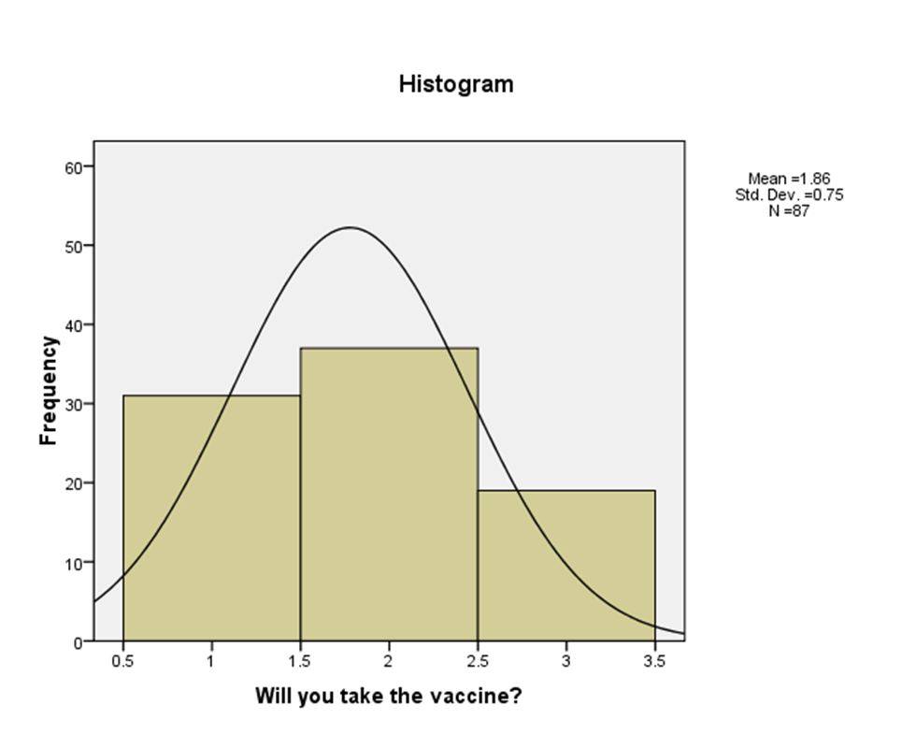

Slide 18
Results
Parameter Estimates from the Final Regression Model for Self Efficacy and Cues to Action (R² = 0.421)
_________________________________________________________________________
Source Unstd. Coeff. Std. Error Std. Coefficients Beta t p-value
_________________________________________________________________________
(constant) 3.926 0.266 14.486 0.000
Self Efficacy -0.160 0.026 -0.547 - 6.268 0.000
Cues to Action -0.042 0.017 -0.218 -2.501 0.014

Slide 19
Discussion
Self-efficacy and cues to action were able to explain some variance in whether males would take the HPV vaccine
Negative relationships were seen among the independent variable and the dependent variable
Results were based on a self-report survey, which could have included both participant bias and dishonesty
Recruiting participants was difficult, leading to a low sample size and the continuous recruitment of more participants
a need for an intervention to increase vaccine acceptability

Slide 20
Limitations
Based on preliminary results
Self-report
Cross-sectional study
Location
Conducted in a University setting only, results and sample size may have been different if recruitment was expanded to outside the university system

