Slide 1
Using Community-Based Participatory Research to address healthy lifestyles and childhood obesity in Charlotte, NC
Meredith King Ledford, MPP,
Health Promotion, Mecklenburg County Health Department
Initiative Coordinator, Healthy Weight, Healthy Child
Jessica Schorr Saxe, MD,
Family Physician, Carolinas Medical Center-Biddle Point
Medical Director, Healthy Weight, Healthy Child

Slide 2
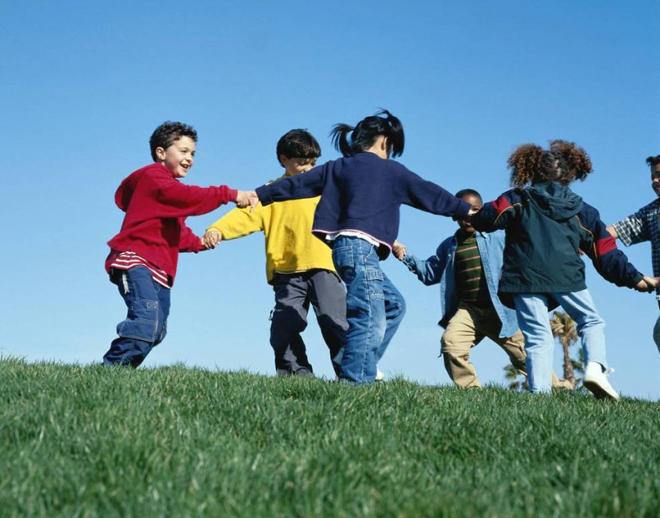
Why Address Childhood Obesity and Healthy Lifestyles?
NC 14th most obese state
11th most overweight and obese for children (2011 Trust for America’s Health F as in Fat report)
Almost 1 of 3 children is overweight or obese

Slide 3
Why Address Childhood Obesity and Healthy Lifestyles?
In Mecklenburg County, 11.5% high school students obese
16.5% high schools students overweight (2009 Youth Behavior Risk Survey
35% low-income children overweight or obese (2008 NC Nutrition and Physical Activity Surveillance System)

Slide 4
Community-Based Participatory Research Principles
Recognizes community as a unit of identity
Builds on strengths and resources within the community
Facilitates collaborative, equitable involvement of all partners in all phases of the research
Integrates knowledge and intervention for mutual benefit of all partners
Promotes a co-learning and empowering process that attends to social inequalities

Slide 5
Community-Based Participatory Research Principles
Involves a cyclical and iterative process
Addresses health from both positive and ecological perspectives
Disseminates findings and knowledge gained to all partners
Involves long-term commitment by all partners.

Slide 6
The Healthy Weight, Healthy Child Initiative
Planning grant from Kate B. Reynolds Charitable Trust for 1 year – September 2009-September 2010
GOALS
Coalition Building
Community Assessment
Action Plan

Slide 7
Focus of the Initiative
Healthy Policies
Healthy
Healthy Behaviors
Healthy People
To suggest, promote, and develop local policies and programs that create healthy environments. In turn, these efforts would create a community of healthy people practicing healthy behaviors in Mecklenburg County.
Environments

Slide 8

Best Practices: Literature Reviews and Networking
Networking with programs across the country
Literature Reviews to help with creation of prioritized lists from each working group

Slide 9
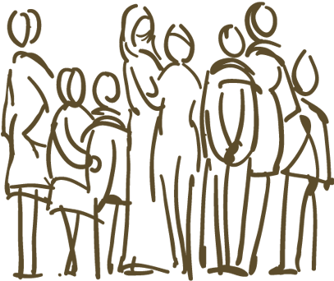
Community Conversations
African-American
Hispanic
  These focused on barriers to physical activity and good nutrition
Notes:
Focus groups

Slide 10
Community Conversations
Charlotte-Mecklenburg School employees
Mental Health professionals
School health nurses
  These focused on interventions to address barriers
Notes:
Focus groups

Slide 11
Coalition Building and Learning Best Practices
Coalition: 10 Working Groups
Government/Elected Officials
Health Care Providers
School-Aged Children Organizations
Pre-School-Aged Children Organizations
Business
Race/Ethnicity-Based Organizations
Community-Based Organizations
Faith Community
Media (Advisory Role)
Research/Academia (Advisory Role)
Notes:
Worked from lit reviews; did not know results of community conversations; responded with interventions; 5 of 8 submitted responses

Slide 12
Key Informant Interviews
State
Local
National
Yael Lehman,
Food Trust
Mildred Thompson,
Policy Link & RWJF
Kate Uslan,
Alliance for a Healthier Generation
Kate B Reynolds Charitable Trust
The Duke Endowment
NC Physical Activity and Nutrition Branch
Superintendent Charlotte-Mecklenburg Schools
Mecklenburg County Commissioner
Health Director Mecklenburg County Health Department
Health Promotion Mecklenburg County Health Department

Slide 13
Health Provider Assessment
4 Focus Groups
  CMC Family Medicine Department
  CMC Pediatric Department
  CMC-Biddle Point
  CMC-North Park
Surveys of Providers
CMC: Carolinas Medical Center

Slide 14
Steering Committee Meeting
Chairs of working groups
Review of results
Opportunity to recommend outside of their areas

Slide 15
Vision of the Blueprint
The Blueprint for a Healthier Generation, 2020 published September 2010 (at end of planning grant)
Aims to reach the following two overarching goals:
    Combat and prevent childhood obesity in Charlotte/Mecklenburg County and
    Ensure access to resources that promote and encourage active living and healthy eating for all children and their families in Charlotte/Mecklenburg County.

Slide 16
The Community-Wide Action Plan

Slide 17
How to Use the Blueprint
Two Parts: Active Living and Healthy Eating
Includes 13 sub-goals, 29 strategies, and numerous interventions
Four Interrelated Tier Approach

Slide 18
Four-Tiered Approach for Systemic Change
Environ-mental Policy
Targeted Community Programs
Institution Policy
Building Public Awareness
Laws
Policies
Regulations
Education
Targeted Messages
Neighborhood and Community Programs
Charlotte Mecklenburg Schools
Health Care System – CHS and Novant
Mecklenburg County Health Department
Local Government

Slide 19
Additional HWHC Efforts
HWHC Website
  http://hwhc.charmeck.org
HWHC Initiative Bulletin – 2nd and 4th Fridays
Continued Strategic Planning

Slide 20
questions

Slide 21
Contact Information
Jessica Schorr Saxe, MD
Jessica.Saxe@carolinashealthcare.org

