Slide 1
The Benefits of Yoga for Teens (and adolescents)
Results from a pilot study based upon a literature review

Slide 3
Psychosocial Challenges for Teens
ADD/ADHD (1 in 10)
Anxiety Disorders (1 in 10)
Depression (1 in 8)
Self-esteem, self-image, self-worth issues (a vast majority)
Self-image
Eating disorders
Obesity
(Less than 25% are treated for these conditions-which can become chronic or lifetime issues)

Slide 4
How can yoga address these issues?
Pranayama
Anxiety, Stress, Depression
3 part breath
Ocean breath

Slide 5
Yoga solutions cont…
Meditation
Concentration point
Slowing down the mind
Combine with pranayama
Movement
Flexibility
Sinking into a pose and holding (opposite of most things in their world)

Slide 6
Youth Yoga Project in Chicago
7th grade students in a public middle school in Illinois (Chicago suburb)
Practice yoga 1-2 times each week in free period (study hall)
There 20 students who participated in the program and also 20 control students (Quasi design)
Students completed a survey three times a year

Slide 7
Measures
Positive And Negative Affect (PANAS)
Life Satisfaction (SWLS)
Perceived Stress
Perceived Sleep Quality
Blood Pressure
Weight
Resting Heart Rate

Slide 8
Outcomes
Decreased reported levels of anxiety
Decreased negative affect
Increased positive affect
Decreased stress post-yoga
Decreased Blood Pressure (for elevated individuals)
Decreased Resting Heart Rate

Slide 9
Qualitative Outcomes
Students reported a way to actually manage a stressful situation by using breath work
Students reported feeling more awake and alert in class
Students reported having fewer issues being able to focus their attention in class (especially those with ADD/ADHD)

Slide 10
Follow-up Study
Replicating this study for a second year with the same students and a new group of control students
Observing the change in students after the 2nd year in yoga
Also replicating among high school students as a substitute for normal PE classes (dodgeball, running laps, softball)

Slide 11
Youth Yoga School in Evansville, IN
Officially started in 2011
Early work began in 2008
Started by Stacey Shanks and Yoga & Life
Currently teaches yoga to students ranging in age from 5-18 years of age at the pre-school, elementary, middle, and high school levels.

Slide 12
Additional Benefits
Teens are more likely to have psychosocial issues than physical issues
Yoga is a tool that is more likely affect their ability to not only manage stressful situations (first time social encounters), but also allow them to grow into themselves.
Explore their own identity
Teens are more curious and open-minded (these trends decrease with age).

Slide 13
Benefits and Opportunities cont..
Teens have formed fewer opinions on what activities they are interested in and what their strengths are.
Additionally, as the population becomes more obese (1/3rd overweight/obese in the USA), students can become more aware of their bodies and how different actions (or inactions) affect their bodies, health, and overall well-being

Slide 14
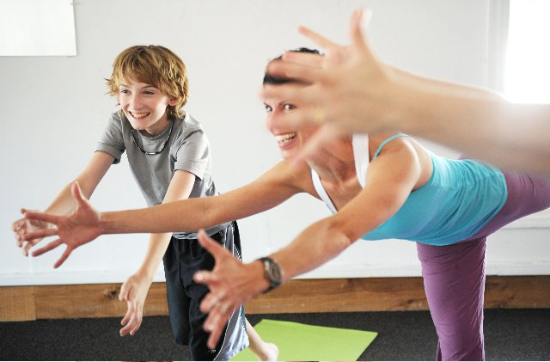

Slide 15
Future Programs
Yoga as a part of PE curriculum (see Dr. Khalsa’s research in MA)
Afterschool yoga programs have limitations
Yoga in place of free periods or study halls (middle and high school students)
Yoga camps (retreats/workshops) for children in elementary and middle school

Slide 16

Questions?

Slide 17

Namaste
Thank you and
Namaste.

